Slide 1
“I don't want to love my enemy - I want to leave them in a pool of their own blood.”

Slide 2
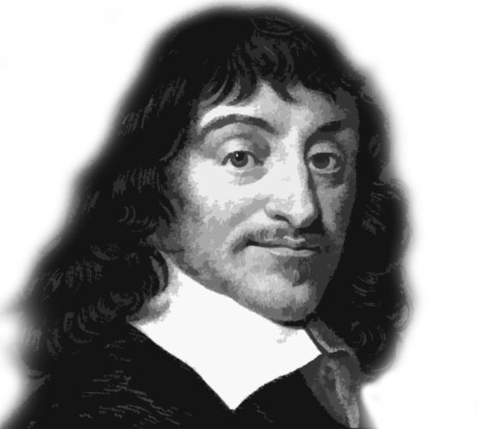
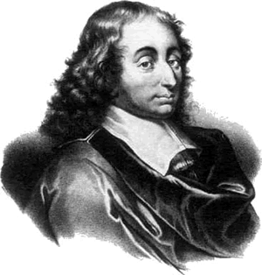
Head & Heart
Is belief in Christianity a matter of...
VS.
...or a ‘False Dilemma’?

Slide 3
“I think, therefore I am.”
“The heart has its reasons which reason knows nothing of.”

Slide 4
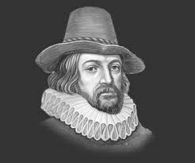
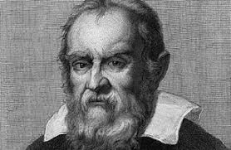
1561 Sir Francis Bacon
1564 Galileo Galilei
1596 René Descartes
1623 Blaise Pascal

Slide 5
Pre-Modernism: Appeal to authority; not just the church.
Modernism: Use reason and science with the goal to argue for and arrive at definitive answers.
Post-Modernism: No truth for many categories; relativism.

Slide 6
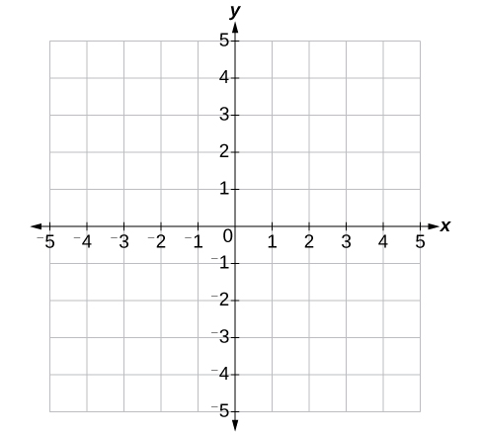
René Descartes
Father of Modern Philosophy
Mathematician
Scientist

Slide 7
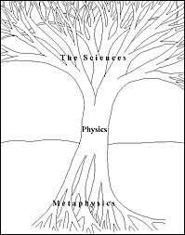
René Descartes

Slide 8
“I think, therefore I am.”

Slide 9
Blaise Pascal
“All children are special, but some children are really special.”

Slide 10
“Year of grace 1654, Monday 23 November, feast of St. Clement . . . from about half past ten at night to about half an hour after midnight, FIRE. God of Abraham, God of Isaac, God of Jacob, not of philosophers and scholars. Certitude, heartfelt joy, peace. God of Jesus Christ. God of Jesus Christ. My God and your God . . . Joy, Joy, Joy, tears of joy. . . Jesus Christ. Jesus Christ. May I never be separated from him.”

Slide 11
Pensées
“How hollow and foul is the heart of man.“
“Man’s greatness comes from knowing
he is wretched.“

Slide 12
Pensées
“A trifle consoles us because a trifle upsets us.“
“Man’s on happiness comes from his inability to stay peacefully alone in his own room.“

Slide 13
Head & Heart
Is belief in Christianity a matter of...
VS.
...or a ‘False Dilemma’?

Slide 14
Blaise Pascal
“The heart has its reasons which reason
knows nothing of...
we know the truth not only by reason, but by the heart."

