Slide 1
Bibles to Avoid
• Translated by a heretical group
• Translation driven by a questionable agenda
• Paraphrases
Bibles to Prefer
• Translated from recent editions of the “critical” Hebrew and Greek texts.
• Translated by a committee rather than an individual.
• Endorsed by respectable scholars.
• Established and widely accepted.
• Appropriate for your reading level.

Slide 2
The New American Standard Bible (NASB)
The English Standard Version (ESV)
The Christian Standard Bible (CSB)
The New International Version (NIV)
The New Living Translation (NLT)

Slide 3
• FORM • FUNCTION
• MAINTAIN CONSTRUCTION • READABILITY
• WORD-FOR-WORD • THOUGHT-FOR-THOUGHT
NASB ESV CSB NIV NLT

Slide 5
1 THESSALONIANS 4:9
NASB, ESV, CSB
Now, about brotherly love . . .
NIV, NLT
Now, about loving one another . . .

Slide 7
ESV READER’S VERSION

Slide 8
INTERNATIONAL CHILDREN’S BIBLE (ICB)

Slide 10
TOPICAL BIBLES

Slide 19
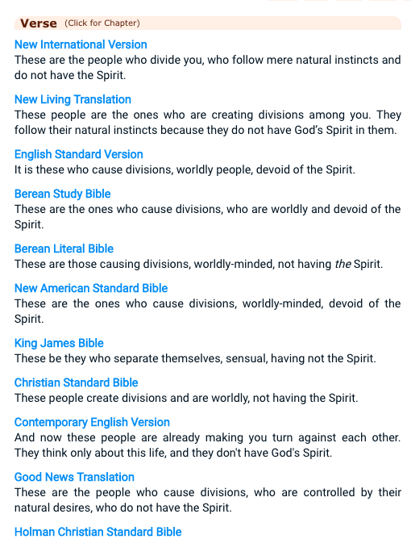
biblehub.com

Slide 20
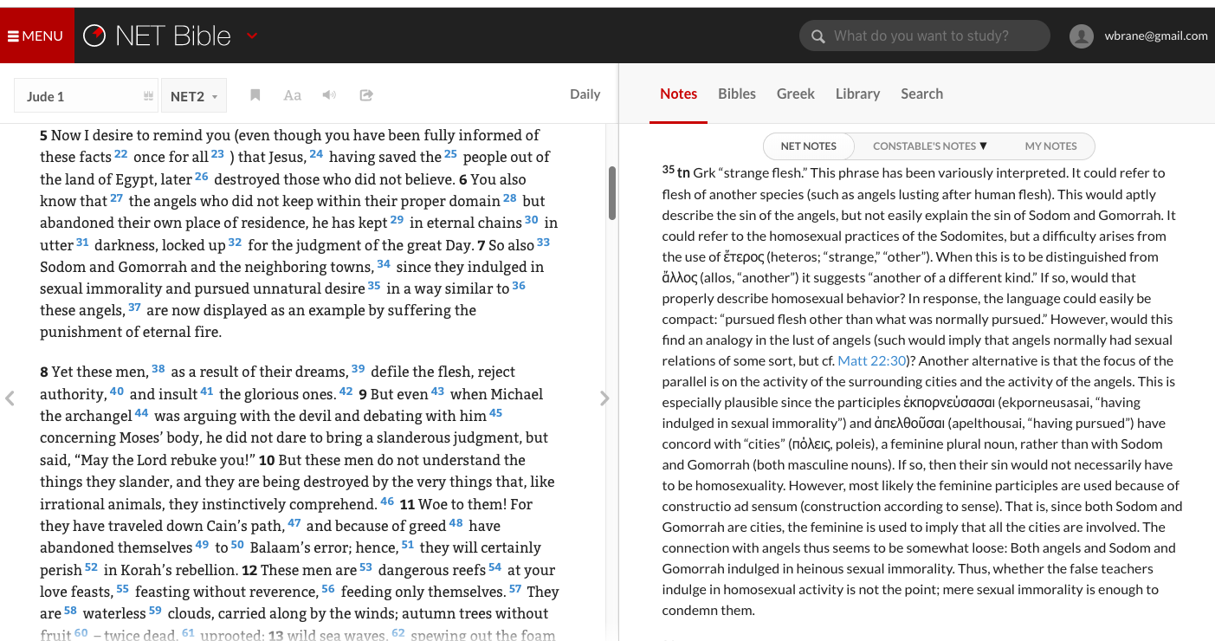
netbible.org

Slide 21
