Slide 1
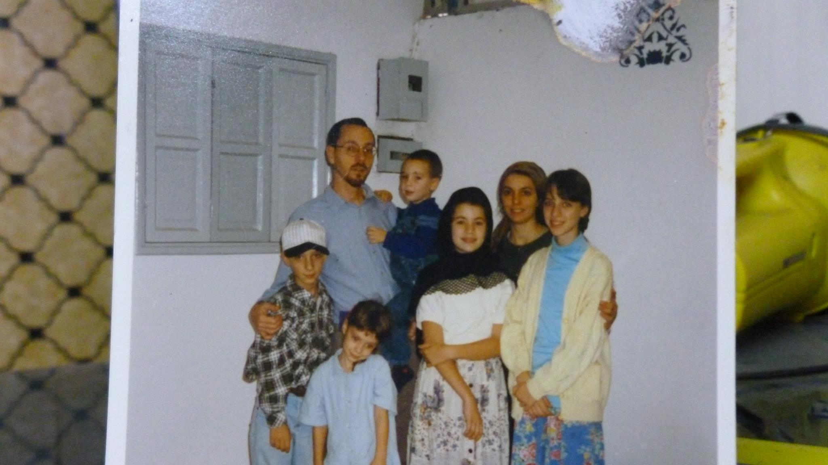

Slide 2
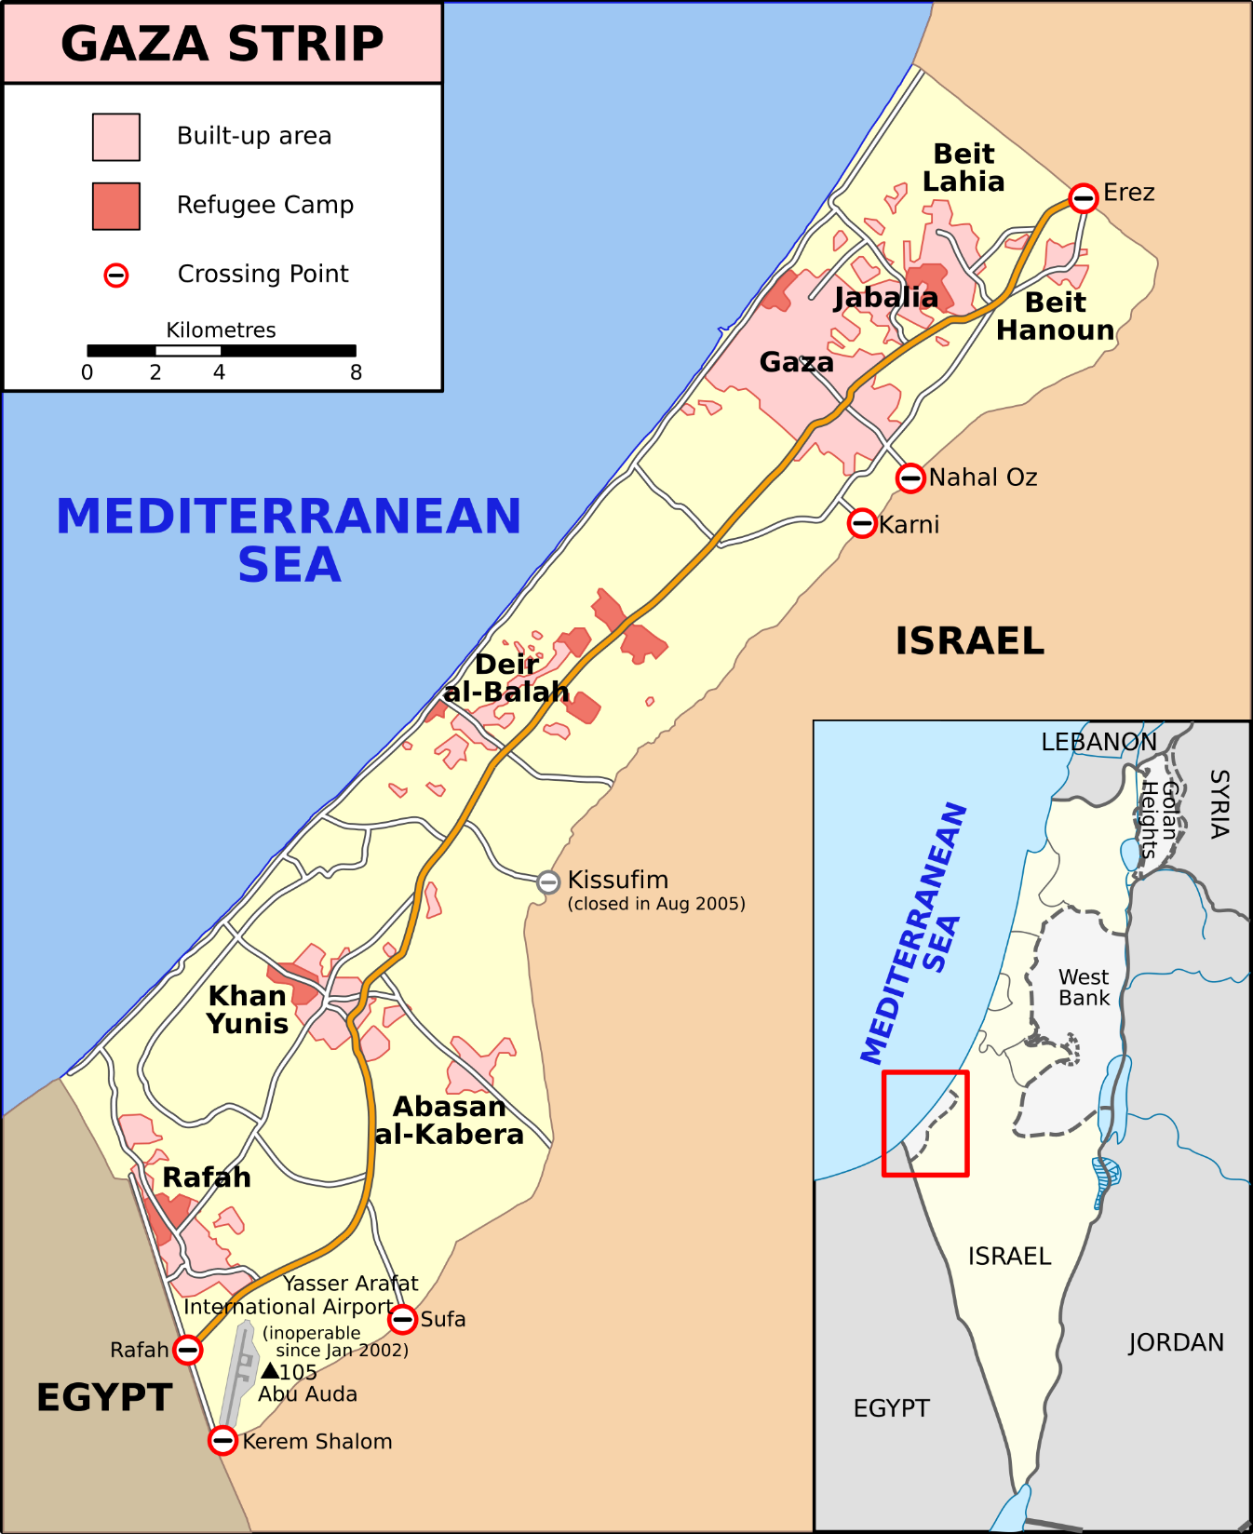

Slide 3
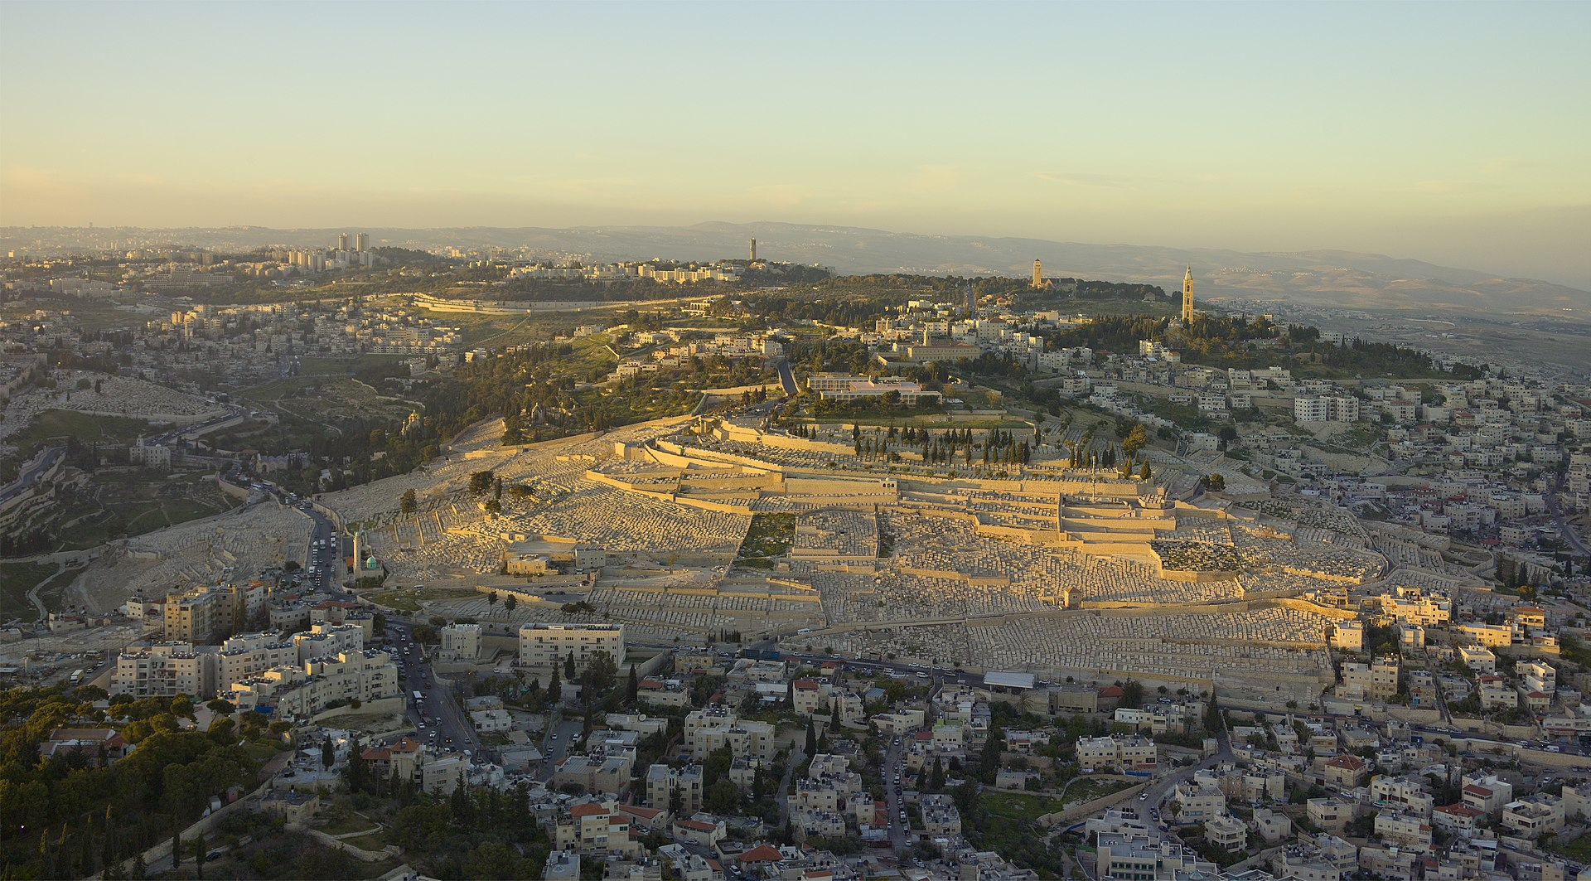

Slide 4
“We are a body knit together by a common religious profession, by unity of discipline, and by the bond of a common hope. We meet together as an assembly and congregation, that, offering up prayer to God as with united force, we may wrestle with Him in our supplications. This strong exertion God delights in.”

Slide 5
“They love all men, and are persecuted by all. They are unknown and condemned; they are put to death, and restored to life. They are poor, yet make many rich; they are in lack of all things, and yet abound in all; they are dishonored, and yet in their very dishonor are glorified. They are evil spoken of, and yet are justified; they are reviled, and bless; they are insulted, and repay the insult with honor; they do good, yet are punished as evil-doers. When punished, they rejoice as if quickened into life.”

Slide 6
“For the Christians are distinguished from other men neither by country, nor language, nor the customs which they observe. For they neither inhabit cities of their own, nor employ a peculiar form of speech, nor lead a life that is marked out by any singularity. The course of conduct which they follow has not been devised by any speculation or deliberation of inquisitive men; nor do they, like some, proclaim themselves the advocates of any merely human doctrines.

Slide 7
But, inhabiting Greek as well as barbarian cities, according as the lot of each of them has determined, and following the customs of the natives in respect to clothing, food, and the rest of their ordinary conduct, they display to us their wonderful and confessedly striking method of life…they dwell in their own countries, but simply as sojourners.

Slide 8
As citizens, they share in all things with others, and yet endure all things as if foreigners. Every foreign land is to them as their native country, and every land of birth as a land of strangers. They marry, as do all; they beget children. They have a common table, but not a common bed.

Slide 9
They are in the flesh but do not live after the flesh. They pass their days on earth, but they are citizens of heaven. They obey the prescribed laws, and at the same time surpass the laws by their lives… The Christians dwell in the world yet are not of the world…The Christians are confined in the world as a prison, and yet they are the preservers of the world…the Christians dwell as sojourners in corruptible bodies, looking for the incorruptible dwelling in the heavens.

Slide 10
Matthew 25:1-13 (ESV) ¹ “Then the kingdom of heaven will be like ten virgins who took their lamps and went to meet the bridegroom. ² Five of them were foolish, and five were wise. ³ For when the foolish took their lamps, they took no oil with them, ⁴ but the wise took flasks of oil with their lamps. ⁵ As the bridegroom was delayed, they all became drowsy and slept. ⁶ But at midnight there was a cry, ‘Here is the bridegroom! Come out to meet him.’

Slide 11
⁷ Then all those virgins rose and trimmed their lamps. ⁸ And the foolish said to the wise, ‘Give us some of your oil, for our lamps are going out.’ ⁹ But the wise answered, saying, ‘Since there will not be enough for us and for you, go rather to the dealers and buy for yourselves.’

Slide 12
¹⁰ And while they were going to buy, the bridegroom came, and those who were ready went in with him to the marriage feast, and the door was shut. ¹¹ Afterward the other virgins came also, saying, ‘Lord, lord, open to us.’ ¹² But he answered, ‘Truly, I say to you, I do not know you.’ ¹³ Watch therefore, for you know neither the day nor the hour.

Slide 13
¹⁰ But the day of the Lord will come like a thief, and then the heavens will pass away with a roar, and the heavenly bodies will be burned up and dissolved, and the earth and the works that are done on it will be exposed.
¹¹ Since all these things are thus to be dissolved, what sort of people ought you to be in lives of holiness and godliness,
¹² waiting for and hastening the coming of the day of God, because of which the heavens will be set on fire and dissolved, and the heavenly bodies will melt as they burn!

Slide 14
¹³ But according to his promise we are waiting for new heavens and a new earth in which righteousness dwells.
¹⁴ Therefore, beloved, since you are waiting for these, be diligent to be found by him without spot or blemish, and at peace.
¹⁵ And count the patience of our Lord as salvation…

Slide 15
¹⁷ You therefore, beloved, knowing this beforehand, take care that you are not carried away with the error of lawless people and lose your own stability.
¹⁸ But grow in the grace and knowledge of our Lord and Savior Jesus Christ. To him be the glory both now and to the day of eternity. Amen.

