Slide 1
Life is hard
…and then you die.

Slide 2
Hebrews 11:8-10 (NLT)
Abraham obeyed when God called him to leave home and go to another land that God would give him as his inheritance.
And even when he reached the land God promised him, he lived there…like a foreigner, living in a tent.
Abraham did this because he was confidently looking forward to a city with eternal foundations, a city designed and built by God.

Slide 3
Hebrews 11:24-26 (NLT)
Moses…refused to be treated as the son of Pharaoh's daughter.
He chose to share the oppression of God's people instead of enjoying the fleeting pleasures of sin.
He thought it was better to suffer for the sake of the Messiah than to own the treasures of Egypt, for he was looking ahead to the great reward that God would give him.

Slide 4
Hebrews 13:14 (NLT)
This world is not our home; we are looking forward to our city in heaven, which is yet to come.

Slide 5
Philippians 3:20 (NLT)
We are citizens of heaven, where the Lord Jesus Christ lives. And we are eagerly waiting for him to return as our Savior.

Slide 6
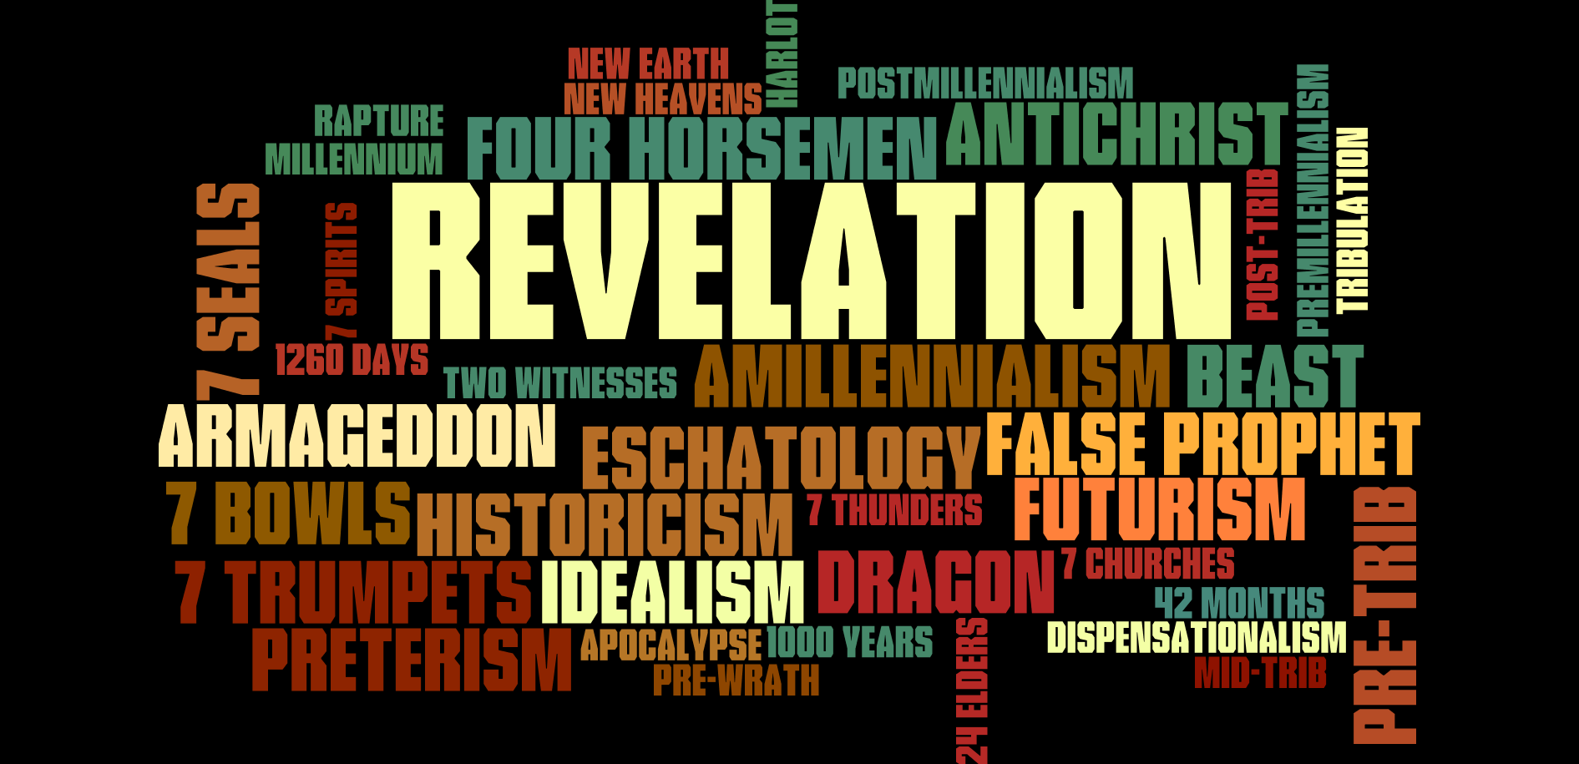

Slide 7
Genesis 3:14-15 (HCSB)
Then the LORD God said to the serpent: “Because you have done this, you are cursed… I will put hostility between you and the woman, and between your seed and her seed. He will strike your head, and you will strike his heel.”

Slide 8
Genesis 22:17-18 (HCSB)
“Your offspring will possess the gates of their enemies, and all the nations of the earth will be blessed by your offspring.”

Slide 9
Genesis 49:9-10 (HCSB)
Judah is a young lion… the scepter will not depart from Judah or the staff from between his feet until He whose right it is comes and the obedience of the peoples belongs to Him.
2 Samuel 7:16 (HCSB)
Your house and kingdom will endure before Me forever, and your throne will be established forever.

Slide 10
Eschatology
the study of the end (last things)
The Day of the LORD
The Messiah
The Kingdom of God
This Present Age
The Age to Come
(Age of Promise)
(Age of Fulfillment)

Slide 11
Jesus came into Galilee, proclaiming the gospel of God, and saying, “The time is fulfilled, and the kingdom of God is at hand.” (Mark 1:14-15, ESV)
Jesus went throughout Galilee…preaching the good news of the kingdom. (Matthew 4:23, NIV)
“Today this Scripture has been fulfilled in your hearing.” (Luke 4:21, ESV)
“If I drive out demons by the Spirit of God, then the kingdom of God has come upon you.” (Matthew 12:28, ESV)
“The kingdom of God is in the midst of you.” (Luke 17:21, ESV)

Slide 12
“Now is the judgment of this world; now will the ruler of this world be cast out.” (John 12:31, ESV)
“The ruler of this world is judged.” (John 16:11, ESV)
“I saw Satan fall like lightning from heaven.” (Luke 10:18, ESV)
“How can anyone enter the strong man’s house and carry off his property, unless he first binds the strong man? And then he will plunder his house.” (Matthew 12:29, NASB)
“You say correctly that I am a king, [but] my kingdom is not of this realm.” (John 18:37,36, NASB)

Slide 13
“Whoever speaks against the Holy Spirit will not be forgiven, either in this age or in the age to come.” (Matthew 12:32, NET)
“No one who has left home or brothers…or [parents] or children or fields for me and the gospel will fail to receive 100 times as much in this present age…and in the age to come, eternal life.” (Mark 10:29-30, NIV)
“The people of this age marry and are given in marriage. But those who are considered worthy of taking part in that age and in the resurrection from the dead will neither marry nor be given in marriage, and they can no longer die.” (Luke 20:34-36, NIV)

Slide 14
The god of this world has blinded the minds of the unbelievers. (2 Corinthians 4:4, ESV)
The whole world lies in the power of the evil one. (1 John 5:19, ESV)
He disarmed the rulers and authorities and put them to open shame, by triumphing over them in him. (Colossians 2:15, ESV)
…who gave himself for our sins to deliver us from the present evil age. (Galatians 1:4, ESV)

Slide 15
…that through death he might destroy the one who has the power of death, that is, the devil. (Hebrews 2:14, ESV)
“You have crowned him with glory and honor, putting everything in subjection under his feet.”
Now in putting everything in subjection to him, he left nothing outside his control.
At present, we do not yet see everything in subjection to him. (Hebrews 2:7-8, ESV)
…have tasted the goodness of the word of God and the powers of the age to come. (Hebrews 6:5, ESV)

Slide 16
Eschatology
the study of the end (last things)
This Present Age
“Already but not yet”
The Age to Come

Slide 17
The Timeframe of Revelation
Ascension of Christ
Destruction of Jerusalem
Second Coming of Christ
Preterist
Futurist
Historicist (progressive)
Idealist (reoccurring)

Slide 18
The first book of the New Testament was written by one of the 12 Apostles to show how the [first] coming of Jesus fulfills the Old Testament prophecies about the Promised King. The restoration of the throne of David is fulfilled in Jesus.
The last book of the New Testament was written by one of the 12 Apostles to show how the [second] coming of Jesus fulfills the Old Testament prophecies about the Promised Kingdom. The restoration of God’s people is fulfilled in Jesus.

