Slide 1
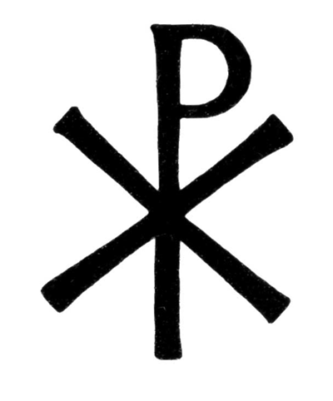
Χριστός

Slide 3
. . . Christ, Son, Lord, Only-begotten, recognized in two natures, without confusion, without change, without division, without separation; the distinction of the natures being in no way annulled by the union, but rather the characteristics of each nature being preserved and coming together to form one person and subsistence, not parted or separated into two persons, but one and the same Son and Only-begotten God the Word, Lord Jesus Christ . . .

Slide 5
