Slide 1
• For to me, to live is Christ and to die is gain.
• Rejoice in the Lord always. I will say it again, Rejoice!
• I can do everything through him who gives me strength.
• Do not be anxious about anything, but in everything, by prayer and petitions, with thanksgiving, present your requests to God.
• And my God will meet all your needs according to his glorious riches in Christ Jesus.
• Being confident of this, that he who began a good work in you will carry it on to completion until the day of Christ Jesus.
• And the peace of God, which transcends all understanding, will guard your hearts and your minds in Christ Jesus.

Slide 2
PHILIPPIANS

Slide 3
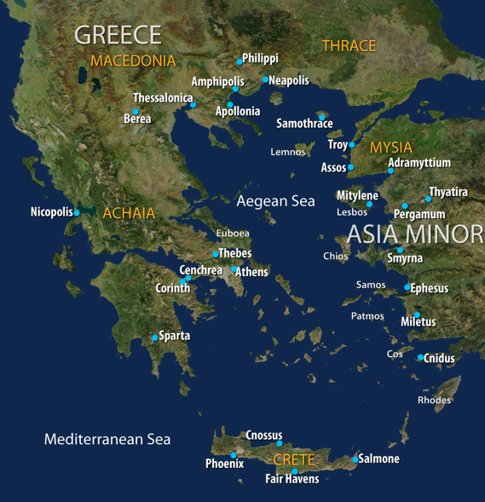

Slide 5
Philippians 4:19 And my God will meet all your needs according to his glorious riches in Christ Jesus.

