Slide 1
Mark 12:38-44
Warning Against the Teachers of the Law
³⁸ As he taught, Jesus said, “Watch out for the teachers of the law. They like to walk around in flowing robes and be greeted with respect in the marketplaces, ³⁹ and have the most important seats in the synagogues and the places of honor at banquets. ⁴⁰ They devour widows’ houses and for a show make lengthy prayers. These men will be punished most severely.”
The Widow’s Offering
⁴¹ Jesus sat down opposite the place where the offerings were put and watched the crowd putting their money into the temple treasury. Many rich people threw in large amounts. ⁴² But a poor widow came and put in two very small copper coins, worth only a few cents.
⁴³ Calling his disciples to him, Jesus said, “Truly I tell you, this poor widow has put more into the treasury than all the others. ⁴⁴ They all gave out of their wealth; but she, out of her poverty, put in everything—all she had to live on.”

Slide 2
Mark 12:38-44
Warning Against the Teachers of the Law
³⁸ As he taught, Jesus said, “Watch out for the teachers of the law. They like to walk around in flowing robes and be greeted with respect in the marketplaces, ³⁹ and have the most important seats in the synagogues and the places of honor at banquets. ⁴⁰ They devour widows’ houses and for a show make lengthy prayers. These men will be punished most severely.”
The Widow’s Offering
⁴¹ Jesus sat down opposite the place where the offerings were put and watched the crowd putting their money into the temple treasury. Many rich people threw in large amounts. ⁴² But a poor widow came and put in two very small copper coins, worth only a few cents.
⁴³ Calling his disciples to him, Jesus said, “Truly I tell you, this poor widow has put more into the treasury than all the others. ⁴⁴ They all gave out of their wealth; but she, out of her poverty, put in everything—all she had to live on.”

Slide 3
Verse 42
And one poor widow having come, cast in two lepta, which is a kodrantes.

Slide 4
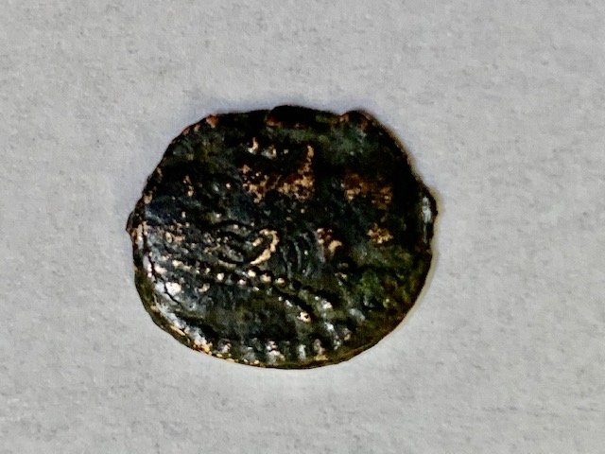
Leptos
Mite

Slide 5
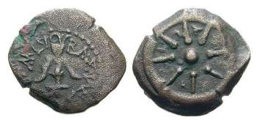
A Leptos that Cathy wouldn’t let me buy.

Slide 6
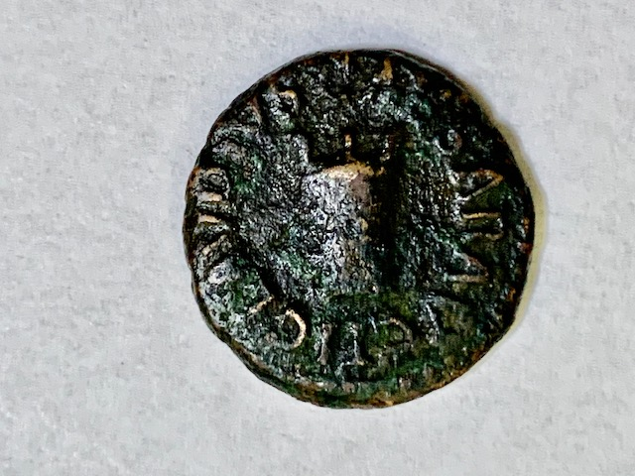
TI CLAUDIUS CAESAR AUG
Tiberius Claudius
Caesar Augustus
T
I
Kodrantas
Quadrans
Farthing
Penny
G
C
U
L
A
A
U
R
D
A
I
S
U
Modios
E
S
A
C

Slide 7
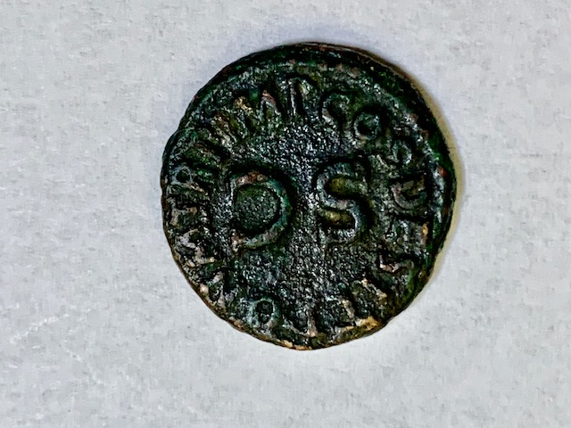
SC = Senatus Consulto
By Decree of the Senate
Kodrantas
P
T
O
I
N
S
PON M TR P IMP COS DES IT
Abbreviation for:
Pontifex Maximus Tribunicia Potestate Imperator Consul Designatio Iterum
Which means:
Greatest Pontif, holding powers of the Tribune, Emperor, Again Appointed for Consulship
M
E
T
D
R
S
P
I
O
C
M
P

Slide 8
Mark 12:38-44
Warning Against the Teachers of the Law
³⁸ As he taught, Jesus said, “Watch out for the teachers of the law. They like to walk around in flowing robes and be greeted with respect in the marketplaces, ³⁹ and have the most important seats in the synagogues and the places of honor at banquets. ⁴⁰ They devour widows’ houses and for a show make lengthy prayers. These men will be punished most severely.”
The Widow’s Offering
⁴¹ Jesus sat down opposite the place where the offerings were put and watched the crowd putting their money into the temple treasury. Many rich people threw in large amounts. ⁴² But a poor widow came and put in two very small copper coins, worth only a few cents.
⁴³ Calling his disciples to him, Jesus said, “Truly I tell you, this poor widow has put more into the treasury than all the others. ⁴⁴ They all gave out of their wealth; but she, out of her poverty, put in everything—all she had to live on.”

Slide 9
Mark 12:38-44
Warning Against the Teachers of the Law
³⁸ As he taught, Jesus said, “Watch out for the teachers of the law. They like to walk around in flowing robes and be greeted with respect in the marketplaces, ³⁹ and have the most important seats in the synagogues and the places of honor at banquets. ⁴⁰ They devour widows’ houses and for a show make lengthy prayers. These men will be punished most severely.”
The Widow’s Offering
⁴¹ Jesus sat down opposite the place where the offerings were put and watched the crowd putting their money into the temple treasury. Many rich people threw in large amounts. ⁴² But a poor widow came and put in two very small copper coins, worth only a few cents.
⁴³ Calling his disciples to him, Jesus said, “Truly I tell you, this poor widow has put more into the treasury than all the others. ⁴⁴ They all gave out of their wealth; but she, out of her poverty, put in everything—all she had to live on.”

Slide 10
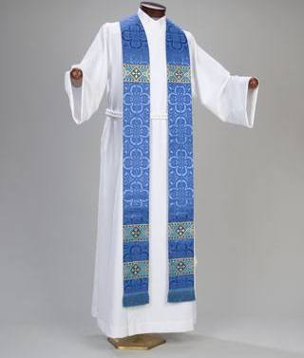

Slide 11
Mark 12:38-44
Warning Against the Teachers of the Law
³⁸ As he taught, Jesus said, “Watch out for the teachers of the law. They like to walk around in flowing robes and be greeted with respect in the marketplaces, ³⁹ and have the most important seats in the synagogues and the places of honor at banquets. ⁴⁰ They devour widows’ houses and for a show make lengthy prayers. These men will be punished most severely.”
The Widow’s Offering
⁴¹ Jesus sat down opposite the place where the offerings were put and watched the crowd putting their money into the temple treasury. Many rich people threw in large amounts. ⁴² But a poor widow came and put in two very small copper coins, worth only a few cents.
⁴³ Calling his disciples to him, Jesus said, “Truly I tell you, this poor widow has put more into the treasury than all the others. ⁴⁴ They all gave out of their wealth; but she, out of her poverty, put in everything—all she had to live on.”

Slide 12
Mark 12:38-44
Warning Against the Teachers of the Law
³⁸ As he taught, Jesus said, “Watch out for the teachers of the law. They like to walk around in flowing robes and be greeted with respect in the marketplaces, ³⁹ and have the most important seats in the synagogues and the places of honor at banquets. ⁴⁰ They devour widows’ houses and for a show make lengthy prayers. These men will be punished most severely.”
The Widow’s Offering
⁴¹ Jesus sat down opposite the place where the offerings were put and watched the crowd putting their money into the temple treasury. Many rich people threw in large amounts. ⁴² But a poor widow came and put in two very small copper coins, worth only a few cents.
⁴³ Calling his disciples to him, Jesus said, “Truly I tell you, this poor widow has put more into the treasury than all the others. ⁴⁴ They all gave out of their wealth; but she, out of her poverty, put in everything—all she had to live on.”

Slide 13
Mark 12:38-44
Warning Against the Teachers of the Law
³⁸ As he taught, Jesus said, “Watch out for the teachers of the law. They like to walk around in flowing robes and be greeted with respect in the marketplaces, ³⁹ and have the most important seats in the synagogues and the places of honor at banquets. ⁴⁰ They devour widows’ houses and for a show make lengthy prayers. These men will be punished most severely.”
The Widow’s Offering
⁴¹ Jesus sat down opposite the place where the offerings were put and watched the crowd putting their money into the temple treasury. Many rich people threw in large amounts. ⁴² But a poor widow came and put in two very small copper coins, worth only a few cents.
⁴³ Calling his disciples to him, Jesus said, “Truly I tell you, this poor widow has put more into the treasury than all the others. ⁴⁴ They all gave out of their wealth; but she, out of her poverty, put in everything—all she had to live on.”

Slide 14
Mark 12:38-44
Warning Against the Teachers of the Law
³⁸ As he taught, Jesus said, “Watch out for the teachers of the law. They like to walk around in flowing robes and be greeted with respect in the marketplaces, ³⁹ and have the most important seats in the synagogues and the places of honor at banquets. ⁴⁰ They devour widows’ houses and for a show make lengthy prayers. These men will be punished most severely.”
The Widow’s Offering
⁴¹ Jesus sat down opposite the place where the offerings were put and watched the crowd putting their money into the temple treasury. Many rich people threw in large amounts. ⁴² But a poor widow came and put in two very small copper coins, worth only a few cents.
⁴³ Calling his disciples to him, Jesus said, “Truly I tell you, this poor widow has put more into the treasury than all the others. ⁴⁴ They all gave out of their wealth; but she, out of her poverty, put in everything—all she had to live on.”

Slide 15
Mark 12:38-44
Warning Against the Teachers of the Law
³⁸ As he taught, Jesus said, “Watch out for the teachers of the law. They like to walk around in flowing robes and be greeted with respect in the marketplaces, ³⁹ and have the most important seats in the synagogues and the places of honor at banquets. ⁴⁰ They devour widows’ houses and for a show make lengthy prayers. These men will be punished most severely.”
The Widow’s Offering
⁴¹ Jesus sat down opposite the place where the offerings were put and watched the crowd putting their money into the temple treasury. Many rich people threw in large amounts. ⁴² But a poor widow came and put in two very small copper coins, worth only a few cents.
⁴³ Calling his disciples to him, Jesus said, “Truly I tell you, this poor widow has put more into the treasury than all the others. ⁴⁴ They all gave out of their wealth; but she, out of her poverty, put in everything—all she had to live on.”

Slide 16
Mark 12:38-44
Warning Against the Teachers of the Law
³⁸ As he taught, Jesus said, “Watch out for the teachers of the law. They like to walk around in flowing robes and be greeted with respect in the marketplaces, ³⁹ and have the most important seats in the synagogues and the places of honor at banquets. ⁴⁰ They devour widows’ houses and for a show make lengthy prayers. These men will be punished most severely.”
The Widow’s Offering
⁴¹ Jesus sat down opposite the place where the offerings were put and watched the crowd putting their money into the temple treasury. Many rich people threw in large amounts. ⁴² But a poor widow came and put in two very small copper coins, worth only a few cents.
⁴³ Calling his disciples to him, Jesus said, “Truly I tell you, this poor widow has put more into the treasury than all the others. ⁴⁴ They all gave out of their wealth; but she, out of her poverty, put in everything—all she had to live on.”

Slide 17
Mark 12:38-44
Warning Against the Teachers of the Law
³⁸ As he taught, Jesus said, “Watch out for the teachers of the law. They like to walk around in flowing robes and be greeted with respect in the marketplaces, ³⁹ and have the most important seats in the synagogues and the places of honor at banquets. ⁴⁰ They devour widows’ houses and for a show make lengthy prayers. These men will be punished most severely.”
The Widow’s Offering
⁴¹ Jesus sat down opposite the place where the offerings were put and watched the crowd putting their money into the temple treasury. Many rich people threw in large amounts. ⁴² But a poor widow came and put in two very small copper coins, worth only a few cents.
⁴³ Calling his disciples to him, Jesus said, “Truly I tell you, this poor widow has put more into the treasury than all the others. ⁴⁴ They all gave out of their wealth; but she, out of her poverty, put in everything—all she had to live on.”

Slide 18
Mark 12:38-44
Warning Against the Teachers of the Law
³⁸ As he taught, Jesus said, “Watch out for the teachers of the law. They like to walk around in flowing robes and be greeted with respect in the marketplaces, ³⁹ and have the most important seats in the synagogues and the places of honor at banquets. ⁴⁰ They devour widows’ houses and for a show make lengthy prayers. These men will be punished most severely.”
The Widow’s Offering
⁴¹ Jesus sat down opposite the place where the offerings were put and watched the crowd putting their money into the temple treasury. Many rich people threw in large amounts. ⁴² But a poor widow came and put in two very small copper coins, worth only a few cents.
⁴³ Calling his disciples to him, Jesus said, “Truly I tell you, this poor widow has put more into the treasury than all the others. ⁴⁴ They all gave out of their wealth; but she, out of her poverty, put in everything—all she had to live on.”

Slide 19
Mark 12:38-44
Warning Against the Teachers of the Law
³⁸ As he taught, Jesus said, “Watch out for the teachers of the law. They like to walk around in flowing robes and be greeted with respect in the marketplaces, ³⁹ and have the most important seats in the synagogues and the places of honor at banquets. ⁴⁰ They devour widows’ houses and for a show make lengthy prayers. These men will be punished most severely.”
The Widow’s Offering
⁴¹ Jesus sat down opposite the place where the offerings were put and watched the crowd putting their money into the temple treasury. Many rich people threw in large amounts. ⁴² But a poor widow came and put in two very small copper coins, worth only a few cents.
⁴³ Calling his disciples to him, Jesus said, “Truly I tell you, this poor widow has put more into the treasury than all the others. ⁴⁴ They all gave out of their wealth; but she, out of her poverty, put in everything—all she had to live on.”

