Slide 1
Notes:
1

Slide 2
Notes:
2

Slide 3
Notes:
3

Slide 4
Notes:
4

Slide 5
Notes:
5

Slide 6
Their Mind is Set on Earthly Things
Chasing Permanence
Notes:
6

Slide 7
Notes:
7

Slide 8
For, as I have often told you before and now tell you again even with tears, many live as enemies of the cross of Christ. Their destiny is destruction, their god is their stomach, and their glory is in their shame. Their mind is set on earthly things.”
- Philippians 3:18-19
Notes:
8

Slide 9
For, as I have often told you before and now tell you again even with tears, many live as enemies of the cross of Christ. Their destiny is destruction, their god is their stomach, and their glory is in their shame. Their mind is set on earthly things.”
- Philippians 3:18-19
Notes:
9

Slide 10
For, as I have often told you before and now tell you again even with tears, many live as enemies of the cross of Christ. Their destiny is destruction, their god is their stomach, and their glory is in their shame. Their mind is set on earthly things.”
- Philippians 3:18-19
Notes:
10

Slide 11
For, as I have often told you before and now tell you again even with tears, many live as enemies of the cross of Christ. Their destiny is destruction, their god is their stomach, and their glory is in their shame. Their mind is set on earthly things.”
- Philippians 3:18-19
Notes:
11

Slide 12
For, as I have often told you before and now tell you again even with tears, many live as enemies of the cross of Christ. Their destiny is destruction, their god is their stomach, and their glory is in their shame. Their mind is set on earthly things.”
- Philippians 3:18-19
Notes:
12

Slide 13
Notes:
13

Slide 14
Notes:
14

Slide 15
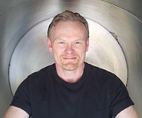
“I want to choose how long I live, and as long as I'm enjoying my life, I want to keep going.”
- Max More, CEO
Notes:
15

Slide 16
Notes:
16

Slide 17
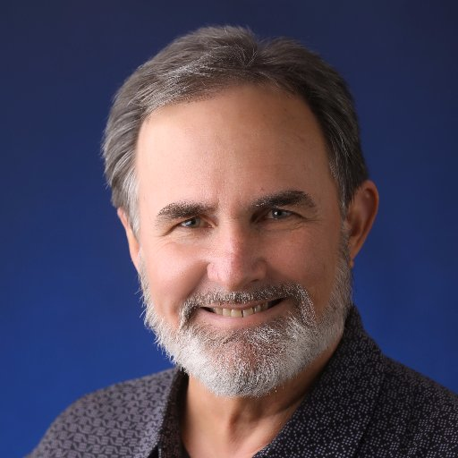
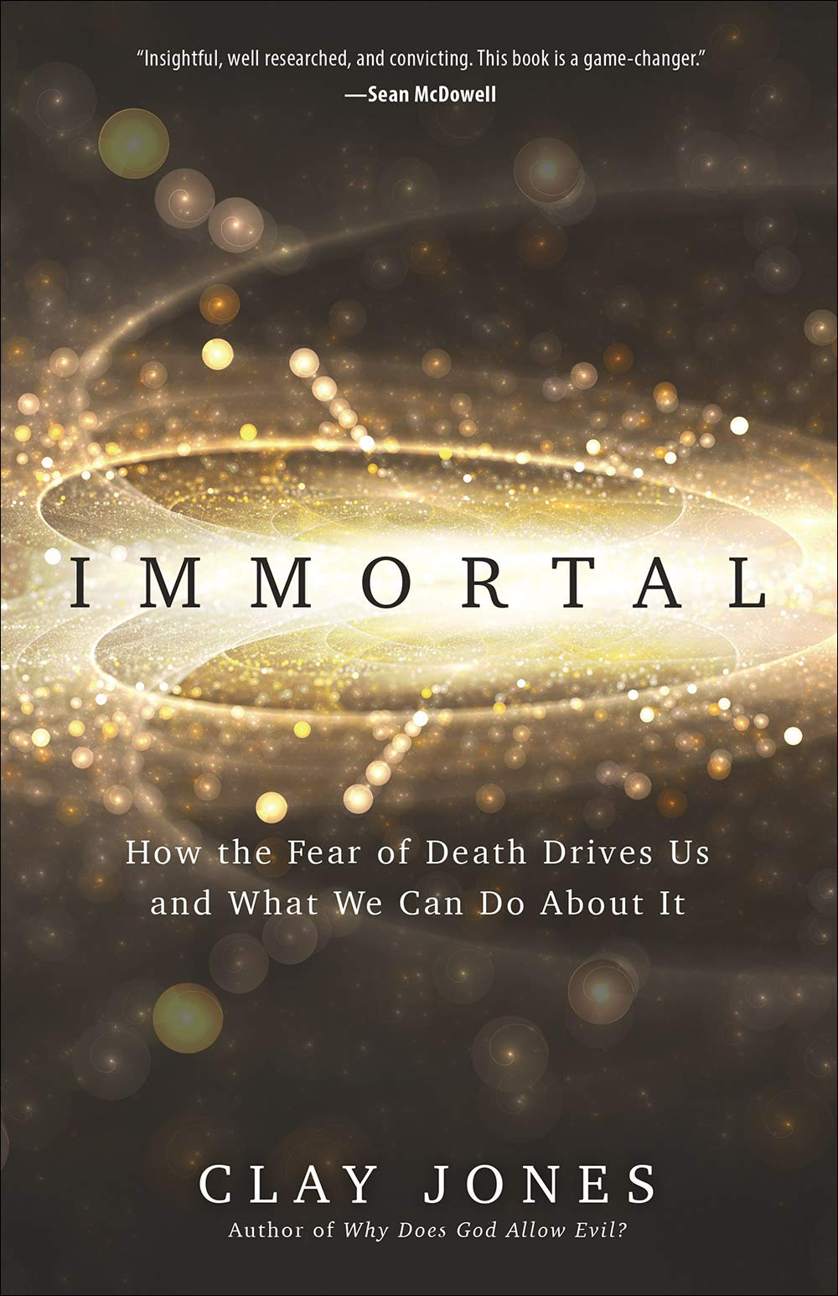
Symbolic Immortality Projects
Notes:
17

Slide 18
Notes:
18

Slide 19
For, as I have often told you before and now tell you again even with tears, many live as enemies of the cross of Christ. Their destiny is destruction, their god is their stomach, and their glory is in their shame. Their mind is set on earthly things.”
- Philippians 3:18-19
Notes:
19

Slide 20
Notes:
20

Slide 21
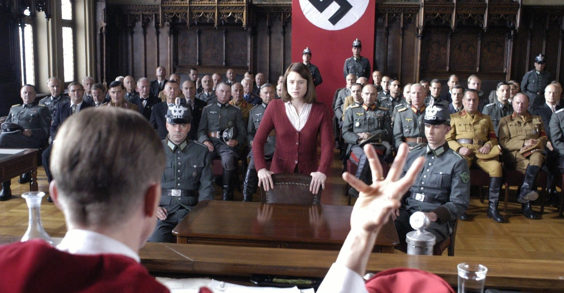
Notes:
21

Slide 22
Notes:
22

Slide 23
But our citizenship is in heaven.
Notes:
23

Slide 24
But our citizenship is in heaven. And we eagerly await a Savior from there, the Lord Jesus Christ, who, by the power that enables him to bring everything under his control, will transform our lowly bodies so that they will be like his glorious body.”
- Philippians 3:20-21
Notes:
24

Slide 25
Notes:
25

Slide 26
Who, being in very nature God,
did not consider equality with God something to be used to his own advantage;
rather, he made himself nothing
by taking the very nature of a servant,
being made in human likeness.
And being found in appearance as a man,
he humbled himself
by becoming obedient to death—
even death on a cross!
- Philippians 2:6-8
Notes:
26

Slide 27
Who, being in very nature God,
did not consider equality with God something to be used to his own advantage;
rather, he made himself nothing
by taking the very nature of a servant,
being made in human likeness.
And being found in appearance as a man,
he humbled himself
by becoming obedient to death—
even death on a cross!
- Philippians 2:6-8
Notes:
27

Slide 28
Notes:
28

Slide 29
But our citizenship is in heaven. And we eagerly await a Savior from there, the Lord Jesus Christ, who, by the power that enables him to bring everything under his control, will transform our lowly bodies so that they will be like his glorious body.”
- Philippians 3:20-21
Notes:
29

