Slide 1
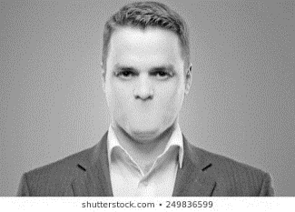
UNMUTING THE PULPIT
Ministry Faithfulness In An Abortion Culture
The pro-life pastor leads the congregation in public prayer for the preborn and for their parents.

Slide 2
UNMUTING THE PULPIT
Ministry Faithfulness In An Abortion Culture
The pro-life pastor leads the congregation in public prayer for the preborn and for their parents.
“Welcome to Park Cities Presbyterian Church. We are glad you joined us today. We want to come alongside you in hospitality & prayer. At the conclusion of our services, there are men & women at the front & back of the sanctuary to meet and pray with you–in complete confidence. If you are experiencing an unplanned pregnancy, you are loved. For support please call us or call Thrive Women’s Clinic at (phone #) or Kari (last name & phone #)”

Slide 3
UNMUTING THE PULPIT
Ministry Faithfulness In An Abortion Culture
The pro-life pastor teaches the congregation about human dignity and human equality so they can engage the culture effectively.

Slide 4
UNMUTING THE PULPIT
Ministry Faithfulness In An Abortion Culture
The pro-life pastor fearlessly condemns abortion from the pulpit for the evil that it is.

Slide 5
UNMUTING THE PULPIT
Ministry Faithfulness In An Abortion Culture
The pro-life pastor leads those who’ve had abortions to the One who died to forgive them.

Slide 6
UNMUTING THE PULPIT
Ministry Faithfulness In An Abortion Culture
The pro-life pastor leads those who’ve had abortions to the One who died to forgive them.
“So if the Son sets you free,
you will be free indeed.”
– John 8:36

Slide 7
UNMUTING THE PULPIT
Ministry Faithfulness In An Abortion Culture
The pro-life pastor leads those who’ve had abortions to the One who died to forgive them.
“Godly sorrow brings repentance that leads to salvation and leaves no regret.”
- 2 Corinthians 7:10

Slide 8
UNMUTING THE PULPIT
Ministry Faithfulness In An Abortion Culture

