Slide 1
3 John: Examples of Proper Thinking and Acting

Slide 2
Last night’s dinner conversation on 3 John
Sharon, “Have you timed your talk?”
John, “No. It’s probably too long.”
Sharon, “You don’t have to go over what was already said about 1 and 2 John. You can just talk about 3 John.
John, “That’ll take about ten minutes.
Sharon, “Good. They’ll like it. It’s a postcard. Tell them to avoid false teachers…”
John, “… and practice hospitality.

Slide 3
3 John
The view from outside space and time
The view from 30,000 feet: Background to 3 John
John
John’s teachings
The view from 1000 feet: The relationship of 1, 2, and 3 John
The view from the ground: 3 John expounded

Slide 4
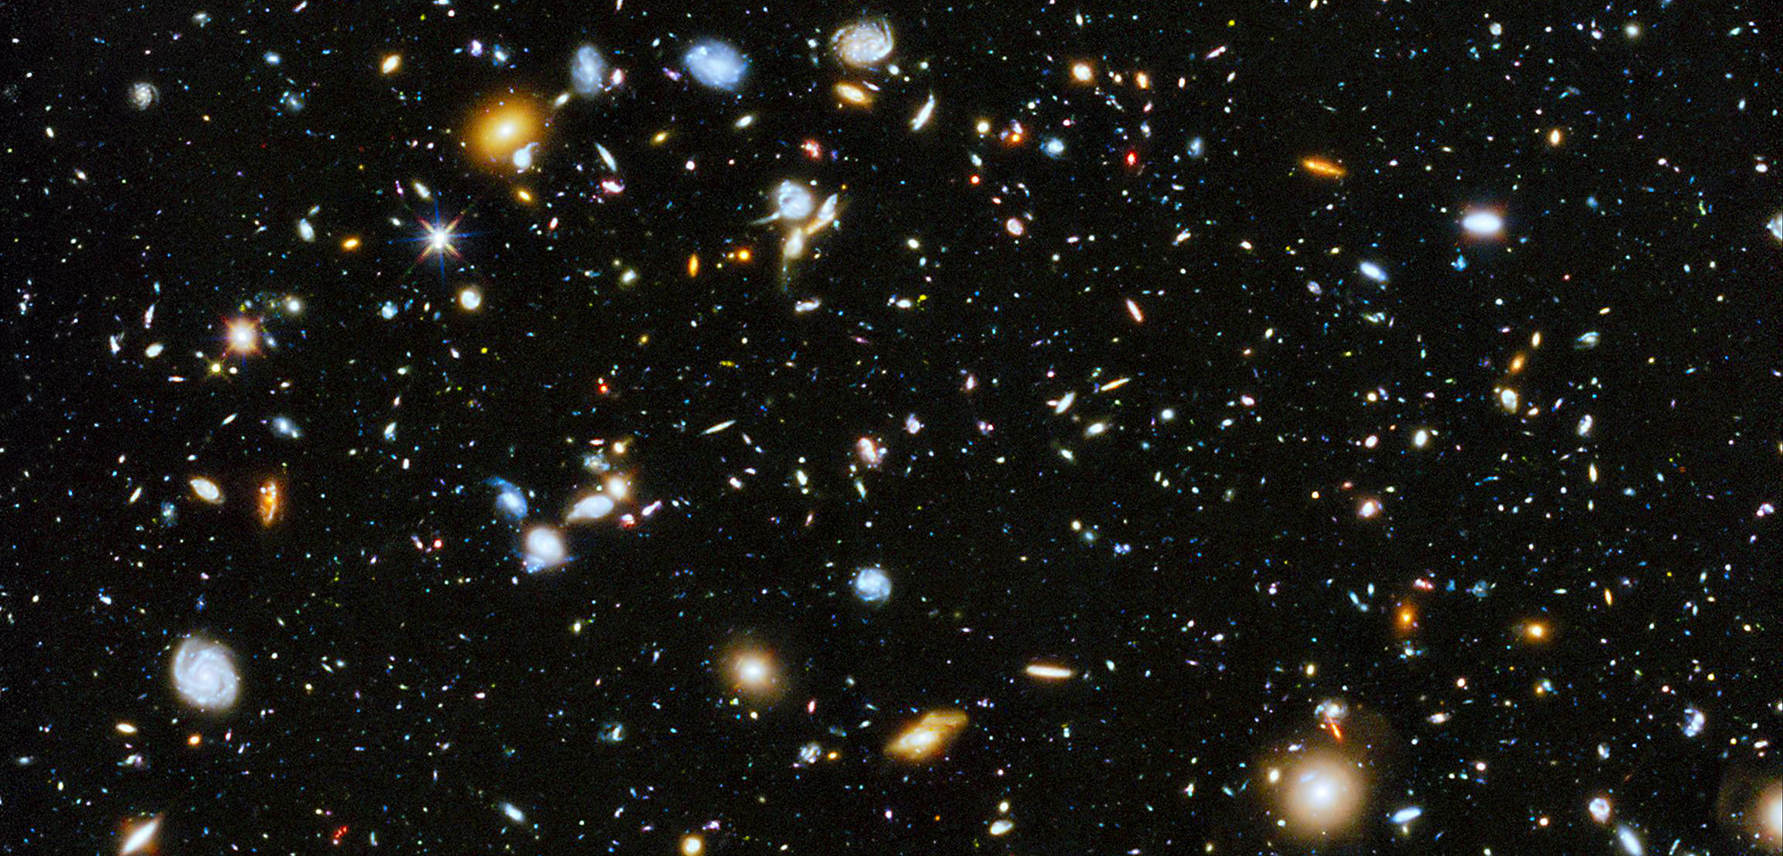
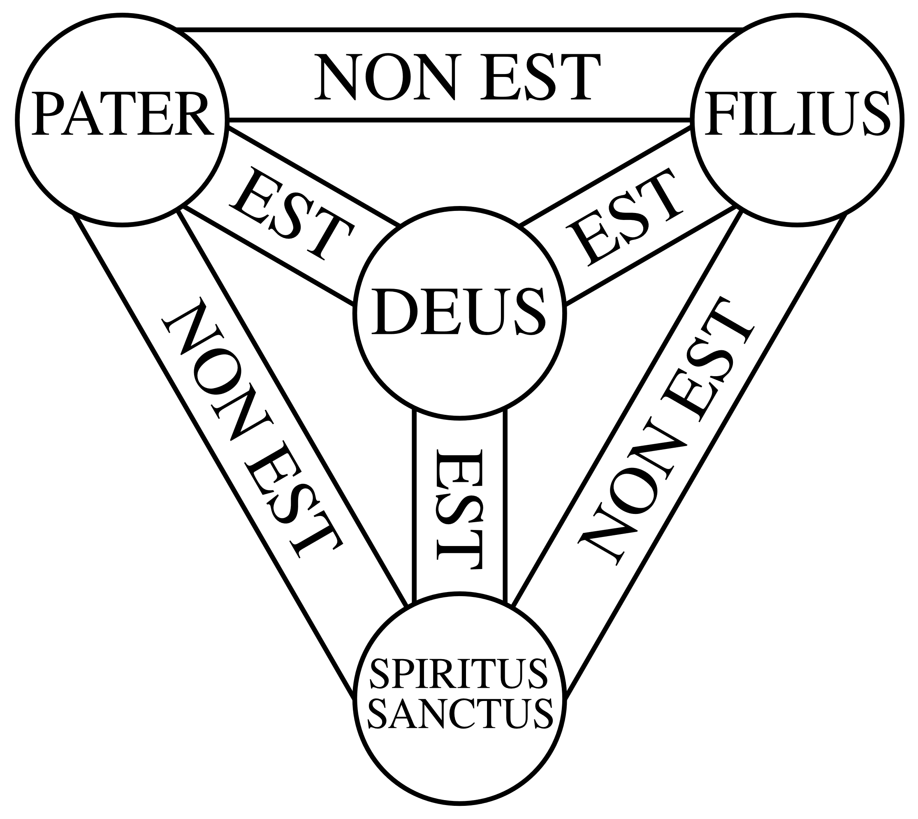
3 John
The view of 3 John from outside space and time
In the beginning, God…
… created the heavens and the earth
… and it was very good

Slide 5
Four relationships
God
Self
People
Others
Creation
Cari Warren mentioned these

Slide 6
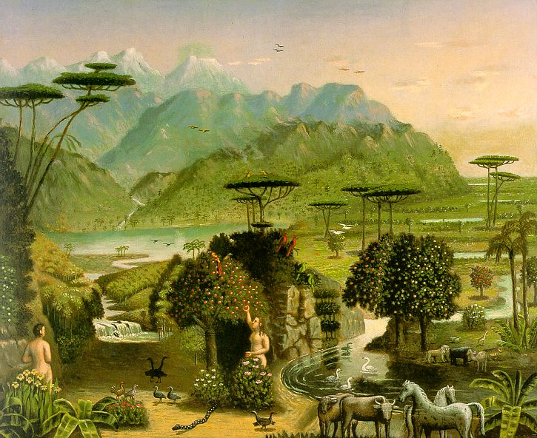
Right relationships - Genesis 1 and 2
God
Self
People
Others
Creation
Erastus Salisbury Field, The Garden of Eden, about 1860

Slide 7
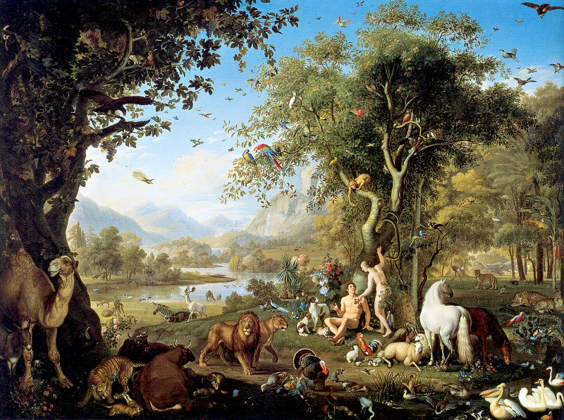
Ruined relationships - Genesis 3
God
Self
People
Others
Creation
Wenzel Peter, Adam and Eve in the Garden of Eden

Slide 8
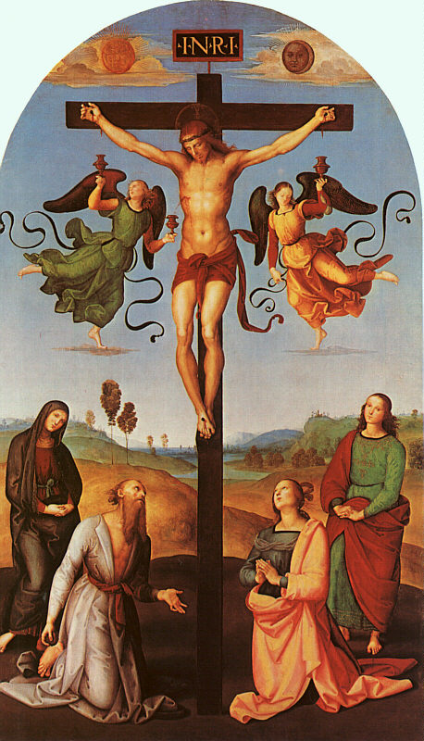
Redeemed relationships - Genesis 3 to eternity
God
Self
People
Others
Creation
Raphael, Christ on the Cross, 1502

Slide 9
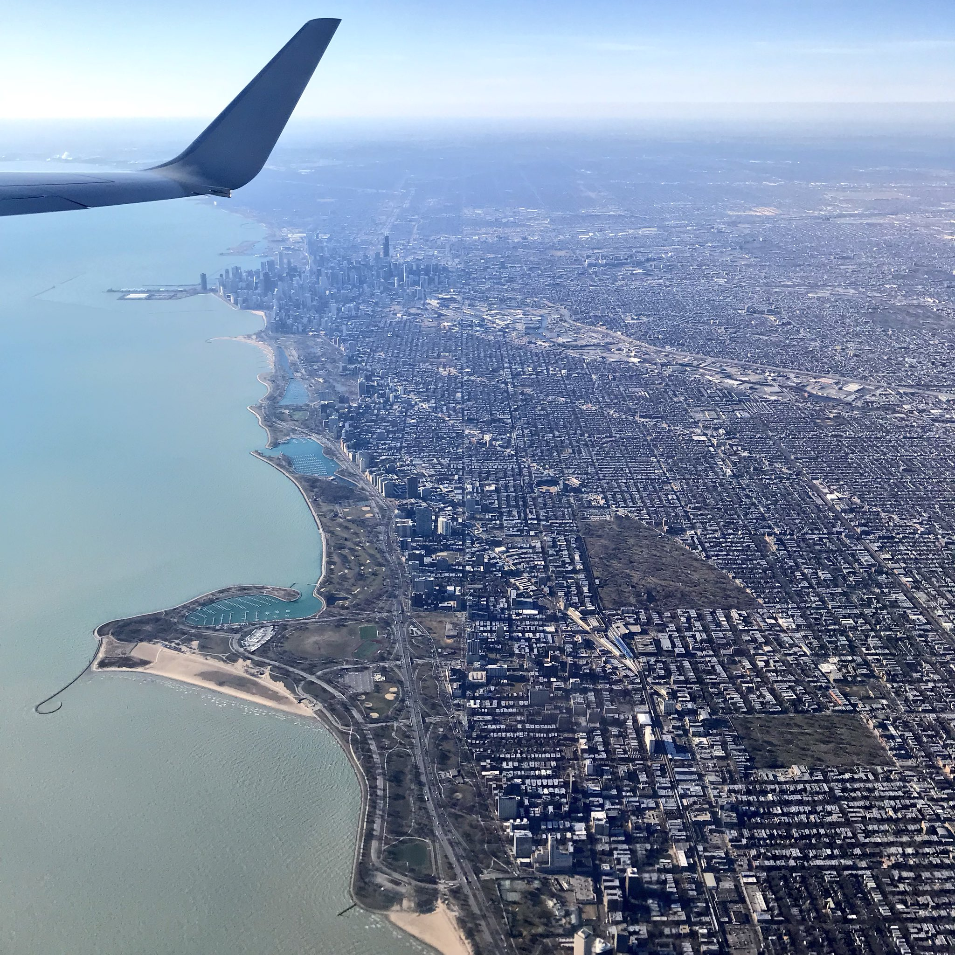
II. The 30,000 foot view: Background to 3 John

Slide 10
A. John
1. Which John?
Just to be clear, the author that we’re talking about is John the _______
Not John the ________
(This is understandable as there are more references to the baptizer in the gospels than to the apostle.)
Nor John Mark.
John also wrote _____.

Slide 11
A. John
1. Which John?
Son of Zebedee and Salome
Brother of James (not the author of the book of James)
James and John were fishing (business) partners with Peter. Luke 5:10
Jesus called James and John the “Sons of Thunder” Mark 3:17
John, in his gospel, calls himself, “the disciple whom Jesus loved.” John 19:26; 20:2; 21:7, 20

Slide 12
A. John
The multitudes
2. John’s background
Jesus’ followers:
John is one of the three disciples who are closest to Jesus
The 72 Luke 10:1
The 12
Disciples
Peter
James
John

Slide 13
A. John
2. John’s background
Called as a disciple: Mt 4:21; Mk 1:19; Lk 5:10
Jesus heals Peter’s mother-in-law. Peter, Andrew, James, and John present: Mk 1:29
Jesus heals Jairus’ daughter. Only Peter, James, and John present: Mk 5:37; Lk 8:51
Only Peter, James, and John see the transfiguration: Mt 17:1; Mk 9:2; Lk 9:28
John tells Jesus that he tried to stop someone from casting out demons. Mk 9:38; Lk 9:49

Slide 14
A. John
2. John’s background
Samaritans reject Jesus. James and John ask Jesus if he wants them to call fire to come from heaven to consume the Samaritans. Lk 9:54
James and John ask Jesus if they can sit next to him in his glory. Mk 10:35
On the temple mount, Peter, James, and John ask Jesus about the end of the age. Mk 13:3
Jesus sends Peter and John to set up the Passover meal. Lk 22:8
John leans on Jesus’ breast at the last supper. John 13:25

Slide 15
A. John
2. John’s background
Jesus takes Peter, James, and John with his to pray in Gethsemane. Mk 14:33
At his crucifixion, Jesus makes Mary and John into Mother and son. John 19:27
After the resurrection, some disciples go fishing. Jesus calls to them. John is the first to recognize him. John 21:7
Mary Magdalene sees the open tomb and runs to tell Peter and John. John 20:2 They both run to the tomb and John gets there first. John 20:4

Slide 16
A. John
2. John’s background
John and the other disciples devote themselves to prayer in the upper room. They choose Matthias to replace Judas. Acts 1:13
Peter and John are going to the temple to pray. A lame begger asks for alms. Peter heals him. Acts 3:1
Peter and John are arrested and brought before the council of Jewish leaders and are asked about the power with which they healed the lame man. Acts 4
Peter and John sent to Samaria and pray that the converts receive the Holy Spirit. Acts 8:14

Slide 17
A. John
2. John’s background
After 14 years of ministry, Paul goes to Jerusalem to check his message with Peter, James, and John. They tell him to continue to preach to the Gentiles. Gal 2:9
Jesus sends and angel to give Revelation to John on the island of Patmos. Rev 1:1; 22:8

Slide 18
B. John’s teachings
When I think of the writings of John, I think of him as the apostle of ______.

Slide 19
B. John’s teachings
1. Love: What is love?
Charity = Agape = ἀγάπη = Selfless love (The greatest love.)
Eros = ἔρως = “Being in love" or "loving" someone.
Friendship = Philia = φιλία = love between Friends.
Affection = Storge = στοργή = the Fondness of family members and those bonded by chance.

Slide 20
NAS New Testament Greek Lexicon (Number of verses) |  | Affection στοργή Storge | Friendship (V) φιλέω Phileo | ἔρως Eros | Love (N) ἀγάπη Agape | To love (V) ἀγαπάω Agapao
Matthew |  | 0 | 4 | 0 | 1 | 7
Mark |  | 0 | 1 | 0 | 0 | 4
Luke | Gospel | 0 | 2 | 0 | 1 | 9
 | Acts | 0 | 0 |  | 0 | 0
John | Gospel | 0 | 10* | 0 | 6 | 27*
 | 1 John | 0 | 0 | 0 | 14* | 17
 | 2 John | 0 | 0 | 0 | 2 | 2
 | 3 John | 0 | 0 | 0 | 1 | 1
 | Revelation | 0 | 2 | 0 | 2 | 4
NT Total |  | 0 | 21 | 0 | 106 | 110
* The greatest number of uses in the New Testament

Slide 21
As an aside philia is often used as a combining word with many others in the New Testament
Friendship = Philia = φιλία – Used as a root word in many other New Testament words including:
Philadelpheia / Philadelphos = brotherly love
Philanthropia = love for mankind
Philautos = lovers of self, (-) 2 Tim 3:2
Philarguria / Philarguros = love of money (silver), (-) 2 Tim 3:2
Philedonos = lovers of pleasure (hedonism), (-) 2 Tim 3:4
Philotheos = loving God, (+) 2 Tim 3:4
Philologos = lover of the Word
Philoproteuo = loves to be first, 3 Jn 1:9
Philoxenia / Philoxenos = love to strangers / hospitable

Slide 22
As an aside …
2 Tim 3:1 But realize this, that in the last days difficult times will come. 2 For men will be lovers of self, lovers of money, boastful, arrogant, revilers, disobedient to parents, ungrateful, unholy, 3 unloving, irreconcilable, malicious gossips, without self-control, brutal, haters of good, 4 treacherous, reckless, conceited, lovers of pleasure rather than lovers of God,

Slide 23
Love (agape and philia) is an important theme for John

Slide 24
Love in the four relationships: Expressed through John
The first movement: Love within the Trinity John 17:26
God
The second movement: God to us John 3:16
The third movement: Us for others
1 John 4:7,12 (CW)
People
Others
Creation

Slide 25
B. John’s teachings
2. Truth
3 John
​¹ The elder to the beloved Gaius, whom I love in truth.
² Beloved, I pray that all may go well with you and that you may be in good health, as it goes well with your soul. ³ For I rejoiced greatly when the brothers came and testified to your truth, as indeed you are walking in the truth. ⁴ I have no greater joy than to hear that my children are walking in the truth.

Slide 26
B. John’s teachings
2. Truth
It’s complicated…
William Lane Craig “The biblical conception of truth is quite multifaceted. The Bible typically uses the words “true” or “truth” in non-philosophical senses to indicate such qualities as fidelity, moral rectitude, reality, and so forth. Occasionally, however, the Scriptures speak of truth in the more philosophical sense of veracity…, and, of course, the biblical writers everywhere presuppose that what they are writing is true in this same sense, that is, that they are not writing falsehoods.”

Slide 27
B. John’s teachings
2. Truth
WLC “For my part, I find some minimalist version of the Correspondence Theory to be most satisfactory.” https://www.reasonablefaith.org/writings/popular-writings/existence-nature-of-god/are-there-objective-truths-about-god/
The correspondence theory - what we believe or say is true if it corresponds to the way things actually are – to the facts. Stanford Encyclopedia of Philosophy

Slide 28
B. John’s teachings
2. Truth
Greg Koukl “When we say that a thing is true—and this is the garden-variety definition of “truth”—we mean the thing itself corresponds to the way the world really is. This is the “correspondence” definition of truth. A thing is true if it corresponds to the way the world really is. Simply put, if you know what a lie is, truth is just the opposite.” https://www.str.org/w/testing-religious-truth-claims?inheritRedirect=true

Slide 29
NAS New Testament Greek Lexicon (Number of verses) |  | Truth (N) ἀλήθεια Aletheia | Truth (Adj) ἀληθής Alethes | True (Adj) ἀληθινός Alethinos
Matthew |  | 1 | 1 | 0
Mark |  | 3 | 1 | 0
Luke | Gospel | 3 | 0 | 1
 | Acts | 3 | 1 | 0
John | Gospel | 20* | 13* | 9
 | 1 John | 8 | 2 | 2
 | 2 John | 4 | 0 | 0
 | 3 John | 5 (6 times) | 1 | 0
 | Revelation | 0 |  | 10*
NT Total |  | 98 | 25 | 26
* The greatest number of uses in the New Testament

Slide 30
Love and truth are important themes for John

Slide 31
II. The view from 30,000 feet: Background to 3 John
B. John’s teachings: Truth and love
should lead to
Thinking properly
Truth = Aletheia
Orthodoxy
Righteous doctrine
Acting properly
Love = Agape
Orthopraxy
Righteous living

Slide 32
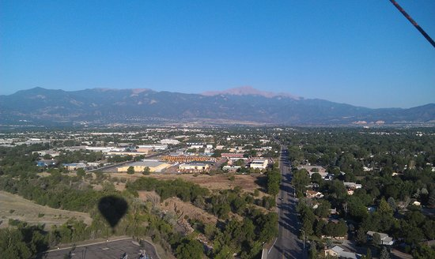
III. The view from 1000 feet: The relationship of 1, 2, and 3 John

Slide 33
III. The view from 1000 feet: The relationship of 1, 2, and 3 John
ESV Study Bible Notes “It has been suggested that 2 and 3 John were originally preserved because they were part of a single packet containing all three Johannine letters. On this view, 3 John was a personal letter to Gaius commending the courier of the shipment, Demetrius (v. 12); 2 John was to be read aloud to Gaius's church; and 1 John was a sermon for general distribution and not a letter in the strict sense. This scenario cannot be verified but is a useful hypothesis in envisioning how John's letters could have arisen and been preserved in early Christianity.”

Slide 34
III. The view from 1000 feet: The relationship of 1, 2, and 3 John
CW (8/2/20) “Three major emphases run through 1 John: right doctrine, righteous living, and love for others. Actually, these three are inseparably intertwined. John spends a considerable part of his letter combatting false teaching about Jesus’ incarnation and reminding his readers of the truth—truth that he and the other apostles knew firsthand since they had heard, seen, and touched Jesus in the flesh.”

Slide 35
III. The view from 1000 feet: The relationship of 1, 2, and 3 John
CW (8/2/20) “John considered right doctrine vital … but he did not see orthodox doctrine as a substitute for righteous living. Right belief isn’t enough. James tells us even demons can have that! Rather, John says the genuineness of our faith is demonstrated by being rightly related to God in obedience and being rightly related to those who bear his image, especially our brothers and sisters in Christ. … Obedience and love are the natural result of believing right doctrine. They prove that we really believe what we claim!”

Slide 36
III. The view from 1000 feet: The relationship of 1, 2, and 3 John
TS (8/30/20) 2 John “Love and truth are inseparable and clearly on John’s mind when he writes to this church.”
“How do we love our brothers and sisters in Christ? John says by walking in obedience to the truth…”

Slide 37
III. The view from 1000 feet: The relationship of 1, 2, and 3 John
TS (8/30/20) 2 John “Truth and love are inseparable. … Truth without love is cold and sterile law … and leads to legalism… On the other side, love without truth leads to what we see today in the tolerance movement…where we see an overabundance of nonjudgment for things that we are clearly called in Scripture to judge. … Neither option works.”

Slide 38
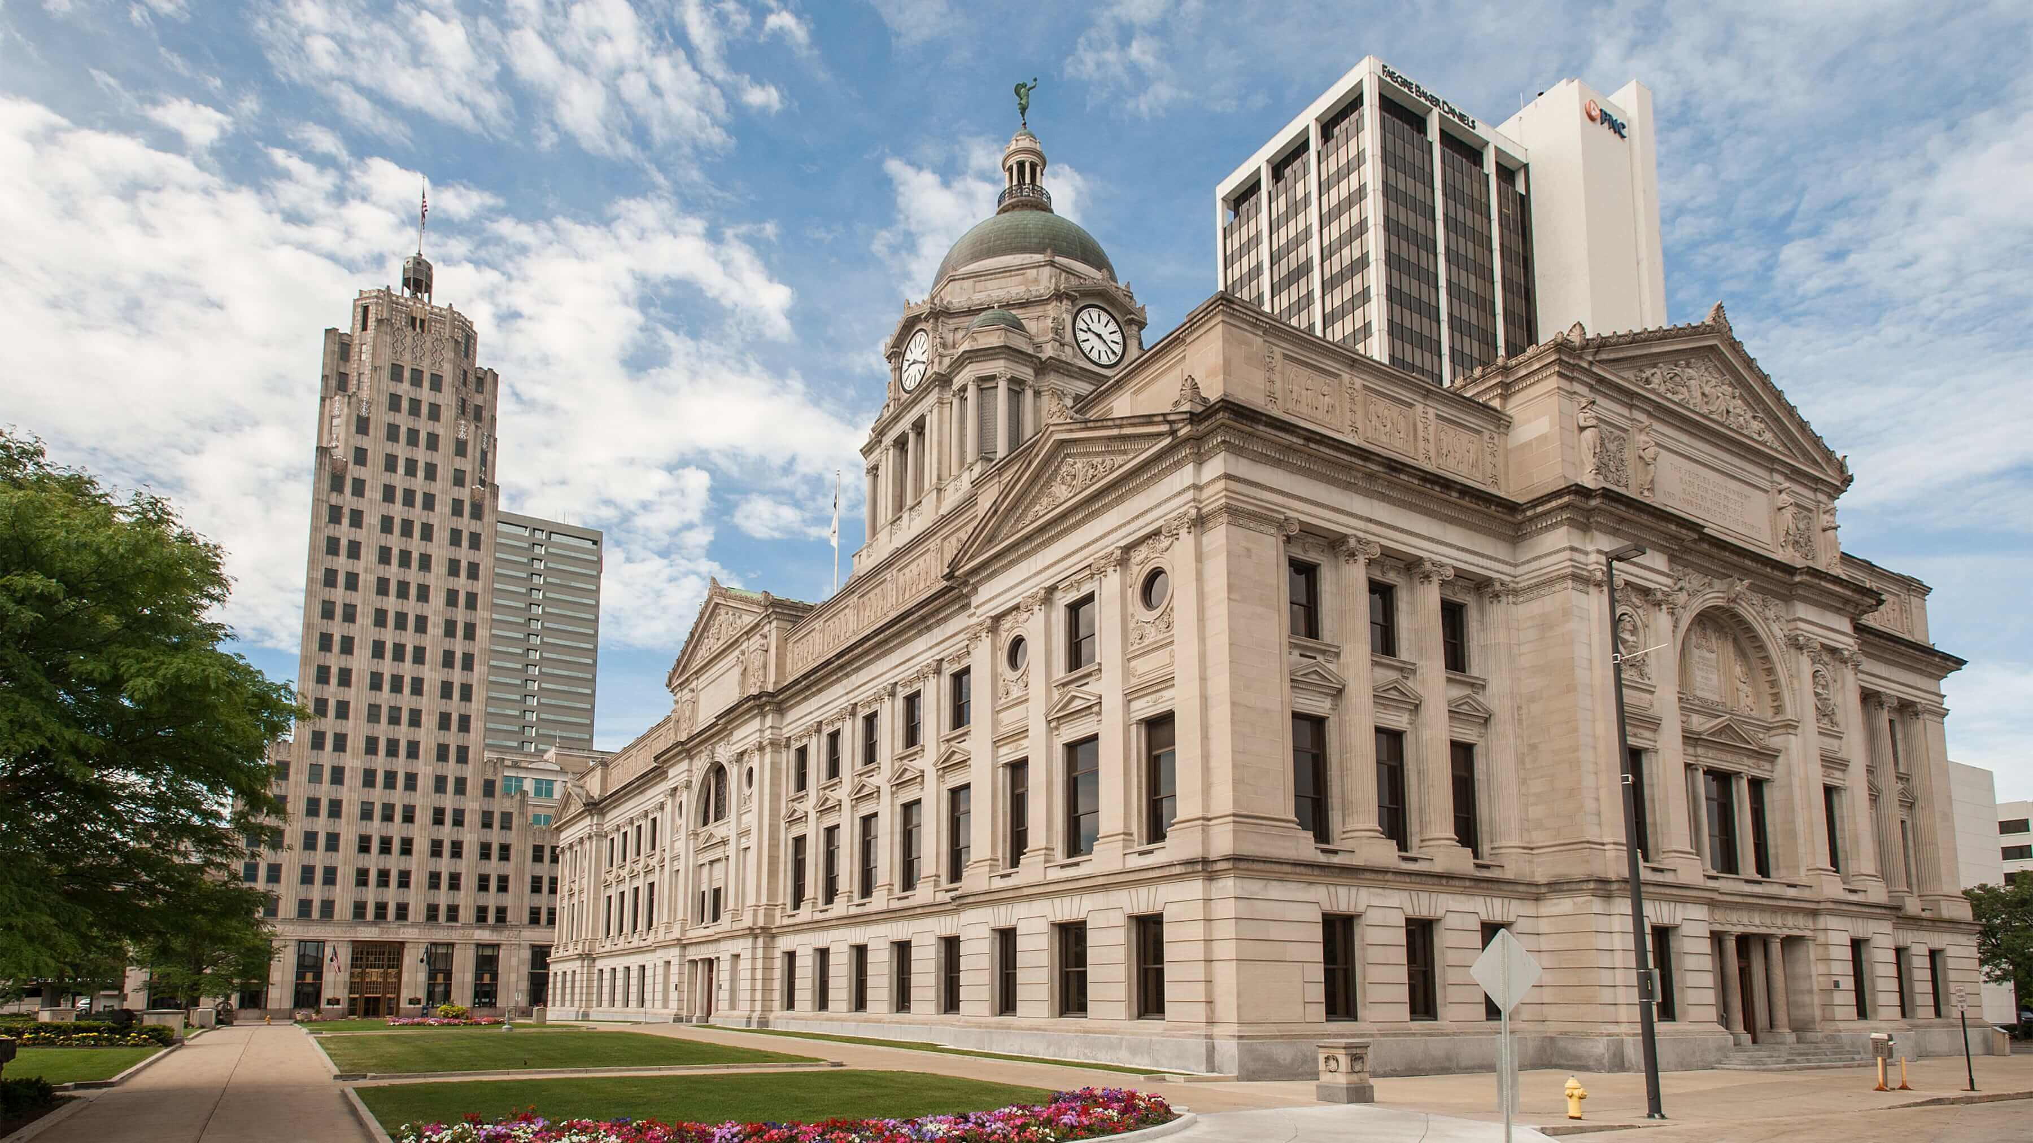
IV. The view from the ground: 3 John expounded

Slide 39
The theme of 3 John
ESV Study Bible Notes “The theme of 3 John is steadfastness in the face of opposition. The recipient of the letter, Gaius, faces a troublemaker named Diotrephes. By “walking in the truth” (vv. 3, 4), Christians can embrace and live out the apostolic message that John conveys in all his letters. “
WB (12/17/08) “This letter actually addresses… the opposite problem of 2 John. Both serve as warnings against false teachers. But here, legitimate missionaries, orthodox teachers, who preach sound doctrine, sent out from John, were being rejected by … a tyrant named Diotrephes.”

Slide 40
IV. The view from the ground: 3 John expounded
John Stott, “Like the Second Epistle, the Third is brief enough to have been written on a single sheet of papyrus. Tyndale New Testament Commentaries
It’s a postcard.
“We simply don’t know who he (Gaius) was.”
Demetrius: *Normal postal service could not be entrusted with Christian correspondence like this letter (and possibly other letters from John as well. So someone like Demetrius served as courier.” ESV Study Bible Notes

Slide 41
IV. The view from the ground: 3 John expounded
3 John 1-4: Greeting to Gaius
​¹ The elder to the beloved Gaius, whom I love in truth. ² Beloved, I pray that all may go well with you and that you may be in good health, as it goes well with your soul. ³ For I rejoiced greatly when the brothers came and testified to your truth, as indeed you are walking in the truth. ⁴ I have no greater joy than to hear that my children are walking in the truth.

Slide 42
IV. The view from the ground: 3 John expounded
B. Support … from Gaius for hospitality
⁵ Beloved, it is a faithful thing you do* in all your efforts for these brothers, strangers as they are, ⁶ who testified to your love before the church. You will do well to send them on their journey in a manner worthy of God**. ⁷ For they have gone out for the sake of the name***, accepting nothing from the Gentiles. ⁸ Therefore we ought to support people like these, that we may be fellow workers for the truth.
*Stott, “He must have received them into his house and entertained them at his own expense.”
** Mt 10:40 “Whoever receives you receives me, and whoever receives me receives him who sent me.”
*** = missionaries

Slide 43
IV. The view from the ground: 3 John expounded
B. … and Opposition from Diotrephes against hospitality
⁹ I have written something to the church, but Diotrephes, who likes to put himself first (philoproteuo,) does not acknowledge our (John’s) authority. ¹⁰ So if I come, I will bring up what he is doing, talking wicked nonsense against us. And not content with that, he refuses to welcome the brothers, and also stops those who want to and puts them out of the church*.
* He must have held an important position

Slide 44
IV. The view from the ground: 3 John expounded
C. Support from Demetrius
¹¹ Beloved, do not imitate evil but imitate good. Whoever does good is from God; whoever does evil has not seen God. ¹² Demetrius has received a good testimony from everyone, and from the truth itself. We also add our testimony, and you know that our testimony is true.

Slide 45
IV. The view from the ground: 3 John expounded
D. Final Greetings
¹³ I had much to write to you, but I would rather not write with pen and ink. ¹⁴ I hope to see you soon, and we will talk face to face. ¹⁵ Peace be to you. The friends greet you. Greet the friends, each by name.

Slide 46
Applications
WB (12/17/08) “… those workers in the Kingdom who are faithful to the truth, and are genuine servants of the Lord, deserve and should receive our support; whether it be hospitality, contributions, prayers, or whatever.
Seek truth
Seek to live in love
Support missionaries

