Slide 1
Romans
Part 4
(2:5–2:16)

Slide 2
Romans
“Therefore,”
“Because of this,”
“What then shall we say, then?”
“Furthermore,”
FLOW
Part 4
(2:5–2:16)

Slide 3
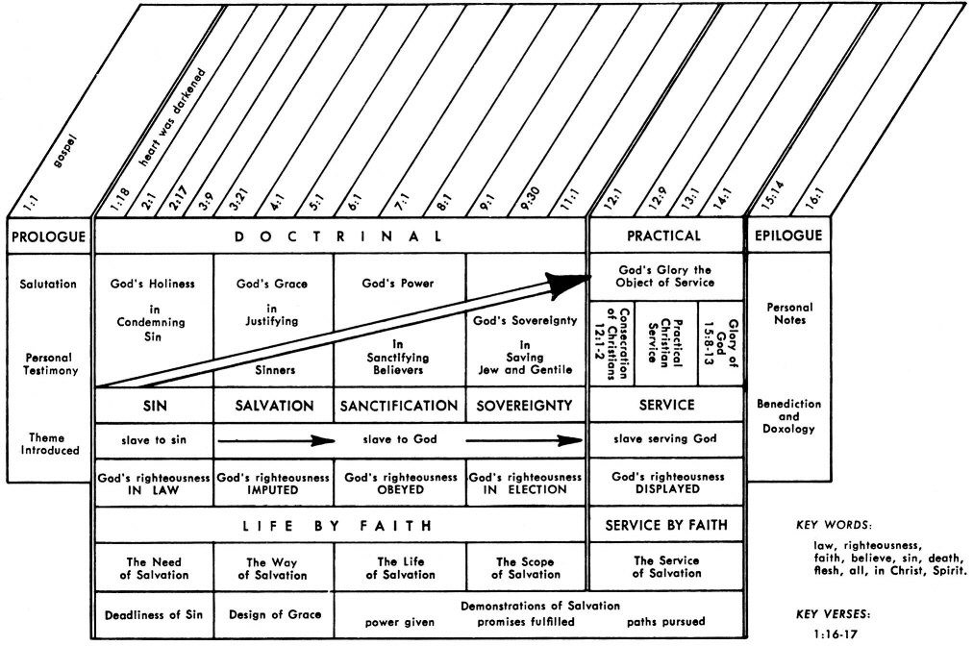
Romans Flowchart

Slide 4
Romans
FLOW
SPECIFICS

Slide 5
Romans 1:16-17 (NIV)
= WHAT
¹⁶ I am not ashamed of the gospel, because it is the power of God for the salvation of everyone who believes: first for the Jew, then for the Gentile.
¹⁷ For in the gospel a righteousness from God is revealed, a righteousness that is by faith from first to last, just as it is written: "The righteous will live by faith."
= HOW

Slide 6
Romans 1:20 & 2:3 (NIV)
^{1:20} …God's invisible qualities - his eternal power and divine nature - have been clearly seen, being understood from what has been made, so that men are without excuse.
^{2:3} So when you, a mere man, pass judgment on them and yet do the same things, do you think you will escape God's judgment?

Slide 7
Romans
FLOW
SPECIFICS
PREPARED

Slide 8
Romans 2:3-4 (NIV)
³ So when you, a mere man, pass judgment on them and yet do the same things, do you think you will escape God's judgment? ⁴ Or do you show contempt for the riches of his kindness, tolerance and patience, not realizing that God's kindness leads you toward repentance?

Slide 9
Romans 2:5-16 (NIV)
⁵ But because of your stubbornness and your unrepentant heart, you are storing up wrath against yourself for the day of God's wrath, when his righteous judgment will be revealed. ⁶ God "will give to each person according to what he has done.” ⁷ To those who by persistence in doing good seek glory, honor and immortality, he will give eternal life. ⁸ But for those who are self-seeking and who reject the truth and follow evil, there will be wrath and anger. ⁹ There will be trouble and distress for every human being who does evil: first for the Jew, then for the Gentile; ¹⁰ but glory, honor and peace for everyone who does good: first for the Jew, then for the Gentile. ¹¹ For God does not show favoritism.

Slide 10
¹² All who sin apart from the law will also perish apart
from the law, and all who sin under the law will be judged by the law. ¹³ For it is not those who hear the law who are righteous in God's sight, but it is those who obey the law who will be declared righteous. ¹⁴ (Indeed, when Gentiles, who do not have the law, do by nature things required by the law, they are a law for themselves, even though they do not have the law, ¹⁵ since they show that the requirements of the law are written on their hearts, their consciences also bearing witness, and their thoughts now accusing, now even defending them.) ¹⁶ This will take place on the day when God will judge men's secrets through Jesus Christ, as my gospel declares.

Slide 11
Romans 2:1-4 (NIV)
¹ You, therefore, have no excuse, you who pass judgment on someone else, for at whatever point you judge the other, you are condemning yourself, because you who pass judgment do the same things. ² Now we know that God's judgment against those who do such things is based on truth. ³ So when you, a mere man, pass judgment on them and yet do the same things, do you think you will escape God's judgment? ⁴ Or do you show contempt for the riches of his kindness, tolerance and patience, not realizing that God's kindness leads you toward repentance?

Slide 12
Romans 2:5-16 (NIV)
⁵ But because of your stubbornness and your unrepentant heart, you are storing up wrath against yourself for the day of God's wrath, when his righteous judgment will be revealed. ⁶ God "will give to each person according to what he has done.” ⁷ To those who by persistence in doing good seek glory, honor and immortality, he will give eternal life. ⁸ But for those who are self-seeking and who reject the truth and follow evil, there will be wrath and anger. ⁹ There will be trouble and distress for every human being who does evil: first for the Jew, then for the Gentile; ¹⁰ but glory, honor and peace for everyone who does good: first for the Jew, then for the Gentile. ¹¹ For God does not show favoritism.

Slide 13
¹² All who sin apart from the law will also perish apart
from the law, and all who sin under the law will be judged by the law. ¹³ For it is not those who hear the law who are righteous in God's sight, but it is those who obey the law who will be declared righteous. ¹⁴ (Indeed, when Gentiles, who do not have the law, do by nature things required by the law, they are a law for themselves, even though they do not have the law, ¹⁵ since they show that the requirements of the law are written on their hearts, their consciences also bearing witness, and their thoughts now accusing, now even defending them.) ¹⁶ This will take place on the day when God will judge men's secrets through Jesus Christ, as my gospel declares.

Slide 14
Romans 2:5-16 (NIV)
⁵ But because of your stubbornness and your unrepentant heart, you are storing up wrath against yourself for the day of God's wrath, when his righteous judgment will be revealed. ⁶ God "will give to each person according to what he has done.” ⁷ To those who by persistence in doing good seek glory, honor and immortality, he will give eternal life. ⁸ But for those who are self-seeking and who reject the truth and follow evil, there will be wrath and anger. ⁹ There will be trouble and distress for every human being who does evil: first for the Jew, then for the Gentile; ¹⁰ but glory, honor and peace for everyone who does good: first for the Jew, then for the Gentile. ¹¹ For God does not show favoritism.

Slide 15
¹² All who sin apart from the law will also perish apart
from the law, and all who sin under the law will be judged by the law. ¹³ For it is not those who hear the law who are righteous in God's sight, but it is those who obey the law who will be declared righteous. ¹⁴ (Indeed, when Gentiles, who do not have the law, do by nature things required by the law, they are a law for themselves, even though they do not have the law, ¹⁵ since they show that the requirements of the law are written on their hearts, their consciences also bearing witness, and their thoughts now accusing, now even defending them.) ¹⁶ This will take place on the day when God will judge men's secrets through Jesus Christ, as my gospel declares.

Slide 16
Romans 2:5-16 (NIV)
ἀμετανόητον (ametanoēton)
σκληρότητα (sklērotēta)
⁵ But because of your stubbornness and your unrepentant heart, you are storing up wrath against yourself for the day of God's wrath, when his righteous judgment will be revealed.
Romans 1:18
The wrath of God is being revealed from heaven against all the godlessness and wickedness of people, who suppress the truth by their wickedness.

Slide 17
Romans 2:6 (NIV)
⁶ God "will give to each person according to what he has done.”
Psalm 62:12 “You reward everyone according to what they have done.”
Prov. 24:12 “Will he not repay everyone according to what they have done?”

Slide 18
Romans 2:7-10 (NIV)
”Keep on seeking”
”Keep on disobeying”
⁷ To those who by persistence in doing good seek glory, honor and immortality, he will give eternal life. ⁸ But for those who are self-seeking and who reject the truth and follow evil, there will be wrath and anger. ⁹ There will be trouble and distress for every human being who does evil: first for the Jew, then for the Gentile; ¹⁰ but glory, honor and peace for everyone who does good: first for the Jew, then for the Gentile.
”Keep on obeying”
”Keeps on producing”
”Keeps on working”

Slide 19
Romans 2:7-10 (NIV)
⁷ To those who by persistence in doing good seek glory, honor and immortality, he will give eternal life. ⁸ But for those who are self-seeking and who reject the truth and follow evil, there will be wrath and anger. ⁹ There will be trouble and distress for every human being who does evil: first for the Jew, then for the Gentile; ¹⁰ but glory, honor and peace for everyone who does good: first for the Jew, then for the Gentile.

Slide 20
Romans 2:9-11 (NIV)
⁹ There will be trouble and distress for every human being who does evil: first for the Jew, then for the Gentile; ¹⁰ but glory, honor and peace for everyone who does good: first for the Jew, then for the Gentile.
¹¹ For God does not show favoritism.

Slide 21
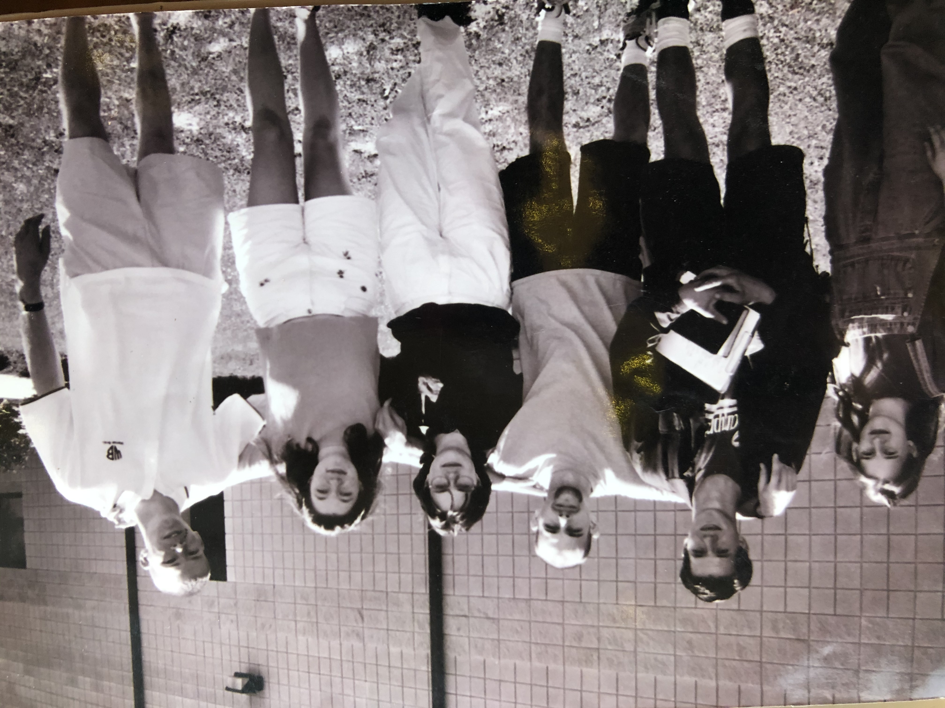

Slide 22
Romans 2:9-11 (NIV)
⁹ There will be trouble and distress for every human being who does evil: first for the Jew, then for the Gentile; ¹⁰ but glory, honor and peace for everyone who does good: first for the Jew, then for the Gentile.
¹¹ For God does not show favoritism.

Slide 23
Romans 2:12-15 (NIV)
¹² All who sin apart from the law will also perish apart from the law, and all who sin under the law will be judged by the law. ¹³ For it is not those who hear the law who are righteous in God's sight, but it is those who obey the law who will be declared righteous. ¹⁴ (Indeed, when Gentiles, who do not have the law, do by nature things required by the law, they are a law for themselves, even though they do not have the law, ¹⁵ since they show that the requirements of the law are written on their hearts, their consciences also bearing witness, and their thoughts now accusing, now even defending them.)
ἔργον
(Ergon)
”work of the law”

Slide 24
Romans 2:12-15 (NIV)
¹² All who sin apart from the law will also perish apart from the law, and all who sin under the law will be judged by the law. ¹³ For it is not those who hear the law who are righteous in God's sight, but it is those who obey the law who will be declared righteous. ¹⁴ (Indeed, when Gentiles, who do not have the law, do by nature things required by the law, they are a law for themselves, even though they do not have the law, ¹⁵ since they show that the requirements of the law are written on their hearts, their consciences also bearing witness, and their thoughts now accusing, now even defending them.)

Slide 25
Romans 2:16 (NIV)
2 Corinthians 5:10 (ESV)
For we must all appear before the judgment seat of Christ, so that each one may receive what is due for what he has done in the body, whether good or evil.
1 Corinthians 4:5 (ESV)
Therefore do not pronounce judgment before the time, before the Lord comes, who will bring to light the things now hidden in darkness and will disclose the purposes of the heart. Then each one will receive his commendation from God.
¹⁶ This will take place on the day when God will judge men's secrets through Jesus Christ, as my gospel declares.
1 Corinthians 3:14-15 (ESV)
If what has been built survives, the builder will receive a reward. If it is burned up, the builder will suffer loss but yet will be saved - even though only as one escaping through the flames.
Romans 2:5 “But because of your stubbornness and your unrepentant heart, you are storing up wrath against yourself for the day of God's wrath, when his righteous judgment will be revealed.
Gal. 1:8 (GNT) “But even if we or an angel from heaven should preach to you a gospel that is different from the one we preached to you, may he be condemned to hell!”

Slide 26
God as Judge
Has all of the facts (TRUTH) 2:1-14
Will pronounce fairly (UNBIASED) 2:5-11
Has proper authority (JESUS) 2:12-16

Slide 27
“Is it not true that even when we try to help people we often do not start with the premise that we as well as they are sinners in need of forgiveness? We tend to focus on improving people’s moral conduct, but Paul’s main point is that we are all involved in a solidarity of sin that embraces the whole human race and so he is concerned with the gospel as God’s approach to truly help and mend the whole person and the whole of mankind.” - Leon Morris

