Slide 1
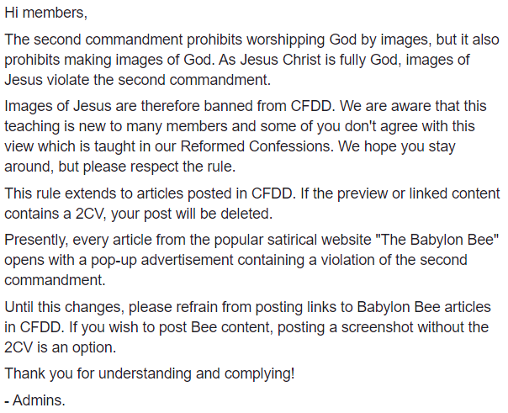

Slide 2
Westminster Larger Catechism
Q. 109:
What are the sins forbidden in the second commandment?
The sins forbidden in the second commandment are:
  …the making any representation of God,
  of all, or of any of the three Persons,
  either inwardly in our mind, or outwardly
  in any kind of image or likeness of any creature whatsoever;
  all worshiping of it, or God in it or by it

Slide 3

“We are not to make use of visual or pictorial representations of the triune God, or of any person of the Trinity, for the purposes of Christian worship.”

Slide 4
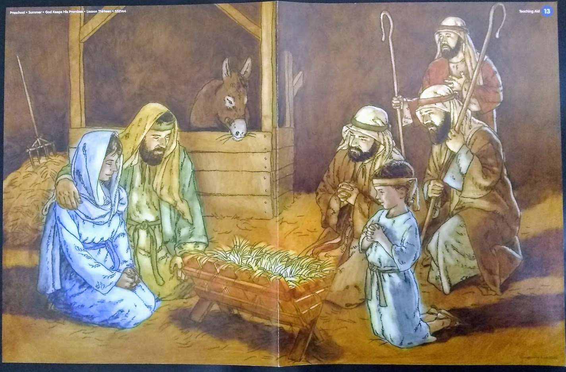

Slide 6
Exodus 20:1-6 (ESV)
And God spoke all these words, saying,
I am the LORD your God, who brought you out of the land of Egypt, out of the house of slavery.
You shall have no other gods before me.
You shall not make for yourself a carved image, or any likeness of anything that is in heaven above, or that is in the earth beneath, or that is in the water under the earth.
You shall not bow down to them or serve them, for I the LORD your God am a jealous God, visiting the iniquity of the fathers on the children to the third and the fourth generation of those who hate me,
but showing steadfast love to thousands of those who love me and keep my commandments.

Slide 7
Deuteronomy 4:11-12 (ESV)
And you came near and stood at the foot of the mountain, while the mountain burned with fire to the heart of heaven, wrapped in darkness, cloud, and gloom.
Then the LORD spoke to you out of the midst of the fire. You heard the sound of words, but saw no form; there was only a voice.

Slide 8
Deuteronomy 4:15-19 (ESV)
Therefore watch yourselves very carefully. Since you saw no form on the day that the LORD spoke to you at Horeb out of the midst of the fire,
beware lest you act corruptly by making a carved image for yourselves, in the form of any figure, the likeness of male or female,
the likeness of any animal that is on the earth, the likeness of any winged bird that flies in the air,
the likeness of anything that creeps on the ground, the likeness of any fish that is in the water under the earth.
And beware lest you raise your eyes to heaven, and when you see the sun and the moon and the stars, all the host of heaven, you be drawn away and bow down to them and serve them, things that the LORD your God has allotted to all the peoples under the whole heaven.

Slide 9
Exodus 32:1 (ESV)
When the people saw that Moses delayed to come down from the mountain, the people gathered themselves together to Aaron and said to him, “Up, make us gods* who shall go before us. As for this Moses, the man who brought us up out of the land of Egypt, we do not know what has become of him.”
*or, “a god”

Slide 10
Nehemiah 9:18 (ESV)
…Even when they had made for themselves a golden calf and said, “This is your God who brought you up out of Egypt,” and had committed great blasphemies…

Slide 11
Exodus 32:4 (ESV)
And he received the gold from their hand and fashioned it with a graving tool and made a golden calf.
And they said, “These are your gods*, O Israel, who brought you up out of the land of Egypt!”
*or, “This is your god/God”
Exodus 20:2 (ESV)
“I am the LORD your God, who brought you out of the land of Egypt…”

Slide 12
Exodus 32:5 (ESV)
When Aaron saw this, he built an altar before it. And Aaron made a proclamation and said, “Tomorrow shall be a feast to the LORD.”

Slide 13
Exodus 32:6 (ESV)
And they rose up early the next day and offered burnt offerings and brought peace offerings. And the people sat down to eat and drink and rose up to play.
Exodus 24:4-5 (ESV)
[Moses] rose early in the morning and built an altar at the foot of the mountain, and twelve pillars, according to the twelve tribes of Israel.
And he sent young men of the people of Israel, who offered burnt offerings and sacrificed peace offerings of oxen to the LORD.

Slide 15
Westminster Larger Catechism (108)
A: The duties required in the second commandment are:
  the receiving, observing, and keeping pure and entire, all such religious worship and ordinances as God hath instituted in his word; particularly:
        prayer and thanksgiving in the name of Christ;
        the reading, preaching, and hearing of the word;
        the administration and receiving of the sacraments;
        church government and discipline, and the ministry and maintenance thereof;
        religious fasting;
        swearing by the name of God, and vowing unto him;
  as also the disapproving, detesting, and opposing all false worship;
  according to each one’s place and calling, removing it and all monuments of idolatry.

Slide 16
Westminster Larger Catechism (109)
A: The sins forbidden in the second commandment are:
all devising, counselling, commanding, using, and anywise approving any religious worship not instituted by God himself;
tolerating a false religion;
the making of any representation of God, of all, or of any of the three Persons, either inwardly in our mind, or outwardly in any kind of image or likeness of any creature whatsoever;
all worshiping of it, or God in it or by it;
the making of any representation of feigned deities, and all worship of them, or service belonging to them;
all superstitious devices, corrupting the worship of God, adding to it, or taking from it, whether invented and taken up of ourselves, or received by tradition from others, though under the title of antiquity, custom, devotion, good intent, or any other pretence whatsoever;
simony;
sacrilege;
all neglect, contempt, hindering, and opposing the worship and ordinances which God hath appointed.

Slide 18
1 Samuel 15:22-23 (ESV)
  Has the LORD as great delight
  in burnt offerings and sacrifices,
  as in obeying the voice of the LORD?
  Behold, to obey is better than sacrifice,
  and to listen than the fat of rams.
  For rebellion is as the sin of divination,
  and presumption is as iniquity and idolatry.

