Slide 1
1 Peter 2:18-25
For to This You Have Been Called

Slide 2
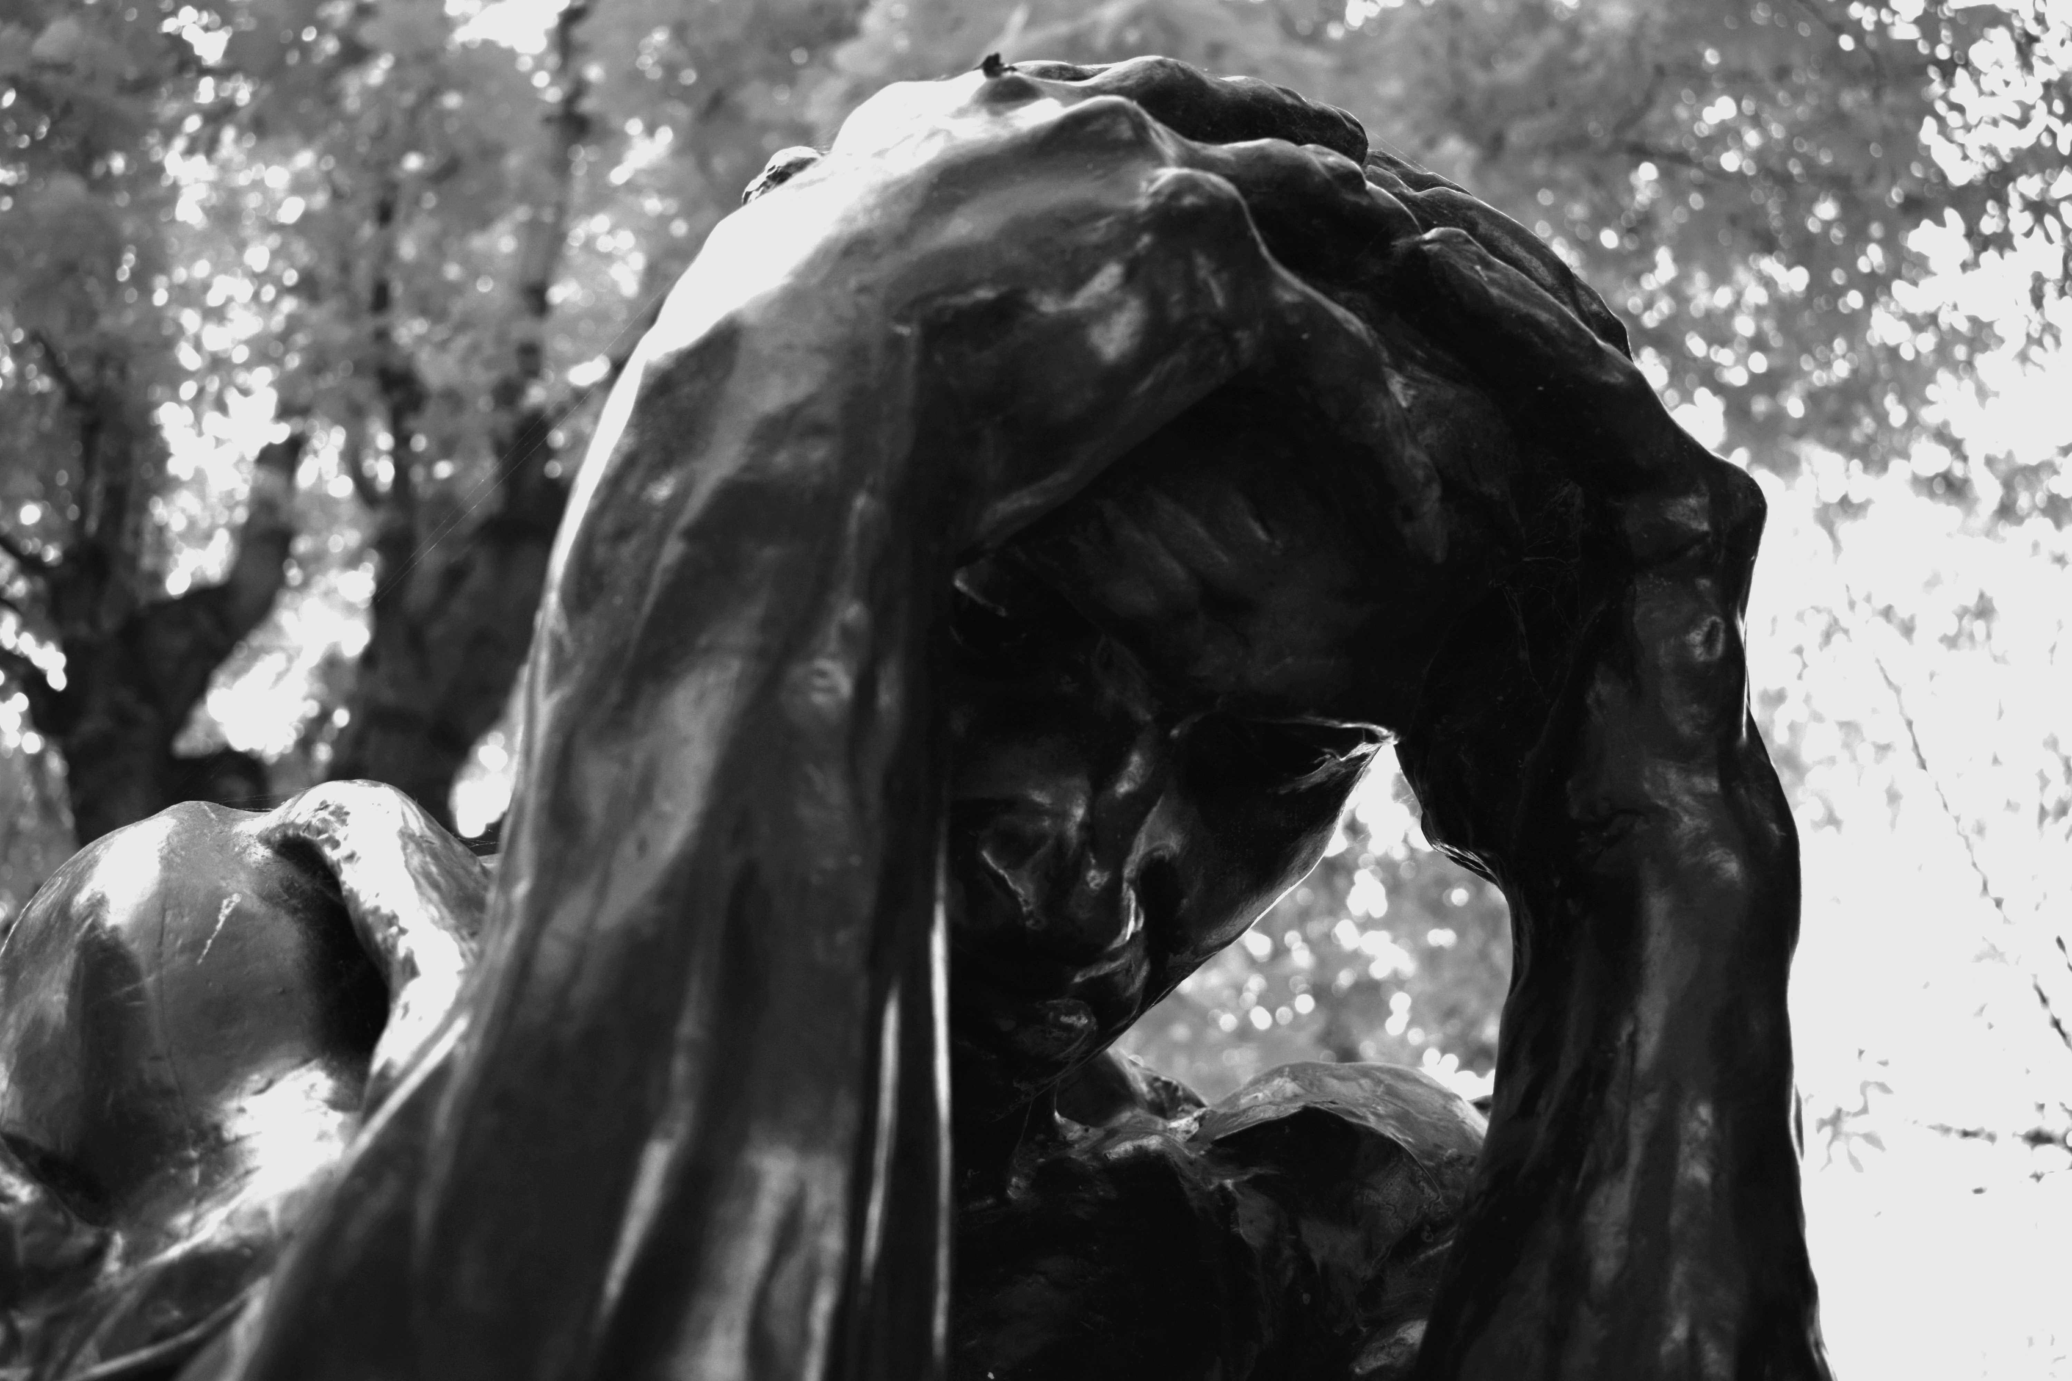
Suffering

Slide 3
Suffering
Experiencing pain
Experiencing grief
Experiencing loss or death
Experiencing defeat
Experiencing punishment
Experiencing sickness
Experiencing persecution

Slide 4
Suffering
Experiencing pain
Experiencing grief
Experiencing loss or death
Experiencing defeat
Experiencing punishment
Experiencing sickness
Experiencing persecution

Slide 6
Suffering
Experiencing pain
Experiencing grief
Experiencing loss or death
Experiencing defeat
Experiencing punishment
Experiencing sickness
Experiencing persecution

Slide 7
1 Peter 2:21-25
For to this you have been called, because Christ also suffered for you, leaving you an example, so that you might follow in his steps. He committed no sin, neither was deceit found in his mouth. When he was reviled, he did not revile in return; when he suffered, he did not threaten, but continued entrusting himself to him who judges justly. He himself bore our sins in his body on the tree, that we might die to sin and live to righteousness. By his wounds you have been healed. For you were straying like sheep, but have now returned to the Shepherd and Overseer of your souls.

Slide 8
Peter’s Christology
“Shows the intimate relationship between it and the Christian life: the past suffering of Christ is the present condition of believers, while the present glory of Christ is the future glory of those who follow in the steps of the suffering Christ.”
– Matera

Slide 9
Mark 8:34-35
“Whoever wants to be my disciple must deny themselves and take up their cross and follow me. For whoever wants to save their life will lose it, but whoever loses their life for me and for the gospel will save it.”

Slide 10
Take up their cross
“Crucifixion, the death implied through Jesus’ words, was the form of execution reserved for the most despised and evil of criminals. After sentence was passed, the victim was scourged with the most severe of the three Roman levels of beating, and then the cross-member was lashed to his arms and shoulders so that he could carry it out to the place of execution. There the cross-member was fastened to the upright member of the cross, already sunk in the ground. Thus, for anyone to, “take up their cross” was to go to the place of painful, shameful, execution.”
- Carson

Slide 11
1 Peter 2:21
…to this you have been called, to doing good and suffering for it, because Christ also suffered for you, leaving you an example, so that you might follow in his footsteps…

Slide 12
1 Peter 2:21
…to this you have been called, to doing good and suffering for it, because Christ also suffered for you, leaving you an example, so that you might follow in his footsteps…

Slide 13
1 Peter 2:22-23
He committed no sin, neither was deceit found in his mouth. When he was reviled, he did not revile in return; when he suffered, he did not threaten, but continued entrusting himself to Him who judges justly…

Slide 14
1 Peter 2:11-20
Honorable conduct & submission to authority
1 Peter 22-25
The example of the suffering servant
1 Peter 3 -4
Submission in the roles of husbands and wives & church conduct

Slide 15
1 Peter 2:23
When he was reviled, he did not revile in return; when he suffered, he did not threaten, but continued entrusting himself to Him who judges justly.

Slide 16
1 Peter 2:23
When he was reviled, he did not revile in return; when he suffered, he did not threaten, but continued entrusting himself to Him who judges justly.

Slide 17
1 Peter 2:21
…to this you have been called, to doing good and suffering for it, because Christ also suffered for you, leaving you an example, so that you might follow in his footsteps…

Slide 18
1 Peter 2:24-25
He himself bore our sins in his body on the tree, that we might die to sin and live to righteousness. By his wounds you have been healed. For you were straying like sheep, but have now returned to the Shepherd and Overseer of your souls.

Slide 19
You are called…
1 Peter 1:15
To holiness
1 Peter 2:10
Out of darkness into light
1 Peter 3:9
To blessing
1 Peter 5:9
To eternal glory

Slide 20
You are called…
1 Peter 1:15
To holiness
1 Peter 2:10
Out of darkness into light
1 Peter 2:21
To doing good and suffering for it
1 Peter 3:9
To blessing
1 Peter 5:9
To eternal glory

Slide 21
John 15:18-20
If the world hates you, keep in mind that it hated me first. If you belonged to the world, it would love you as its own. As it is, you do not belong to the world, but I have chosen you out of the world. That is why the world hates you. Remember what I told you: ‘A servant is not greater than his master.’ If they persecuted me, they will persecute you also.

Slide 22
1 Peter 4:12-16,19
Dear friends, do not be surprised at the fiery ordeal that has come on you to test you, as though something strange were happening to you. But rejoice inasmuch as you participate in the sufferings of Christ, so that you may be overjoyed when his glory is revealed. If you are insulted because of the name of Christ, you are blessed, for the Spirit of glory and of God rests on you. If you suffer, it should not be as a murderer or a thief or any other kind of criminal, or even as a meddler. However, if you suffer as a Christian, do not be ashamed, but praise God that you bear that name… (19) so then, those who suffer according to God’s will should commit themselves, entrust themselves, to their faithful creator and continue to do good.

Slide 23
Isaiah 41:9-13
“You are my servant, I have chosen you and not cast you off; fear not, for I am with you; be not dismayed, for I am your God; I will strengthen you, I will help you, I will uphold you with my righteous right hand. Behold, all who are incensed against you will be put to shame and confounded; those who strive against you will be as nothing and will perish. You will seek those who contend with you, but you will not find them; those who war against you will be as nothing at all. For I, the LORD your God, hold your right hand; it is I who say to you, “Fear not, I am the one who helps you.”

