Slide 1
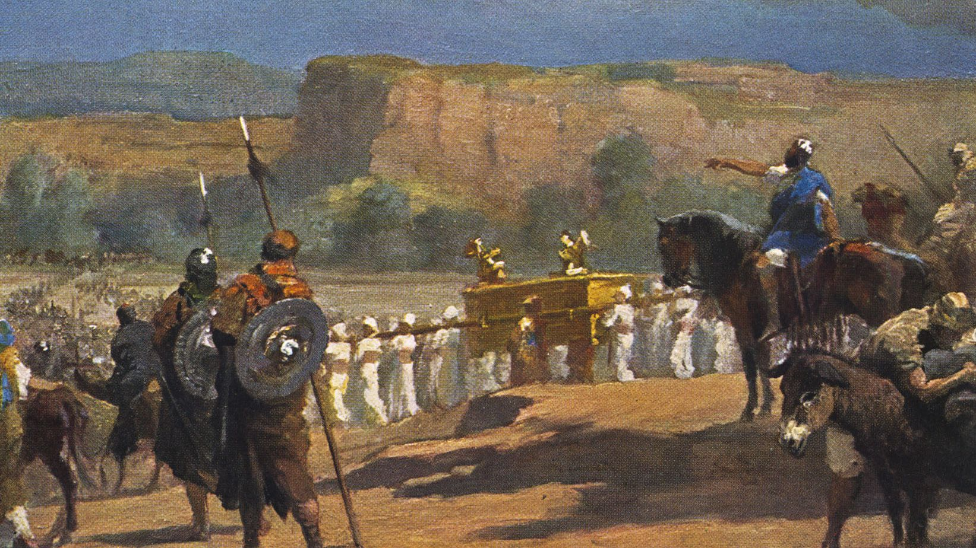
God & Canaan, Part 1 Because of the wickedness of the nations

Slide 2
Called into question
God’s existence
God’s character and motives
The inerrancy of scripture

Slide 3
Galatians 5:17
The sinful nature wants to do evil, which is just the opposite of what the Spirit wants. And the Spirit gives us desires that are the opposite of what the sinful nature desires. These two forces are constantly fighting each other, so you are not free to carry out your good intentions.

Slide 4
Why does god seem so violent in the ot?
How do we come to terms with the perceived atrocities of the Old Testament?

Slide 5
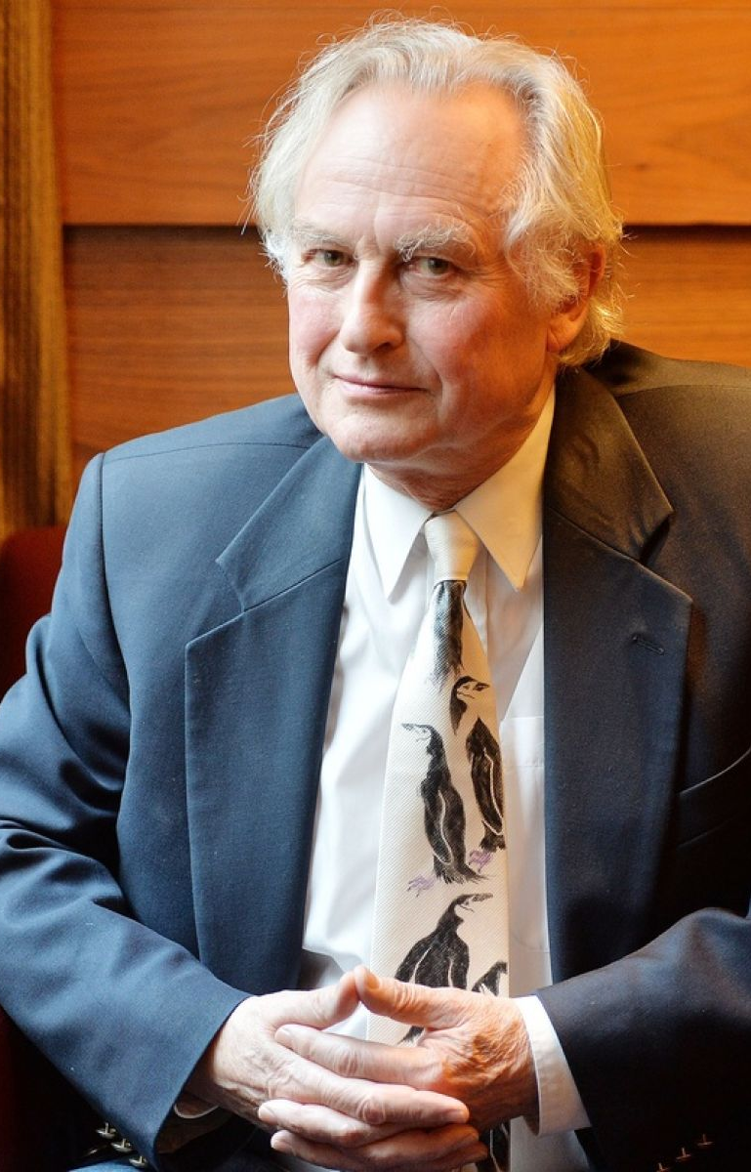
Richard Dawkins – The God Delusion
“The God of the OT is arguably the most unpleasant character in all fiction. He’s jealous, and proud of it. He’s a petty, unjust, unforgiving control-freak; a vindictive, bloodthirsty ethnic cleanser, a misogynistic, homophobic, racist, infanticidal, genocidal, filicidal, pestilential, megalomaniacal, sadomasochistic, capriciously malevolent bully.”

Slide 6
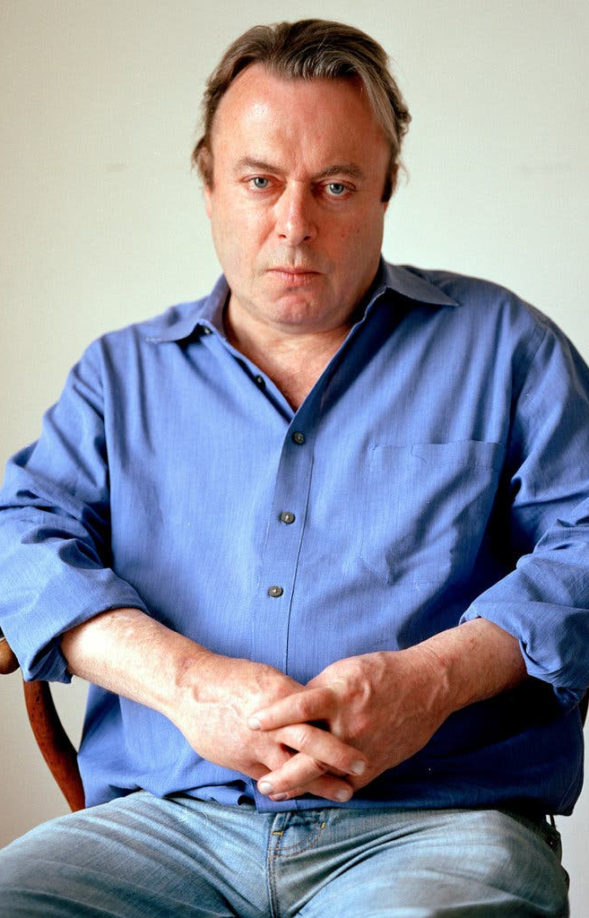
Christopher Hitchens: God is not Great: How Religion poisons everything
The Canaanites were pitilessly driven out of their homes to make room for the ungrateful and mutinous children of Israel…

Slide 7
God is:
Petty
Unjust
Unforgiving
Controlling
Vindictive
Blood thirsty
A racist ethnic cleanser
Genocidal
Guilty of indiscriminate massacres
An evil monster

Slide 8
Deuteronomy 20 – laws concerning warfare
16 But in the cities of these peoples that the LORD your God is giving you for an inheritance, you shall save alive nothing that breathes, 17 but you shall devote them to complete destruction, the Hittites and the Amorites, the Canaanites and the Perizzites, the Hivites and the Jebusites, as the LORD your God has commanded, 18 that they may not teach you to do according to all their abominable practices that they have done for their gods, and so you sin against the LORD your God

Slide 9
Joshua 6:21
The Israelites devoted all in the city to destruction, both men and women, young and old, oxen, sheep, and donkeys, with the edge of the sword.

Slide 10
Approach 1: Divine Command morality
Our moral duties are constituted by God’s commands
If God commanded the Israelites to destroy Canaan, the morally correct choice would be obedience.

Slide 11
Approach 2: Context, context, context

Slide 12
Approach 2: Context, Context, Context
Genesis 1-3
God’s good creation & man’s rebellion

Slide 13
Approach 2: Context, Context, Context
Genesis 1-3
God’s good creation & man’s rebellion
Genesis 4-11
The fruit of rebellion

Slide 14
Approach 2: Context, Context, Context
Genesis 1-3
God’s good creation & man’s rebellion
Genesis 4-11
The fruit of rebellion
Genesis 12
God reveals himself to Abram

Slide 15
Approach 2: Context, Context, Context
Genesis 15
God makes a covenant with Abram
Canaan is promised

Slide 16
Genesis 15:13-16
13 Then the LORD said to Abram, “Know for certain that your offspring will be sojourners in a land that is not theirs and will be servants there, and they will be afflicted for four hundred years.14 But I will bring judgment on the nation that they serve, and afterward they shall come out with great possessions. 15 As for you, you shall go to your fathers in peace; you shall be buried in a good old age. 16 And they shall come back here in the fourth generation, for the iniquity of the Amorites is not yet complete.”

Slide 17
God’s promises
Descendants will be a great nation
The land of Canaan will be turned over to them
After four centuries

Slide 18
The Canaanites: Genesis 15:20
Kenites
Kenizzites
Kadmonites
Hittites
Perizzites
Rephaites (Rephaim)
Amorites
Canaanites
Girgashites
Jebusites

Slide 19
The Canaanites: Deuteronomy 7
Hittites
Girgashites
Amorites
Canaanites
Perizzites
Hivites
Jebusites

Slide 20
The Canaanites: Deuteronomy 20
Hittites
Amorites
Canaanites
Perizzites
Hivites
Jebusites

Slide 21
Kenites
Kenizzites
Kadmonites
Hittites
Perizzites
Rephaites
Amorites
Canaanites
Girgashites
Jebusites
Hivites

Slide 22
Kenites
Kenizzites
Kadmonites
Hittites
Perizzites
Rephaites
Amorites
Canaanites
Girgashites
Jebusites
Hivites
Canaanites

Slide 23
Genesis 15:16
6 And they shall come back here in the fourth generation, for the iniquity of the Amorites is not yet complete.

Slide 24
Deuteronomy 9:5
5 Not because of your righteousness or the uprightness of your heart are you going in to possess their land, but because of the wickedness of these nations the Lord your God is driving them out from before you

Slide 25
Leviticus 18:26-28
26 But you shall keep my statutes and my rules and do none of these abominations, either the native or the stranger who sojourns among you 27 (for the people of the land, who were before you, did all of these abominations, so that the land became unclean), 28 lest the land vomit you out when you make it unclean, as it vomited out the nation that was before you.

Slide 26
God & Canaan, Part 1 Because of the wickedness of the nations

