Slide 1
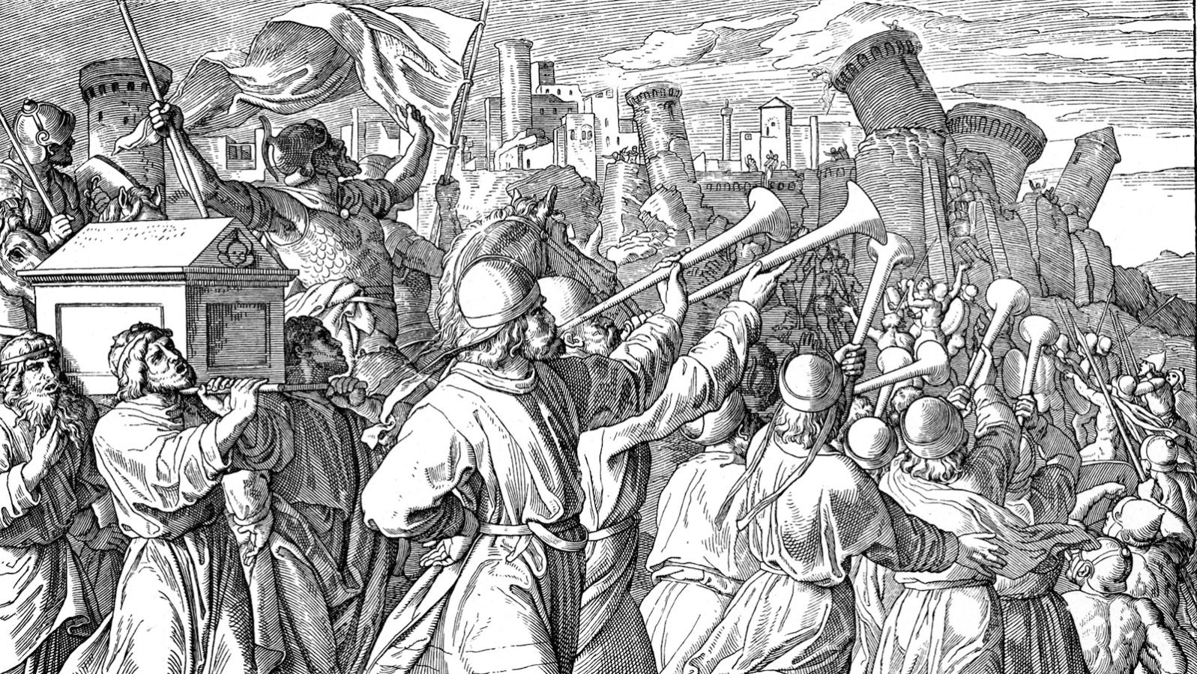
God & Canaan Part 2
Rhetoric & Hyperbole

Slide 2
Deuteronomy 16:18, Joshua 6:21
But in the cities of these peoples that the LORD your God is giving you for an inheritance, you shall save alive nothing that breathes, but you shall devote them to complete destruction, the Hittites and the Amorites, the Canaanites and the Perizzites, the Hivites and the Jebusites, as the LORD your God has commanded,
Then they devoted all in the city to destruction, both men and women, young and old, oxen, sheep, and donkeys, with the edge of the sword

Slide 3
Numbers 21:1, 21:21-23
When the Canaanite, the king of Arad, who lived in the Negeb, heard that Israel was coming by the way of Atharim, he fought against Israel, and took some of them captive.
Then Israel sent messengers to Sihon king of the Amorites, saying, “Let me pass through your land. We will not turn aside into field or vineyard. We will not drink the water of a well. We will go by the King’s Highway until we have passed through your territory.” But Sihon would not allow Israel to pass through his territory. He gathered all his people together and went out against Israel to the wilderness and came to Jahaz and fought against Israel.

Slide 4
Numbers 13:28
However, the people who dwell in the land are strong, and the cities are fortified and very large. And besides, we saw the descendants of Anak there.

Slide 5
Deuteronomy 7:1
“When the LORD your God brings you into the land that you are entering to take possession of it, and clears away many nations before you, the Hittites, the Girgashites, the Amorites, the Canaanites, the Perizzites, the Hivites, and the Jebusites, seven nations more numerous and mightier than you

Slide 6
Deuteronomy 9:1-2
“Hear, O Israel: you are to cross over the Jordan today, to go in to dispossess nations greater and mightier than you, cities great and fortified up to heaven, a people great and tall, the sons of the Anakim, whom you know, and of whom you have heard it said, ‘Who can stand before the sons of Anak?’

Slide 7
Joshua 10 & 11
As for Makkedah, Joshua captured it on that day and struck it, and its king, with the edge of the sword. He devoted to destruction every person in it; he left none remaining. And he did to the king of Makkedah just as he had done to the king of Jericho.
Then Joshua and all Israel with him passed on from Makkedah to Libnah and fought against Libnah. And the LORD gave it also and its king into the hand of Israel. And he struck it with the edge of the sword, and every person in it; he left none remaining in it. And he did to its king as he had done to the king of Jericho.
And the LORD gave Lachish into the hand of Israel, and he captured it on the second day and struck it with the edge of the sword, and every person in it, as he had done to Libnah.
So Joshua struck the whole land, the hill country and the Negeb and the lowland and the slopes, and all their kings. He left none remaining, but devoted to destruction all that breathed, just as the LORD God of Israel commanded.
And Joshua turned back at that time and captured Hazor and struck its king with the sword, for Hazor formerly was the head of all those kingdoms. And they struck with the sword all who were in it, devoting them to destruction; there was none left that breathed. And he burned Hazor with fire.

Slide 8
2 Samuel 11:1
In the spring of the year, the time when kings go out to battle, David sent Joab, and his servants with him, and all Israel. And they ravaged the Ammonites and besieged Rabbah. But David remained at Jerusalem.

Slide 9
Similarities between Israel & its Contemporaries
Israel
Fought at the command of God
Attributed victories to God
Viewed victory as God’s favor
Viewed defeat as God’s disfavor
Contemporaries
Fought at the command of deities
Attributed victories to their gods
Viewed victory as favor of the gods
Viewed defeat as divine disfavor

Slide 10
Hyperbole
The use of extreme exaggeration to make a point or to place emphasis

Slide 11
Ancient War Text Hyperbole
Numerical Hyperbole
Generalized or exaggerated numbers of enemies present or killed

Slide 12
Ancient War Text Hyperbole
Numerical Hyperbole
Generalized or exaggerated numbers of enemies present or killed
Speed Hyperbole
Exaggeration of time frames

Slide 13
Ancient War Text Hyperbole
Numerical Hyperbole
Generalized or exaggerated numbers of enemies present or killed
Speed Hyperbole
Exaggeration of time frames
Severity Hyperbole
Exaggerated accounts of damage inflicted on enemies

Slide 14
Ancient War Text Hyperbole
Numerical Hyperbole
Generalized or exaggerated numbers of enemies present or killed
Speed Hyperbole
Exaggeration of time frames
Severity Hyperbole
Exaggerated accounts of damage inflicted on enemies
Extent Hyperbole
Exaggerated extent of geographical control

Slide 15
Joshua 10 & 11
As for Makkedah, Joshua captured it on that day and struck it, and its king, with the edge of the sword. He devoted to destruction every person in it; he left none remaining. And he did to the king of Makkedah just as he had done to the king of Jericho.
Then Joshua and all Israel with him passed on from Makkedah to Libnah and fought against Libnah. And the LORD gave it also and its king into the hand of Israel. And he struck it with the edge of the sword, and every person in it; he left none remaining in it. And he did to its king as he had done to the king of Jericho.
And the LORD gave Lachish into the hand of Israel, and he captured it on the second day and struck it with the edge of the sword, and every person in it, as he had done to Libnah.
So Joshua struck the whole land, the hill country and the Negeb and the lowland and the slopes, and all their kings. He left none remaining, but devoted to destruction all that breathed, just as the LORD God of Israel commanded.
And Joshua turned back at that time and captured Hazor and struck its king with the sword, for Hazor formerly was the head of all those kingdoms. And they struck with the sword all who were in it, devoting them to destruction; there was none left that breathed. And he burned Hazor with fire.

Slide 16
Judges 1:1
After the death of Joshua, the people of Israel inquired of the LORD, “Who shall go up first for us against the Canaanites, to fight against them?

Slide 17
Joshua 13:1-5
Now Joshua was old and advanced in years, and the LORD said to him, “You are old and advanced in years, and there remains yet very much land to possess. This is the land that yet remains: all the regions of the Philistines, and all those of the Geshurites (from the Shihor, which is east of Egypt, northward to the boundary of Ekron, it is counted as Canaanite; there are five rulers of the Philistines, those of Gaza, Ashdod, Ashkelon, Gath, and Ekron), and those of the Avvim,

Slide 18
Joshua 12:7-10
And these are the kings of the land whom Joshua and the people of Israel defeated on the west side of the Jordan, from Baal-gad in the Valley of Lebanon to Mount Halak, that rises toward Seir (and Joshua gave their land to the tribes of Israel as a possession according to their allotments, in the hill country, in the lowland, in the Arabah, in the slopes, in the wilderness, and in the Negeb, the land of the Hittites, the Amorites, the Canaanites, the Perizzites, the Hivites, and the Jebusites) the king of Jericho, one; the king of Ai, which is beside Bethel, one; the king of Jerusalem, one; the king of Hebron, one;

Slide 19
Joshua 15:63
But the Jebusites, the inhabitants of Jerusalem, the people of Judah could not drive out, so the Jebusites dwell with the people of Judah at Jerusalem to this day.

Slide 20
Joshua 12:21-23
The king of Taanach, one; the king of Megiddo, one; 22 the king of Kedesh, one; the king of Jokneam in Carmel, one; the king of Dor in Naphath-dor, one; the king of Goiim in Galilee, one; 24 the king of Tirzah, one: in all, thirty-one kings

Slide 21
Joshua 17:12
Also in Issachar and in Asher Manasseh had Beth-shean and its villages, and Ibleam and its villages, and the inhabitants of Dor and its villages, and the inhabitants of En-dor and its villages, and the inhabitants of Taanach and its villages, and the inhabitants of Megiddo and its villages; the third is Naphath.Yet the people of Manasseh could not take possession of those cities, but the Canaanites persisted in dwelling in that land.

Slide 22
Joshua 10:33 & Joshua 10:40
Then Horam king of Gezer came up to help Lachish. And Joshua struck him and his people, until he left none remaining.
So Joshua struck the whole land, the hill country and the Negeb and the lowland and the slopes, and all their kings. He left none remaining, but devoted to destruction all that breathed, just as the LORD God of Israel commanded.

Slide 23
Joshua 16:10
However, they did not drive out the Canaanites who lived in Gezer, so the Canaanites have lived in the midst of Ephraim to this day but have been made to do forced labor.

Slide 24
Joshua 23:7
Therefore, be very strong to keep and to do all that is written in the Book of the Law of Moses, turning aside from it neither to the right hand nor to the left, that you may not mix with these nations remaining among you or make mention of the names of their gods or swear by them or serve them or bow down to them, but you shall cling to the LORD your God just as you have done to this day. For the LORD has driven out before you great and strong nations. And as for you, no man has been able to stand before you to this day. One man of you puts to flight a thousand, since it is the LORD your God who fights for you, just as he promised you. Be very careful, therefore, to love the LORD your God. For if you turn back and cling to the remnant of these nations remaining among you and make marriages with them, so that you associate with them and they with you, know for certain that the LORD your God will no longer drive out these nations before you, but they shall be a snare and a trap for you, a whip on your sides and thorns in your eyes, until you perish from off this good ground that the LORD your God has given you.

Slide 25
Ancient War Text Hyperbole
Numerical Hyperbole
Generalized or exaggerated numbers of enemies present or killed
Speed Hyperbole
Exaggeration of time frames
Severity Hyperbole
Exaggerated accounts of damage inflicted on enemies
Extent Hyperbole
Exaggerated extent of geographical control

Slide 26
Speed Hyperbole
Joshua 6
Joshua 8
Joshua 10
Rapid expansion and conquest

Slide 27
Speed Reality
Joshua 11:18
Joshua 16:10
Joshua 17:13
Judges 1
Drawn out expansion and conquest

Slide 28
Severity Hyperbole
Joshua 21:44
Joshua 10
Joshua 11
No effective resistance, no survivors, total annihilation

Slide 29
Severity Reality
Joshua 13
Joshua 15
Joshua 16
Joshua 17
Joshua 23
Strong resistance, military victories, leaders executed, civilians left intact

Slide 30
Extent Hyperbole
Joshua 11
Joshua 21
Joshua 23
Israel conquered and controlled all of Canaan

Slide 31
Extent Reality
Joshua 13
Joshua 15
Joshua 16
Joshua 17
Canaan partially conquered with portions not in full Israelite control

Slide 32
Hyperbole
An accepted part of war rhetoric

Slide 33
Hyperbole
An accepted part of war rhetoric
The presence of Hyperbole doesn’t invalidate the text

Slide 34
Hyperbole
An accepted part of war rhetoric
The presence of hyperbole doesn’t invalidate the text
Know what to take literally

Slide 35
Hyperbole
An accepted part of war rhetoric
The presence of hyperbole doesn’t invalidate the text
Know what to take literally
Remember the importance of context

Slide 36
Miroslav Volf
I used to think that wrath was unworthy of God. Isn’t God love? Shouldn’t divine love be beyond wrath? God is love. And God loves every person and every creature. But that’s exactly why God is wrathful against some of them. My last resistance to the idea of God’s wrath was a casualty of the war in the former Yugoslavia, the region from which I come. According to some estimates, 200,000 people were killed and over 3 million were displaced. My villages and cities were destroyed. My people shelled. Day in and day out. Some of them brutalized beyond imagination. And I could not imagine God NOT BEING angry. How did God react to the carnage? By doting on the perpetrators in a grandfatherly fashion? By refusing to condemn the bloodbath but instead affirming the perpetrator’s basic goodness? Wasn’t God fiercely angry with them? Though I used to complain about the indecency of God’s wrath, I came to think that I would have to rebel against a God who wasn’t wrathful at the sight of the world’s evil.
God isn’t wrathful in spite of being love. God is wrathful because God is love.

Slide 37
God & Canaan Part 2
Rhetoric & Hyperbole

