Slide 1
1 Peter 2:20-21
If you suffer for doing good and you endure it, this is commendable before God. To this you were called, because Christ suffered for you, leaving you an example, that you should follow in his steps.

Slide 2
Since January 24
• Nasdaq Stock Exchange
• United Nations
• Bethany Christian Services
• Harry Potter
• The Equality Act
• Canadian Pastor
• U. S. Supreme Court Ruling

Slide 3
Since January 24
• Toronto Father
• Biden’s Nominee
• Blue’s Clues & You

Slide 4
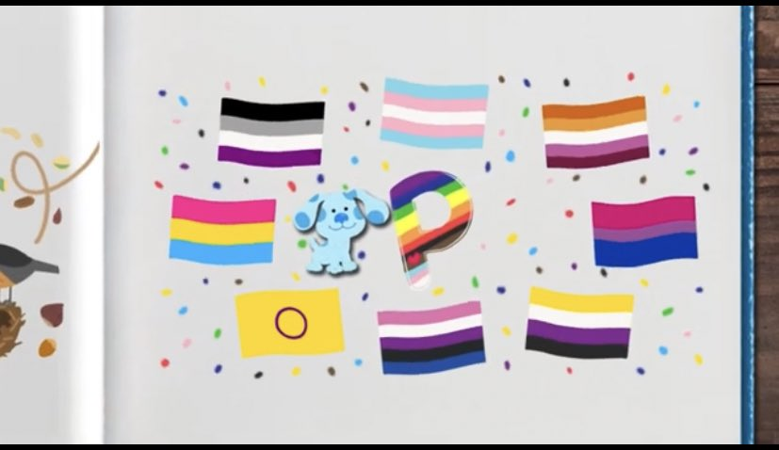

Slide 5
Since January 24
• Toronto Father
• Biden’s Nominee
• Blue’s Clues & You
• NY Sex Education
• Covid Relief Bill
• Grace Church School
• John Macarthur
• Ryan Anderson

Slide 6
Since January 24
• Hallmark Channel
• England
• Federal Identification Gender
• YouTube / LifeSiteNews
• Twitter / LifeSiteNews
• State University of NY
• Mr. Potato Head
• Gainesville, Florida

Slide 7
Review
• Defining persecution
• The kind of suffering that God honors
• Persecuted for living out our beliefs
• Conflicts result from our refusal to embrace a lie
• Hardship, yes. The guillotine, not yet.
• Preparing for what lies ahead

Slide 8
Preparing For What Lies Ahead
• Biblical attitude about both hardship and persecution
• Hoping in God and his provision, not in one’s own resources
• Standing up now when the cost is relatively low
• Plugged into a church family where we bear each other’s burdens

