Slide 2
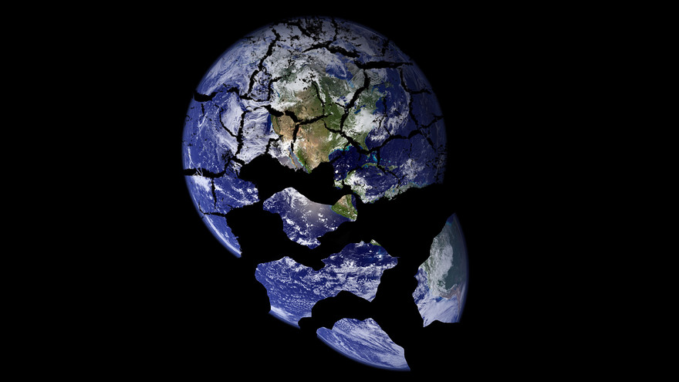

Slide 4
What’s Wrong with the World?
Truly Executing Justice

Slide 5
“Social Justice”

Slide 6
“Social Justice”
Truth

Slide 7
“Social Justice”
Truth
Problem

Slide 8
“Social Justice”
Truth
Problem
Solution

Slide 10
“He has told you, O man, what is good; and what does the Lord require of you but to do justice, and to love kindness, and to walk humbly with your God?”
- Micah 6:8

Slide 11
“For if you truly amend your ways and your deeds, if you truly execute justice one with another … then I will let you dwell in this place ...”
- Jeremiah 7:5

Slide 12
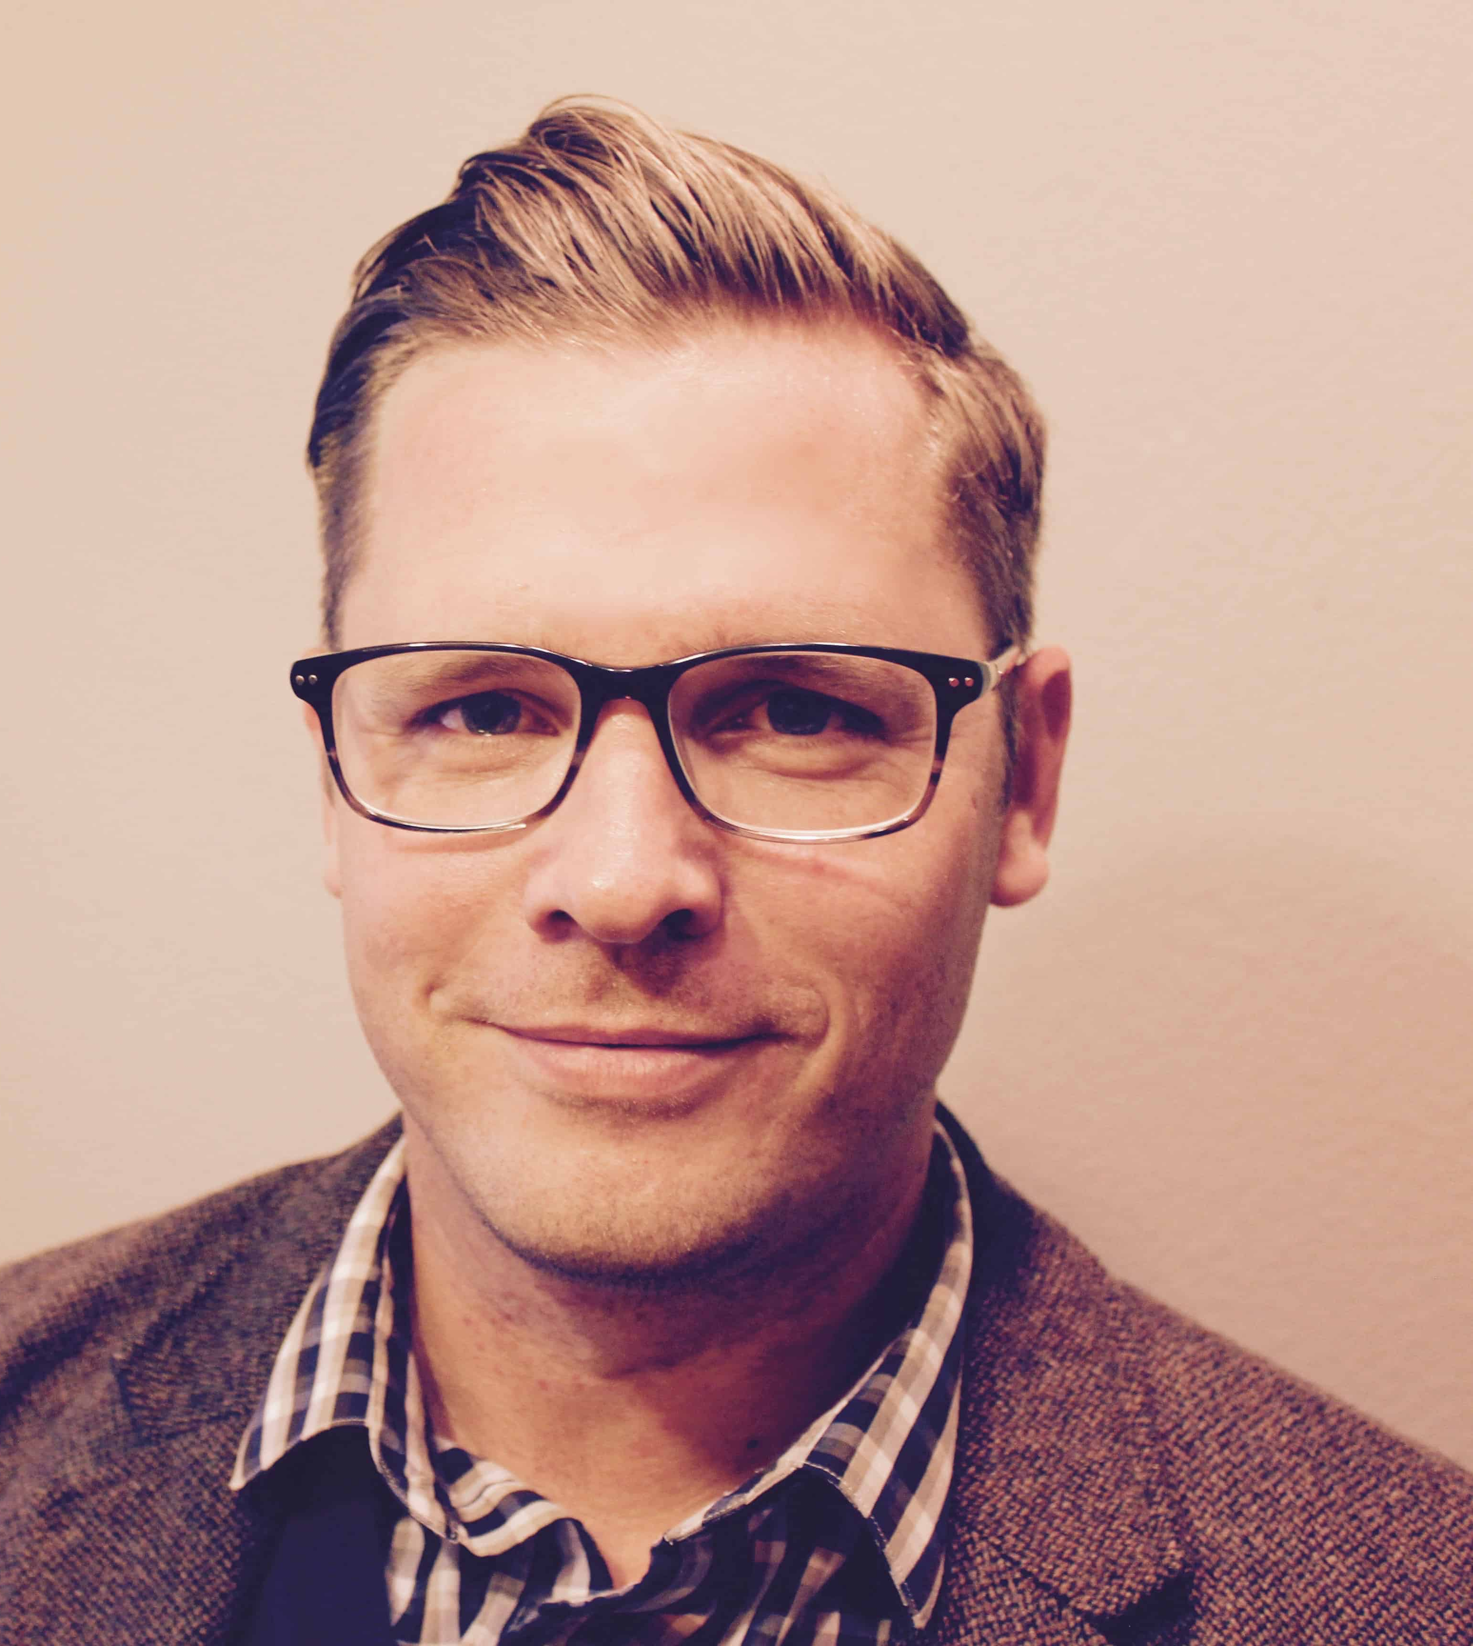
“That presupposes there are untrue ways to execute justice, ways of trying to make the world a better place that aren’t in sync with reality and end up unleashing more havoc in the universe.”
Thaddeus Williams

Slide 13
“That presupposes there are untrue ways to execute justice, ways of trying to make the world a better place that aren’t in sync with reality and end up unleashing more havoc in the universe.”

Slide 15
TRUTH

Slide 16
TRUTH
Biblical Worldview
Truth: Telling it like it is.

Slide 17
TRUTH
Biblical Worldview
Truth: Telling it like it is.
Presupposes:
There is a real world.
We can know things about that real world.

Slide 18
TRUTH
“You don’t have the life experience to make an informed choice. You can have an opinion, but you also have the privilege of walking away from pregnancy; and that might make the choices involved seem easier than they really are.”

Slide 19
TRUTH
Biblical Worldview
Social Justice Worldview
Truth: Secret knowledge accessible only to oppressed.
Truth: Telling it like it is.

Slide 20
TRUTH
“Stop with the discussion groups, workshops or committees. Accept the grievances of faculty of color without question.”
Tyler Tsay, student, anti-racist activist

Slide 21
TRUTH
“To ask students who are suffering from white supremacy to tell us about the instances of white supremacy is itself racism. We must stop asking them because we are inflicting harm. To ask for evidence of racism is racism with a capital R.”
Professor Naima Lowe

Slide 22
TRUTH
Biblical Worldview
Social Justice Worldview
Truth: Secret knowledge accessible only to oppressed.
Truth: Telling it like it is.

Slide 23
TRUTH
Neil Shenvi & Pat Sawyer

Slide 24
TRUTH
“One of the most brutal struggles the early church faced was against Gnosticism, a movement which insisted that certain spiritual truths could only be obtained through secret knowledge available to select individuals.
“Contra Gnosticism, the church insisted Christian theology had to be founded on public revelation God had supplied to the Church from its inception.”
Neil Shenvi & Pat Sawyer

Slide 25
PROBLEM

Slide 26
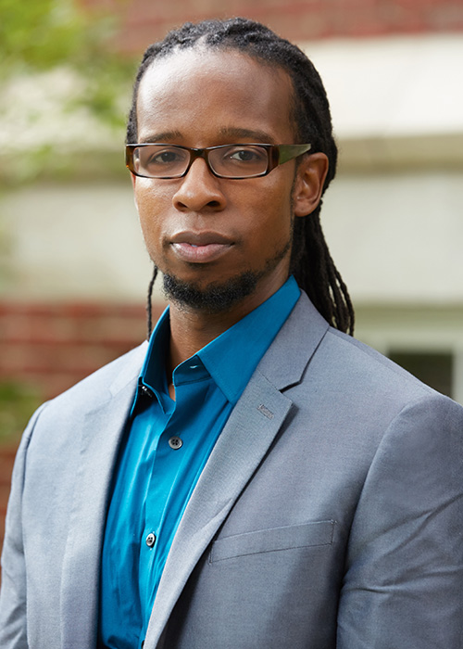
PROBLEM
“As an anti-racist, when I see racial disparities, I see racism.”
Ibram X. Kendi

Slide 28
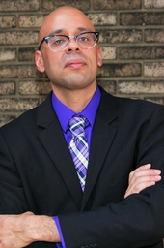
PROBLEM
“… relatively well-off, highly educated, liberal whites tend to be among the most zealous in identifying and prosecuting new forms of racism …”
Musa al-Gharbi

Slide 29
SOLUTION

Slide 30
SOLUTION
“Contrary to popular opinion, questioning whether and to what extent sexism, racism, or any other antibiblical ism is the real problem is siding with the oppressed.”
Thaddeus Williams

Slide 31
SOLUTION

Slide 32
SOLUTION
Mercy Muroki

Slide 33
SOLUTION
“We have to have these conversations about why it is that [these disparities] take place and, yes, it involves making awkward and uncomfortable hypotheses relating to family and culture, and nobody wants to go there …”
Mercy Muroki

Slide 34
SOLUTION

Slide 35
SOLUTION
Peter Kirsanow

Slide 36
SOLUTION
“… the data make clear that blacks are overrepresented among victims of police shootings,
Peter Kirsanow

Slide 37
SOLUTION
“… the data make clear that blacks are overrepresented among victims of police shootings, but they are underrepresented relative to their overrepresentation in crime, particularly violent crime.”
Peter Kirsanow

Slide 39
“He has told you, O man, what is good; and what does the Lord require of you but to do justice, and to love kindness, and to walk humbly with your God?”
- Micah 6:8

Slide 40
“He has told you, O man, what is good; and what does the Lord require of you but to do justice, and to love kindness, and to walk humbly with your God?”
- Micah 6:8

Slide 42
WHAT’S WRONG WITH THE WORLD?

Slide 43
WHAT’S WRONG WITH THE WORLD?
G. K. Chesterton

Slide 44
WHAT’S WRONG WITH THE WORLD?
“I am.”
G. K. Chesterton

