Slide 3
Section 1 – Interpretation and application
Section 2 – Overview of each of the 5 books
Section 3 – Interesting/controversial parts of the Pentateuch

Slide 5
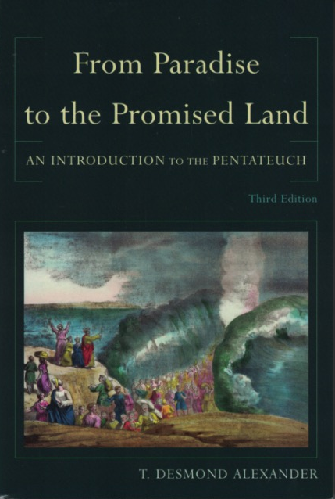

Slide 6
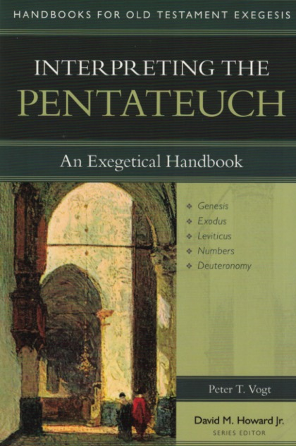

Slide 7
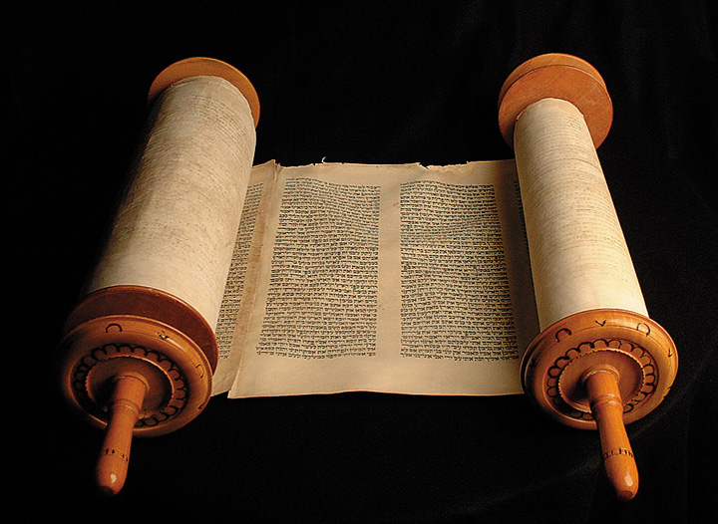

Slide 8
The OT Law is theologically centered instruction in things necessary for the people of God to know in order to live a righteous life.

Slide 10
Marcion
School of Alexandria
School of Antioch
Thomas Aquinas
Martin Luther
John Calvin
Christian Reconstructionism
Dispensationalism

Slide 11
• There is a clear and decisive break between the Old and New Covenants, and therefore none of the Pentateuch’s laws are binding.
- Marcion
- Scool of Antioch
- Dispensationalism
• There is continuity between the two covenants and therefore many of the laws are still binding, especially the moral ones.
- School of Alexandria
- Thomas Aquinas
- John Calvin
- Christian Reconstructionism

Slide 13
THE INDIVIDUAL LAWS
DEEPER PRINCIPLES (IMITATING GOD)
NATURE AND CHARACTER OF GOD

