Slide 1
THE ART OF ARGUING WELL
Winning the Abortion Debate Without Losing Your Opponent

Slide 2
THE ART OF ARGUING WELL
Take an honest interest in others

Slide 3
THE ART OF ARGUING WELL
Take an honest interest in others
“Many of us are mono-maniacs when it comes to the Christian faith. That’s all we can talk about, and people find us profoundly boring.”
- John Lennox

Slide 4
THE ART OF ARGUING WELL
Take an honest interest in others
Define “winning” biblically

Slide 5
THE ART OF ARGUING WELL
Take an honest interest in others
Define “winning” biblically
Attack arguments, not people

Slide 6
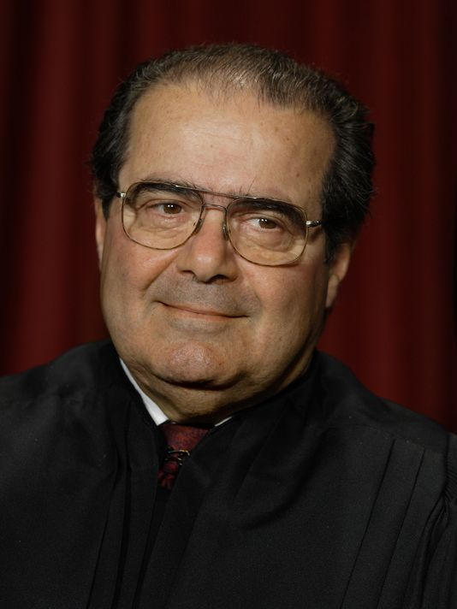
THE ART OF ARGUING WELL
Take an honest interest in others
Define “winning” biblically
Attack arguments, not people
“I attack ideas; I don’t attack people. And some very good people have some very bad ideas. And if you can’t separate the two you gotta get another day job.”
- Antonin Scalia ***

Slide 7
THE ART OF ARGUING WELL
Take an honest interest in others
Define “winning” biblically
Attack arguments, not people
Take time to warm up the conversation

Slide 8
THE ART OF ARGUING WELL
Take an honest interest in others
Define “winning” biblically
Attack arguments, not people
Take time to warm up the conversation
Proverbs 16:24, “Gracious words are a honeycomb, sweet to the soul and healing to the bones.”

Slide 9
THE ART OF ARGUING WELL
Take an honest interest in others
Define “winning” biblically
Attack arguments, not people
Take time to warm up the conversation
Be the one to end the conversation

Slide 10
THE ART OF ARGUING WELL
Take an honest interest in others
Define “winning” biblically
Attack arguments, not people
Take time to warm up the conversation
Be the one to end the conversation
Remember, you’re being watched!

