Slide 1
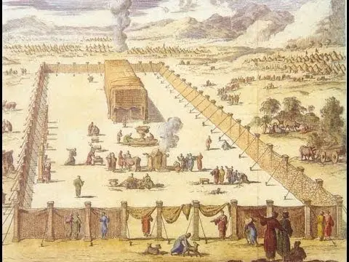

Slide 2
Melchizedek

Slide 3
Melchizedek Habakkuk

Slide 4
Melchizedek Habakkuk Armageddon

Slide 5
Melchizedek Habakkuk Armageddon Pentateuch

Slide 6
Melchizedek Habakkuk Armageddon Pentateuch Leviticus

Slide 7
Offering Types
Burnt
Peace
Trespass
Sin
Grain

Slide 8
Hebrew Holidays and Observances
Weekly Sabbath
New Moon Celebration and Feast of Trumpets
Sabbatical Year
The Passover
Year of Jubilee
Feast of Weeks
Feast of Booths

