Slide 1
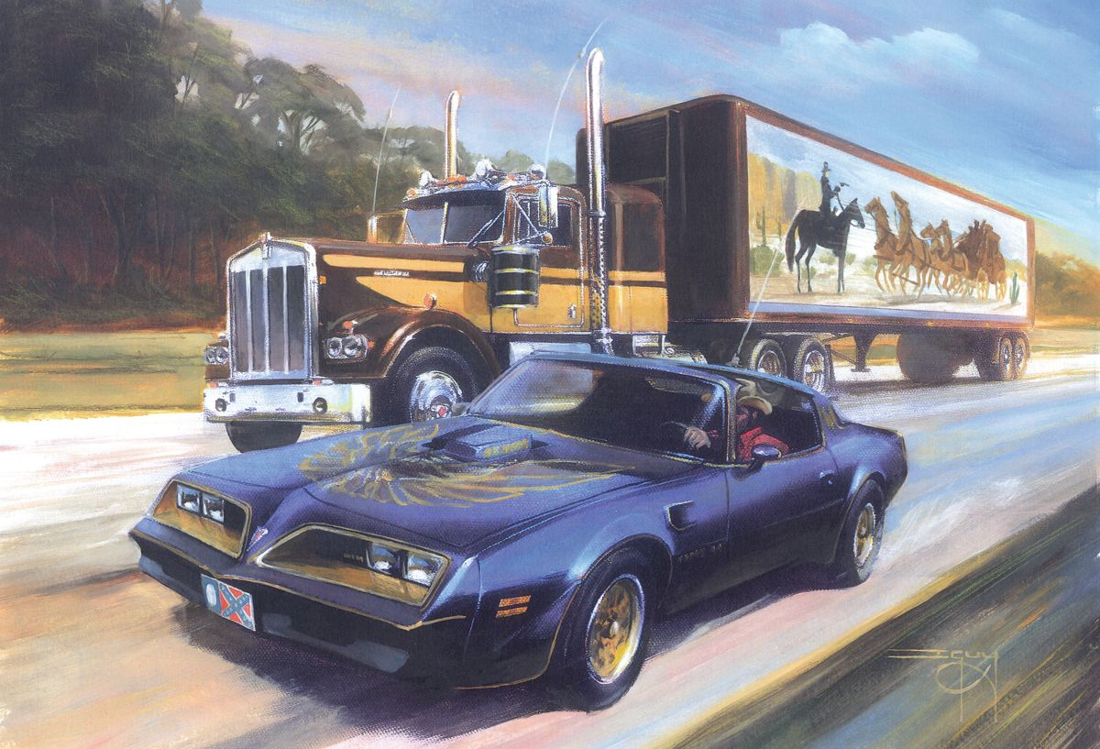

Slide 2
The Pentateuch
Genesis
Exodus
Leviticus
Numbers
Deuteronomy

Slide 3
English: Numbers
Latin: Numeri
Greek: Arithmoi ("numbers")
Hebrew: Bemidbar ("in the wilderness")
or
Chumash ("fifth") HaPekudim ("counting")

Slide 4
Numbers 1:2-3 (NASB)
Take a census of all the congregation of the sons of Israel, by their families, by their fathers’ households, according to the number of names, every male, head by head from twenty years old and upward, whoever is able to go out to war in Israel, you and Aaron shall number them by their armies.

Slide 5
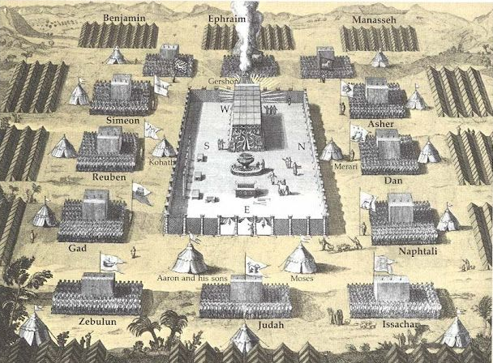
Numbers: "the mustered"
muster: assemble (troops), especially for inspection or in preparation for battle (synonyms: gather, collect, marshal)

Slide 6
Outline of Numbers
Chapters 1-14
First Approach to the Promised Land
(First Army)
Chapters 15-36
Second Approach to the Promised Land
(Second Army)

Slide 7
Outline of Numbers
Ch 1-14 First Approach to Canaan
Ch 15-20 The Nomadic Years
Ch 21-36 Second approach to Canaan

Slide 8
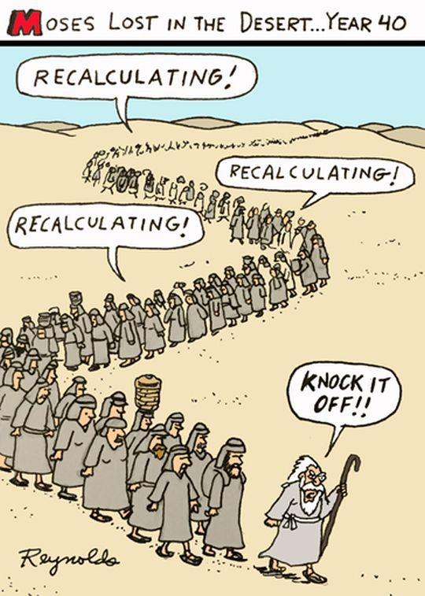
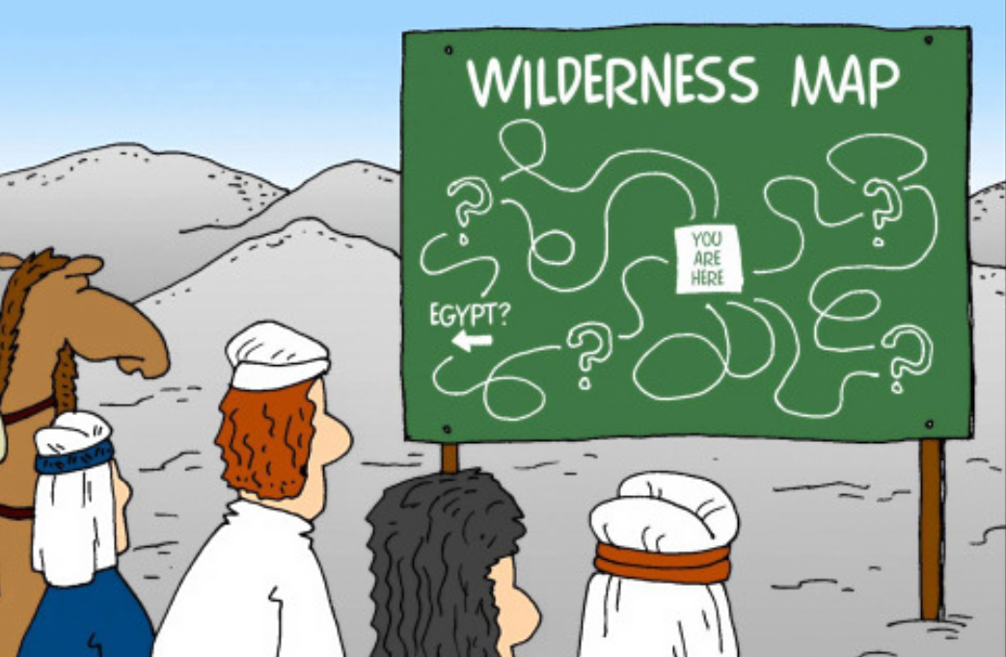

Slide 9
Outline of Numbers
Ch 1-14 First Approach to Canaan
Ch 15-20 The Nomadic Years
Ch 21-36 Second approach to Canaan

Slide 10
Ch 1-14 First Approach to Canaan
Ch 1-9 Preparation to leave Mt. Sinai
Ch 10-12 First approach to Canaan
Ch 13-14 Rejecting God’s Plan

Slide 11
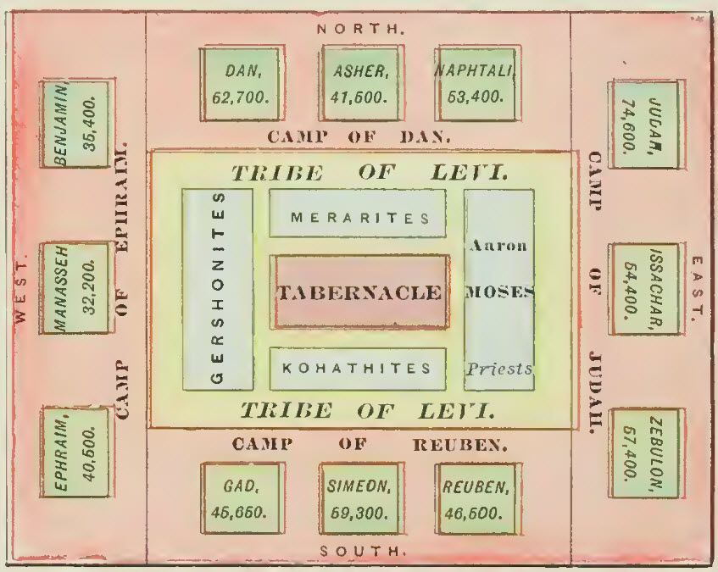
I.A. Ch 1-9 Preparation to leave Mt. Sinai

Slide 12
Numbers 3:6-8,10,38 (ESV)
Bring the tribe of Levi near, and set them before Aaron the priest, that they may minister to him.
They shall keep guard over him and over the whole congregation before the tent of meeting, as they minister at the tabernacle. They shall guard all the furnishings of the tent of meeting, and keep guard over the people of Israel as they minister at the tabernacle.
But if any outsider comes near, he shall be put to death.
Those who were to camp before the tabernacle on the east, before the tent of meeting toward the sunrise, were Moses and Aaron and his sons, guarding the sanctuary itself, to protect the people of Israel. And any outsider who came near was to be put to death.

Slide 13
Numbers 3:12-13 (ESV)
Behold, I have taken the Levites from among the people of Israel instead of every firstborn who opens the womb among the people of Israel.
The Levites shall be mine, for all the firstborn are mine.
On the day that I struck down all the firstborn in the land of Egypt, I consecrated for my own all the firstborn in Israel, both of man and of beast. They shall be mine: I am the LORD.

Slide 14
I.B. Ch 10-12 First approach to Canaan
The People Complain
Moses Complains
Miriam and Aaron Complain

Slide 15
I.C. Ch 13-14 Rejecting God’s Plan
The 12 Spies
Lack of Faith
Threat, Pardon, Punishment

Slide 16
Ch 15-20 The Nomadic Years
Various laws
Korah’s Rebellion
More laws
More complaining
The Death of Miriam and Aaron

Slide 17
Ch 21-36 Second approach to Canaan
The First Victory
More complaining
The Bronze Serpent
More Victories
Balak and Balaam
The Incident at Peor
The Second Census
More laws
Revenge against Midian
Planning arrangements
Journey Summary
More laws

Slide 18
1 Corinthians 10:1-4 (ESV)
For I do not want you to be unaware, brothers, that our fathers were all under the cloud, and all passed through the sea, and all were baptized into Moses in the cloud and in the sea, and all ate the same spiritual food, and all drank the same spiritual drink.

Slide 19
1 Corinthians 10:1-4, 11 (ESV)
For I do not want you to be unaware, brothers, that our fathers were all under the cloud, and all passed through the sea, and all were baptized into Moses in the cloud and in the sea, and all ate the same spiritual food, and all drank the same spiritual drink.
Now these things happened to them as an example, but they were written down for our instruction, on whom the end of the ages has come.

Slide 20
1 Corinthians 10:4-5 (ESV)
For they drank from the spiritual Rock that followed them, and the Rock was Christ.
Nevertheless, with most of them God was not pleased, for they were overthrown in the wilderness.

Slide 21
1 Corinthians 10:6-10 (ESV)
Now these things took place as examples for us, that we might not desire evil as they did.
Do not be idolaters as some of them were; as it is written, “The people sat down to eat and drink and rose up to play.”
We must not indulge in sexual immorality as some of them did, and twenty-three thousand fell in a single day.
We must not put Christ to the test, as some of them did and were destroyed by serpents,
nor grumble, as some of them did and were destroyed by the Destroyer.

Slide 22
1 Corinthians 10:11, 21 (ESV)
11) Therefore let anyone who thinks that he stands take heed lest he fall.
21) You cannot drink the cup of the Lord and the cup of demons. You cannot partake of the table of the Lord and the table of demons.

Slide 23
Numbers 13:30 (ESV)
But Caleb quieted the people before Moses and said, “Let us go up at once and occupy it, for we are well able to overcome it.”
Numbers 14:8-9 (ESV)
If the LORD delights in us, he will bring us into this land and give it to us, a land that flows with milk and honey.
Only do not rebel against the LORD. And do not fear the people of the land, for they are bread for us. Their protection is removed from them, and the LORD is with us; do not fear them.”

Slide 24
Numbers 6:24-26 (ESV)
The LORD bless you and keep you;
the LORD make his face to shine upon you and be gracious to you;
the LORD lift up his countenance upon you and give you peace.

