Slide 1
Deuteronomy
An Overview of the Last Book of the Pentateuch

Slide 2
Docendo discimus: “by teaching we learn”

Slide 3
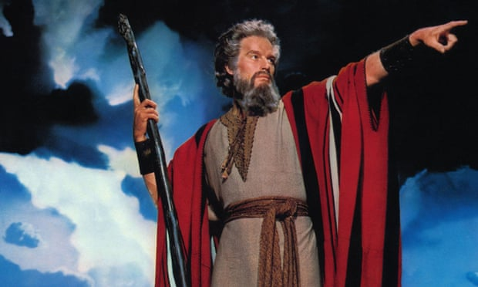

Slide 5
Overview of Deuteronomy
Notes About the Title
Evidence for Authorship of Deuteronomy
Context
Structure
First Speech
Second Speech
The Shema
Expounding on the Laws
Third Speech
Conclusion

Slide 6
Notes About the Title
Hebrew: “Devarim” or “Words”
1:1 – “These are the words Moses spoke…”
Greek: “Deuteronómion” or “Second Law”
“deuteron” (second)
“nomos” (law)
Given the first time at Mt. Sinai
Repeated and expounded upon before entering the promised land

Slide 7
Evidence for Authorship of Deuteronomy
Distinct claim of the book itself is that Moses wrote it (1:1, 4:44, 29:1).
Most quoted book of the Law in the NT, cited over eighty times (Acts 3:22, Romans 10:19, 1 Corinthians 9:9).
Jesus quoted Deuteronomy as the authoritative Word of God by which he resisted Satan (Matt. 4:7, 10) and directly attributed it to Moses in Matthew 19:7, Mark 7:10 and John 5:46-47.
Joshua, Moses’ successor, attributed it to him in Joshua 1:7.
The remainder of the OT attributes Deuteronomy and the rest of the Law to Moses.
The unity and integrity of thought are Mosaic.
Geographical and historical details display a firsthand, informed knowledge such as Moses would have had.
Recent studies of the form and content of Near Eastern covenants indicate that Deuteronomy is from the period of Moses.

Slide 8
Evidence for Authorship of Deuteronomy (cont’d)
Apparent Challenges:
Description of death of Moses in chapter 34
Moses written about in third person
Wording that suggests it comes from a later period
Answer:
Involvement of an editor or editors

Slide 9
Evidence for Authorship of Deuteronomy (cont’d)
Rejection of Mosaic Authorship By Modern Scholars:
The Documentary Hypothesis
Deuteronomy was produced by scribes in 7th Century B.C.
Used for political reform by King Josiah

Slide 10
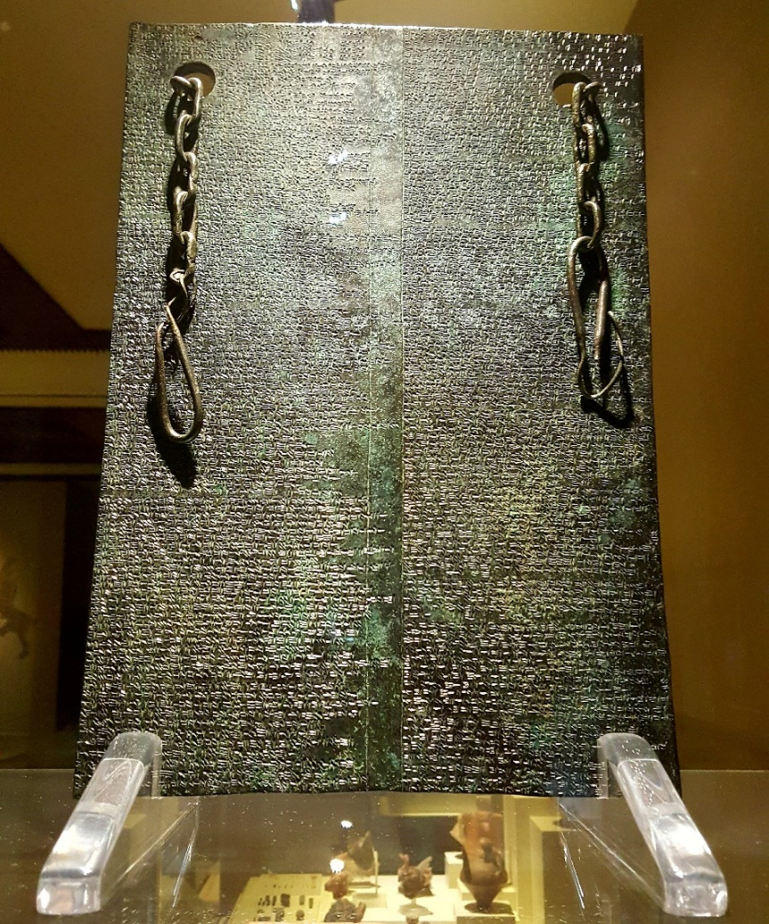
Suzerainty Treaties
Suzerain: a superior, sovereign, dominant state
Vassal: a subservient, subordinate state
Six Elements:
Preamble (identifying the parties)
Historical prologue (summary)
Stipulations (demands/rules/laws, i.e., a list of the vassal’s obligations)
Document deposit (an accessible copy of the treaty)
Sanctions imposed for stipulations (either rewards for obedience, or punishments for disobedience)
Witnesses to the proceedings and conclusion
Text of a treaty, Hittite cuneiform, bronze tablet, 13th. cen. B.C., from Hattusha (capital city of Hittites), at the Anatolian Civilizations Museum.

Slide 11
Suzerainty Treaties – Parallels with Deuteronomy
Preamble: Deuteronomy 1:1-5
Historical prologue: Deuteronomy 1:6-3:29
Stipulations: Deuteronomy 5-28
Document deposit: Deuteronomy 31:9-13
Sanctions imposed for stipulations: Deuteronomy 7-30
Witnesses to the proceedings and conclusion: Deuteronomy 31:28, 32

Slide 12
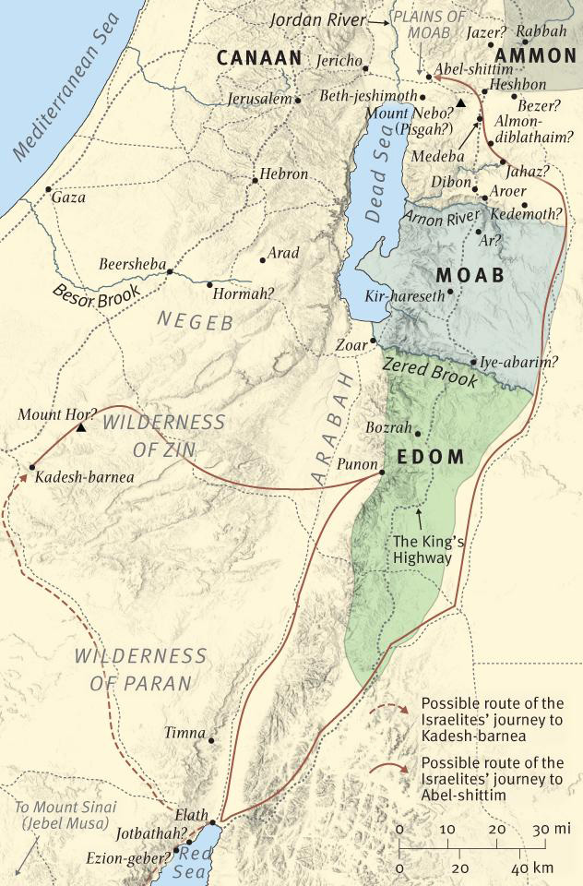
Context
Exodus from Egypt
Covenant at Mt. Sinai (Horeb)
40 Years of Wandering
On the Plains of Moab
~1405 B.C.
New generation (old generation has died)
Preparing to enter the Promised Land
Moses is getting ready to die
Transferring leadership to Joshua

Slide 13
Structure
Introduction: 1:1-5
First Speech: 1:6-4:43
Second Speech: 4:44-28
Third Speech: 29-32
Historical (Retrospective) look at Israel’s past
A review of Israel’s wanderings
Calls on new generation to be more faithful than their parents were to the Covenant.
Legislative (Introspective) look at the present
Restatement of Sinaitic Laws (5-11)
The Shema (6:4-9)
Restatement of Special Laws (12-26)
Blessings and Curses (27-28)
Prophetical (Prospective) look at Israel’s future
Covenant Ratification, Failure, and Future Hope (29-30)
Planning for the Future (31-32)
Benediction: 33
Conclusion: 34

Slide 14
Deuteronomy 4:32-40 (NIV)
Ask now about the former days, long before your time, from the day God created human beings on the earth; ask from one end of the heavens to the other. Has anything so great as this ever happened, or has anything like it ever been heard of? Has any other people heard the voice of God speaking out of fire, as you have, and lived? Has any god ever tried to take for himself one nation out of another nation, by testings, by signs and wonders, by war, by a mighty hand and an outstretched arm, or by great and awesome deeds, like all the things the Lord your God did for you in Egypt before your very eyes?
You were shown these things so that you might know that the Lord is God; besides him there is no other. From heaven he made you hear his voice to discipline you. On earth he showed you his great fire, and you heard his words from out of the fire. Because he loved your ancestors and chose their descendants after them, he brought you out of Egypt by his Presence and his great strength, to drive out before you nations greater and stronger than you and to bring you into their land to give it to you for your inheritance, as it is today.
Acknowledge and take to heart this day that the Lord is God in heaven above and on the earth below. There is no other. Keep his decrees and commands, which I am giving you today, so that it may go well with you and your children after you and that you may live long in the land the Lord your God gives you for all time.

Slide 15
Structure
Introduction: 1:1-5
First Speech: 1:6-4:43
Second Speech: 4:44-28
Third Speech: 29-32
Historical (Retrospective) look at Israel’s past
A review of Israel’s wanderings
Calls on new generation to be more faithful than their parents were to the Covenant.
Legislative (Introspective) look at the present
Restatement of Sinaitic Laws (5-11)
The Shema (6:4-9)
Restatement of Special Laws (12-26)
Blessings and Curses (27-28)
Prophetical (Prospective) look at Israel’s future
Covenant Ratification, Failure, and Future Hope (29-30)
Planning for the Future (31-32)
Benediction: 33
Conclusion: 34

Slide 16
Deuteronomy 4:5-8 (NIV)
See, I have taught you decrees and laws as the Lord my God commanded me, so that you may follow them in the land you are entering to take possession of it. Observe them carefully, for this will show your wisdom and understanding to the nations, who will hear about all these decrees and say, “Surely this great nation is a wise and understanding people.” What other nation is so great as to have their gods near them the way the Lord our God is near us whenever we pray to him? And what other nation is so great as to have such righteous decrees and laws as this body of laws I am setting before you today?
Deuteronomy 6:1-3 (NIV)
These are the commands, decrees and laws the Lord your God directed me to teach you to observe in the land that you are crossing the Jordan to possess, so that you, your children and their children after them may fear the Lord your God as long as you live by keeping all his decrees and commands that I give you, and so that you may enjoy long life. Hear, Israel, and be careful to obey so that it may go well with you and that you may increase greatly in a land flowing with milk and honey, just as the Lord, the God of your ancestors, promised you.

Slide 17
Shema (Sh’ma) – Deuteronomy 6:4-9
Hear, O Israel: The Lord our God, the Lord is one. Love the Lord your God with all your heart and with all your soul and with all your strength. These commandments that I give you today are to be on your hearts. Impress them on your children. Talk about them when you sit at home and when you walk along the road, when you lie down and when you get up. Tie them as symbols on your hands and bind them on your foreheads. Write them on the doorframes of your houses and on your gates.

Slide 18
Shema (Sh’ma) – Deuteronomy 6:4-9
Hear, O Israel: The Lord our God, the Lord is one.
Shema: “listen,” “heed” or “hear and do”
No present-tense verb equivalent to the English verb “is” in Ancient Hebrew
Example:
English: “The car is red.”
Ancient Hebrew: “The car red.”
In Hebrew, the prayer consists of four nouns in a row:
Hebrew: YHWH ‘elohenu YHWH ekhad
English: Lord our god Lord one
Different sentences with different emphases:
The Lord our God is one Lord.
The Lord is our God, the Lord is one.
The Lord our God, the Lord is one.
The Lord is our God, the Lord one (alone).

Slide 19
Shema (Sh’ma) – Deuteronomy 6:4-9
Hear, O Israel: The Lord our God, the Lord is one. Love the Lord your God with all your heart and with all your soul and with all your strength.
Love (ahavah): affection and action
Heart (lev): will and affection
Soul (nephesh): whole life and physical being
Strength (me’od): with “muchness” (your whole capacity)

Slide 20
Shema (Sh’ma) – Deuteronomy 6:4-9
Hear, O Israel: The Lord our God, the Lord is one. Love the Lord your God with all your heart and with all your soul and with all your strength. These commandments that I give you today are to be on your hearts. Impress them on your children. Talk about them when you sit at home and when you walk along the road, when you lie down and when you get up. Tie them as symbols on your hands and bind them on your foreheads. Write them on the doorframes of your houses and on your gates.

Slide 21
Structure
Introduction: 1:1-5
First Speech: 1:6-4:43
Second Speech: 4:44-28
Third Speech: 29-32
Historical (Retrospective) look at Israel’s past
A review of Israel’s wanderings
Calls on new generation to be more faithful than their parents were to the Covenant.
Legislative (Introspective) look at the present
Restatement of Sinaitic Laws (5-11)
The Shema (6:4-9)
Restatement of Special Laws (12-26)
Blessings and Curses (27-28)
Prophetical (Prospective) look at Israel’s future
Covenant Ratification, Failure, and Future Hope (29-30)
Planning for the Future (31-32)
Benediction: 33
Conclusion: 34

Slide 22
Restatement of Special Laws in Context of Ten Words
1st and 2nd Commandments: Forbids worship of other gods and idolatry
Deuteronomy 12:1-3: Destroy Canaanite sanctuaries throughout the land
4th Commandment: Command to observe the Sabbath
Deuteronomy 15: Holy time; relief from debt slavery during the sabbatical year
5th Commandment: Command to honor parents
Deuteronomy 16:18-18:22: Respect for authority
7th Commandment: Forbids adultery
Deuteronomy 22:13-21: Sexual purity before marriage

Slide 23
Structure
Introduction: 1:1-5
First Speech: 1:6-4:43
Second Speech: 4:44-28
Third Speech: 29-32
Historical (Retrospective) look at Israel’s past
A review of Israel’s wanderings
Calls on new generation to be more faithful than their parents were to the Covenant.
Legislative (Introspective) look at the present
Restatement of Sinaitic Laws (5-11)
The Shema (6:4-9)
Restatement of Special Laws (12-26)
Blessings and Curses (27-28)
Prophetical (Prospective) look at Israel’s future
Covenant Ratification, Failure, and Future Hope (29-30)
Planning for the Future (31-32)
Benediction: 33
Conclusion: 34

Slide 24
Deuteronomy 30:1-6 (NIV)
When all these blessings and curses I have set before you come on you and you take them to heart wherever the Lord your God disperses you among the nations, and when you and your children return to the Lord your God and obey him with all your heart and with all your soul according to everything I command you today, then the Lord your God will restore your fortunes and have compassion on you and gather you again from all the nations where he scattered you. Even if you have been banished to the most distant land under the heavens, from there the Lord your God will gather you and bring you back. He will bring you to the land that belonged to your ancestors, and you will take possession of it. He will make you more prosperous and numerous than your ancestors. The Lord your God will circumcise your hearts and the hearts of your descendants, so that you may love him with all your heart and with all your soul, and live.

Slide 25
Deuteronomy 30:19-20 (NIV)
This day I call the heavens and the earth as witnesses against you that I have set before you life and death, blessings and curses. Now choose life, so that you and your children may live and that you may love the Lord your God, listen to his voice, and hold fast to him. For the Lord is your life, and he will give you many years in the land he swore to give to your fathers, Abraham, Isaac and Jacob.

Slide 26
Structure
Introduction: 1:1-5
First Speech: 1:6-4:43
Second Speech: 4:44-28
Third Speech: 29-32
Historical (Retrospective) look at Israel’s past
A review of Israel’s wanderings
Calls on new generation to be more faithful than their parents were to the Covenant.
Legislative (Introspective) look at the present
Restatement of Sinaitic Laws (5-11)
The Shema (6:4-9)
Restatement of Special Laws (12-26)
Blessings and Curses (27-28)
Prophetical (Prospective) look at Israel’s future
Covenant Ratification, Failure, and Future Hope (29-30)
Planning for the Future (31-32)
Benediction: 33
Conclusion: 34

Slide 27
Structure
Introduction: 1:1-5
First Speech: 1:6-4:43
Second Speech: 4:44-28
Third Speech: 29-32
Historical (Retrospective) look at Israel’s past
A review of Israel’s wanderings
Calls on new generation to be more faithful than their parents were to the Covenant.
Legislative (Introspective) look at the present
Restatement of Sinaitic Laws (5-11)
The Shema (6:4-9)
Restatement of Special Laws (12-26)
Blessings and Curses (27-28)
Prophetical (Prospective) look at Israel’s future
Covenant Ratification, Failure, and Future Hope (29-30)
Planning for the Future (31-32)
Benediction: 33
Blesses the Tribes
Conclusion: 34
Moses’ Death and Burial

Slide 28
Deuteronomy 34:10-12 (NIV)
Since then, no prophet has risen in Israel like Moses, whom the Lord knew face to face, who did all those signs and wonders the Lord sent him to do in Egypt—to Pharaoh and to all his officials and to his whole land. For no one has ever shown the mighty power or performed the awesome deeds that Moses did in the sight of all Israel.

