Slide 1
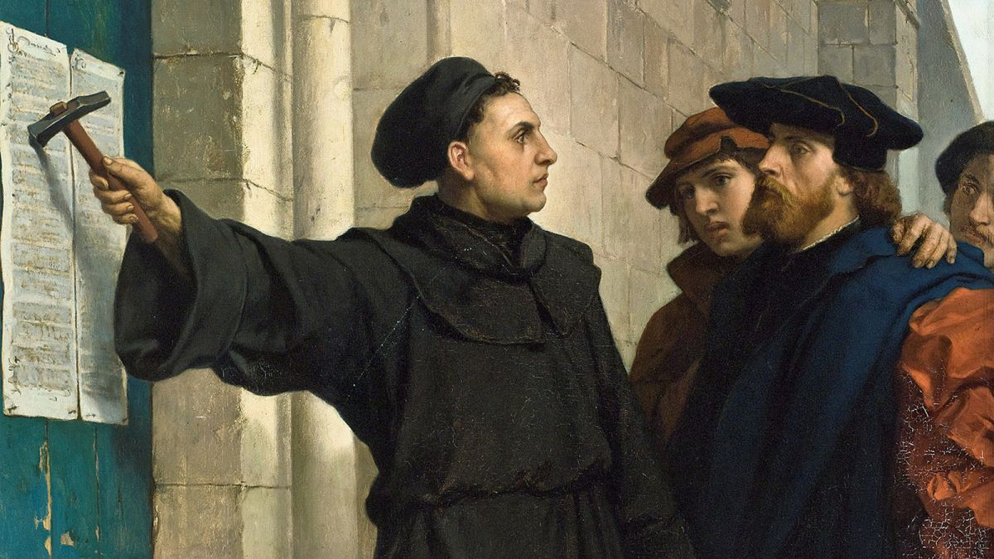

Slide 2
Chapter 19
Are we expected to obey this particular law?
Why or why not?
If so, how do we do that?

Slide 3
• A civil law, as it is stated, is not binding. But there may be a deeper principle behind it that should be honored.
• A ceremonial law, as it is stated, has been fulfilled in Christ and is no longer relevant. Yet, there are often valuable lessons to be learned from such laws.
• A moral law will still apply. If we are unclear on whether something is a moral law, we should look to see if it is repeated or reinforced in the NT.
• Laws that are difficult to categorize, and aren’t repeated in the NT, would still reflect deeper principles that should be honored.

Slide 4
Chapter 19
Are we expected to obey this particular law?
Why or why not?
If so, how do we do that?

Slide 5
Chapter 18 – Do not imitate the wickedness of your neighbors
Chapter 19 – Be holy
Chapter 20 – Do not imitate the wickedness of your neighbors

Slide 6
Chapter 19
Are we expected to obey this particular law?
Why or why not?
If so, how do we do that?

Slide 7
• You must no longer live as the Gentiles do. (Eph 4:17)
• Have nothing to do with the fruitless deeds of darkness. (Eph 5:11)
• You cannot drink the cup of the Lord and the cup of demons too. (1Cor 10:21)
• Do not conform any longer to the pattern of this world. (Rom 12:2)
• I urge you as aliens and strangers in the world, to abstain from sinful desires. (1Pet 2:11)
• Just as he who called you is holy, so be holy in all you do. (1Pet 1:16)
• . . . and to keep oneself from being polluted by the world. (Jam 1:27)

Slide 8
Chapter 19
Are we expected to obey this particular law?
Why or why not?
If so, how do we do that?

Slide 9
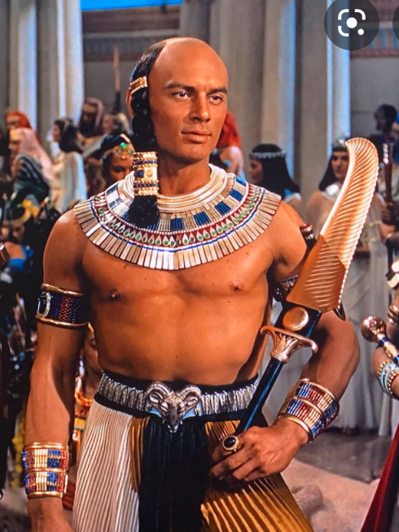
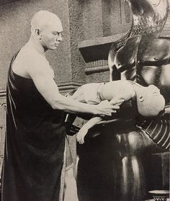
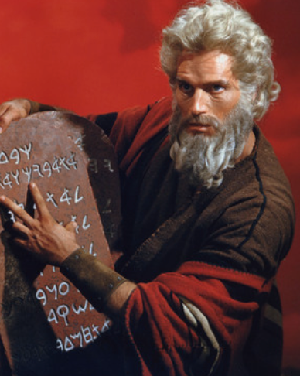

Slide 10
Chapter 19
Are we expected to obey this particular law?
Why or why not?
If so, how do we do that?

Slide 11
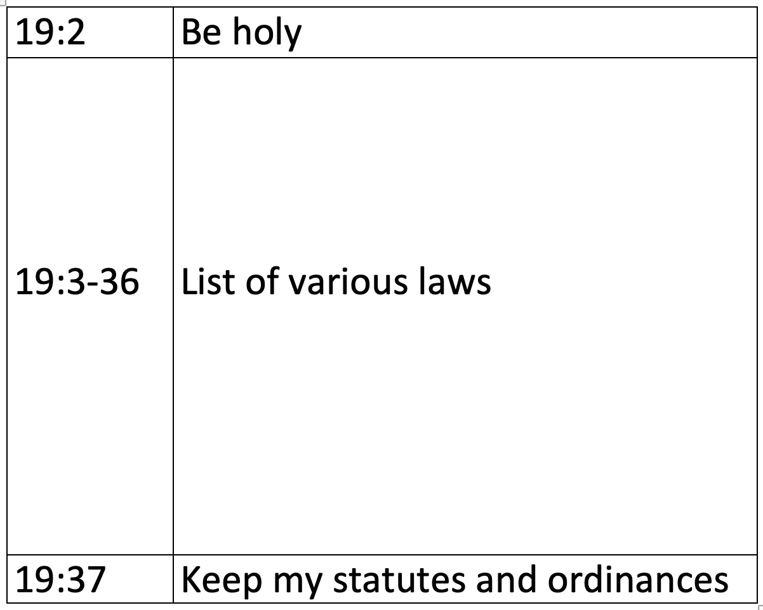

Slide 12
Leviticus 19:13 Do not oppress your neighbor or rob him. The wages due a hired worker must not remain with you until morning.
James 5:4 Look! The pay that you withheld from the workers who mowed your fields cries out, and the outcry of the harvesters has reached the ears of the Lord of Armies.

Slide 13
Leviticus 19:15 Do not act unjustly when deciding a case. Do not be partial to the poor or give preference to the rich; judge your neighbor fairly.
James 2:1, 2:9 My brothers and sisters, do not show favoritism as you hold on to the faith in our glorious Lord Jesus Christ. . . . If you show favoritism, you commit sin and are convicted by the law as transgressors.

Slide 14
Leviticus 19:16 Do not go about spreading slander among your people; do not jeopardize your neighbor’s life; I am the LORD.
James 4:11-12 Don’t criticize one another, brothers and sisters. Anyone who defames or judges a fellow believer defames and judges the law. . . .There is one lawgiver and judge who is able to save and to destroy. But who are you to judge your neighbor?

Slide 15
Leviticus 19:17b Rebuke your neighbor directly, and you will not incur guilt because of him.
James 5:19-20 My brothers and sisters, if any among you strays from the truth, and someone turns him back, let that person know that whoever turns a sinner from the error of his way will save his soul from death and cover a multitude of sins.

Slide 16
Leviticus 19:18a Do not take revenge or bear a grudge against members of your community.
James 5:9 Brothers and sisters, do not complain about one another, so that you will not be judged.

Slide 17
Leviticus 19:18b . . . but love your neighbor as yourself; I am the LORD.
James 2:8 Indeed, if you fulfill the royal law prescribed in the Scripture, “Love your neighbor as yourself,” you are doing well.

