Slide 1
Romans
3:1-18
Part 6

Slide 2
Romans
FLOW
3:1-18
Part 6

Slide 3
Romans
FLOW
SPECIFICS
3:1-18
Part 6

Slide 4
Romans 1:16-17 (NIV)
= WHAT
¹⁶ I am not ashamed of the gospel, because it is the power of God for the salvation of everyone who believes: first for the Jew, then for the Gentile.
¹⁷ For in the gospel a righteousness from God is revealed, a righteousness that is by faith from first to last, just as it is written: "The righteous will live by faith."
= HOW

Slide 5
Romans
“…we must not select a few favorite passages to the exclusion of others. Nothing less than a whole Bible can make a whole Christian.”
- A.W. Tozer
“Like newborn infants, long for the pure spiritual milk, that by it you may grow up into salvation Dash if indeed you have tasted that the Lord is good.”
- 1 Pet. 2:2
FLOW
SPECIFICS
3:1-18
Part 6
MATURITY

Slide 6
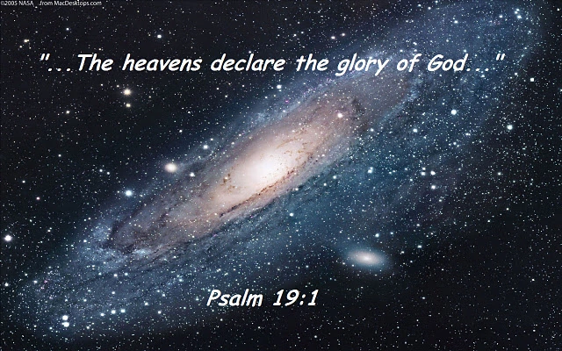
Romans 1:20
²⁰ For since the creation of the world God's invisible qualities - His eternal power and divine nature--have been clearly seen, being understood from what has been made, so that men are without excuse.
Romans 2:15
¹⁵ since they (Gentiles) show that the requirements of the law are written on their hearts, their consciences also bearing witness, and their thoughts now accusing, now even defending them.

Slide 7
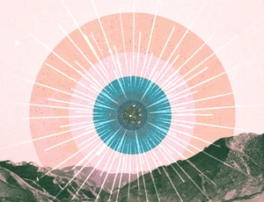
General Revelation
Hmm…
1. Lacking precision
Natural
Theology
2. Universally available

Slide 8
Confidence in Natural Theology
‘For albeit that all men have a certain natural knowledge implanted in their minds, whereby they naturally perceive what they ought to do … yet notwithstanding man's reason is so corrupt and blind through the malice of the devil, that it understands not this knowledge wherewith it is born; or else, being admonished by the Word of God, it understands it, and yet (such is the power of Satan) knowingly neglects and condemns it.’ – Martin Luther
‘Yet hence it appears that if men were taught only by nature, they would hold to nothing certain or solid or clear-cut, but would be so tied to confused principles as to worship an unknown god.’
Calvin’s Institutes
Book 1, Chapter 5, Section 12
“By nature, unbelievers know God as Creator and preserver. They know him imperfectly. They don’t know how to worship him rightly. But by revelation, believers know God as Redeemer. They know how to worship him rightly.”
- Francis Turretin
“It was necessary for the salvation of man that certain truths which exceed human reason should be made known to him by divine revelation.”
- Thomas Aquinas
Weak Strong
NO value Salvific

Slide 9
Romans 1:18
¹⁸ The wrath of God is being revealed from heaven against all the godlessness and wickedness of men who suppress the truth by their wickedness.
Romans 2:14-15
^{2:14} Indeed, when Gentiles…do by nature things required by the law…¹⁵ they show that the requirements of the law are written on their hearts.

Slide 10
Romans
3:1-18
Part 6

Slide 11
Romans 2:17-24 (NIV)
¹⁷ Now you, if you call yourself a Jew; if you rely on the law and brag about your relationship to God. … ²⁴ As it is written: "God's name is blasphemed among the Gentiles because of you."
Romans 2:25-29 (NIV)
²⁵ Circumcision has value if you observe the law, but if you break the law, you have become as though you had not been circumcised. ²⁶ So then, if those who are not circumcised keep the law’s requirements, will they not be regarded as though they were circumcised?… ²⁹ No, a man is a Jew if he is one inwardly; and circumcision is circumcision of the heart, by the Spirit, not by the written code.

Slide 12
Romans 2:29 (NIV)
²⁹ No, a man is a Jew if he is one inwardly; and circumcision is circumcision of the heart, by the Spirit, not by the written code.
Such a man's praise is not from men, but from God.

Slide 13
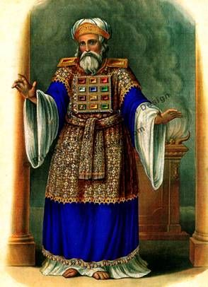
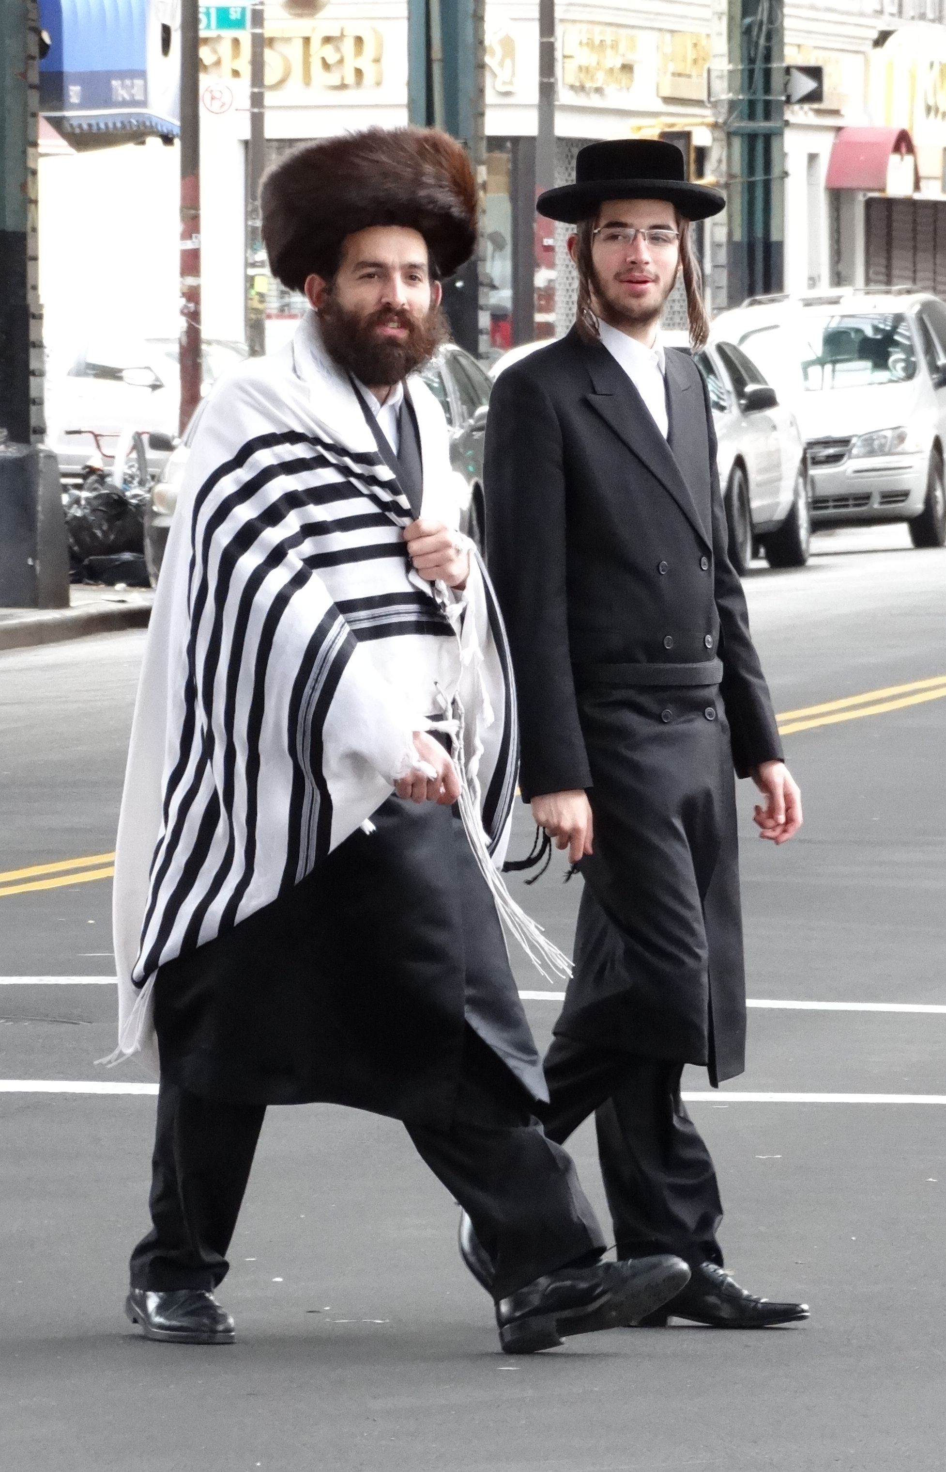
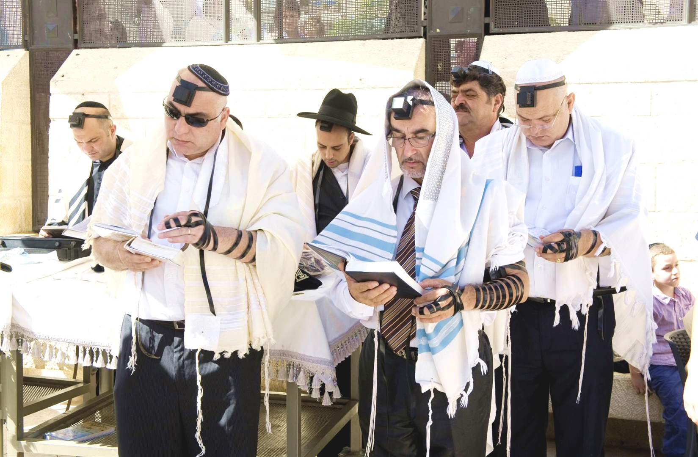

Slide 14
Romans 2:29 (NIV)
²⁹ No, a man is a Jew if he is one inwardly; and circumcision is circumcision of the heart, by the Spirit, not by the written code.
Such a man's praise is not from men, but from God.
Psalm 139
²³ Search me, God, and know my heart; test me and know my anxious thoughts.
²⁴ See if there is any offensive way in me, and lead me in the way everlasting.
“Human beings aren’t comfortable with what is outward, visible, material and superficial.”
- John Stott

Slide 15
Romans
3:1-18
Part 6

Slide 16
Romans 3:1
¹ What advantage, then, is there in being a Jew, or what value is there in circumcision? ² Much in every way!
⁹ What shall we conclude then? Are we any better? Not at all!
Romans 3:9

Slide 17
Romans 3:1-4 (NIV)
2:25-29
2:17-24
¹ What advantage, then, is there in being a Jew, or what value is there in circumcision? ² Much in every way!
First of all, they have been entrusted with the very words of God. ³ What if some did not have faith? Will their lack of faith nullify God's faithfulness? ⁴ Not at all! Let God be true, and every man a liar. As it is written:
"So that you may be proved right when
you speak and prevail when you judge."
“Against you, you only, have I sinned and done what is evil in your sight; so you are right in your verdict and justified when you judge.” Psalms 51:4

Slide 18
Romans 3:5-8 (NIV)
⁵ But if our unrighteousness brings out God's righteousness more clearly, what shall we say? That God is unjust in bringing his wrath on us? (I am using a human argument.) ⁶ Certainly not! If that were so, how could God judge the world? ⁷ Someone might argue, "If my falsehood enhances God's truthfulness and so increases his glory, why am I still condemned as a sinner?" ⁸ Why not say -as we are being slanderously reported as saying and as some claim that we say- "Let us do evil that good may result"? Their condemnation is deserved.
“One of the greatest powers of rationalization ever seen is the ability of people to explain away their sin.”
- Grant Osborne

Slide 19
Romans 3:9-18 (NIV)
¹ The fool says in his heart, “There is no God.” They are corrupt, their deeds are vile; there is no one who does good.
² The Lord looks down from heaven on all mankind to see if there are any who understand, any who seek God. ³ All have turned away, all have become corrupt; there is no one who does good, not even one.
⁴ Do all these evildoers know nothing?
They devour my people as though eating bread; they never call on the Lord. ⁵ But there they are, overwhelmed with dread, for God is present in the company of the righteous. ⁶ You evildoers frustrate the plans of the poor, but the Lord is their refuge.
Psalms 14:1-6
⁹ What shall we conclude then? Are we any better? Not at all! We have already made the charge that Jews and Gentiles alike are all under sin. ¹⁰ As it is written: "There is no one righteous, not even one; ¹¹ there is no one who understands, no one who seeks God. ¹² All have turned away, they have together become worthless; there is no one who does good, not even one." ¹³ ”Their throats are open graves; their tongues practice deceit. The poison of vipers is on their lips." ¹⁴ ”Their mouths are full of cursing and bitterness." ¹⁵ ”Their feet are swift to shed blood; ¹⁶ ruin and misery mark their ways, ¹⁷ and the way of peace they do not know." ¹⁸ ”There is no fear of God before their eyes."

Slide 20
Romans 3:9-18 (NIV)
⁹ What shall we conclude then? Are we any better? Not at all! We have already made the charge that Jews and Gentiles alike are all under sin. ¹⁰ As it is written: "There is no one righteous, not even one; ¹¹ there is no one who understands, no one who seeks God. ¹² All have turned away, they have together become worthless; there is no one who does good, not even one." ¹³ ”Their throats are open graves; their tongues practice deceit. The poison of vipers is on their lips." ¹⁴ ”Their mouths are full of cursing and bitterness." ¹⁵ ”Their feet are swift to shed blood; ¹⁶ ruin and misery mark their ways, ¹⁷ and the way of peace they do not know." ¹⁸ ”There is no fear of God before their eyes."

Slide 21
Romans
3:1-18
Part 6

