Slide 1
Genesis 1-11
Freedoms and Limitations

Slide 2
Freedoms and Limitations
Historical Considerations
Theological Commitments
Apologetic Ramifications

Slide 3
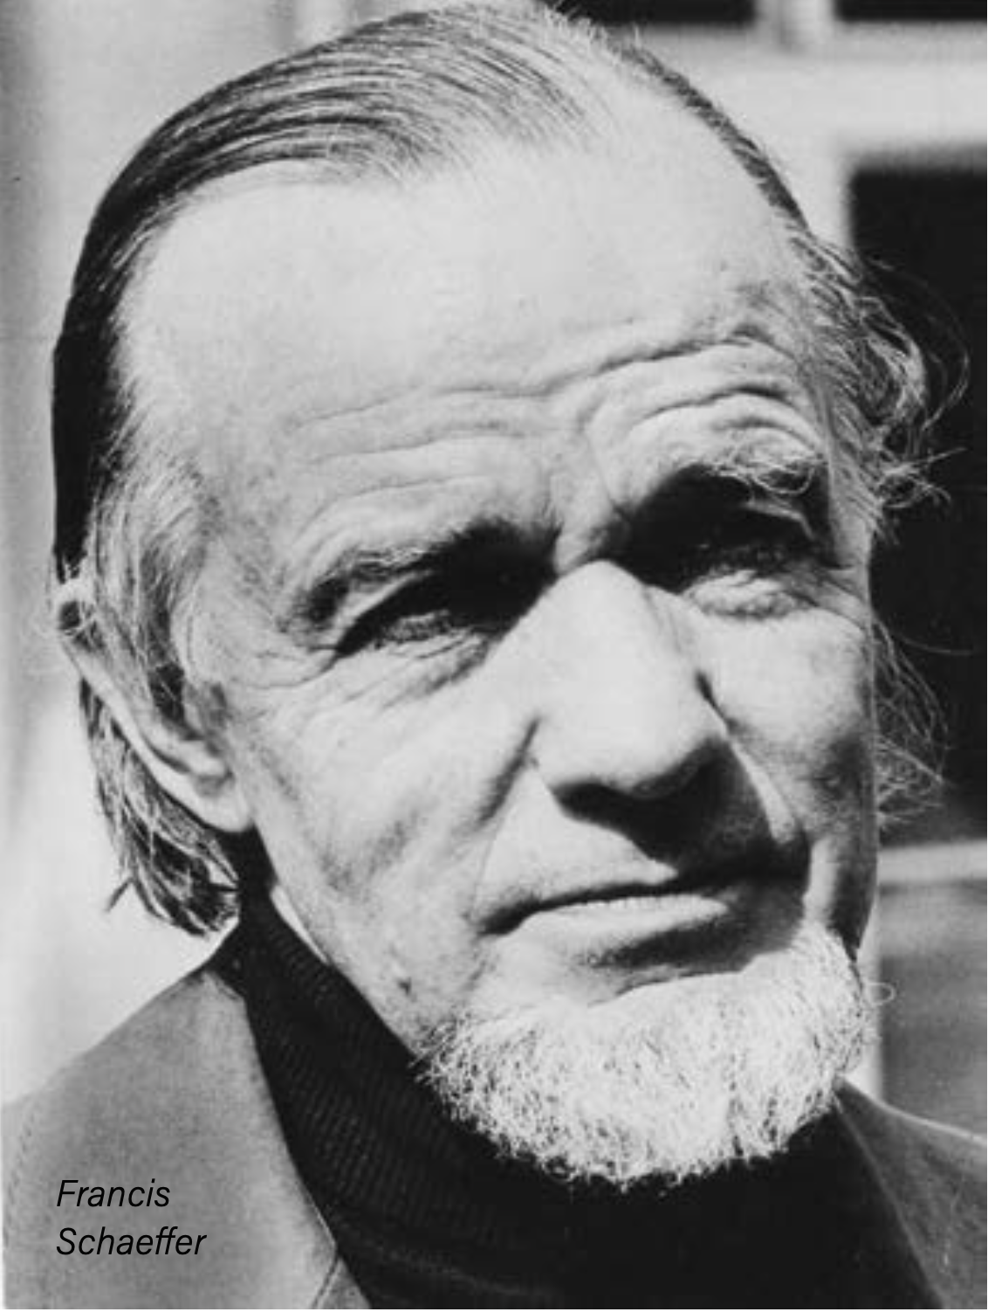
Francis Schaeffer’s Freedoms and Limitations

Slide 4
Francis Schaeffer’s Freedoms
God may have created a “grown up universe”.
There may have been a time gap between verses 1 and 2, and verses 2 and 3.
It is possible that Genesis 1 talk about a “long day”.
The flood may have affected the geological data.
The word “kind” in Gen 1:11 is not synonymous with species.
There may have been animal death before the Fall.
Only the word ‘bara’ must imply an absolute beginning.

Slide 5
Francis Schaeffer’s Freedoms and Limitations
“I urge you again to remember that I am not saying that any of these positions are my own or that they will prove to be the case. I am simply stating theoretical possibilities as we consider the correlations between what the Bible sets forth about cosmogony and what we can study from general revelation.” Francis Schaeffer, No Final Conflict p33-34

Slide 6
Francis Schaeffer’s Limitations
Creation, Creation of Sentient Life, Creation of Man
Historical Adam and Eve

Slide 7
The Church Concentric Circle Model
Essential
Crucial
Open

Slide 8
Historical Overview

Slide 9
Historical Overview
The use of "evening" and "morning" may be held to limit "day" to the solar day; but the frequent parabolic use of natural phenomena may warrant the conclusion that each creative "day" was a period of time marked off by a beginning and ending.
Scofield Reference Bible Note for Genesis 1:5 (1917 edition)

Slide 11
Copernican Revolution

Slide 12
Copernican Revolution
“The Christian is not to compromise so as to obscure the distinction between good and evil and is to avoid the errors of those dreamers who have a spirit of bitterness and contradiction, who reprove everything and prevent the order of nature. We will see some who are so deranged, not only in religion but who in all things reveal their monstrous nature, that they will say that the sun does not move, and that it is the earth which shifts and turns. When we see such minds we must indeed confess that the devil posses them, and that God sets them before us as mirrors, in order to keep us in his fear.” John Calvin, “Sermon on 1 Corinthians 10:19-24”

Slide 13
Copernican Revolution
…they may be getting a better sense of the truth by studying the natural revelation, from what I get for ignoring natural revelation…I don’t have to face that problem, because I believe both spheres are God’s spheres of revelation.
R.C. Sproul, “Science, Scripture, and the Age of the Universe” from Ligonier Ministries.

Slide 14
Augustine on Genesis
“Usually, even a non-Christian knows something about the earth, the heavens, and the other elements of this world, about the motion and orbit of the stars and even their size and relative positions, about the predictable eclipses of the sun and moon, the cycles of the years and the seasons, about the kinds of animals, shrubs, stones, and so forth, and this knowledge he holds to as being certain from reason and experience.

Slide 15
Augustine on Genesis
Now, it is a disgraceful and dangerous thing for an infidel to hear a Christian, presumably giving the meaning of Holy Scripture, talking nonsense on these topics; and we should take all means to prevent such an embarrassing situation, in which people show up vast ignorance in a Christian and laugh it to scorn.

Slide 16
Augustine on Genesis
The shame is not so much that an ignorant individual is derided, but that people outside the household of faith think our sacred writers held such opinions, and, to the great loss of those for whose salvation we toil, the writers of our Scripture are criticized and rejected as unlearned men.

Slide 17
Augustine on Genesis
If they find a Christian mistaken in a field which they themselves know well and hear him maintaining his foolish opinions about our books, how are they going to believe those books in matters concerning the resurrection of the dead, the hope of eternal life, and the kingdom of heaven, when they think their pages are full of falsehoods and on facts which they themselves have learnt from experience and the light of reason?

Slide 18
Augustine on Genesis
Reckless and incompetent expounders of Holy Scripture bring untold trouble and sorrow on their wiser brethren when they are caught in one of their mischievous false opinions and are taken to task by those who are not bound by the authority of our sacred books.

Slide 19
Augustine on Genesis
If they find a Christian mistaken in a field which they themselves know well and For then, to defend their utterly foolish and obviously untrue statements, they will try to call upon Holy Scripture for proof and even recite from memory many passages which they think support their position, although they understand neither what they say nor the things about which they make assertion."

Slide 20
Recent Scholarship on Genesis 1-11
“Inerrancy means that when all facts are known, the Scriptures in their original autographs and properly interpreted will be shown to be wholly true in everything that they affirm, whether that has to do with doctrine or morality or with the social, physical, or life sciences"
Paul Feinberg

Slide 21
Recent Scholarship on Genesis 1-11
C. John Collins
John Walton
S. Joshua Swamidass
Richard E. Averbeck
Kevin Vanhoozer
William Lane Craig

Slide 22
Fundamentals in Genesis 1-11
God is one, a personal, transcendent Creator of all physical reality, perfectly good and worthy of worship.
God has designed the physical world and is the ultimate source of its structure and life-forms.
Man is the pinnacle of the physical creation, a personal, if finte, agent like God, and therefore uniquely capable of all Earth's creatures of knowing God.
Mankind is gendered, man and woman being of equal value, with marriage given to mankind for procreation and mutuality, the wife being a helper to her husband.

Slide 23
Fundamentals in Genesis 1-11
Work is good, a sacred assignment by God to mankind to steward the earth and its creatures.
Human exploration and discovery of the workings of nature are a natural outgrowth of mans’ capacities, rather than divine bestowals without human initiative and effort.
Mankind is to set apart one day per week as sacred and for refreshment from work.
Man and woman alike have freely chosen to disobey God, suffering alienation from God and spiritual death as their just desert, condemned to a life of hardship and suffering during this mortal existence.

Slide 24
Fundementals in Genesis 1-11
Human sin is agglomerative and self-destructive, resulting in God’s just judgment.
Despite human rebellion against God, God’s original purpose to bless all mankind remains intact, as he graciously finds a way to work his will despite human defiance.

Slide 25
“These are a few of the fundamental truths taught by the primaeval history of Genesis 1-11. Such truths do not depend on reading the narratives literalistically.”
God is one, a personal, transcendent Creator of all physical reality, perfectly good and worthy of worship.
God has designed the physical world and is the ultimate source of its structure and life-forms.
Man is the pinnacle of the physical creation, a personal, if finte, agent like God, and therefore uniquely capable of all Earth's creatures of knowing God.
Mankind is gendered, man and woman being of equal value, with marriage given to mankind for procreation and mutuality, the wife being a helper to her husband.
Work is good, a sacred assignment by God to mankind to steward the earth and its creatures.
Human exploration and discovery of the workings of nature are a natural outgrowth of mans’ capacities, rather than divine bestowals without human initiative and effort.
Mankind is to set apart one day per week as sacred and for refreshment from work.
Man and woman alike have freely chosen to disobey God, suffering alienation from God and spiritual death as their just desert, condemned to a life of hardship and suffering during this mortal existence.
Human sin is agglomerative and self-destructive, resulting in God’s just judgment.
Despite human rebellion against God, God’s original purpose to bless all mankind remains intact, as he graciously finds a way to work his will despite human defiance.

Slide 26
Conclusion
Challenge Revisit Limitations and Freedoms
Witness to an unbelieving world

