Slide 1
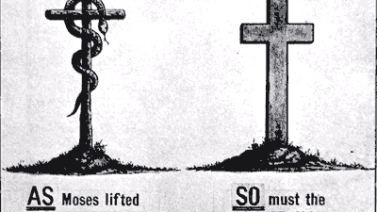
An Introduction to Typology

Slide 2
Luke 24:13-34

Slide 3
Typology
The Biblical study of types

Slide 4
Type
Any historical person, event, or institution that foreshadows or finds fulfillment in a future (greater) person, event, or institution (antitype)

Slide 5
Examples of Types
Type
antitype
God’s redemption of his people from bondage in Egypt through the Exodus & the Passover
God’s redemption of his people from sin and death through Christ Jesus

Slide 6
Examples of Types
Type
antitype
The OT temple structure, priests, and atoning sacrifices, as conditions of approaching God
Christ: The temple, the ultimate high priest, the ultimate sacrifice, the ultimate atonement, and the once-for-all way to approach God

Slide 7
Examples of Types
Type
antitype
God’s rescue offered to his people, Israel, through the bronze serpent in the wilderness
God’s rescue offered to the world, through Christ

Slide 8
Examples of Types
Type
antitype
Adam, the head of the human race, brought death, separation, brokenness, and condemnation
Christ, the head of a new race, brought life, restoration, salvation, and justification

Slide 9
Type Commonalities
OT Type
NT antitype
Exodus & Passover
The temple, priests, & sacrifice
The bronze serpent
Adam
Christ & his redemptive work
Christ & his redemptive work
Christ & his redemptive work
Christ & his redemptive work

Slide 10
TYPES
Not all types have Christ as the direct antitype

Slide 11
TYPES
Not all types have Christ as the direct antitype, but most (if not all) relate to his person, work, or mediation of the new covenant in one way or another

Slide 12
TYPES
There may be some types not yet identified

Slide 13
TYPES
There may be some types not yet identified but if found, they must be discernable from biblical text, not create new or contradictory doctrine, and not simply be a product of wild imagination

