Slide 1
Nestorianism

Slide 2
Who was conceived in the womb of Mary?

Slide 3
Jesus is truly and fully divine.
Jesus is truly and fully human.
How is it that he can be both?
What is the relationship between his humanity and divinity?
What are the implications of how we understand this?

Slide 4
Nestorianism
1. The setting
2. The events
3. The theology
4. The problem
5. Orthodoxy

Slide 5
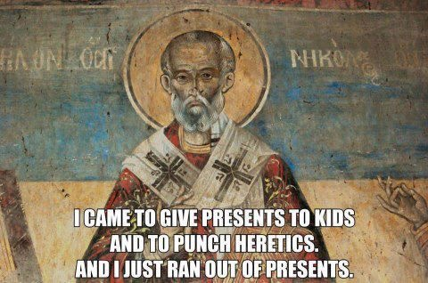

Slide 6
Nestorianism
1. The setting
2. The events
3. The theology
4. The problem
5. Orthodoxy

Slide 7
33 Birth of the Church
313 Persecution Ends
64 Persecution Begins

Slide 8
313 Persecution Ends
325 Council of Nicaea
381 Council of Constantinople

Slide 9
ECUMENICAL COUNCILS
1. Nicea
2. Constantinople
3. Ephesus
4. Chalcedon
5. Constantinople II
6. Constantinople III
7. Nicea II

Slide 10
313 Persecution Ends
325 Council of Nicaea
381 Council of Constantinople

Slide 11
313 Persecution Ends
325 Council of Nicaea
428 Nestorius Appointed
381 Council of Constantinople
431 Council of Ephesus

Slide 18
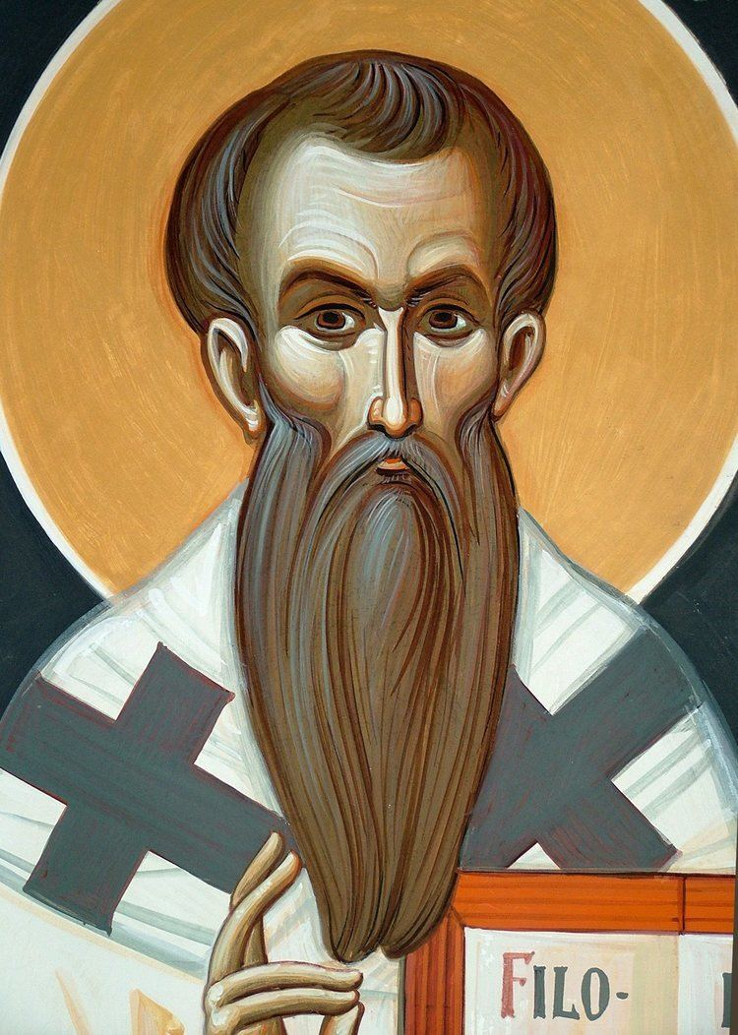
• Attempts to rid his city of all Arians
• Burns Arian chapel; city catches on fire
• Has his thugs beat up two Monks
• Welcomes two Pelagian heretics who had been excommunicated from Rome
• Opposes the treasured term used of Mary, “Theotokos”
• Seems to believe that Jesus consisted of two different persons
Nestorius

Slide 19
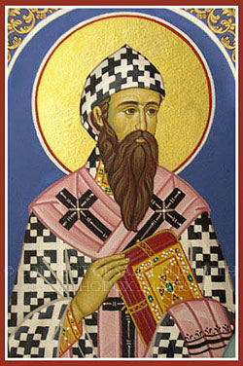
• Patriarch of Alexandria
• Contentious, powerful, devious
• Theologically superior to Nestorius
Cyril of Alexandria

Slide 20
Nestorius
Cyril

Slide 21
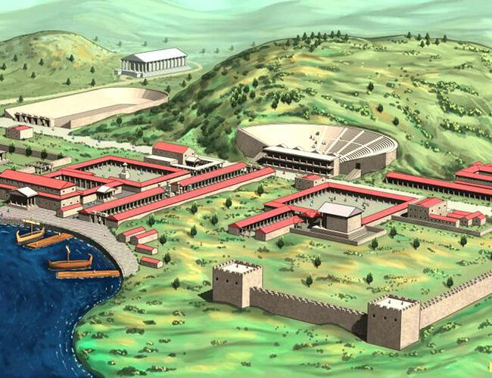
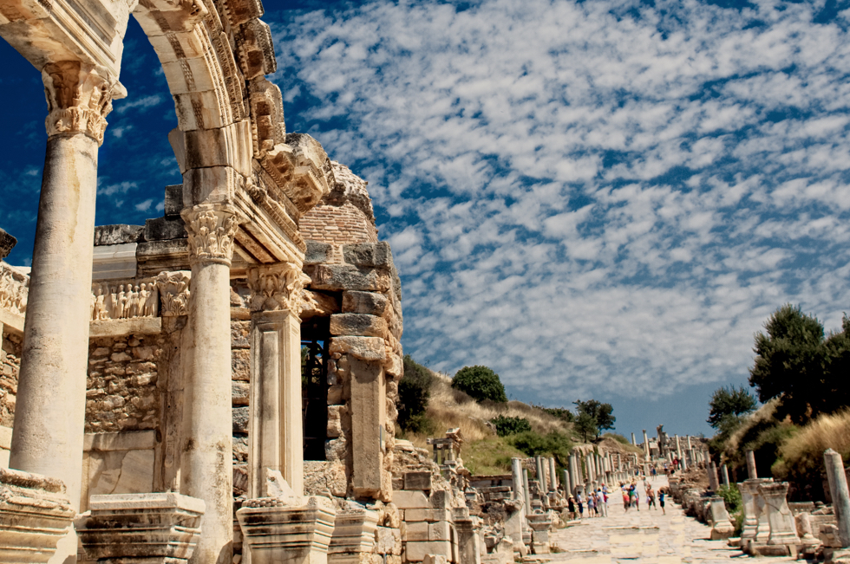
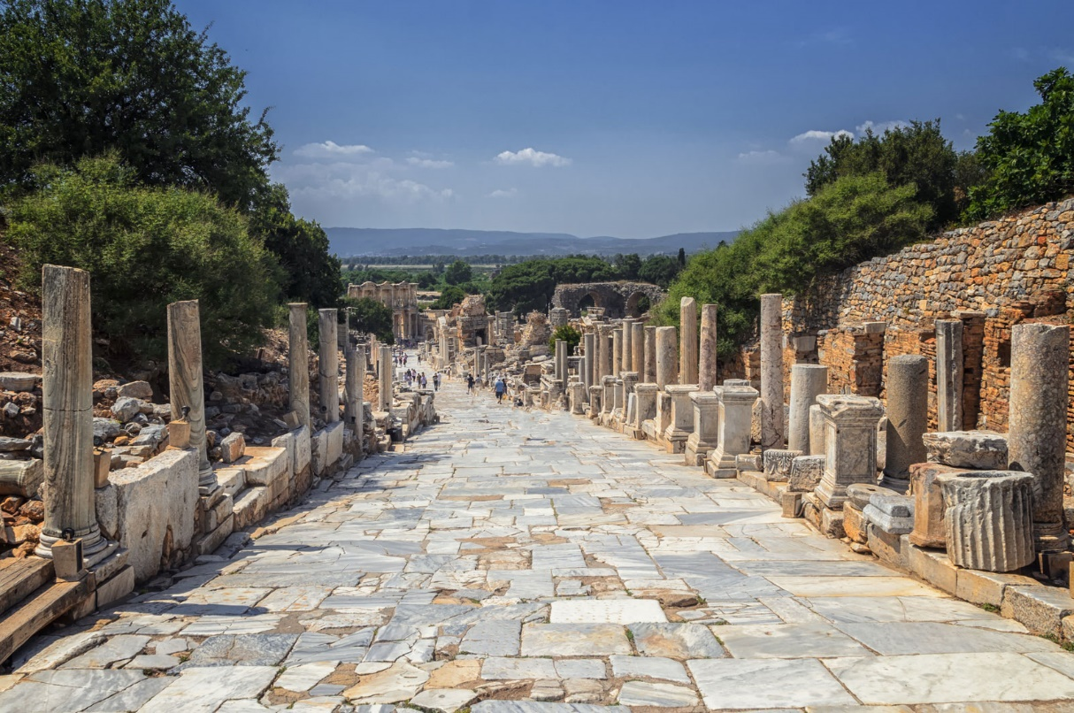
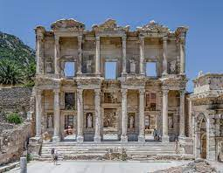

Slide 22
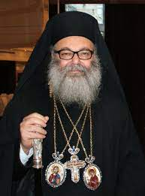
John of Antioch

Slide 23
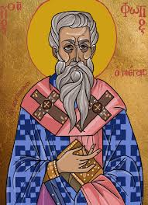
John of Antioch

Slide 25
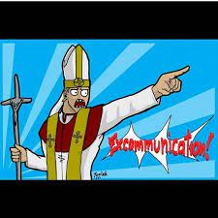
Nestorius

Slide 28
John of Antioch

Slide 29
Cyril

Slide 30
John of Antioch

Slide 32
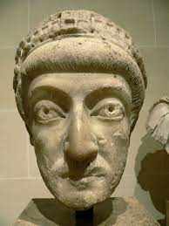

Slide 33
WHEN THE DUST SETTLED . . .
• Decisions of the original council are affirmed
• Nestorius is condemned and sent into exile
• Cyril, though rebuked, is freed from jail
• Cyril and John of Antioch sign Formula for Union
• A monk named Eutyches takes Cyril’s theology to the next level
• Eutychianism inflames a need for the 4th Ecumenical Council
• Nestorianism spreads to regions east of the Roman Empire
• Major questions remain unsettled

