Slide 1
Jesus Christ is consubstantial with the Father and with us.

Slide 2
The union of divinity and humanity in one person
- A profound mystery
- Not completely unfathomable
- Significant implications

Slide 3
Jesus is truly and fully divine.
Jesus is truly and fully human.
How is it that he can be both?
What is the relationship between his humanity and divinity?
What are the implications of how we understand this?

Slide 4
1. The challenges involved
2. The theology of Nestorius
3. The problems with Nestorianism
4. Orthodoxy

Slide 5
“HYPOSTATIC UNION”
Theologians use the term to refer to the union of the divine nature and the human nature in the person of Jesus Christ.
The term sets it apart from other kinds of unions (metaphysical, essential, and moral).

Slide 6
THE CHALLENGES INVOLVED
• This union involves 2 completely different natures, that by definition, have contradictory attributes.
• The Bible doesn’t offer any direct teaching on the matter.
• Limitations of our own capacity to figure it all out.

Slide 7
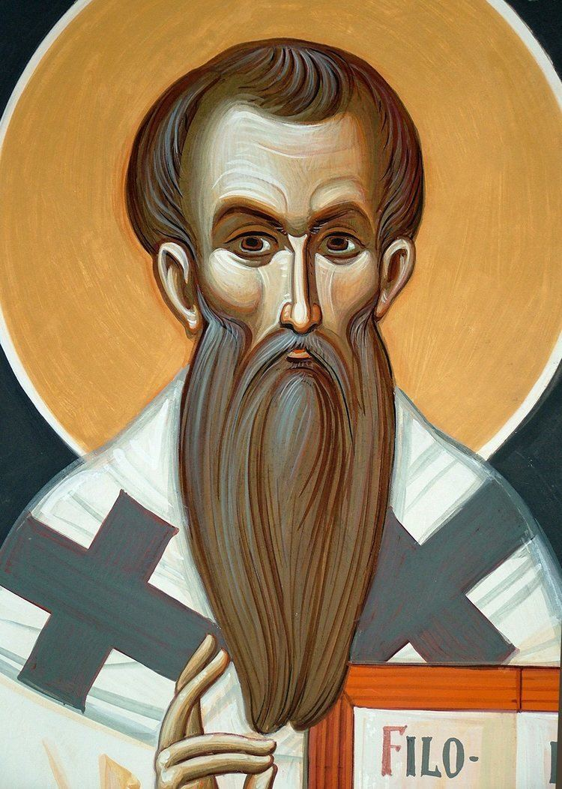
• Patriarch of Constantinople
• Opposes the treasured term used of Mary, “Theotokos”
• Let us confess “God in a man but not God as a man”
• God is not a baby, 3 weeks old
• God does not change, grow, learn, suffer, experience pain or death
• The 2 natures are coupled together
• Jesus consists of 2 distinct persons?
Nestorious

Slide 8
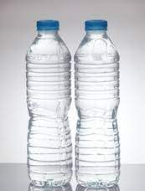

Slide 9
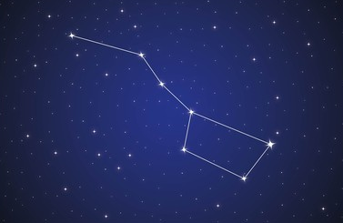

Slide 10
Feared that any substantial union of Christ’s divinity with his humanity would result in overpowering that humanity.
A union would drastically compromise the properties of each nature, jeopardizing our salvation.
Nestorious

Slide 11
“We confess God in a man but not God as a man.”
It was Jesus, the Son of God, who walked on water, healed the sick, raised the dead, and calmed the storms.
It was Jesus, the Son of Mary, who grew in wisdom and stature, hungered, thirsted, wept, experienced fatigue, suffered pain, and died on the cross.
Nestorious

Slide 12
PROBLEMS WITH NESTORIANISM
1. There is nothing in Scripture to suggest that Christ’s humanity and his divinity go back-and-forth directing his activity. All he does, he does as a single subject: a unified person, the God-man.
2. Scriptures ascribe divine titles to his so-called “human” activity and human titles to his so-called “divine” activity. This conflicts with Nestorianism’s dualism.

Slide 13
John 3:13 No one has ever gone into heaven except the one who came from heaven—the Son of Man.
1 Corinthians 2:8 None of the rulers of this age understood it, for if they had, they would not have crucified the Lord of glory.
Romans 9:5 Theirs are the patriarchs, and from them is traced the human ancestry of the Messiah, who is God over all, forever praised! Amen.

Slide 14
PROBLEMS WITH NESTORIANISM
1. There is nothing in the Scriptures to suggests that Christ’s humanity and his divinity go back-and-forth in directing his activity. All he does, he does as a single subject: a unified person, the God-man.
2. Scriptures ascribe divine titles to his so-called “human” activity and human titles to his so-called “divine” activity.
3. The efficacy of the atonement requires the death of one who is divine. Only an infinite being can truly bear the infinite wrath against all the sins of the world.
4. In Christ, the gap between God and man was bridged. If there is no union between his divinity and humanity, the gap remains.

Slide 15
HOW SHALL WE THINK ABOUT THE HYPOSTATIC UNION?

Slide 16
HOW SHALL WE THINK ABOUT THE HYPOSTATIC UNION?
Stay inside the boundaries.
The union compromises the integrity of each nature
No genuine union of the two natures

Slide 17
There is a union of the two natures.
But in that union, the two natures remain distinct.
The properties of divinity are not compromised.
The properties of humanity are not compromised.
And yet the union is real – it is hypostatic.

Slide 18
HOW SHALL WE THINK ABOUT THE HYPOSTATIC UNION?
• We should view the incarnation not as a change, but as an addition. In the womb of Mary, God the Son added to his divinity, humanity. “Remaining what he was, he became what he was not.”
• The meaning of the Word being flesh is not that the divine nature was changed into flesh, but that the divine nature assumed our flesh. (Augustine)
• In becoming man, he did not cease to be God; he voluntarily laid aside the independent exercise of his divine attributes.

Slide 19
HOW SHALL WE THINK ABOUT THE HYPOSTATIC UNION?
• Christ’s deity is never present anywhere in isolation and separation from his humanity. (William Shedd)
• Jesus is truly, perfectly, and wholly God, and he is truly, perfectly, and wholly man. (Evangelical Dictionary of Theology)
• The Word united man to God through himself. (Irenaeus)
• He took man into himself. Thereby, the invisible became visible; the incomprehensible was made comprehensible; the impassible became capable of suffering. (Irenaeus)

Slide 20
HOW SHALL WE THINK ABOUT THE HYPOSTATIC UNION?
• Was not God really crucified? And having been really crucified, did he not really die? (Tertullian)
• Each nature has its own essential attributes. The full set of attributes of each work for our salvation.
• Christ is in his people. He is there in his deity; and by union of his humanity with his deity, also in his humanity. (Henry Theissen).

Slide 21
HOW SHALL WE THINK ABOUT THE HYPOSTATIC UNION?
• Christ’s divine and human natures remain distinct and retain their own properties, yet they are eternally and inseparably united in one person. (Milliard Erickson)
• The Son did not unite himself with an independently existing human being but with the human nature, and that in a most mysterious manner. Hence there can be no two Sons or two persons. (G. C. Berkouwer)

Slide 22
HOW SHALL WE THINK ABOUT THE HYPOSTATIC UNION?
• The unique and altogether singular event of the Incarnation of the Son of God does not mean that Jesus Christ is part God and part man, nor does it imply that he is the result of a confused mixture of the divine and the human. He became truly man while remaining truly God. (Catechism of the Catholic Church)
• Nowhere do we have an indication of the human and divine natures talking to each other or struggling withing Christ, or any such thing. Rather, we have a consistent picture of a single person acting in wholeness and unity. (Wayne Grudem)

Slide 23
HOW SHALL WE THINK ABOUT THE HYPOSTATIC UNION?
We see in him some things so human that they appear to differ in no respect from the common frailty of mortals. We also see some things so divine that they can appropriately belong to nothing else than to the primal and ineffable nature of deity. . . . The truth of both natures may be clearly shown to exist in one and the same being. . . . To utter these things in human ears, and to explain them in words, far surpasses the powers either of our rant, or of our intellect and language. I think that it surpasses the power even of the holy apostles. Nay, the explanation of that mystery may perhaps be beyond the grasp of the entire creation of celestial powers. (Origen)

Slide 24
HOW SHALL WE THINK ABOUT THE HYPOSTATIC UNION?
What we have in Jesus Christ is an irreversible union between the Word as God and Jesus as man. This is a personal or hypostatic union and cannot be duplicated or repeated. It is not a mystical union in which Jesus is one with God only in the core of his personality. Nor is it an essential union in which the being of Jesus blends into the being of God. Neither is it a moral union in which Jesus is united with God only in his will. The hypostatic union means that Jesus is one with the Logos, the preexistent Word who was with God in the beginning and who was God. Jesus therefore is more than a great teacher, a spiritual master or a pathfinder; he is a divine Savior, “very God and very man” in one person. (Donald Bloesch)

Slide 25
HOW SHALL WE THINK ABOUT THE HYPOSTATIC UNION?
What we have in Jesus Christ is an irreversible union between the Word as God and Jesus as man. This is a personal or hypostatic union and cannot be duplicated or repeated. It is not a mystical union in which Jesus is one with God only in the core of his personality. Nor is it an essential union in which the being of Jesus blends into the being of God. Neither is it a moral union in which Jesus is united with God only in his will. The hypostatic union means that Jesus is one with the Logos, the preexistent Word who was with God in the beginning and who was God. Jesus therefore is more than a great teacher, a spiritual master or a pathfinder; he is a divine Savior, “very God and very man” in one person. (Donald Bloesch)

Slide 26
HOW SHALL WE THINK ABOUT THE HYPOSTATIC UNION?
. . . for us men and for our salvation, of Mary the Virgin, the God-bearer one and the same Christ, Son, Lord, Only-begotten, recognized in two natures, without confusion, without change, without division, without separation; the distinction of the natures being in no way annulled by the union, but rather the characteristics of each nature being preserved and coming together to form one person and subsistence, not parted or separated into two persons, but one and the same Son and Only-begotten God the Word, Lord Jesus Christ . . . (Chalcedon)

Slide 27
HOW SHALL WE THINK ABOUT THE HYPOSTATIC UNION?
. . . for us men and for our salvation, of Mary the Virgin, the God-bearer one and the same Christ, Son, Lord, Only-begotten, recognized in two natures, without confusion, without change, without division, without separation; the distinction of the natures being in no way annulled by the union, but rather the characteristics of each nature being preserved and coming together to form one person and subsistence, not parted or separated into two persons, but one and the same Son and Only-begotten God the Word, Lord Jesus Christ . . . (Chalcedon)

Slide 28
HOW SHALL WE THINK ABOUT THE HYPOSTATIC UNION?
. . . Christ . . . recognized in two natures,
- without confusion
- without change
- without division
- without separation
the distinction of the natures being in no way annulled by the union . . .

Slide 29
Without Confusion
WHAT THIS UNION IS NOT
WHAT THIS UNION IS
Without Division
Without Separation
WHAT THIS UNION IS NOT
Without Change

