Slide 1
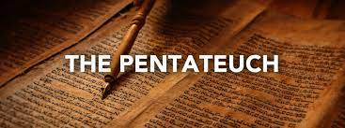

Slide 2
Purposeful stories retelling historical events

Slide 3
Biblical narratives consist of
• A scene
• A plot
• A plot resolution
• Characters
• Dialogue
• The narrator

Slide 4
The 3 levels of an OT narrative
• 3rd – The grand story of redemption history
• 2nd – The larger story of God’s covenant people
• 1st – The story of the event itself

Slide 6
. . . the men of the city of Sodom, both young and old, the whole population, surrounded the house.

Slide 8
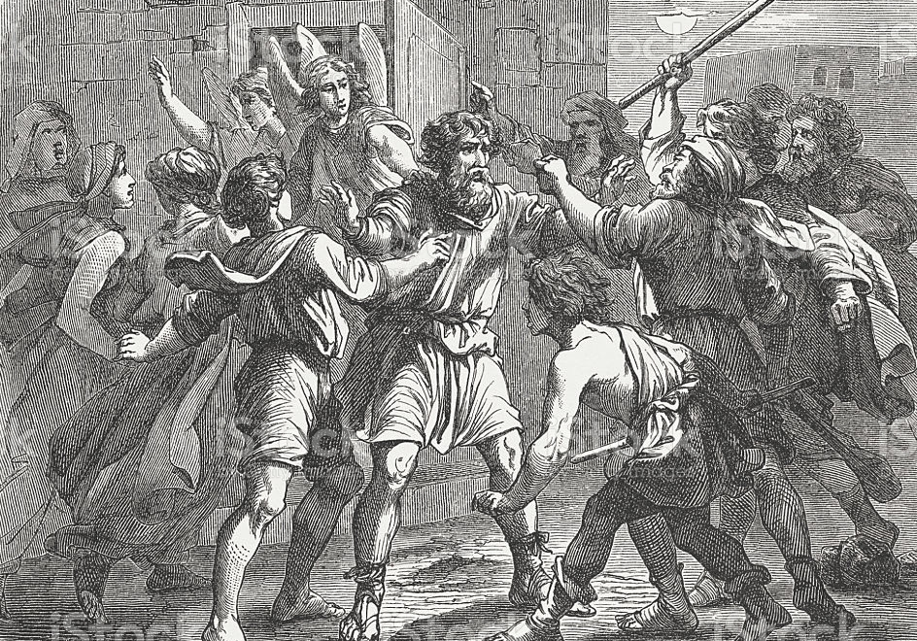

Slide 9
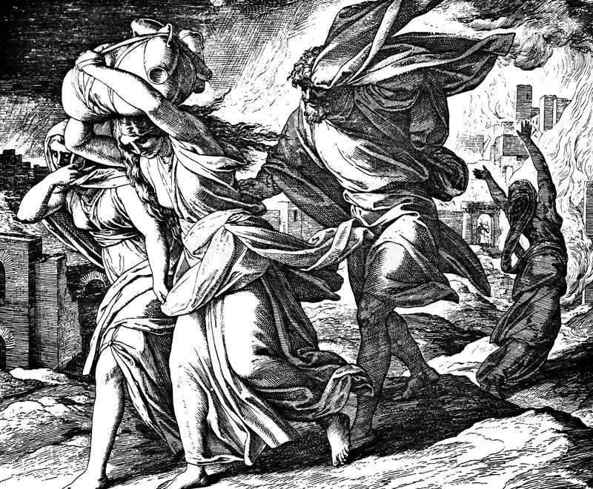

Slide 10
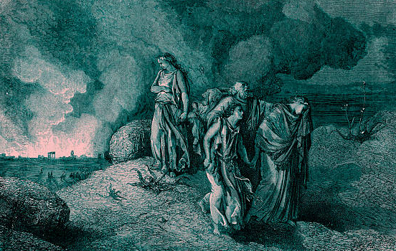

Slide 11
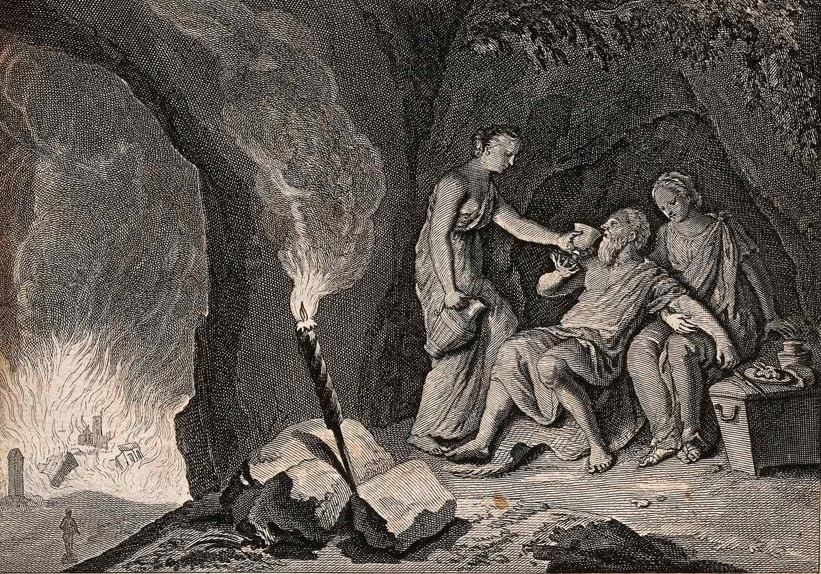

Slide 12
Major Themes from Genesis 19
- God’s swift judgment on the residents of Sodom
- Lot’s close attachment to that wicked society
- God’s merciful sparing of Lot from the impending doom
- The rebirth of Sodom in the cave near Zoar

Slide 13
The 3 levels of an OT narrative
• 3rd – The grand story of redemption history
• 2nd – The larger story of God’s covenant people
• 1st – The story of the event itself

Slide 14
The 3 levels of an OT narrative
• 3rd – The grand story of redemption history
• 2nd – The larger story of God’s covenant people
• 1st – The story of the event itself

Slide 15
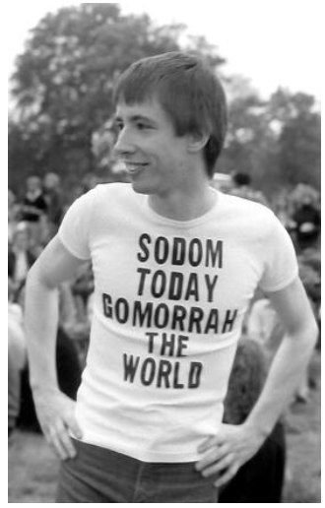
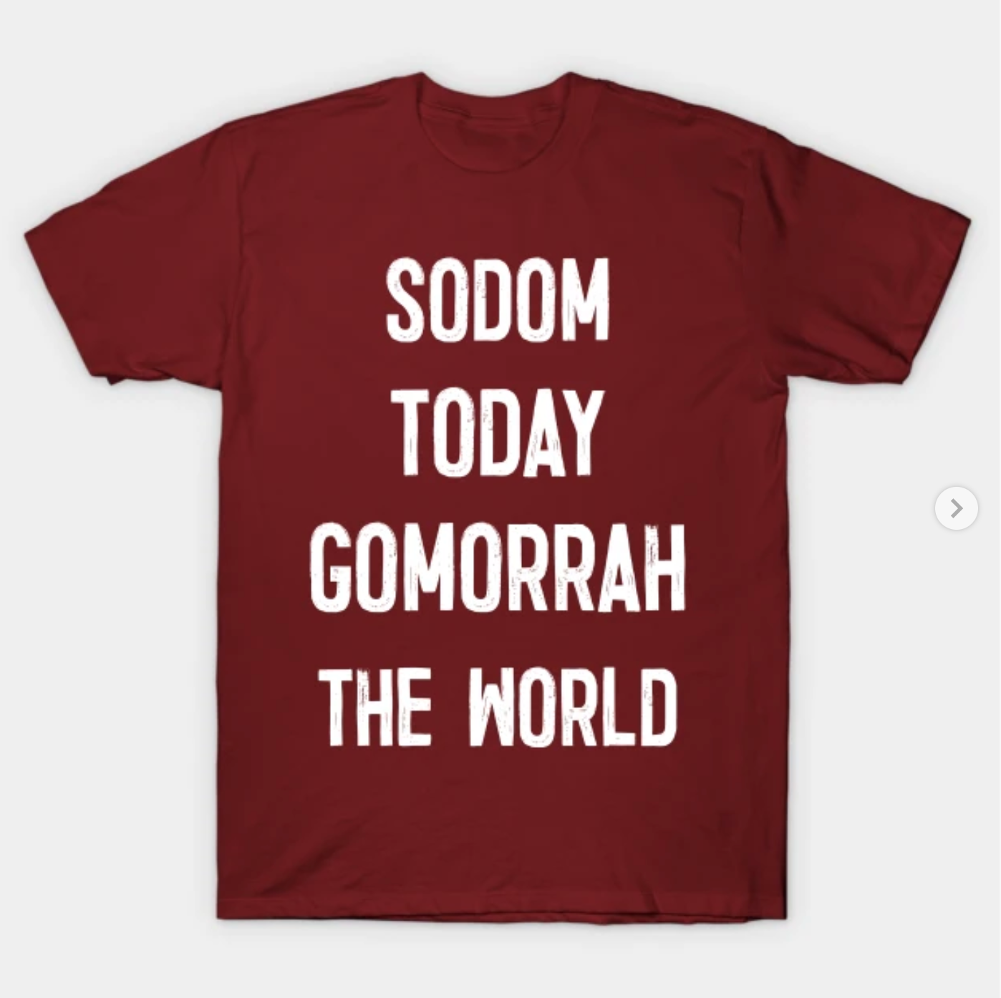

Slide 16
The 3 levels of an OT narrative
• 3rd – The grand story of redemption history
• 2nd – The larger story of God’s covenant people
• 1st – The story of the event itself

Slide 17
1 Peter 2:6 . . . [The Lord] condemned the cities of Sodom and Gomorrah by burning them to ashes, and made them an example of what is going to happen to the ungodly. . .

Slide 18
Alternate interpretations on why Sodom was destroyed:
• Lack of hospitality
• Homosexual rape
• Wickedness in general

Slide 19
Jude 1:7 Likewise, Sodom and Gomorrah and the surrounding towns committed sexual immorality and perversions, and serve as an example by undergoing the punishment of eternal fire.

