Slide 2
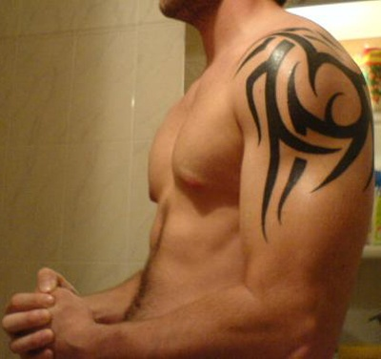

Slide 5
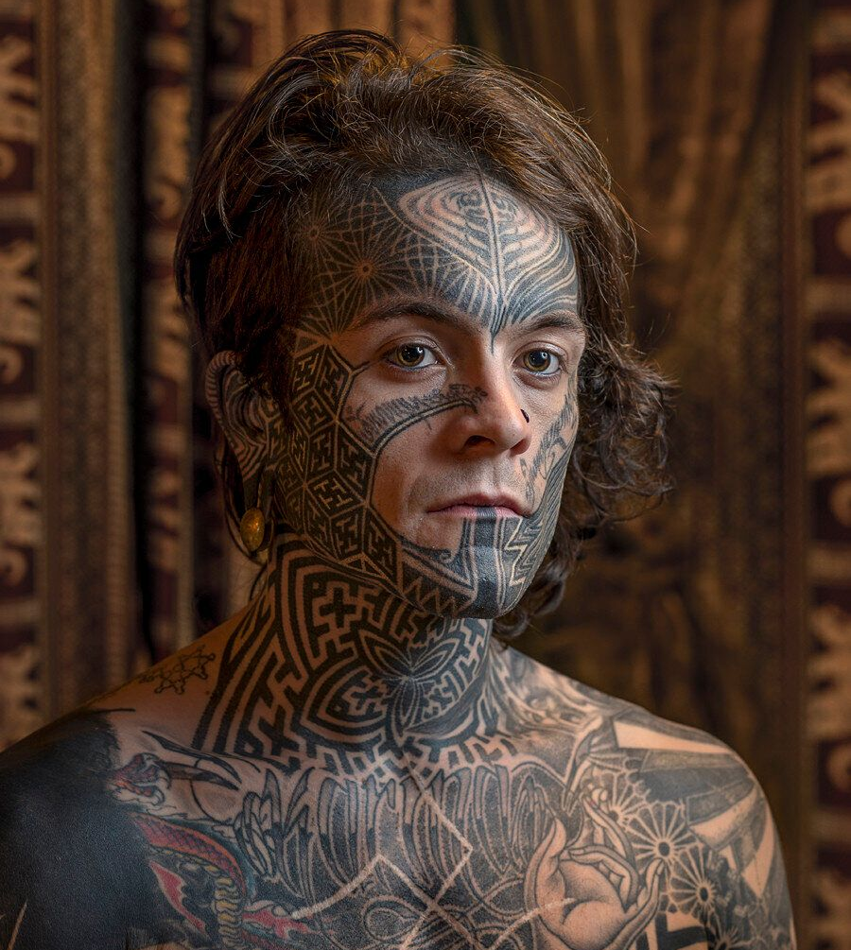

Slide 6
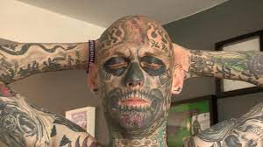

Slide 7
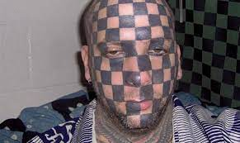

Slide 8
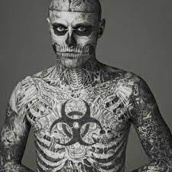

Slide 9
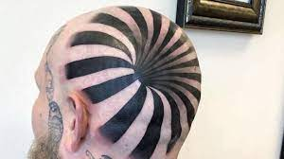

Slide 12
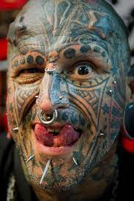

Slide 13
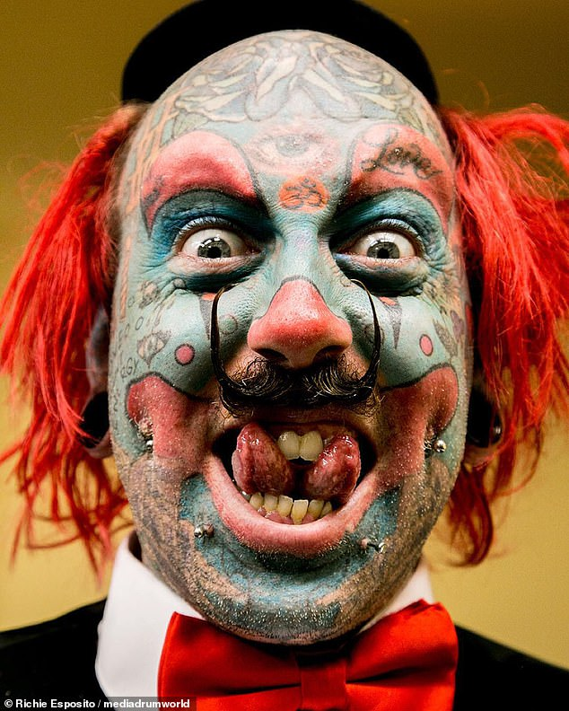

Slide 15
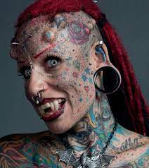

Slide 16
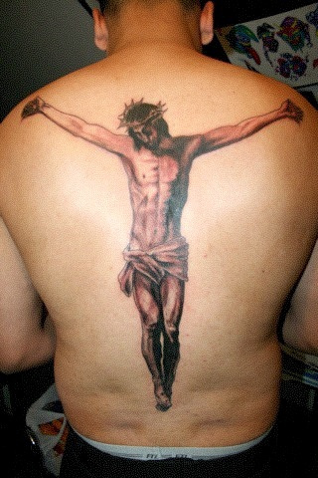

Slide 17
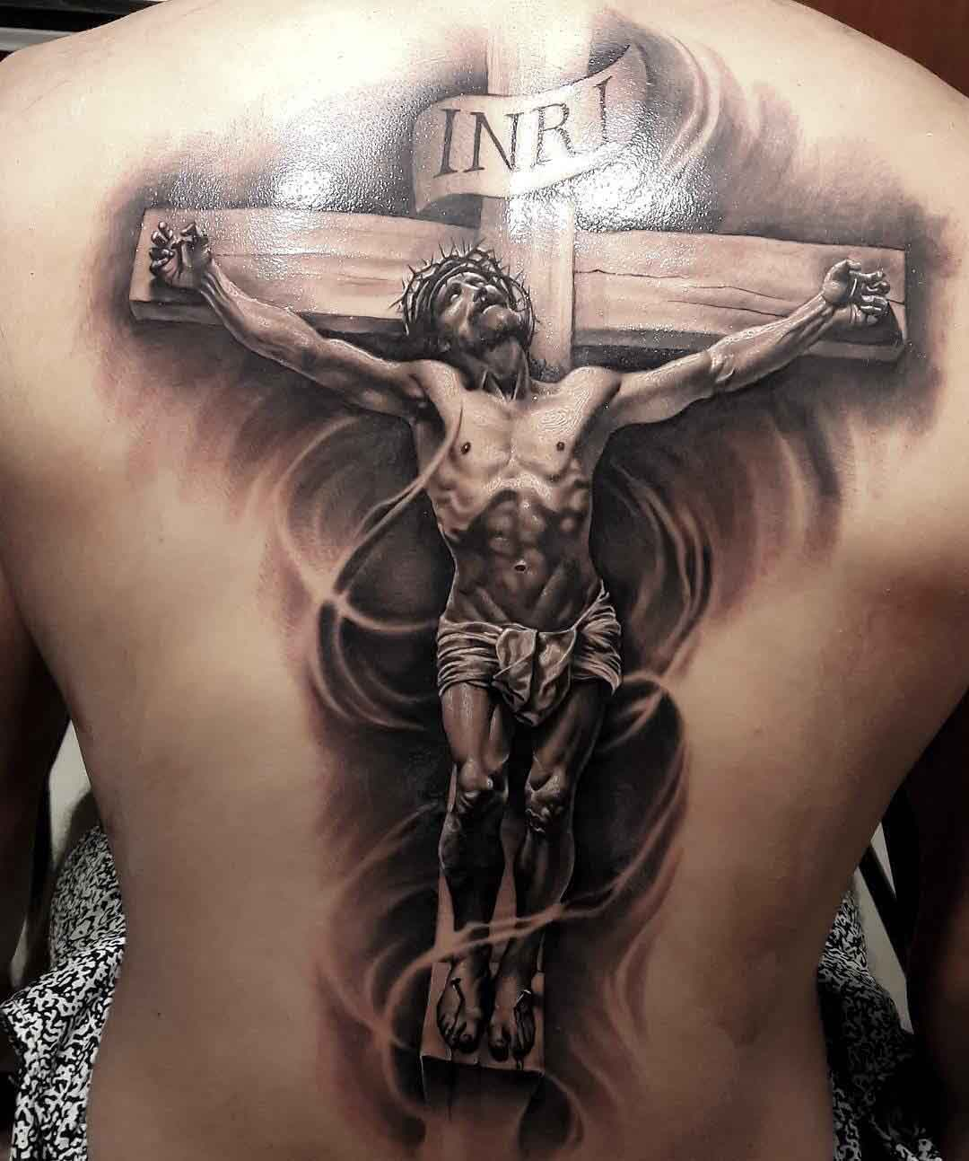

Slide 18
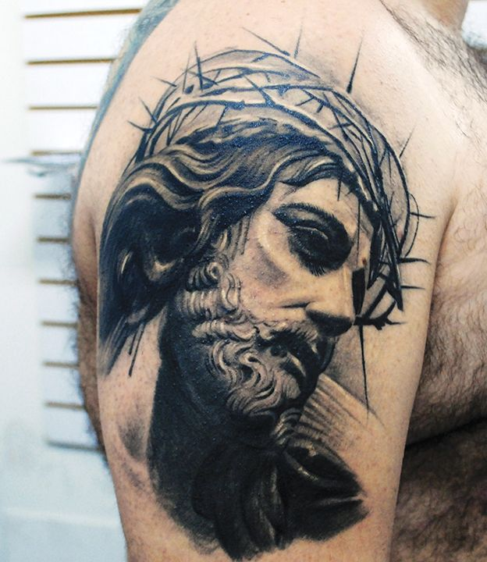
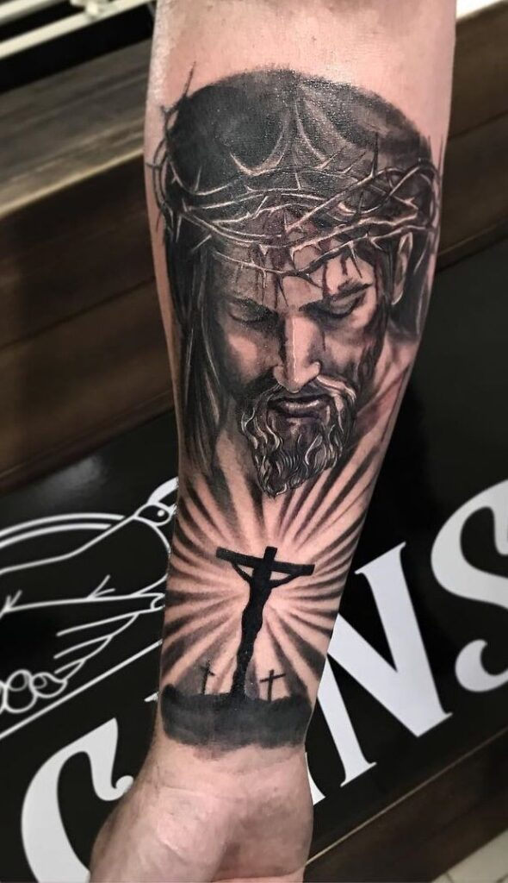

Slide 19
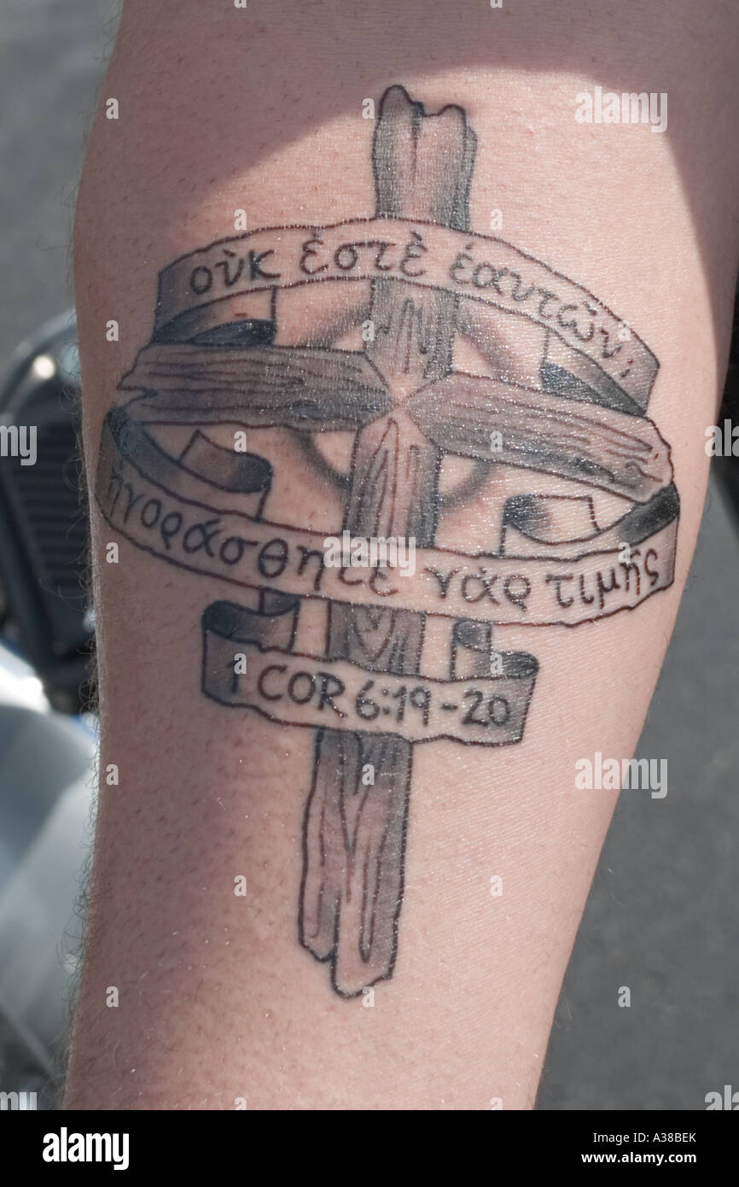

Slide 22
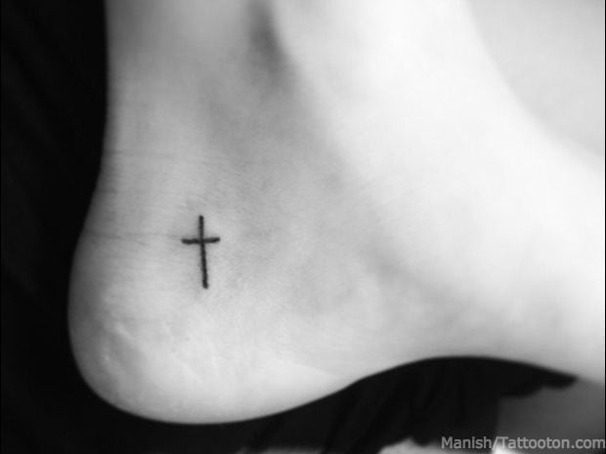

Slide 23
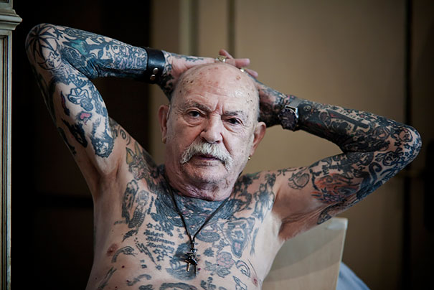

Slide 24
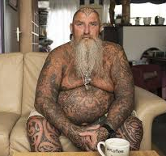

Slide 26
Leviticus 19:28 You are not to make gashes on your bodies for the dead or put tattoo marks on yourselves; I am the Lord.

Slide 27
²⁶ You are not to eat anything with blood in it. You are not to practice divination or witchcraft.
²⁷ You are not to cut off the hair at the sides of your head or mar the edge of your beard.
²⁸ You are not to make gashes on your bodies for the dead or put tattoo marks on yourselves; I am the Lord.
²⁹ Do not debase your daughter by making her a prostitute, or the land will be prostituted and filled with depravity.
³⁰ Keep my Sabbaths and revere my sanctuary; I am the Lord.

Slide 28
HISTORICAL CONTEXT
• Advertise sexual services
• Promote idols
• Appeal to certain deities

Slide 29
LEVITICUS 19
²⁶ You are not to eat anything with blood in it. You are not to practice divination or witchcraft.
²⁷ You are not to cut off the hair at the sides of your head or mar the edge of your beard.
²⁸ You are not to make gashes on your bodies for the dead or put tattoo marks on yourselves; I am the Lord.
²⁹ Do not debase your daughter by making her a prostitute, or the land will be prostituted and filled with depravity.
³⁰ Keep my Sabbaths and revere my sanctuary; I am the Lord.

Slide 31
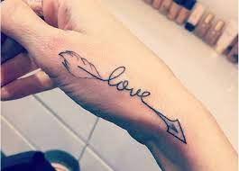

Slide 32
Leviticus 19:28 You are not to . . . put tattoo marks on yourselves.
Possible Reasons Include:
To avoid association with pagan rituals and practices
To set the ancient Hebrews apart from their neighbors
To remind them that they (and their bodies) belonged to YHWH

Slide 33
IS IT WISE?

Slide 35
IS IT WISE?

Slide 36
PERSONAL CONSCIENCE

Slide 37
Romans 14:22-23 Blessed is the one who does not condemn himself by what he approves. But whoever has doubts is condemned if they eat, because their eating is not from faith; and everything that does not come from faith is sin.

