Slide 1
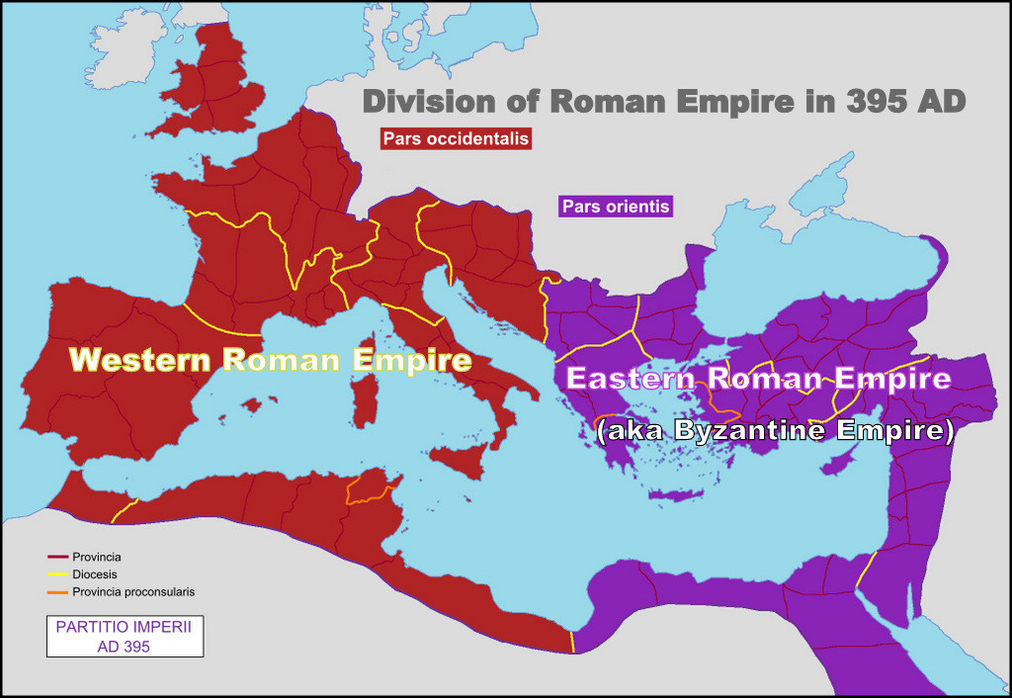

Slide 2
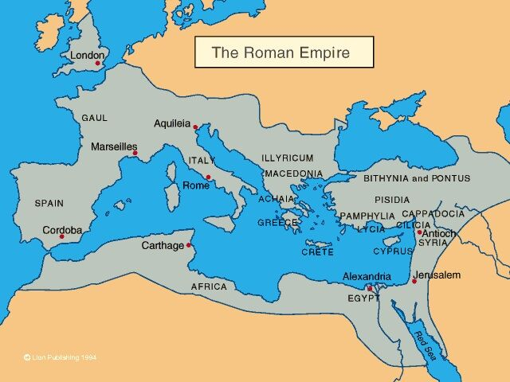

Slide 3
Simon Peter

Slide 4
Andrew

Slide 5
Philip

Slide 6
James, John’s brother

Slide 7
John

Slide 8
Bartholomew

Slide 9
James, son of Alphaeus

Slide 10
Thaddaeus

Slide 11
Matthew

Slide 12
Simon the Zealot

Slide 13
Mattathias

Slide 15
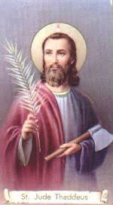
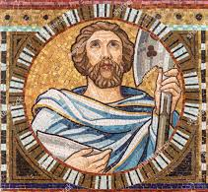
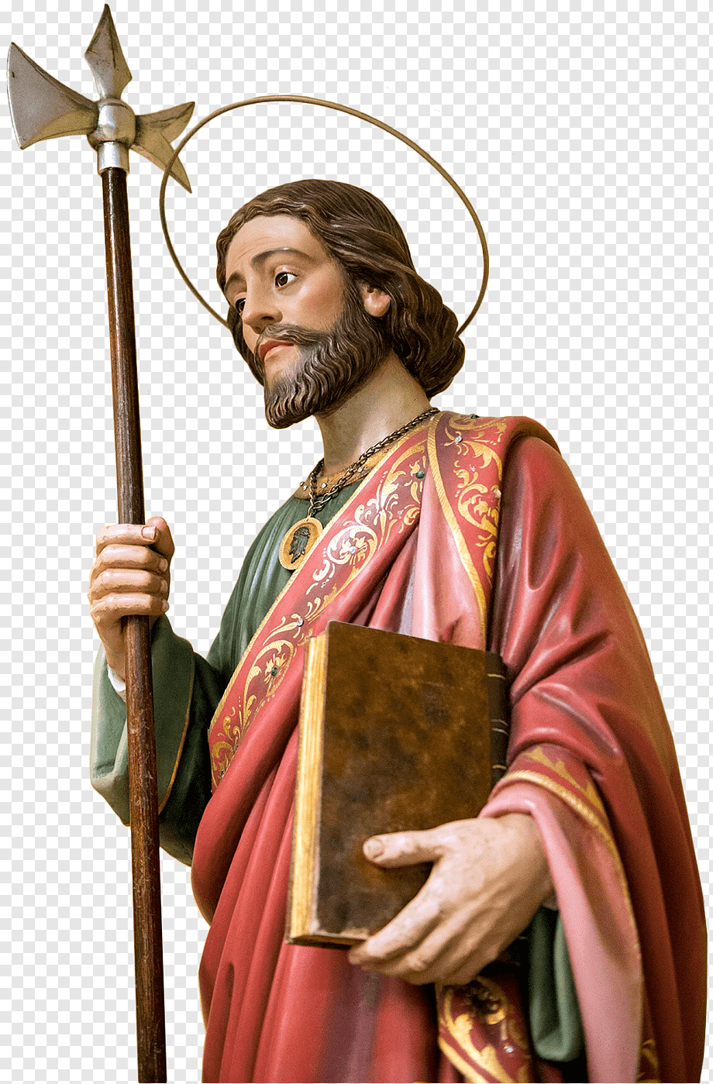
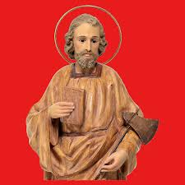
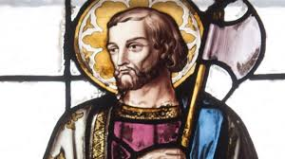

Slide 17
ELEMENTS OF EITHER JEWISH OR ORIENTAL MYSTICISM
PLATONISM
ELEMENTS OF
CHRISTIANITY
GNOSTICISM
EBIONISM
DOCETISM

Slide 19
