Slide 1
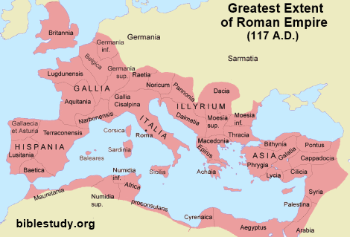

Slide 2
ELEMENTS OF EITHER JEWISH OR ORIENTAL MYSTICISM
PLATONISM
ELEMENTS OF
CHRISTIANITY
GNOSTICISM
EBIONISM
DOCETISM

Slide 3
PLATONISM
ELEMENTS OF EITHER JEWISH OR ORIENTAL MYSTICISM
ELEMENTS OF
CHRISTIANITY
GNOSTICISM
EBIONISM
DOCETISM
VALENTIANISM
MARCIONISM

Slide 5
The Supreme Good

Slide 6
The Supreme Good

Slide 7
The Supreme Good

Slide 8
The Supreme Good

Slide 9
The Supreme Good
The Pleroma

Slide 10
The Supreme Good
Wisdom
The Pleroma

Slide 11
The Supreme Good
Wisdom
The Pleroma
Child of Chaos

Slide 12
The Supreme Good
Wisdom
Child of Chaos
Physical Matter

Slide 13
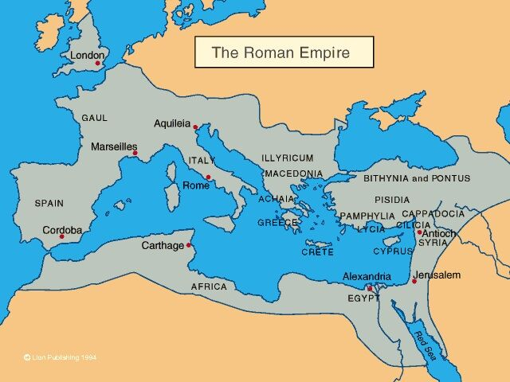

Slide 14
The Supreme Good
Wisdom
Child of Chaos
Physical Matter
The Workman

Slide 15
The Supreme Good
Wisdom
Child of Chaos
Physical Matter
▽
The Cosmos and the World
The Workman

