Slide 1
Romans
Part 8

Slide 2
Romans
1:1 - 3:26
Parts 1-7

Slide 3
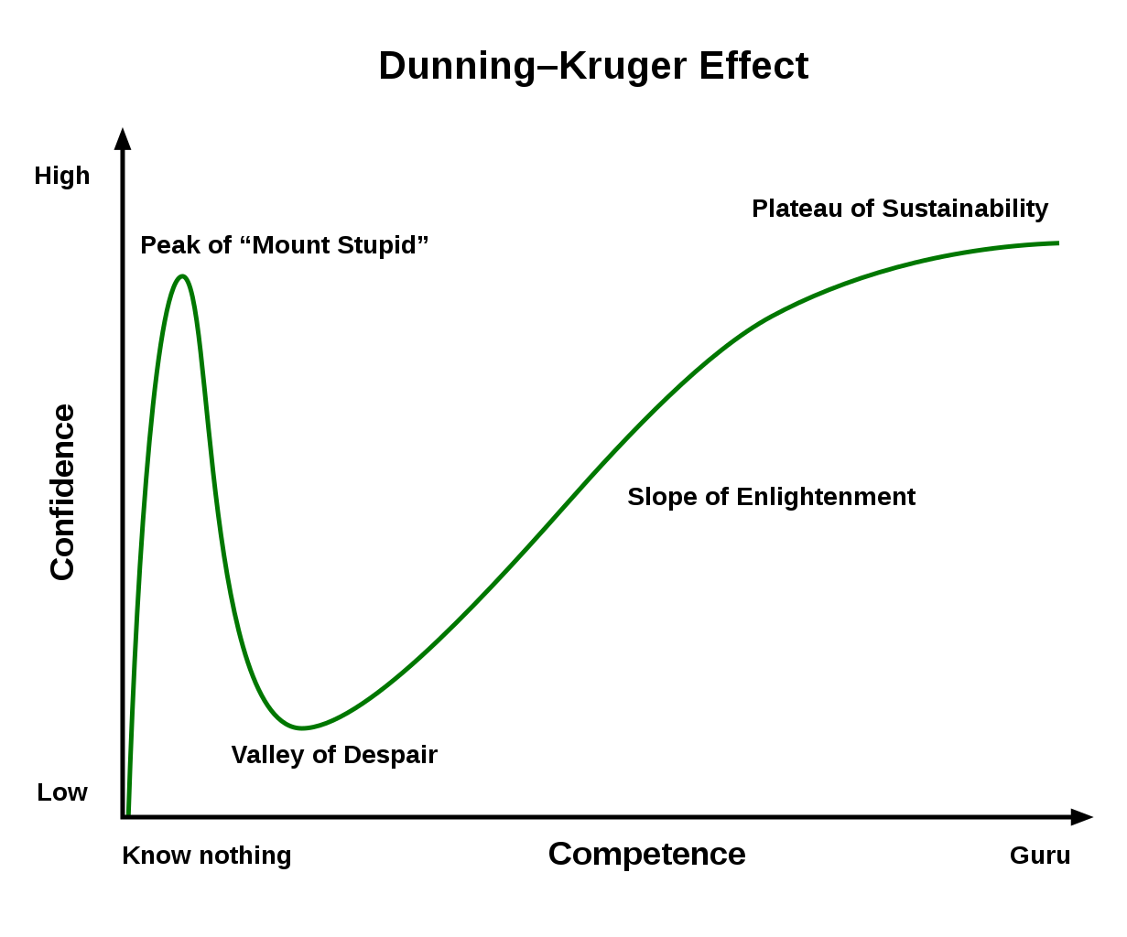
“Therefore, no one will be declared righteous in God’s sight by the works of the law, rather, through the law we become conscious of sin.” Romans 3:20

Slide 4
Romans 1:16-17 (NIV)
¹⁶ I am not ashamed of the gospel, because it is the power of God for the salvation of everyone who believes: first for the Jew, then for the Gentile.
¹⁷ For in the gospel a righteousness from God is revealed, a righteousness that is by faith from first to last, just as it is written:
"The righteous will live by faith."
*
= HOW
= HOW

Slide 5
Romans 3:21-26 (NIV)
²¹ But now a righteousness from God, apart from law, has been made known, to which the Law and the Prophets testify. ²² This righteousness from God comes through faith in Jesus Christ to all who believe. There is no difference, ²³ for all have sinned and fall short of the glory of God, ²⁴ and are justified freely by his grace through the redemption that came by Christ Jesus.
²⁵ God presented him as a sacrifice of atonement, through faith in his blood. He did this to demonstrate his justice, because in his forbearance he had left the sins committed beforehand unpunished-- ²⁶ he did it to demonstrate his justice at the present time, so as to be just and the one who justifies those who have faith in Jesus.

Slide 6
Romans 1:16-17 (NIV)
¹⁶ I am not ashamed of the gospel, because it is the power of God for the salvation of everyone who believes: first for the Jew, then for the Gentile.
¹⁷ For in the gospel a righteousness from God is revealed, a righteousness that is by faith from first to last, just as it is written:
"The righteous will live by faith."
*
= HOW

Slide 7
Romans
3:27 – 4:25
Part 8

Slide 8
Romans 3:27-31 (NIV)
²⁷ Where, then, is boasting? It is excluded. On what principle? On that of observing the law? No, but on that of faith. ²⁸ For we maintain that a man is justified by faith apart from observing the law. ²⁹ Is God the God of Jews only? Is he not the God of Gentiles too? Yes, of Gentiles too, ³⁰ since there is only one God, who will justify the circumcised by faith and the uncircumcised through that same faith. ³¹ Do we, then, nullify the law by this faith? Not at all! Rather, we uphold the law.

Slide 9
Faith

Slide 10
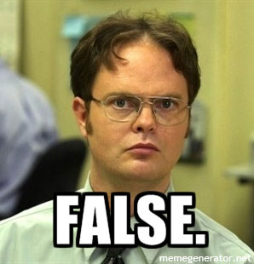
"Faith is the great cop-out, the great excuse to evade the need to think and evaluate evidence. Faith is belief in spite of, even perhaps because of, the lack of evidence.”
Richard Dawkins, Pg.23

Slide 11
Episode 332
“Is God a Delusion?”
William Lane Craig panel
at the Sheldonian
Theatre, Oxford

Slide 12
Romans 3:27-31 (NIV)
²⁷ Where, then, is boasting? It is excluded. On what principle? On that of observing the law? No, but on that of faith. ²⁸ For we maintain that a man is justified by faith apart from observing the law. ²⁹ Is God the God of Jews only? Is he not the God of Gentiles too? Yes, of Gentiles too, ³⁰ since there is only one God, who will justify the circumcised by faith and the uncircumcised through that same faith. ³¹ Do we, then, nullify the law by this faith? Not at all! Rather, we uphold the law.
Now you, if you call yourself a Jew; if you rely on the law and boast in God; if you know his will and approve of what is superior because you are instructed by the law… Romans 2:17-18

Slide 13
Romans 3:27-31 (NIV)
²⁷ Where, then, is boasting? It is excluded. On what principle? On that of observing the law? No, but on that of faith. ²⁸ For we maintain that a man is justified by faith apart from observing the law. ²⁹ Is God the God of Jews only? Is he not the God of Gentiles too? Yes, of Gentiles too, ³⁰ since there is only one God, who will justify the circumcised by faith and the uncircumcised through that same faith. ³¹ Do we, then, nullify the law by this faith? Not at all! Rather, we uphold the law.
You see that a person is justified by works and not by faith alone.
James 2:24

Slide 14
FAITH is not mere belief, but trust demonstrated through obedience.

Slide 15
Romans 3:27-31 (NIV)
²⁷ Where, then, is boasting? It is excluded. On what principle? On that of observing the law? No, but on that of faith. ²⁸ For we maintain that a man is justified by faith apart from observing the law. ²⁹ Is God the God of Jews only? Is he not the God of Gentiles too? Yes, of Gentiles too, ³⁰ since there is only one God, who will justify the circumcised by faith and the uncircumcised through that same faith. ³¹ Do we, then, nullify the law by this faith? Not at all! Rather, we uphold the law.

Slide 16
Romans 3:27-31 (NIV)
²⁷ Where, then, is boasting? It is excluded. On what principle? On that of observing the law? No, but on that of faith. ²⁸ For we maintain that a man is justified by faith apart from observing the law. ²⁹ Is God the God of Jews only? Is he not the God of Gentiles too? Yes, of Gentiles too, ³⁰ since there is only one God, who will justify the circumcised by faith and the uncircumcised through that same faith. ³¹ Do we, then, nullify the law by this faith? Not at all! Rather, we uphold the law.

Slide 17
Romans 4 Abraham Justified by Faith
v.2-8 Works vs. Faith (A)
v.9-12 Inclusivity of the Promise (B)
v.13-15 Nature of the Promise (C)
v.16-17 Conclusion: If A, B, C then D
v.18-25 Faith in Action

Slide 18
Romans 4 Abraham Justified by Faith
⁵ However, to the man who does not work but trusts God who justifies the wicked, his faith is credited as righteousness.

Slide 19
Romans 3:22 (NIV)
This righteousness from God comes through
faith in Jesus Christ to all who believe.
or – “faith of Jesus Christ”

Slide 20
Romans 4 Abraham Justified by Faith
⁵ However, to the man who does not work but trusts God who justifies the wicked, his faith is credited as righteousness.
And without faith it is impossible to please God, because anyone who comes to him must believe that he exists and that he rewards those who earnestly seek him.
Hebrews 11:6

Slide 21
Romans 4 Abraham Justified by Faith
³ What does the Scripture say?
"Abraham believed God, and it was
credited to him as righteousness."
²³ The words "it was credited to him" were written not for him alone, ²⁴ but also for us, to whom God will credit righteousness--for us who believe in him who raised Jesus our Lord from the dead

Slide 22
Romans 4 Abraham Justified by Faith
¹⁸ Against all hope, Abraham in hope believed and so became the father of many nations, just as it had been said to him, "So shall your offspring be." ¹⁹ Without weakening in his faith, he faced the fact that his body was as good as dead--since he was about a hundred years old--and that Sarah's womb was also dead. ²⁰ Yet he did not waver through unbelief regarding the promise of God, but was strengthened in his faith and gave glory to God, ²¹ being fully persuaded that God had power to do what he had promised. ²² This is why "it was credited to him as righteousness.” ²³ The words "it was credited to him" were written not for him alone, ²⁴ but also for us, to whom God will credit righteousness--for us who believe in him who raised Jesus our Lord from the dead.
For we live by faith, not by sight.
2 Cor. 5:7

Slide 23
Hebrews 11:1
Now faith is confidence in what we hope for and assurance about what we do not see. (NIV)
Faith shows the reality of what we hope for; it is the evidence of things we cannot see. (NLT)
Now faith is the reality of what is hoped for,
the proof of what is not seen. (CSB)
Now faith is the assurance of things hoped for, the conviction of things not seen. (ESV)

Slide 24
Hebrews 11 (NIV)
³ By faith we understand that the universe was formed at God’s command, so that what is seen was not made out of what was visible.

Slide 25
”Certainty is an unrealistic and unattainable ideal.”
- William Lane Craig
When Jesus told him that all things are possible to him who believes, the man cried out,
“I believe; help my unbelief!” Mark 9:24

Slide 26
Hebrews 11 (NIV)
Genesis Noah
Genesis 22 Abraham/ Sacrifice of Isaac
Exodus Moses
1 Samuel 17 David & Goliath
Joshua 6 Joshua
³⁸ …the world was not worthy of them.

Slide 27
Romans 10:12-14,17 (NIV)
¹² For there is no difference between Jew and Gentile—the same Lord is Lord of all and richly blesses all who call on him, ¹³ for,
“Everyone who calls on the name of the Lord will be saved.”
¹⁴ How, then, can they call on the one they have not believed in? And how can they believe in the one of whom they have not heard? And how can they hear without someone preaching to them?
¹⁷ Consequently, faith comes from hearing the message, and the message is heard through the word about Christ.

Slide 28
(To have faith in Christ) means, of course, trying to do all that He says. There would be no sense in saying you trusted a person if you would not take his advice. Thus, if you have really handed yourself over to Him, it must follow that you are trying to obey Him.
- C.S. Lewis

Slide 29
Hebrews 11:14-16 (NIV)
¹⁴ People who say such things show that they are looking for a country of their own. ¹⁵ If they had been thinking of the country they had left, they would have had opportunity to return. ¹⁶ Instead, they were longing for a better country—a heavenly one. Therefore, God is not ashamed to be called their God, for he has prepared a city for them.

