Slide 1
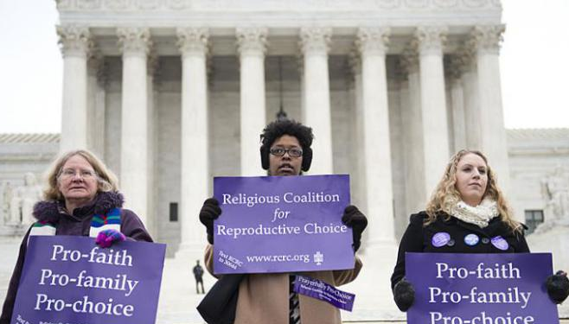
“The Bible is pro-abortion.”
Arguments and Responses

Slide 2
Argument 1: “Humans become persons at first breath.”

Slide 3
Argument 1: “Humans become persons at first breath.”
“then the Lord God formed the man of dust from the ground and breathed into his nostrils the breath of life, and the man became a living creature.”
- Genesis 2:7

Slide 4
Argument 1: “Humans become persons at first breath.”
JUSTIFY ABORTION?

Slide 5
Argument 1: “Humans become persons at first breath.”
JUSTIFY ABORTION?
Many born humans aren’t persons.

Slide 6
Argument 1: “Humans become persons at first breath.”
JUSTIFY ABORTION?
Many born humans aren’t persons.
or
Many abortions are wrong.

Slide 7
Argument 1: “Humans become persons at first breath.”
INTERPRETATION?

Slide 8
Argument 1: “Humans become persons at first breath.”
INTERPRETATION?
The narrative of Adam’s creation is not normative for us.

Slide 10
Argument 2: “That passage in Exodus …”

Slide 11
Argument 2: “That passage in Exodus …”
“When people who are fighting injure a pregnant woman so that there is a miscarriage, and yet no further harm follows, the one responsible shall be fined what the woman’s husband demands, paying as much as the judges determine. If any harm follows, then you shall give life for life, eye for eye, tooth for tooth, hand for hand, foot for foot, burn for burn, wound for wound, stripe for stripe.”
- Exodus 21:22-25 (NRSV)

Slide 12
Argument 2: “That passage in Exodus …”
“When people who are fighting injure a pregnant woman so that there is a miscarriage, and yet no further harm follows, the one responsible shall be fined what the woman’s husband demands, paying as much as the judges determine. If any harm follows, then you shall give life for life, eye for eye, tooth for tooth, hand for hand, foot for foot, burn for burn, wound for wound, stripe for stripe.”
- Exodus 21:22-25 (NRSV)

Slide 13
Argument 2: “That passage in Exodus …”
JUSTIFY ABORTION?

Slide 14
Argument 2: “That passage in Exodus …”
JUSTIFY ABORTION?
Harming fetus is still immoral

Slide 15
Argument 2: “That passage in Exodus …”
JUSTIFY ABORTION?
Harming fetus is still immoral
At best, lesser penalty for accidentally killing baby

Slide 16
Argument 2: “That passage in Exodus …”
JUSTIFY ABORTION?
Harming fetus is still immoral
At best, lesser penalty for accidentally killing baby
Irrelevant to intentionally killing baby

Slide 17
Argument 2: “That passage in Exodus …”
INTERPRETATION?

Slide 18
Argument 2: “That passage in Exodus …”
INTERPRETATION?
“If people are fighting and hit a pregnant woman and
she gives birth prematurely but there is no serious injury, the offender must be fined whatever the woman’s husband demands and the court allows. But if there is serious injury, you are to take life for life, eye for eye, tooth for tooth, hand for hand, foot for foot … .” (NIV)

Slide 19
Argument 2: “That passage in Exodus …”
INTERPRETATION?
yeleḏ (“child”)
yāṣā’ (“to go out”)

Slide 20
Argument 2: “That passage in Exodus …”
INTERPRETATION?
yeleḏ (“child”)
Hebrew children (Ex 1:17, 18)
Moses (Ex 2:3, 6-10)
Children of slaves (Ex 21:4)
yāṣā’ (“to go out”)

Slide 21
Argument 2: “That passage in Exodus …”
INTERPRETATION?
yeleḏ (“child”)
Hebrew children (Ex 1:17, 18)
Moses (Ex 2:3, 6-10)
Children of slaves (Ex 21:4)
yāṣā’ (“to go out”)
Hebrews leave Egypt (Ex 3:10-12)
Moses & Aaron leave Pharaoh (Ex 5:20; 8:12, 29-30)
Noah leaves Ark (Gen 8:16)

Slide 22
Argument 2: “That passage in Exodus …”
INTERPRETATION?
yāṣā’ (“to go out”)
“It is often used to refer to the ordinary birth of children, as coming forth either from the loins of the father or from the womb of the mother … in no case is the word used of a miscarriage.”
- Millard Erickson, Christian Theology

Slide 23
Argument 2: “That passage in Exodus …”
INTERPRETATION?
“Do not let her be like a stillborn infant coming from its mother’s womb with its flesh half eaten away.” – Num 12:12

Slide 24
Argument 2: “That passage in Exodus …”
INTERPRETATION?
“Do not let her be like a stillborn infant coming from its mother’s womb with its flesh half eaten away.” – Num 12:12
“If people are fighting and hit a pregnant woman and she gives birth prematurely but there is no serious injury, the offender must be fined …”
– Ex 21:22

Slide 26
Argument 3: “That weird passage about a potion.”

Slide 27
Argument 3: “That weird passage about a potion.”
“If she has made herself impure and been unfaithful to her husband, this will be the result: When she is made to drink the water that brings a curse and causes bitter suffering, it will enter her, her abdomen will swell and her womb will miscarry …”
- Numbers 5:27 (2011 NIV)

Slide 28
Argument 3: “That weird passage about a potion.”
“If she has made herself impure and been unfaithful to her husband, this will be the result: When she is made to drink the water that brings a curse and causes bitter suffering, it will enter her, her abdomen will swell and her womb will miscarry …”
- Numbers 5:27 (2011 NIV)

Slide 29
Argument 3: “That weird passage about a potion.”
JUSTIFY ABORTION?

Slide 30
Argument 3: “That weird passage about a potion.”
JUSTIFY ABORTION?
God causes abortion.

Slide 31
Argument 3: “That weird passage about a potion.”
JUSTIFY ABORTION?
God causes abortion.
Therefore, we can cause abortions.

Slide 32
Argument 3: “That weird passage about a potion.”
JUSTIFY ABORTION?
God causes abortion.
Whatever God does, we are justified in doing, too.
Therefore, we can cause abortions.

Slide 33
Argument 3: “That weird passage about a potion.”
JUSTIFY ABORTION?
God causes abortion.
Whatever God does, we are justified in doing, too.
Therefore, we can cause abortions.

Slide 34
Argument 3: “That weird passage about a potion.”
INTERPRETATION?

Slide 35
Argument 3: “That weird passage about a potion.”
INTERPRETATION?
Not an abortifacient drug.

Slide 36
Argument 3: “That weird passage about a potion.”
INTERPRETATION?
Not an abortifacient drug.
God renders the verdict.

Slide 37
Argument 3: “That weird passage about a potion.”
INTERPRETATION?
Not an abortifacient drug.
God renders the verdict.
Innocent: Will conceive children. | Guilty: Probably sterility.

