Slide 1
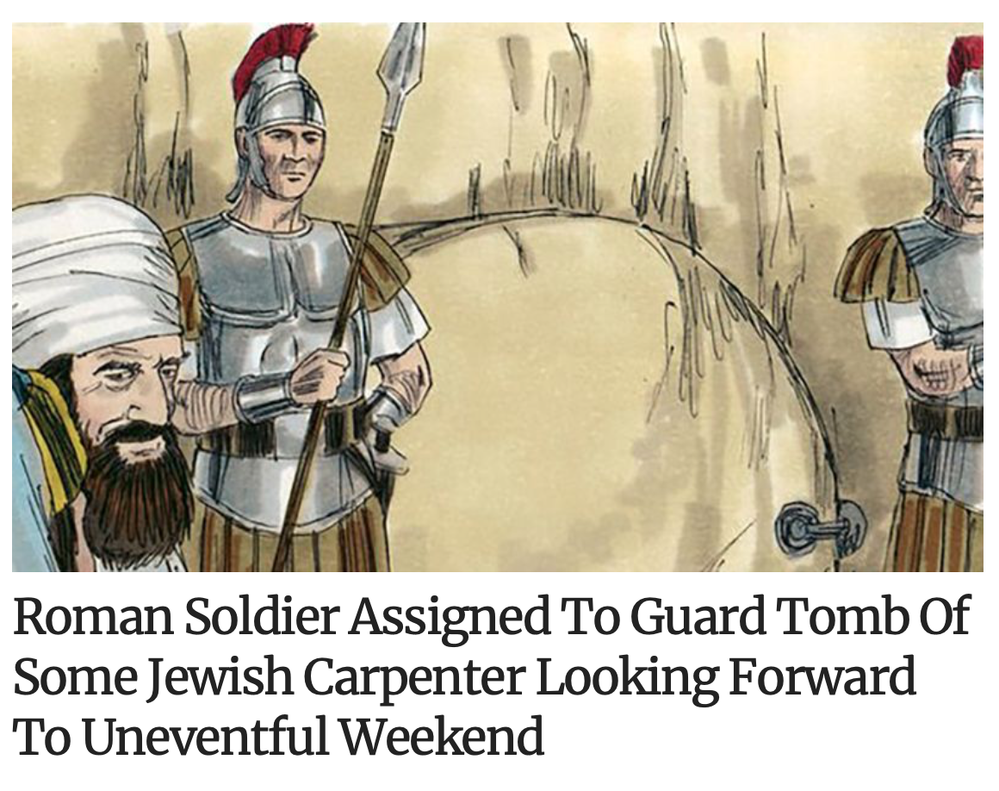

Slide 2
From What Was Jesus Resurrected?
4/17/22

Slide 3
PRELIMINARY POINTS
1. Though Bible doesn’t provide any direct teaching on the subject, it does offer some information.
2. In death, one’s body descends into the grave, and that image carries over to soul as well. The soul “descends” in the sense that it leaves the land of the living.
3. When most people use the word “hell” they have in mind the final state of the wicked, not the intermediate state in Hades. However, the two words are often used interchangeably, which causes confusion.

Slide 4
PRELIMINARY POINTS
4. “Hades” is a general term that refers to the realm of the dead. It is a prison that we are unable to free ourselves from, and it is the common destination of all who die.
5. Hades appears to consist of 2 separate domains, one for the righteous and the other for the wicked. All who dwell there are under the power of death, separated from their bodies.
6. Though Jesus descended into Hades, there is nothing in the Scriptures that says he descended into hell. Likewise, there is nothing in Scriptures that says he suffered while in Hades.

Slide 6
RECEIVED FORM
I believe in God, the Father Almighty, maker of heaven and earth. And in Jesus Christ, his only Son, our Lord, who was conceived by the Holy Spirit, and born of the virgin Mary, suffered under Pontius Pilate, was crucified, died and was buried. He descended into hell. On the third day He rose again from the dead. He ascended into heaven and sits at the right hand of God the Father Almighty. From whence He will come to judge the living and the dead. I believe in the Holy Spirit, the holy catholic church, the communion of saints, the forgiveness of sins, the resurrection of the body, and the life everlasting.

Slide 7
RECEIVED FORM
I believe in God, the Father almighty, maker of heaven and earth. And in Jesus Christ, his only Son, our Lord, who was conceived by the Holy Spirit, and born of the virgin Mary, suffered under Pontius Pilate, was crucified, died and was buried. He descended into hell. On the third day He rose again from the dead. He ascended into heaven and sits at the right hand of God the Father Almighty. From whence He will come to judge the living and the dead. I believe in the Holy Spirit, the holy catholic church, the communion of saints, the forgiveness of sins, the resurrection of the body, and the life everlasting.
OLD ROMAN FORM
I believe in God almighty and in Christ Jesus, his only Son, our Lord. Who was born of the Holy Spirit and the Virgin Mary. Who was crucified under Pontius Pilate and was buried and the third day rose from the dead. Who ascended into heaven and sits on the right hand of the Father whence he comes to judge the living and the dead. And in the Holy Ghost, the holy church, the remission of sins, the resurrection of the flesh, the life everlasting.

Slide 8
AN ALTERED VERSION FOUND IN THE 4TH CENTURY
I believe in God almighty and in Christ Jesus, his only Son, our Lord. Who was born of the Holy Spirit and the Virgin Mary. Who was crucified under Pontius Pilate and was buried. He descended into hell, and the third day rose from the dead. Who ascended into heaven and sits on the right hand of the Father whence he comes to judge the living and the dead. And in the Holy Ghost, the holy church, the remission of sins, the resurrection of the flesh, the life everlasting.

Slide 9
RECEIVED FORM
I believe in God, the Father almighty, maker of heaven and earth. And in Jesus Christ, his only Son, our Lord, who was conceived by the Holy Spirit, and born of the virgin Mary, suffered under Pontius Pilate, was crucified, died and was buried. He descended into hell. On the third day He rose again from the dead. He ascended into heaven and sits at the right hand of God the Father Almighty. From whence He will come to judge the living and the dead. I believe in the Holy Spirit, the holy catholic church, the communion of saints, the forgiveness of sins, the resurrection of the body, and the life everlasting.

Slide 10
Acts 2:26-27 “Therefore, my heart is glad and my tongue rejoices; my body also will live in hope, because you will not abandon me to the grave [Hades], nor will you let your Holy One see decay.” (Peter quoting from Psalm 16)
Acts 2:24 “God raised him from the dead, freeing him from the agony of death, because it was impossible for death to keep its hold on him.”
Luke 23:42-43 Then he said, "Jesus, remember me when you come into your kingdom.” Jesus answered him, "I tell you the truth, today you will be with me in paradise."

Slide 11
1Peter 3:18-20 For Christ died for sins once for all, the righteous for the unrighteous, to bring you to God. He was put to death in the body but made alive by the Spirit, through whom also he went and preached to the spirits in prison who disobeyed long ago when God waited patiently in the days of Noah while the ark was being built.

Slide 13
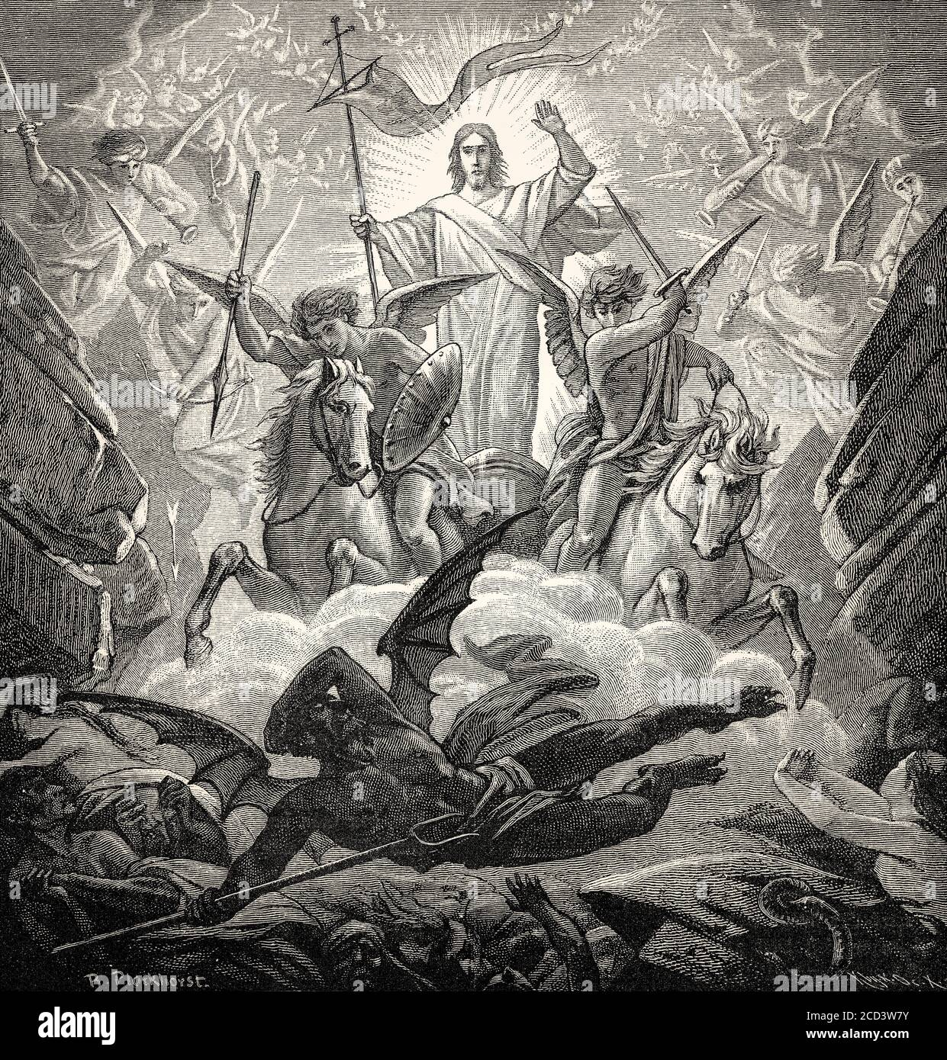

Slide 14
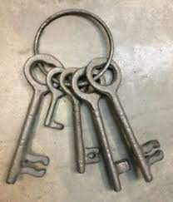
Revelation 1:18
Do not be afraid. I am the First and the Last.
I am the Living One; I was dead, and behold I am alive for ever and ever.
And I hold the keys of death and Hades.

Slide 16
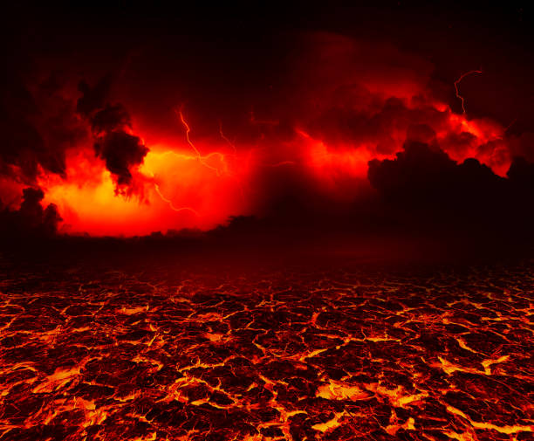
Revelation 20:14
Then death and Hades were thrown into the lake of fire.
The lake of fire is the second death.

