Slide 1
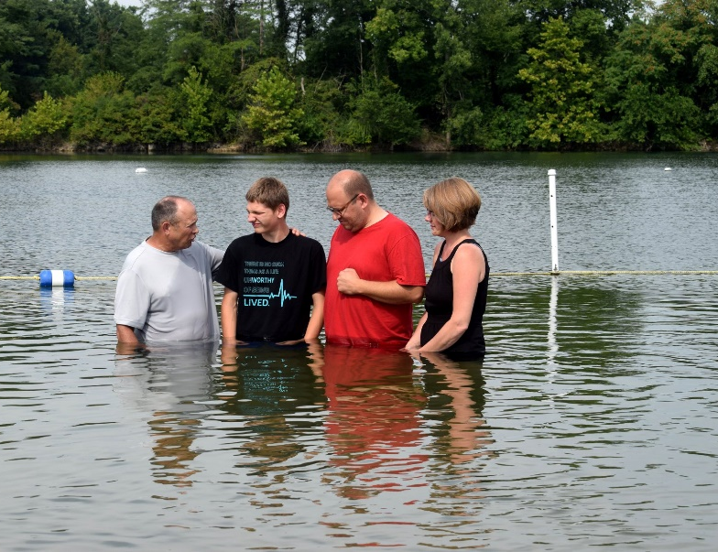
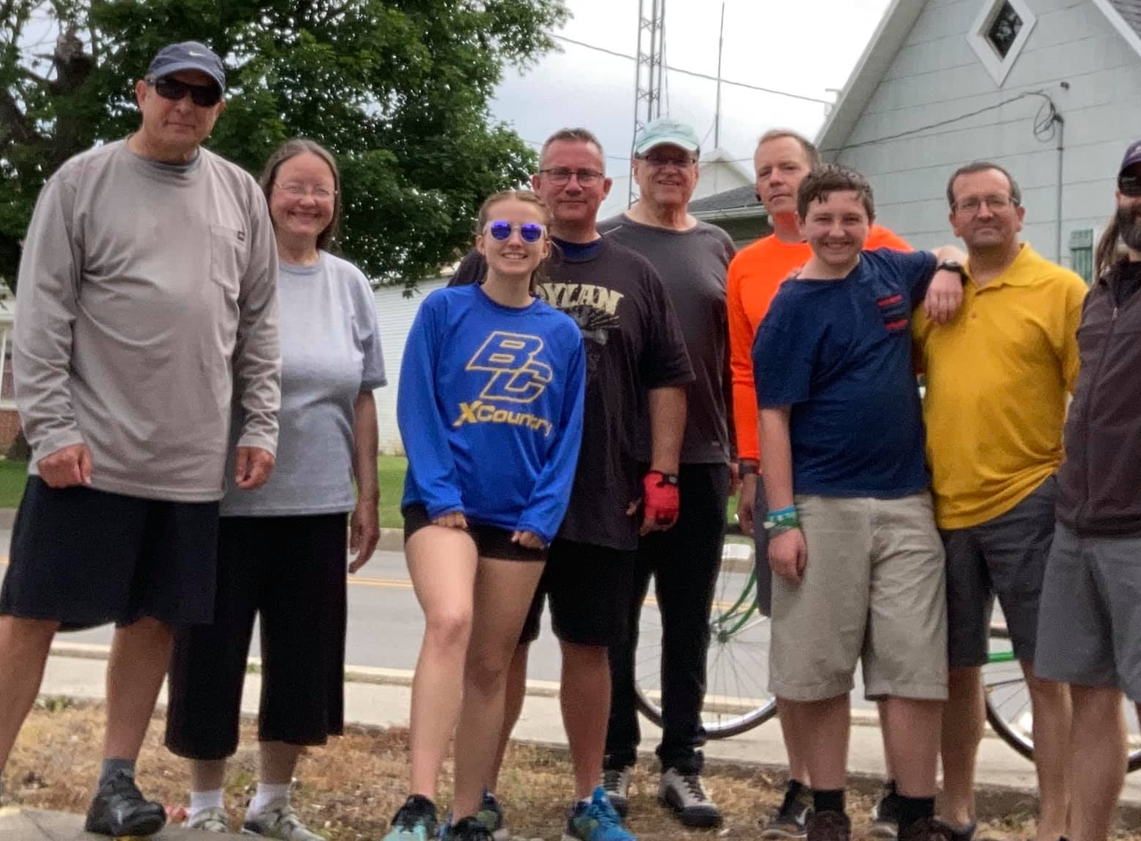
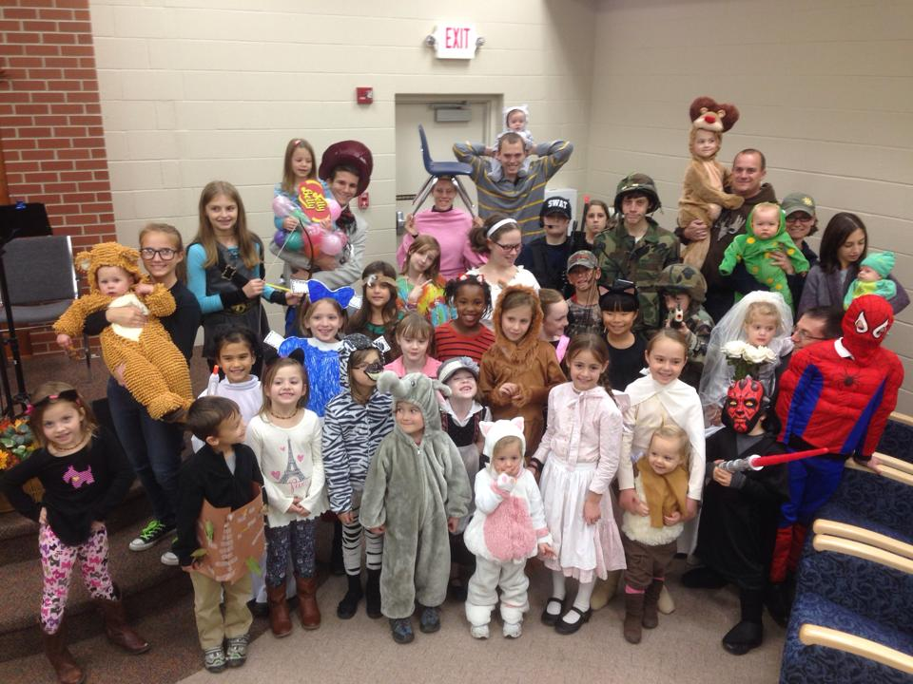
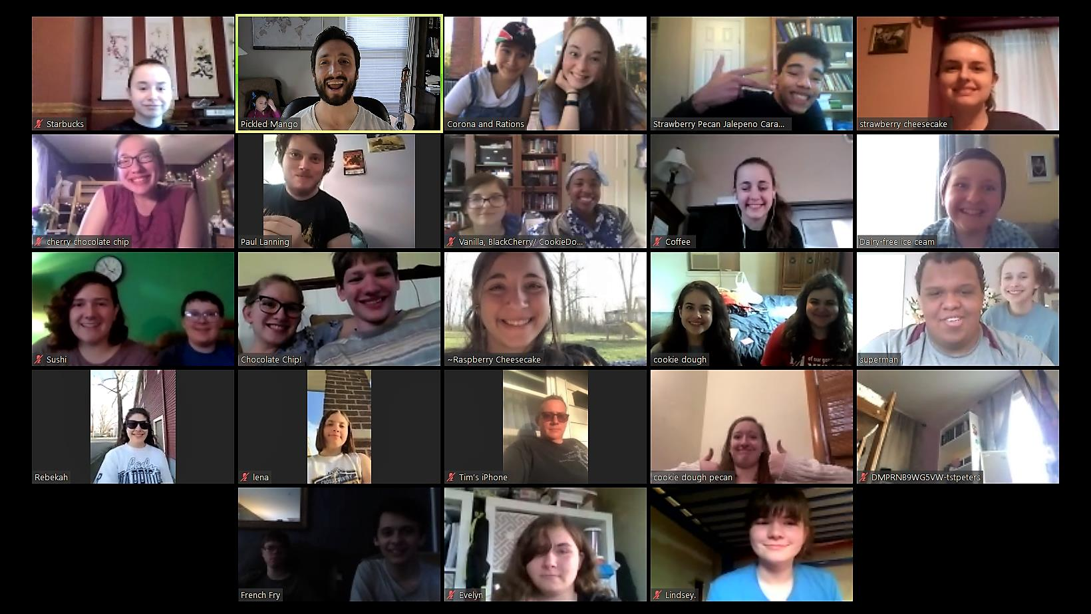
Prioritizing the Church

Slide 2
Matthew 12:49-50
And stretching out His hand toward His disciples, He said, “Behold My mother and My brothers! “For whoever does the will of My Father who is in heaven, he is My brother and sister and mother.”
Ephesians 1:5
He predestined us to adoption as sons through Jesus Christ to Himself, according to the kind intention of His will…
Galatians 3:26
For you are all sons of God through faith in Christ Jesus.
2 Corinthians 6:18
“And I will be a father to you, And you shall be sons and daughters to Me,” Says the Lord Almighty.
1 John 3:1
See how great a love the Father has bestowed on us, that we would be called children of God; and such we are. For this reason the world does not know us, because it did not know Him.

Slide 3
2 Corinthians 6:16
Or what agreement has the temple of God with idols? For we are the temple of the living God; just as God said, “I will dwell in them and walk among them; and I will be their God and they shall be my people.”
Ephesians 1:22-23
And He put all things in subjection under His feet and gave Him as head over all things to the church, which is His body, the fullness of Him who fills all in all.
1 Corinthians 12:12-27
…Now you are Christ’s body, and individually members of it…

Slide 4
Ephesians 5:31-32
For this reason, a man shall leave his father and his mother and shall be joined to his wife, and the two shall become one flesh. This mystery is great; but I am speaking with reference to Christ and the church.
John 15:5
“I am the vine, you are the branches; he who abides in Me and I in him, he bears much fruit, for apart from Me you can do nothing.”
1 Peter 2:4-8
And coming to Him as to a living stone which has been rejected by men, but is choice and precious in the sight of God, you also, as living stones, are being built up as a spiritual house for a holy priesthood, to offer up spiritual sacrifices acceptable to God through Jesus Christ…

Slide 5
Hebrews 3:6
But Christ was faithful as a Son over His house—whose house we are, if we hold fast our confidence and the boast of our hope firm until the end.
Hebrews 3:3
For He has been counted worthy of more glory than Moses, by just so much as the builder of the house has more honor than the house.

Slide 6
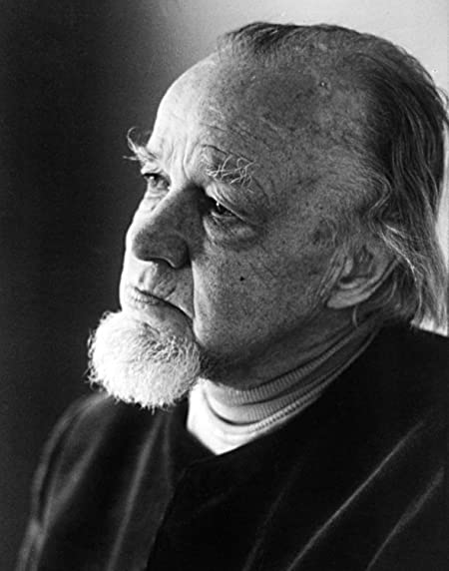
Francis Schaeffer
“The invisible church is the body of believers united by faith in Christ in the full biblical sense. This includes the church today, people who are alive today, who are currently at war and in exile in this present world, and those who have fought the good fight and are now in peace, waiting for the resurrection. The invisible church is the church universal; the church Jesus spoke of in Matthew 16:18 when he said, “I will build my church.” It’s also the church the author of Hebrews referred to in Hebrews 12:22 and 23, speaking of the unity of the body, of all believers, of all times and places.”

Slide 7
Acts 2:41-47

Slide 8
Acts 2:41-47
So those who received his word were baptized, and there were added that day about three thousand souls.
And they devoted themselves to the apostles' teaching and the fellowship, to the breaking of bread and the prayers. And awe came upon every soul, and many wonders and signs were being done through the apostles. And all who believed were together and had all things in common. And they were selling their possessions and belongings and distributing the proceeds to all, as any had need. And day by day, attending the temple together and breaking bread in their homes, they received their food with glad and generous hearts, praising God and having favor with all the people. And the Lord added to their number day by day those who were being saved.

Slide 9
Ephesians 2:3
Among them we too all formerly lived in the lusts of our flesh, indulging the desires of the flesh and of the mind, and were by nature children of wrath, even as the rest.

Slide 10
John 1:12-13
But as many as received Him, to them He gave the right to become children of God, even to those who believe in His name, who were born, not of blood nor of the will of the flesh nor of the will of man, but of God.

Slide 11
1 Timothy 3:15
I write so that you will know how one ought to conduct himself in the household of God, which is the church of the living God, the pillar and support of the truth.

Slide 12
Ephesians 1:3-7
Blessed be the God and Father of our Lord Jesus Christ, who has blessed us with every spiritual blessing in the heavenly places in Christ, just as He chose us in Him before the foundation of the world, that we would be holy and blameless before Him. In love He predestined us to adoption as sons through Jesus Christ to Himself, according to the kind intention of His will, to the praise of the glory of His grace, which He freely bestowed on us in the Beloved. In Him we have redemption through His blood, the forgiveness of our trespasses, according to the riches of His grace

Slide 13
Ephesians 1:9-10
God has now revealed to us his mysterious will regarding Christ—which is to fulfill his own good plan. And this is the plan: At the right time he will bring everything together under the authority of Christ—everything in heaven and on earth.

Slide 14
Ephesians 3:9-11
To me, the very least of all saints, this grace was given, to preach to the Gentiles the unfathomable riches of Christ, and to bring to light what is the administration of the mystery which for ages has been hidden in God who created all things; so that the manifold wisdom of God might now be made known through the church to the rulers and the authorities in the heavenly places. This was in accordance with the eternal purpose which He carried out in Christ Jesus our Lord…

Slide 15
Ephesians 3:20-21
Now to Him who is able to do far more abundantly beyond all that we ask or think, according to the power that works within us, to Him be the glory in the church and in Christ Jesus to all generations forever and ever. Amen.

Slide 17
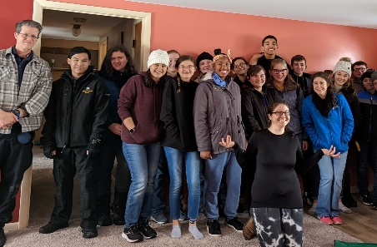
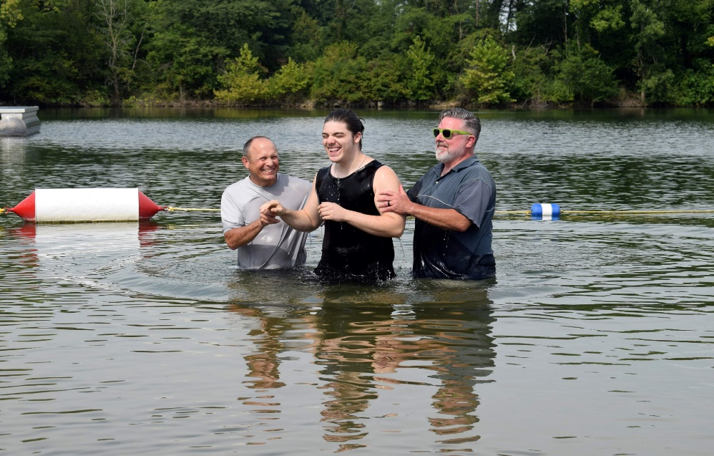
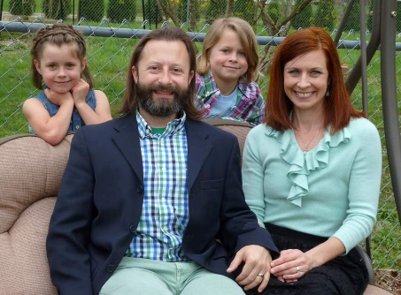
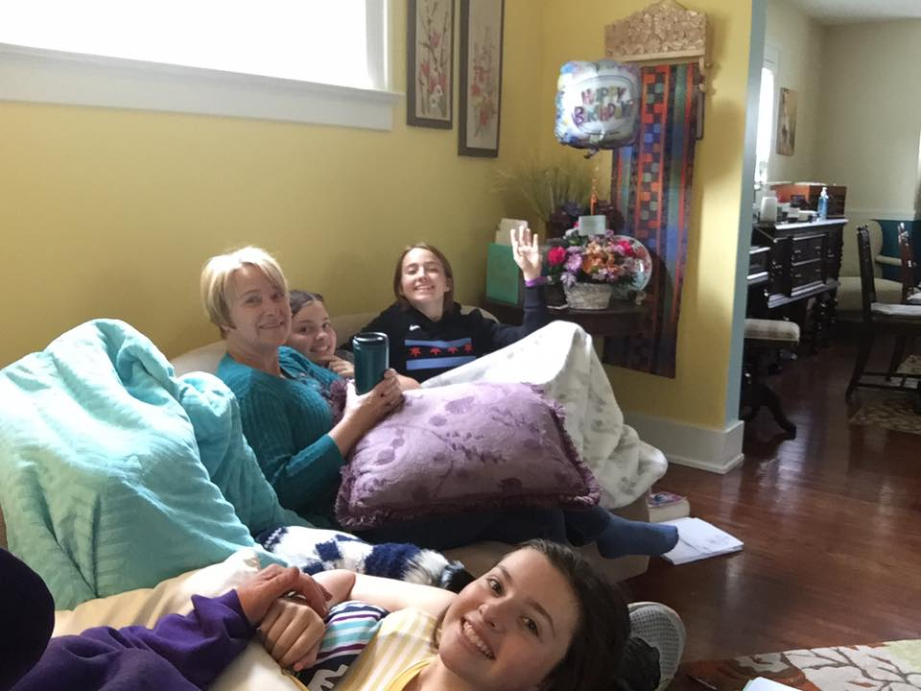
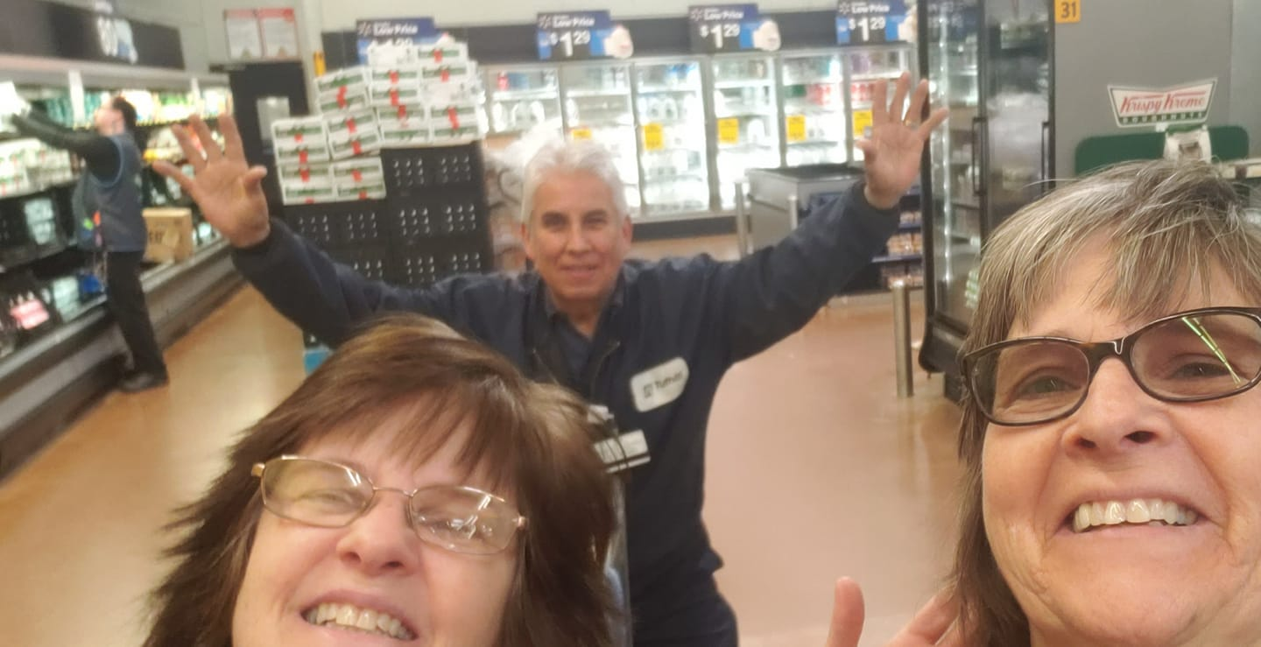
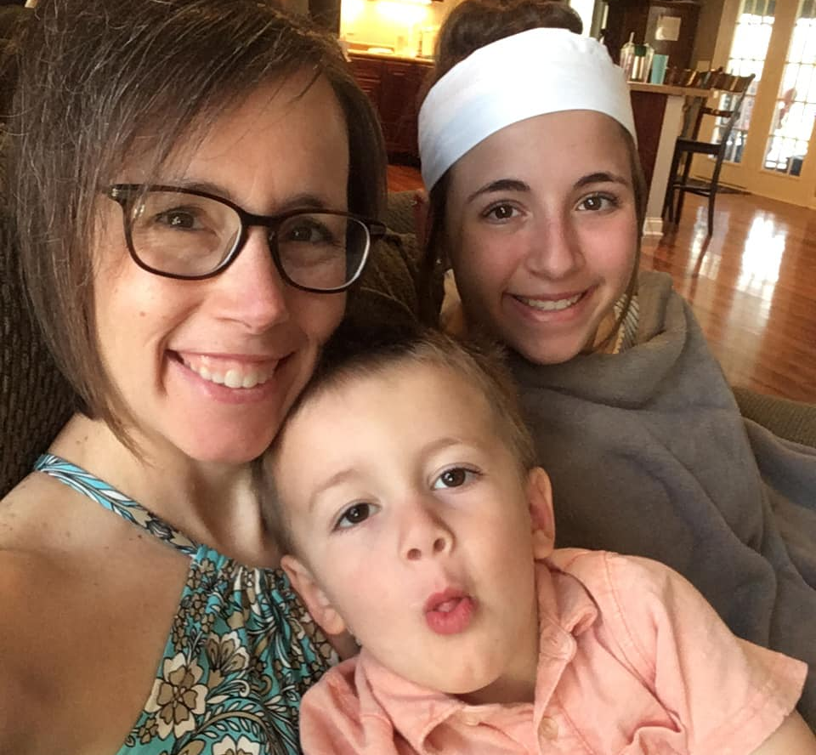

Slide 18
