Slide 1
• Preterism
• Historicism
• Futurism
• Idealism

Slide 2
• Preterism
- The prophecies were fulfilled in the first century
• Historicism
- The prophecies are being fulfilled through the course of history
• Futurism
- The prophecies will be fulfilled in the future
• Idealism
- The prophecies are not actually prophecies, but illustrations

Slide 4
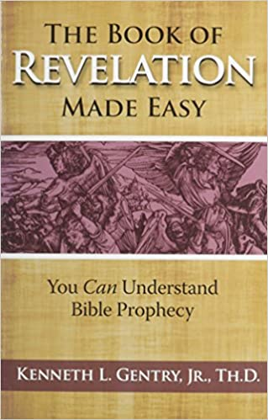

Slide 5
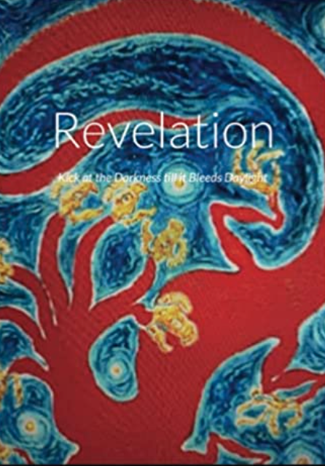

Slide 7
Revelation 8:7 The first angel sounded his trumpet, and there came hail and fire mixed with blood, and it was hurled down upon the earth. A third of the earth was burned up, a third of the trees were burned up, and all the green grass was burned up.

