Slide 1
Remember 9/11.

Slide 2
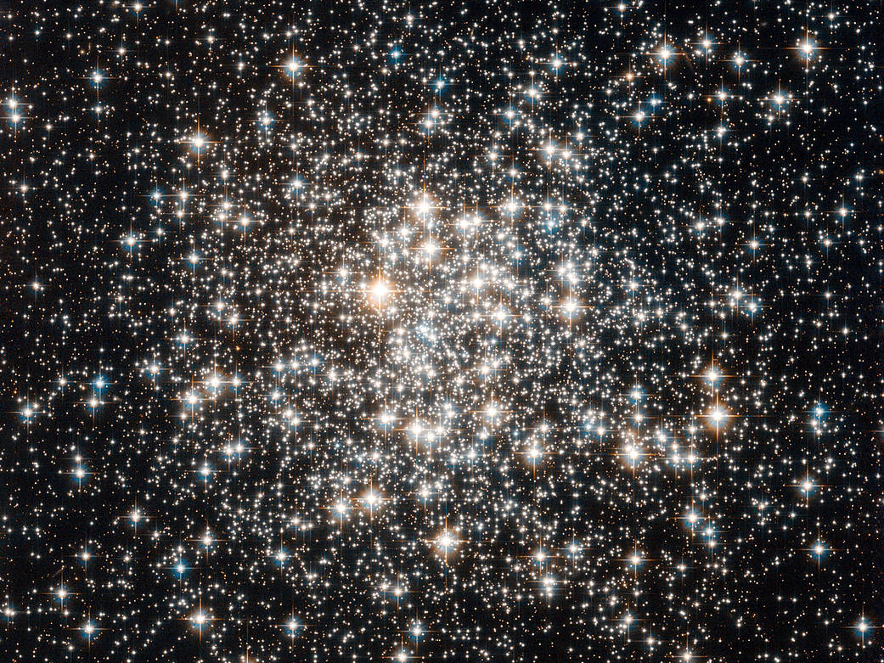
Why is the Universe Fine-Tuned for Life?

Slide 3
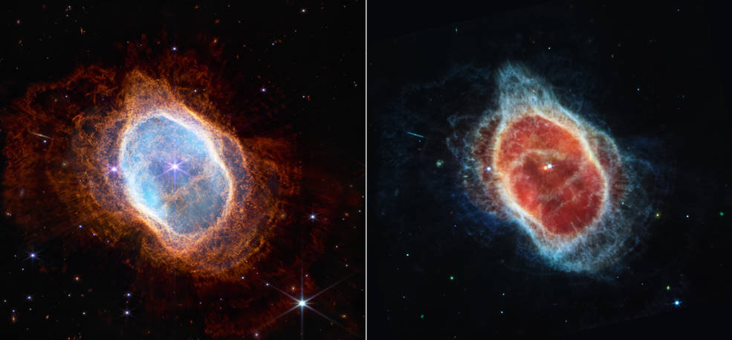
The creation has always pointed people to a creator.
First Images from the James Webb Space Telescope

Slide 4
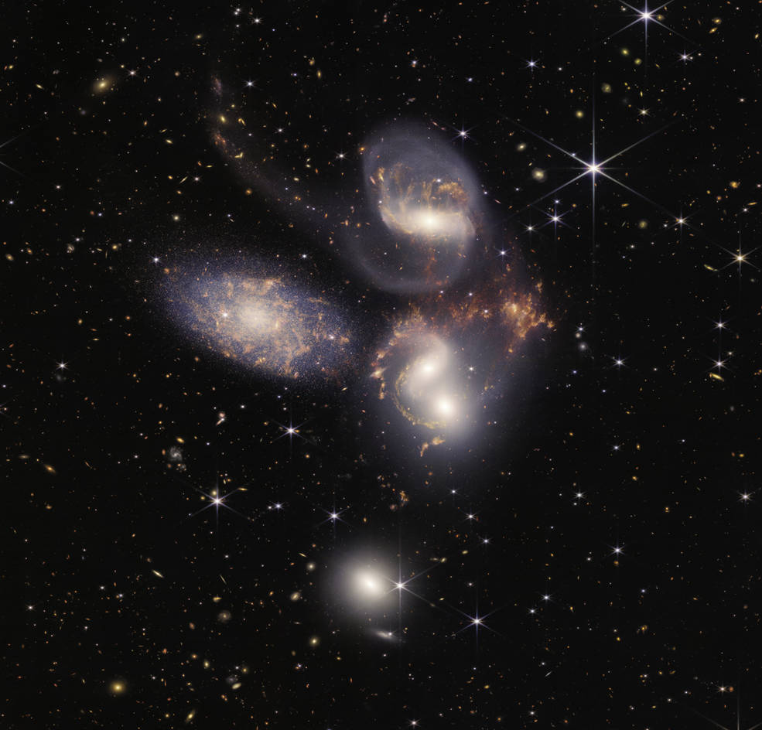
The creation has always pointed people to a creator. First Images from the James Webb Space Telescope

Slide 5
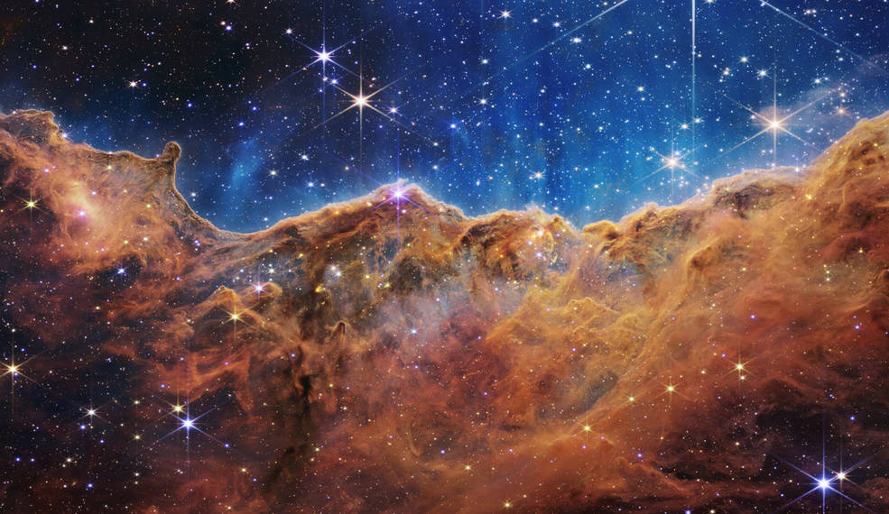
The creation has always pointed people to a creator. First Images from the James Webb Space Telescope

Slide 6
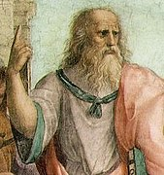
The creation has always pointed people to a creator.
… the order of the motion of the stars, and of all things under the dominion of the Mind which ordered the universe.
Laws 12.966e
… the order of the motion of the stars, and of all things [occur] under the dominion of the Mind which ordered the universe.
Laws 12.966e
Plato
~428-348 BC

Slide 7
The creation has always pointed people to a creator.
… the order of the motion of the stars, and of all things under the dominion of the Mind which ordered the universe.
Laws 12.966e
… thus when they would
suddenly gain sight of the earth, seas, and the sky… most certainly they would have judged both that there exists gods and that all these marvelous works are the handiwork of the gods.
On Philosophy
Aristotle
384-322 BC

Slide 8
Psalm 19 To the choirmaster. A Psalm of David.
¹ The heavens declare the glory of God,
and the sky above proclaims his handiwork.
² Day to day pours out speech,
and night to night reveals knowledge.
³ There is no speech, nor are there words,
whose voice is not heard.
⁴ Their voice goes out through all the earth,
and their words to the end of the world.
In them he has set a tent for the sun,
⁵ which comes out like a bridegroom leaving his chamber,
and, like a strong man, runs its course with joy.
⁶ Its rising is from the end of the heavens,
and its circuit to the end of them,
and there is nothing hidden from its heat.

Slide 9
The creation has always pointed people to a creator.
Romans 1:19 For what can be known about God is plain to them, because God has shown it to them. ²⁰ For his invisible attributes, namely, his eternal power and divine nature, have been clearly perceived, ever since the creation of the world, in the things that have been made. So they are without excuse.

Slide 10
Review: What is apologetics?
Apologetics is NOT _____.
Apologetics IS _____.
1 Peter 3:15 “… but in your hearts honor Christ the Lord as holy, always being prepared to make a defense to anyone who asks you for a reason for the hope that is in you; yet do it with gentleness and respect, …”

Slide 11
Why study apologetics?
To give answers to unbelievers.
To give answers to believers and to ourselves when we are weak and doubt.

Slide 12
The creation has always pointed people to a creator.
A modern argument for the presence of a Creator:
Ch.5 Why is the Universe Fine-Tuned for Life?

Slide 13
William Lane Craig
This is a high school book.
This is a college text.

Slide 14
Don’t get discouraged, philosophy is hard stuff…
WMC
… but not for everyone.
I checked this out of the church library when I was 16.

Slide 15
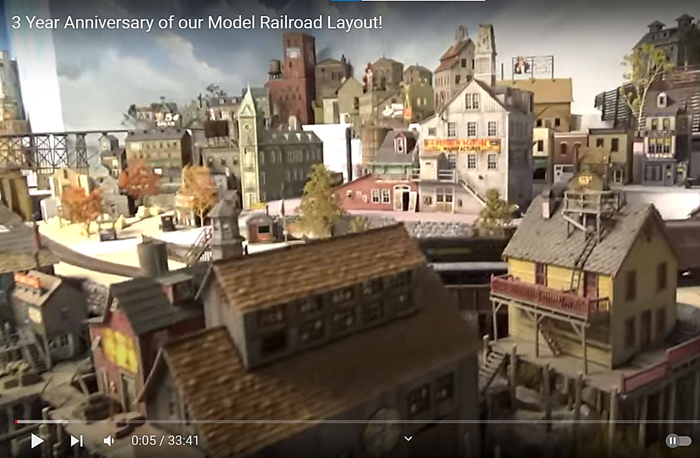
Modelling Nature

Slide 16
Modelling Nature
Observe nature.
Use mathematics to describe nature.
(Put the equations into a computer to simulate nature.)
F = G m₁m₂ / r²
Constant
Variables
m³
kg . sec²
G = 6.674×10⁻¹¹

Slide 17
Fine-Tuning
Fine-tuning – the constants and quantities of the universe must fall into an extraordinarily narrow range of values for the universe to be life permitting.
An example is the value for G.

Slide 18
Fine-Tuning
Fine-tuning – the constants and quantities of the universe must fall into an extraordinarily narrow range of values for the universe to be life permitting.
Quantities are amounts that the universe had at it’s beginning.
An example is the amount of entropy (disorder) in the universe at the Big Bang.

Slide 19
Fine-Tuning
Fine-tuning – the constants and quantities of the universe must fall into an extraordinarily narrow range of values for the universe to be life permitting.
If these constants and quantities were different by an extraordinarily small amount, then life would not exist in the universe.
One in a thousand chance is 1:1,000 = 1:10³
One in a million chance is 1:1,000,000 = 1:10⁶
One in a billion chance is 1:1,000,000,000 = 1:10⁹
A change in the constant G of 1:10¹⁰⁰ → No life
a change in the quantity of entropy of 1:10¹²⁰⁰ → No life
The term “fine-tuning” is neutral. It does not mean design.
“Life” means any life-form.

Slide 20
WHY is the universe fine tuned for life? The Fine-Tuning / Design / Teleological Argument
PRO
P1. The fine-tuning of the universe is due to either physical necessity, chance or design.
P2. It is not due to physical necessity or chance.
C. Therefore, it is due to design.

Slide 21
The Design Argument: P1
PRO
Physics says that the universe had to be life producing.
P1. The fine-tuning of the universe is due to either physical necessity, chance or design.
We just got lucky.
Our hypothesis. It was made by a designer (God)

Slide 22
The Design Argument: P1
PRO
P1. The fine-tuning of the universe is due to either physical necessity, chance or design.
This is true.
Fine-tuning is well accepted by the scientists who study this area.
Fine-tuning is a scientific fact.

Slide 23
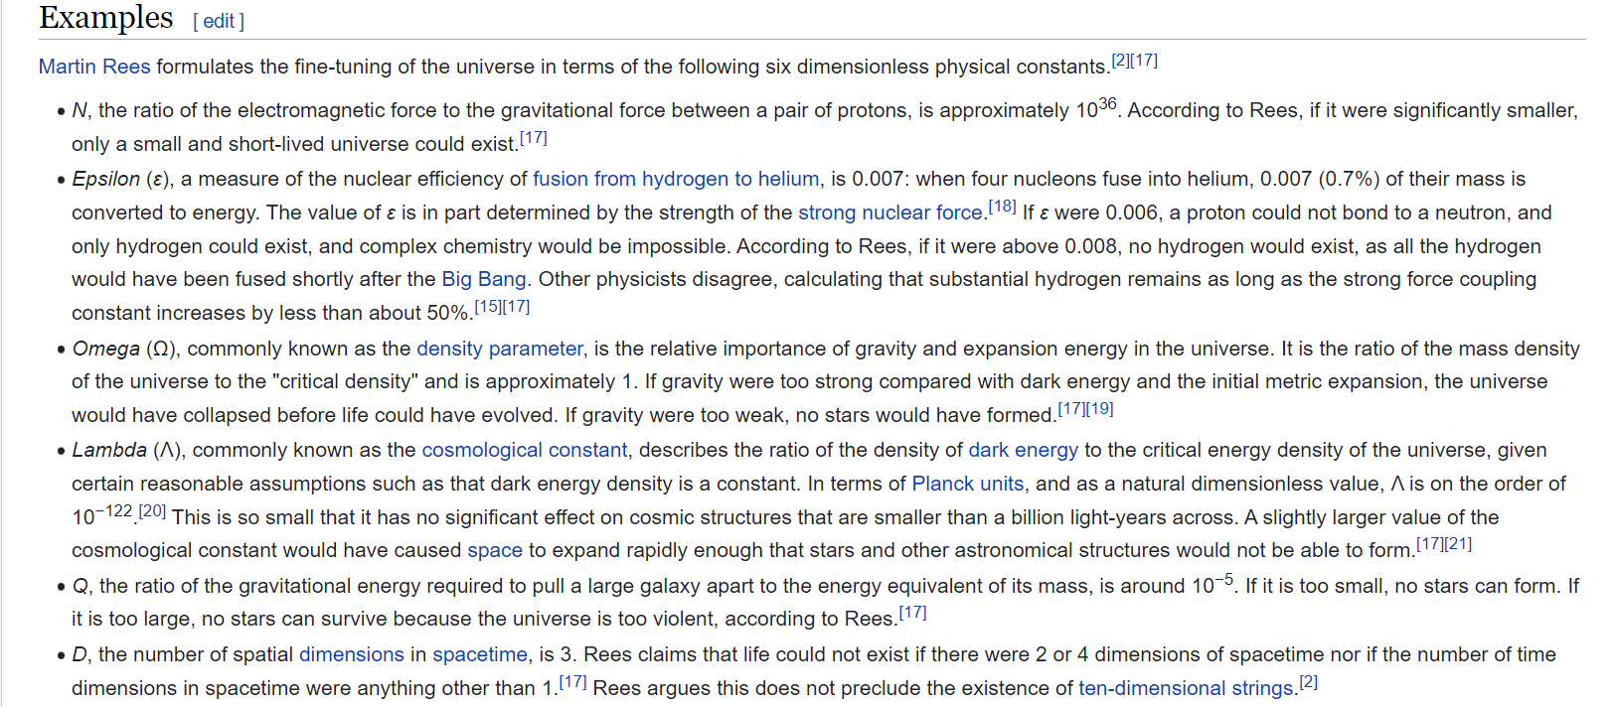
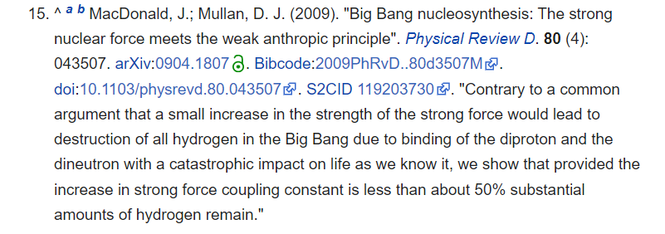
Examples of fine-tuned universe (from the Wikipedia page)

Slide 24
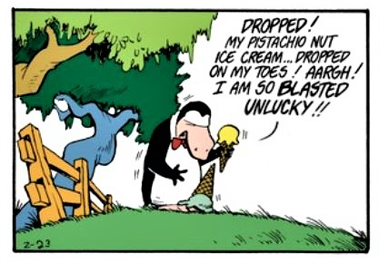
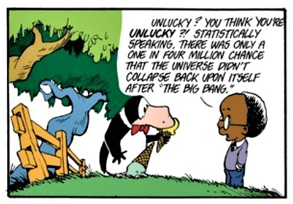
Oliver Wendell Jones

Slide 25
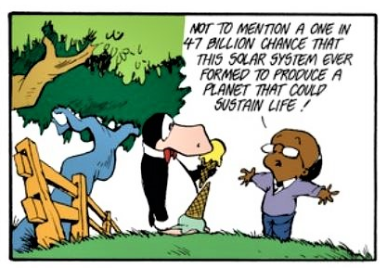
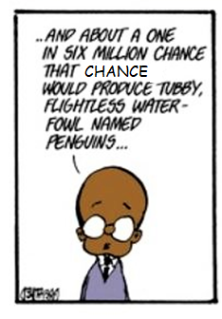
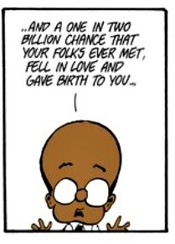
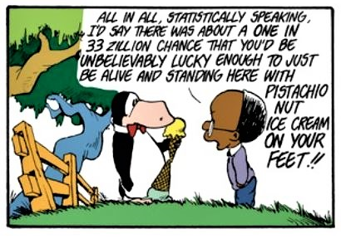
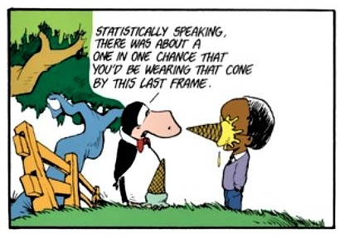

Slide 26
The Design Argument: P1
PRO
P1. The fine-tuning of the universe is due to either physical necessity, chance or design.
Fine-tuning is a scientific fact.
These are the only options for explaining fine-tuning.

Slide 27
The Design Argument: P2
PRO
P2. It (fine tuning) is not due to physical necessity or chance.
This claim says that the universe had to be life permitting.
Not physical necessity.
But, the constants and quantities are independent of nature’s laws.
There could exist universes with the same laws of physics, but with different constants that would not permit life.

Slide 28
The Design Argument: P2
PRO
CON
P2. It (fine tuning) is not due to physical necessity or chance.
Not physical necessity.
The constants and quantities are independent of nature’s laws.
A TOE will explain everything.

Slide 29
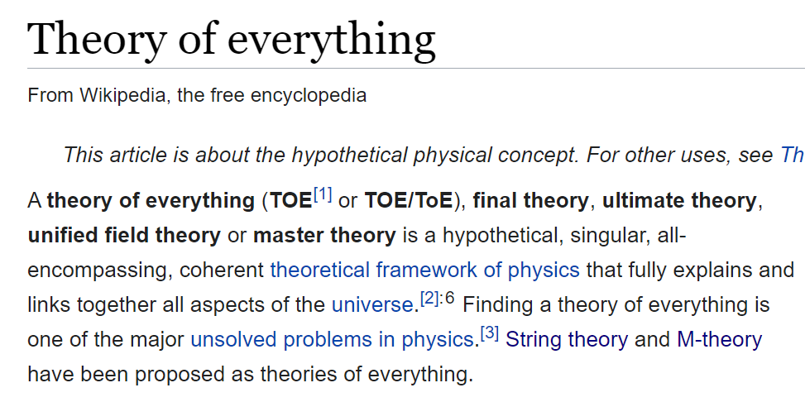

Slide 30
The Design Argument: P2
PRO
CON
P2. It (fine tuning) is not due to physical necessity or chance.
Not physical necessity.
Constants and quantities are independent of nature’s laws.
A TOE will explain everything.
A TOE “only” tries to unify gravity with quantum mechanics (which unites:
the strong nuclear force,
the weak nuclear force, and electromagnetism.
A TOE doesn’t explain everything.

Slide 31
The Design Argument: P2
PRO
CON
P2. It (fine tuning) is not due to physical necessity or chance.
Not physical necessity.
Constants and quantities are independent of nature’s laws.
A TOE will explain everything.
A TOE doesn’t explain everything.
It actually predicts 10⁵⁰⁰ possible universes and the probability of a life-permitting one is exceedingly small.
M-theory does not predict ONLY a life-permitting universe.

Slide 32
The Design Argument: P2
PRO
P2. It (fine tuning) is not due to physical necessity or chance.
The probability of a life-supporting universe popping into existence out of chance are exceedingly small.
Not physical necessity.
Not chance.
Many are pushing this one to avoid the design inference.

Slide 33
The Design Argument: P2
PRO
CON
P2. It (fine tuning) is not due to physical necessity or chance.
Some universe must exist, no matter how improbable. We’re here!
Not chance.
But whichever universe exists, it will probably not be life-permitting.
Anthropic principle: We can observe only life-permitting universes, so no explanation is needed.
This truism does not remove the need for an explanation.
Many worlds/multiverse hypothesis. *An infinite number of unobservable universes exist.*
A multiverse still requires fine-tuning.
There are good reasons to reject the multiverse

Slide 34
The Design Argument: P2
PRO
CON
P2. It (fine tuning) is not due to physical necessity or chance.
Many worlds hypothesis. (We live in a multiverse)
Not chance.
There are good reasons to reject the multiverse
The multiverse is finite. Time is not infinite.
Invasion of the Boltzmann brains.

Slide 35
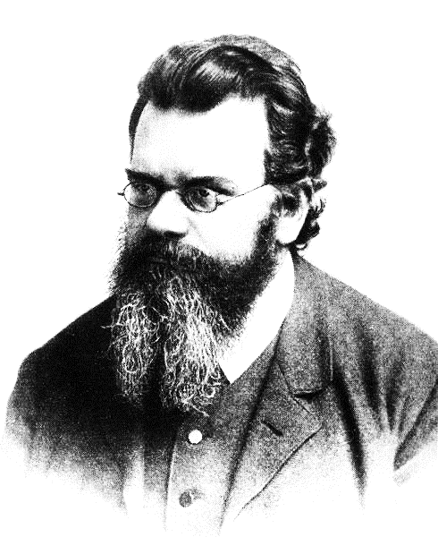
The Boltzmann brain thought experiment
… the order of the motion of the stars, and of all things under the dominion of the Mind which ordered the universe.
Laws 12.966e
It might be more likely for a single brain to spontaneously form in a void (complete with a memory of having existed in our universe) rather than for the entire universe to come about.
Ludwig Boltzmann
1844 - 1906

Slide 36
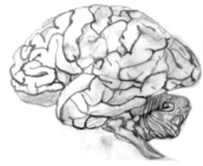
Boltzmann Brains
… the order of the motion of the stars, and of all things under the dominion of the Mind which ordered the universe.
Laws 12.966e
I exist and have the illusion of a complete universe

Slide 37
The Design Argument: C
PRO
CON
C. Therefore, it is due to design.
This follows from P1 and P2.
Who designed the Designer?
To recognize an explanation as the best, you don’t need an explanation of the explanation.
Mind is simpler than the universe.

Slide 38
The Design Argument
PRO
P1. The fine-tuning of the universe is due to either physical necessity, chance or design.
These are the only options.
Physical necessity: The universe doesn’t have to be life permitting.
P2. It is not due to physical necessity or chance.
Chance: The probabilities are too low for chance.
C. Therefore, it is due to design.
This follows logically.

Slide 39
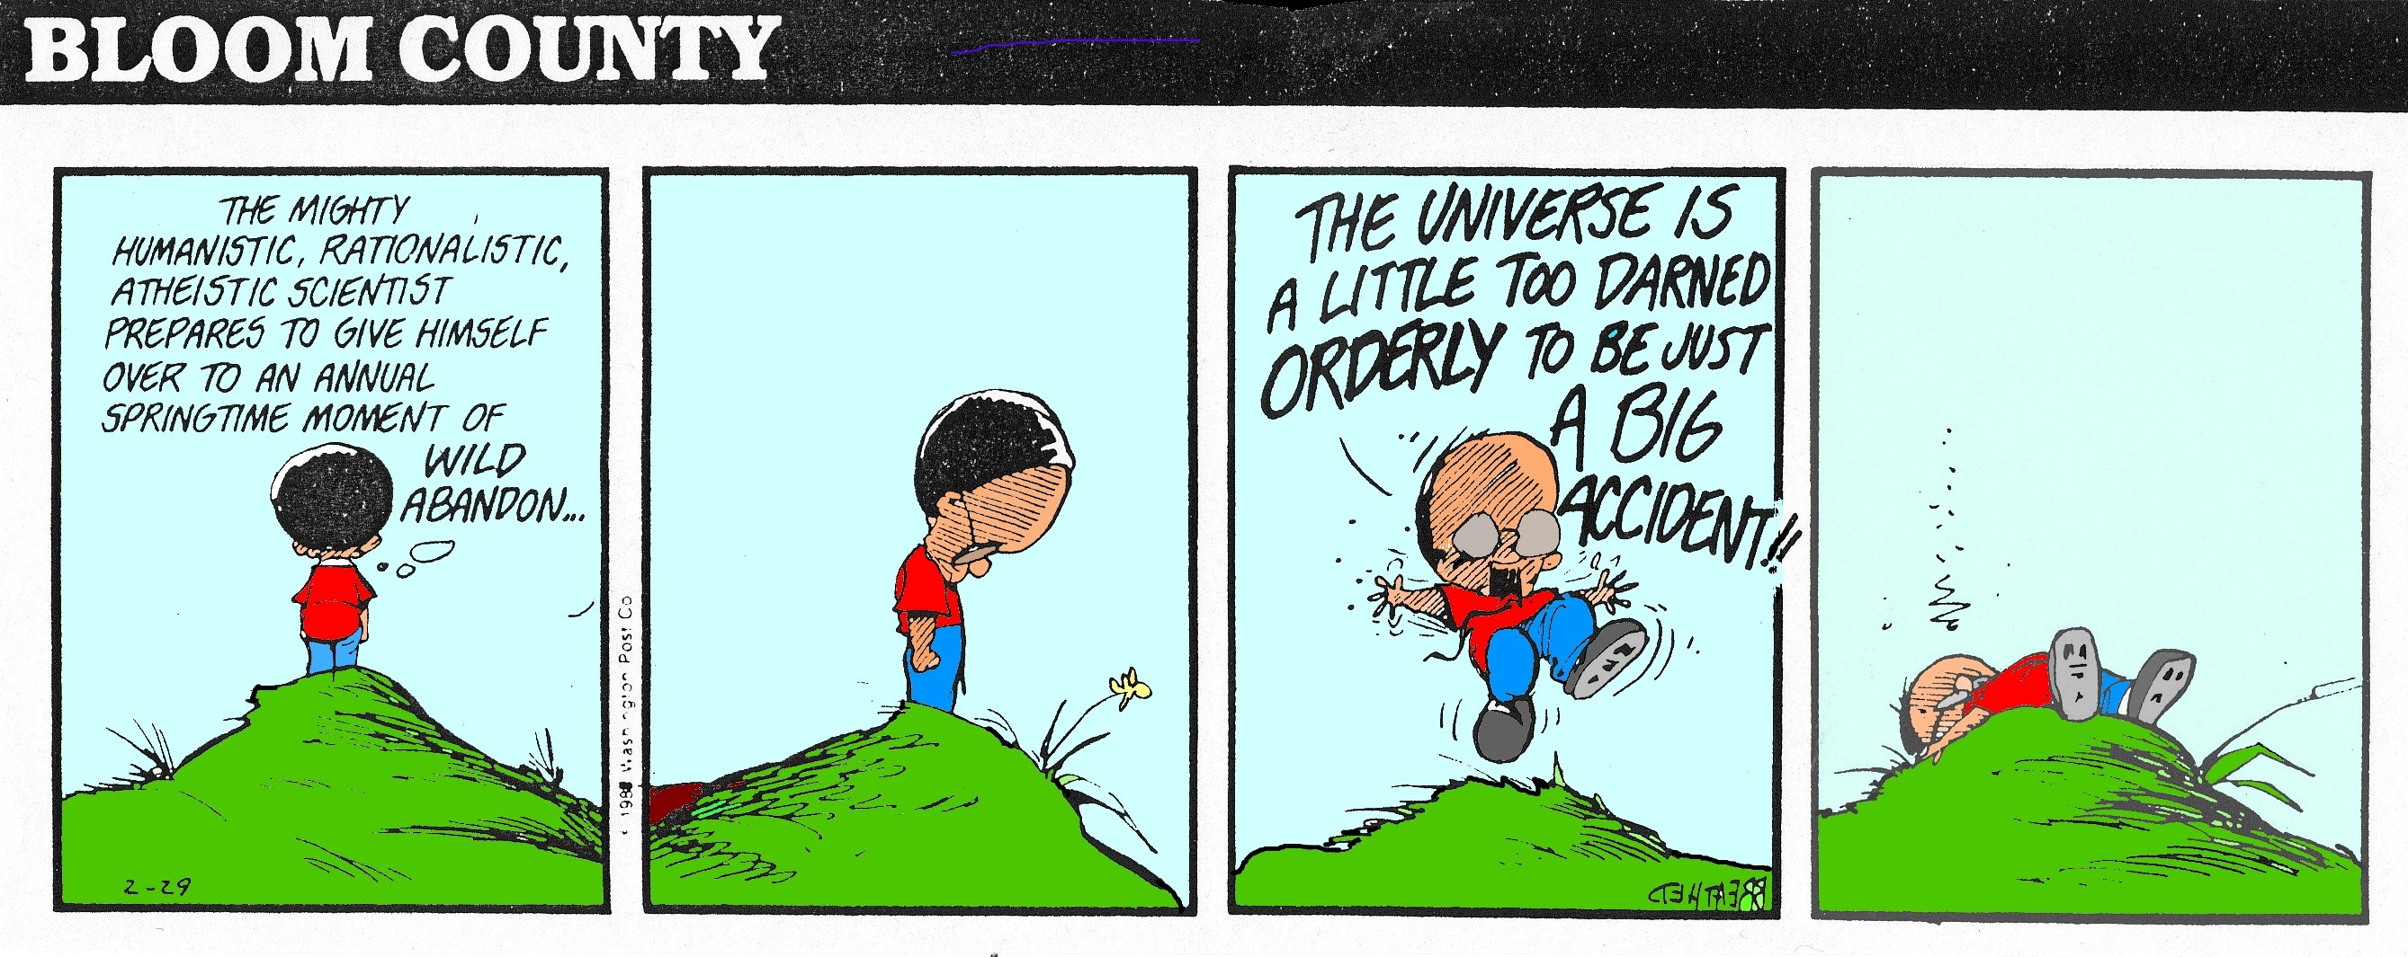
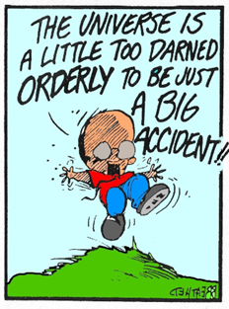
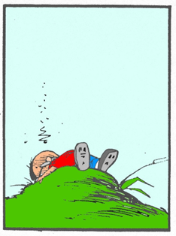

Slide 40
The Fine-Tuning of the Universe https://www.youtube.com/watch?v=EE76nwimuT0

Slide 41
A few comments last comments
Don’t think that you have to convert someone in your first conversation.
John 4:36 Already the one who reaps is receiving wages and gathering fruit for eternal life, so that sower and reaper may rejoice together. ³⁷ For here the saying holds true, ‘One sows and another reaps.’ ³⁸ I sent you to reap that for which you did not labor. Others have labored, and you have entered into their labor.”
Pick an argument that you like.
As Greg Koukl says, our job is to “put a pebble in their shoe.”
Greg Koukl also says “Bloom where you are planted.”

Slide 42
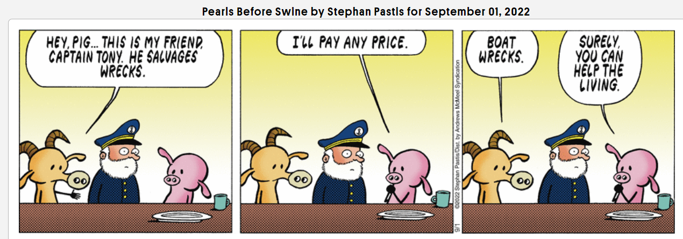
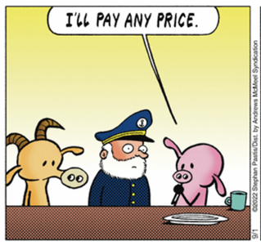
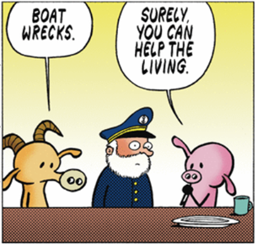
Where am I planted?

