Slide 1
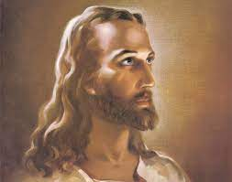
Who did Christ Claim to be?
Chapter 8

Slide 2
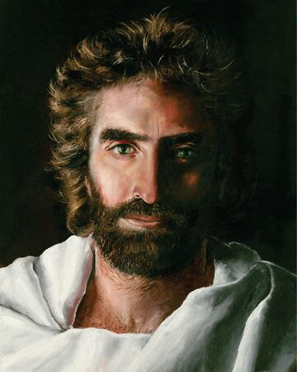
Three Claims:
Messiah
Son of God
Son of Man

Slide 3
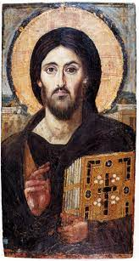
Jesus’ Authority:
His Teachings
His Use of the Phrase “Truly I Say Unto You
Casting out Demons
His Claim to Forgive Sins

Slide 4
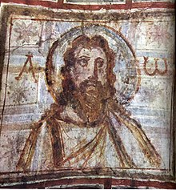
Also:
Jesus’ Miracles
Raising the Dead
Accepts Worship
Jesus’ Role as Judge
Belief in Christ Essential
to Salvation

Slide 5
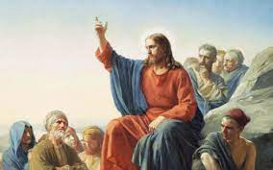
Conclusions:
Jesus’ Radical Self-Concept:
Clearly Deity (Messiah, God’s only Son, and the Son of Man spoken of in Daniel).
Divine Authority, Exorcist, Forgave Sins, Miracle Worker, Raising the Dead, and Accepted Worship.
Judge and Salvation Giver.

Slide 6
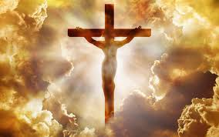

Slide 7
Ransom Theory
The Ransom Theory of the Atonement is one of the first major theories. It finds its roots in the early church, particularly with Origen from the 3rd Century. This theory essentially teaches that Jesus died as a ransom sacrifice, paid either to Satan or to God the Father.

Slide 8
Moral Influence Theory
Christ death is seen more as a ramification of His moral life. In this view, the purpose and result of Christ's death was to influence mankind toward moral improvement. This theory denies that Christ died to satisfy any principle of divine justice, but teaches instead, that His death was designed to impress mankind with a sense of God's love, resulting in softening their hearts and leading them to repentance.

Slide 9
Christus Victor
This was the dominant view up until the 12th Century. In this view, folks like Irenaeus and Athanasius, saw Jesus’ act of dying on the cross as a triumphant victor who redeems us from slavery, ransoms us from evil, revives, restores, and reconciles us. By defeating the evil powers that oppose God, Jesus rescued his people from Satan and established himself as the rightful king.

Slide 10
Satisfaction Theory
In this theory, Christ’s death is understood as a death to satisfy the justice of God. Satisfaction here means restitution, the mending of what was broken, and the paying back of a debt. In this theory, Anselm emphasizes the justice of God and claims that sin is an injustice that must be balanced. Anslem’s satisfaction theory says essentially that Christ died in order to pay back the injustice of human sin and to satisfy the justice of God.

Slide 11
Penal Substitution Theory
They added a more legal framework into this notion of the cross as satisfaction in that Jesus dies to satisfy God’s wrath against human sin. Jesus is punished in the place of sinners in order to satisfy the justice of God and the legal demand of God to punish sin. In light of Christ’s death, God can now forgive the sinner because Jesus has been punished in the place of the sinner. Contrasting this with Anselm’s theory, the reformers felt that God is not satisfied with a debt just being paid, but that God is satisfied with punishing Jesus in the place of mankind.

Slide 12
Salvation as a Process
We are justified the moment we repent and put faith in Christ’s atoning work and are filled with the Spirit.
Then we are sanctified day by day as we are being delivered from the power of sin, growing, working out our salvation with fear and trembling, and being led to become more like Jesus.
And, finally glorification comes in the future after death.

Slide 13
Some Essentials
There is one triune God (3 persons/one essence) who created all things
Christ became incarnate by the Holy Spirit and the Virgin Mary
Christ was crucified, buried, and rose again on the third day
He ascended to Heaven and sits at the right hand of the Father
He will come again in glory to judge the living and the dead

Slide 14
What About?
Deathbed Conversions
Different Expectations between Elders/Teachers and non-elders/teachers
OT Believers vs. Early NT Believers vs. Us Today
Babies, Children, and the Disabled
Those Who’ve Never Heard

Slide 15
Isaiah 7:16
¹⁶ for before the boy knows enough to reject the wrong and choose the right, the land of the two kings you dread will be laid waste.

Slide 16
John 9
³⁹ Jesus said, “For judgment I have come into this world, so that the blind will see and those who see will become blind.”
⁴⁰ Some Pharisees who were with him heard him say this and asked, “What? Are we blind too?”
⁴¹ Jesus said, “If you were blind, you would not be guilty of sin; but now that you claim you can see, your guilt remains.

Slide 17
What about those who’ve never heard?

Slide 18
1 Corinthians 9:16
“Woe to me if I do not preach the Gospel”.

