Slide 1
EUTHANASIA AND ASSISTED SUICIDE
What Is Real Compassion in the Face of Suffering?

Slide 2
EUTHANASIA & ASSISTED SUICIDE
What is real compassion in the face of suffering?
EUTHANASIA (Greek, “Good Death”)

Slide 3
EUTHANASIA & ASSISTED SUICIDE
What is real compassion in the face of suffering?
EUTHANASIA (Greek, “Good Death”)
Active Euthanasia – direct & intentional efforts (generally by a doctor) to actively help a patient kill himself.

Slide 4
EUTHANASIA & ASSISTED SUICIDE
What is real compassion in the face of suffering?
EUTHANASIA (Greek, “Good Death”)
Active Euthanasia – direct & intentional efforts (generally by a doctor) to actively help a patient kill himself.
Passive Euthanasia – terminating treatment already initiated or withholding treatment causing the patient to die.

Slide 5
EUTHANASIA & ASSISTED SUICIDE
What is real compassion in the face of suffering?
EUTHANASIA (Greek, “Good Death”)
Active Euthanasia – direct & intentional efforts (generally by a doctor) to actively help a patient kill himself.
Passive Euthanasia – terminating treatment already initiated or withholding treatment causing the patient to die.
Involuntary Euthanasia – killing without consent.

Slide 6
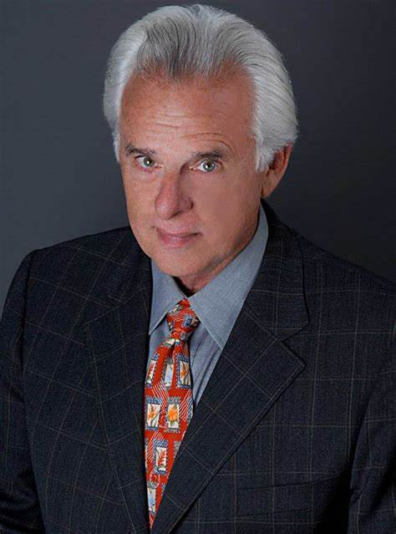
EUTHANASIA & ASSISTED SUICIDE
What is real compassion in the face of suffering?
EUTHANASIA (Greek, “Good Death”)
“The practical distinctions between euthanasia and assisted suicide are about as substantial as the differences between the actions of the left and the right leg in walking: one step naturally follows the other.”
– Wesley J. Smith

Slide 7
EUTHANASIA & ASSISTED SUICIDE
What is real compassion in the face of suffering?
EUTHANASIA (Greek, “Good Death”)
ABORTION
“Product of Conception”
“Women’s Rights”
“Choice”
“Reproductive Justice”

Slide 8
EUTHANASIA & ASSISTED SUICIDE
What is real compassion in the face of suffering?
EUTHANASIA (Greek, “Good Death”)
ABORTION
EUTHANASIA
“Product of Conception”
“Women’s Rights”
“Choice”
“Reproductive Justice”
“Right To Die”
“Death with Dignity”
“Mercy Killing”
“Happy Release”

Slide 9
EUTHANASIA & ASSISTED SUICIDE
What is real compassion in the face of suffering?
THE SLIPPERY SLOPE OF LEGALIZED KILLING:

Slide 10
EUTHANASIA & ASSISTED SUICIDE
What is real compassion in the face of suffering?
THE SLIPPERY SLOPE OF LEGALIZED KILLING:
Iowa state legislature introduces bill to legalize euthanasia for “terminally ill adults” and for “hideously deformed or idiotic children.”
1905-1906

Slide 11
EUTHANASIA & ASSISTED SUICIDE
What is real compassion in the face of suffering?
THE SLIPPERY SLOPE OF LEGALIZED KILLING:
1973

Slide 12
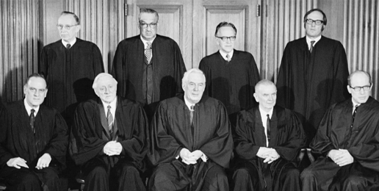
EUTHANASIA & ASSISTED SUICIDE
What is real compassion in the face of suffering?
THE SLIPPERY SLOPE OF LEGALIZED KILLING:
Roe v. Wade
1973

Slide 13
EUTHANASIA & ASSISTED SUICIDE
What is real compassion in the face of suffering?
THE SLIPPERY SLOPE OF LEGALIZED KILLING:
“CALIFORNIA NATURAL DEATH ACT”
California becomes first state to grant “terminally ill” persons the “right to die.”
1976

Slide 14
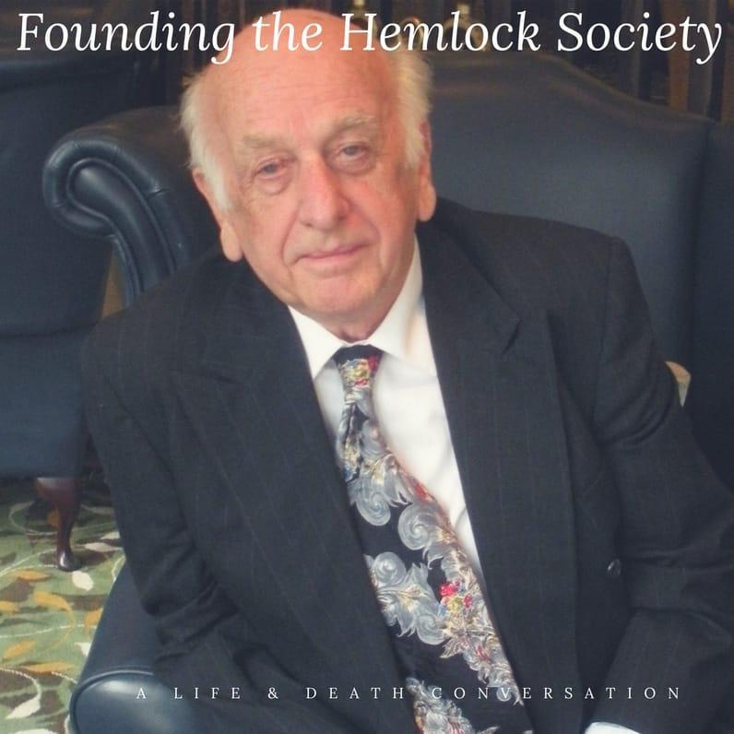
EUTHANASIA & ASSISTED SUICIDE
What is real compassion in the face of suffering?
THE SLIPPERY SLOPE OF LEGALIZED KILLING:
1980

Slide 15
EUTHANASIA & ASSISTED SUICIDE
What is real compassion in the face of suffering?
THE SLIPPERY SLOPE OF LEGALIZED KILLING:
“Killing a defective infant is not morally equivalent to killing a person. Sometimes it is not wrong at all.”
1980
Peter Singer

Slide 16
EUTHANASIA & ASSISTED SUICIDE
What is real compassion in the face of suffering?
THE SLIPPERY SLOPE OF LEGALIZED KILLING:
“My ultimate aim is to make euthanasia a positive experience.”
1989
Jack Kevorkian

Slide 17
EUTHANASIA & ASSISTED SUICIDE
What is real compassion in the face of suffering?
THE SLIPPERY SLOPE OF LEGALIZED KILLING:
1990-2005
Terri Schiavo

Slide 18
EUTHANASIA & ASSISTED SUICIDE
What is real compassion in the face of suffering?
THE SLIPPERY SLOPE OF LEGALIZED KILLING:
2010

Slide 19
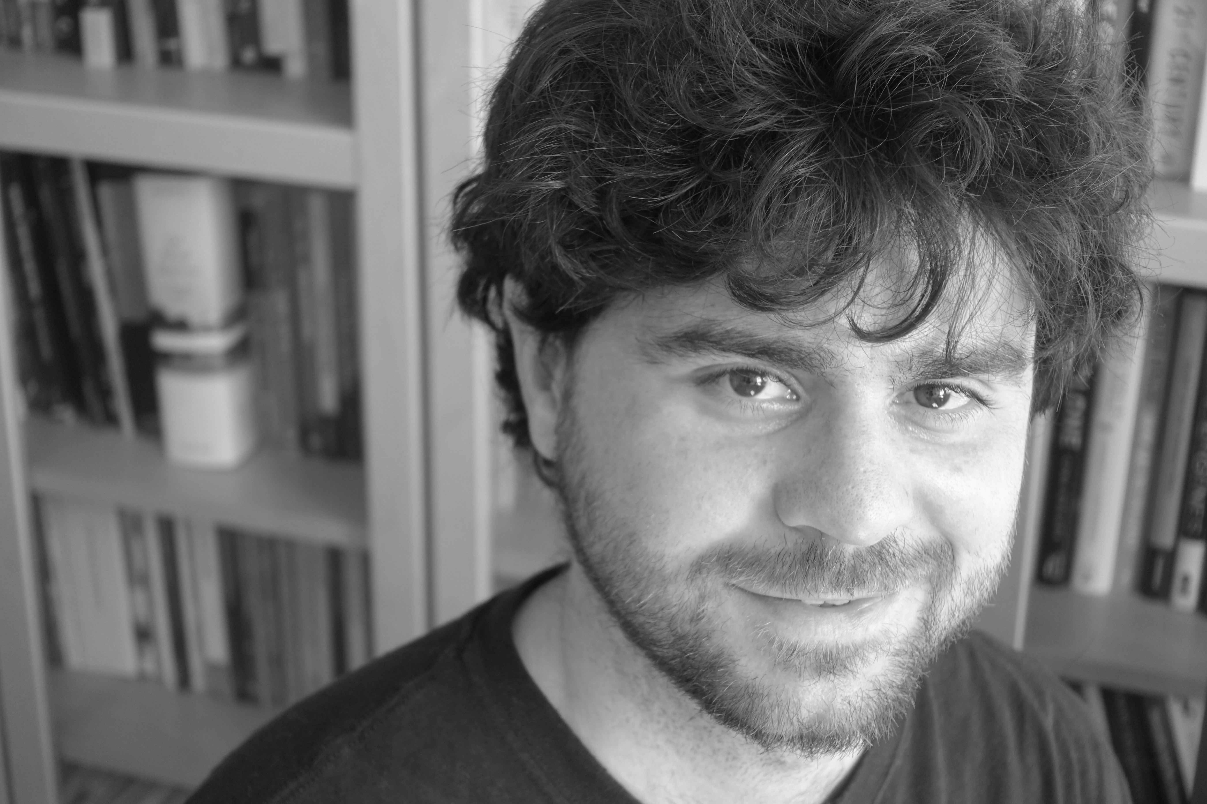
EUTHANASIA & ASSISTED SUICIDE
What is real compassion in the face of suffering?
THE SLIPPERY SLOPE OF LEGALIZED KILLING:
“We argue that, when circumstances occur after birth such that they would have justified abortion, what we call ‘after-birth abortion’ should be permissible.”
2013
– Alberto Giubilini & Francesca Minerva, After-Birth Abortion: Why Should The Baby Live?

Slide 20
EUTHANASIA & ASSISTED SUICIDE
What is real compassion in the face of suffering?
THE SLIPPERY SLOPE OF LEGALIZED KILLING:
2016

Slide 21
EUTHANASIA & ASSISTED SUICIDE
What is real compassion in the face of suffering?
THE SLIPPERY SLOPE OF LEGALIZED KILLING:
Gallup: 72% of Americans believe doctors should be able to help terminally ill patients die.
2018

Slide 22
EUTHANASIA & ASSISTED SUICIDE
What is real compassion in the face of suffering?
THE SLIPPERY SLOPE OF LEGALIZED KILLING:
2022
Physician assisted suicide now legal in in 9 states and in Washington D.C.

Slide 23
EUTHANASIA & ASSISTED SUICIDE
What is real compassion in the face of suffering?
THE SLIPPERY SLOPE OF LEGALIZED KILLING:
Ultimately, suicide activists are not fighting merely for the “right to die;” they’re fighting for the doctors’ right to kill.

Slide 24
EUTHANASIA & ASSISTED SUICIDE
What is real compassion in the face of suffering?
THE SLIPPERY SLOPE OF LEGALIZED KILLING:
“In the last 30 yrs. Dutch doctors have expanded euthanasia practice exponentially, going from killing the terminally ill who ask for it, to killing the chronically ill who ask for it, to killing the depressed who have no physical illness who ask for it, to killing newborn babies in their cribs because they have birth defects, even though they cannot possibly ask for it.”
– Wesley J. Smith

Slide 25
EUTHANASIA & ASSISTED SUICIDE
What is real compassion in the face of suffering?
ARGUMENTS FOR EUTHANASIA REST ON FIVE MISGUIDED MOTIVATIONS:

Slide 26
EUTHANASIA & ASSISTED SUICIDE
What is real compassion in the face of suffering?
ARGUMENTS FOR EUTHANASIA REST ON FIVE MISGUIDED MOTIVATIONS:
A belief that personal autonomy/independence is supreme.

Slide 27
EUTHANASIA & ASSISTED SUICIDE
What is real compassion in the face of suffering?
ARGUMENTS FOR EUTHANASIA REST ON FIVE MISGUIDED MOTIVATIONS:
A belief that personal autonomy/independence is supreme.

Slide 28
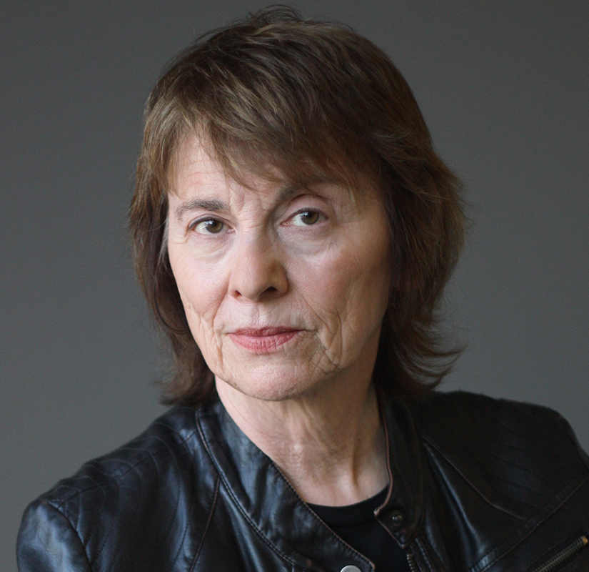
EUTHANASIA & ASSISTED SUICIDE
What is real compassion in the face of suffering?
ARGUMENTS FOR EUTHANASIA REST ON FIVE MISGUIDED MOTIVATIONS:
A belief that personal autonomy/independence is supreme.
“Fate, not God, has given us this flesh. We have absolute claims to our bodies and may do with them as we see fit.”
Camille Paglia

Slide 29
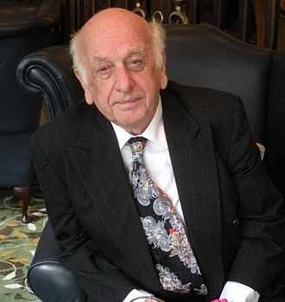
EUTHANASIA & ASSISTED SUICIDE
What is real compassion in the face of suffering?
ARGUMENTS FOR EUTHANASIA REST ON FIVE MISGUIDED MOTIVATIONS:
A belief that personal autonomy/independence is supreme.
"The right to choose to die when in advanced terminal or hopeless illness is the ultimate civil liberty."
Derek Humphry,
Final Exit

Slide 30
EUTHANASIA & ASSISTED SUICIDE
What is real compassion in the face of suffering?
ARGUMENTS FOR EUTHANASIA REST ON FIVE MISGUIDED MOTIVATIONS:
Fear: We’re uncertain what we’d do in painful or seemingly hopeless circumstances.

Slide 31
EUTHANASIA & ASSISTED SUICIDE
What is real compassion in the face of suffering?
ARGUMENTS FOR EUTHANASIA REST ON FIVE MISGUIDED MOTIVATIONS:
Sympathy: We hurt when others hurt and naturally desire to relieve their pain.

Slide 32
EUTHANASIA & ASSISTED SUICIDE
What is real compassion in the face of suffering?
ARGUMENTS FOR EUTHANASIA REST ON FIVE MISGUIDED MOTIVATIONS:
Sympathy: We hurt when others hurt and naturally desire to relieve their pain.
“No decent human being would allow an animal to suffer without putting it out of its misery. It is only to human beings that human beings are so cruel as to allow them to live on in pain, in hopelessness, in living death, without moving a muscle to help them.”
– Isaac Asimov

Slide 33
EUTHANASIA & ASSISTED SUICIDE
What is real compassion in the face of suffering?
ARGUMENTS FOR EUTHANASIA REST ON FIVE MISGUIDED MOTIVATIONS:
An argument from utility.

Slide 34
EUTHANASIA & ASSISTED SUICIDE
What is real compassion in the face of suffering?
ARGUMENTS FOR EUTHANASIA REST ON FIVE MISGUIDED MOTIVATIONS:
An argument from utility.
Argues euthanasia promotes “greatest good for greatest number of people.

Slide 35
EUTHANASIA & ASSISTED SUICIDE
What is real compassion in the face of suffering?
ARGUMENTS FOR EUTHANASIA REST ON FIVE MISGUIDED MOTIVATIONS:
An argument from utility.
Argues euthanasia promotes “greatest good for greatest number of people.
Rising health-care costs causing more hospitals & insurance companies to put a price tag on human life.

Slide 36
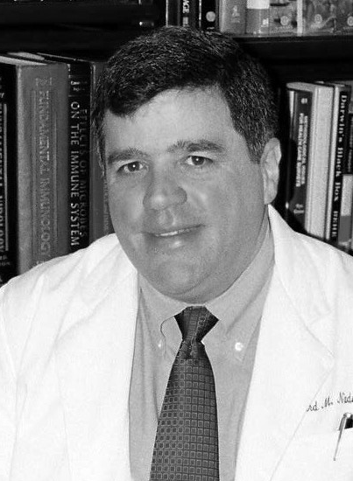
EUTHANASIA & ASSISTED SUICIDE
What is real compassion in the face of suffering?
ARGUMENTS FOR EUTHANASIA REST ON FIVE MISGUIDED MOTIVATIONS:
An argument from utility.
“This is an absolute descent into madness. We doctors spend close to twenty years of our adult lives in training, and for what? This? Medicine no longer seeks to better the human condition. It makes the problems go away by killing the patients…We don’t need extensive education for this anymore. We simply need executioners. And this is what national healthcare will deliver.”
– Dr. Gerard Nadal,
Executive Director, Children First Foundation

Slide 37
EUTHANASIA & ASSISTED SUICIDE
What is real compassion in the face of suffering?
ARGUMENTS FOR EUTHANASIA REST ON FIVE MISGUIDED MOTIVATIONS:
A faulty distinction between biological life and biographical life.

Slide 38
EUTHANASIA & ASSISTED SUICIDE
What is real compassion in the face of suffering?
ARGUMENTS FOR EUTHANASIA REST ON FIVE MISGUIDED MOTIVATIONS:
A faulty distinction between biological life and biographical life.
But if one’s “biographical” life is gone and only a body exists, can we treat her like a corpse? Bury her alive? Experiment on her?

Slide 39
EUTHANASIA & ASSISTED SUICIDE
What is real compassion in the face of suffering?
TWO PRO-EUTHANASIA/ASSISTED SUICIDE POSITIONS:

Slide 40
EUTHANASIA & ASSISTED SUICIDE
What is real compassion in the face of suffering?
TWO PRO-EUTHANASIA/ASSISTED SUICIDE POSITIONS:
THE SPLIT POSITION – assistance for some, prevention for others.

Slide 41
EUTHANASIA & ASSISTED SUICIDE
What is real compassion in the face of suffering?
TWO PRO-EUTHANASIA/ASSISTED SUICIDE POSITIONS:
?
THE SPLIT POSITION – assistance for some, prevention for others.
If a man is ready to jump to his death, how do we know if we should push him or pull him?

Slide 42
EUTHANASIA & ASSISTED SUICIDE
What is real compassion in the face of suffering?
TWO PRO-EUTHANASIA/ASSISTED SUICIDE POSITIONS:
THE SPLIT POSITION – assistance for some, prevention for others.

Slide 43
EUTHANASIA & ASSISTED SUICIDE
What is real compassion in the face of suffering?
TWO PRO-EUTHANASIA/ASSISTED SUICIDE POSITIONS:
THE SPLIT POSITION – assistance for some, prevention for others.

Slide 44
EUTHANASIA & ASSISTED SUICIDE
What is real compassion in the face of suffering?
TWO PRO-EUTHANASIA/ASSISTED SUICIDE POSITIONS:
THE SPLIT POSITION – assistance for some, prevention for others.

Slide 45
EUTHANASIA & ASSISTED SUICIDE
What is real compassion in the face of suffering?
TWO PRO-EUTHANASIA/ASSISTED SUICIDE POSITIONS:
THE SPLIT POSITION – assistance for some, prevention for others.
This isn’t about ”autonomy” or a ”right to die”; it’s about an underlying judgment that some lives aren’t worth living and are better off dead.

Slide 46
EUTHANASIA & ASSISTED SUICIDE
What is real compassion in the face of suffering?
TWO PRO-EUTHANASIA/ASSISTED SUICIDE POSITIONS:
THE TOTAL CHOICE POSITION - assistance for everyone.

Slide 47
EUTHANASIA & ASSISTED SUICIDE
What is real compassion in the face of suffering?
TWO PRO-EUTHANASIA/ASSISTED SUICIDE POSITIONS:
?
THE TOTAL CHOICE POSITION - assistance for everyone.
Should we ever try to prevent suicide? Is it ever a tragedy?

Slide 48
EUTHANASIA & ASSISTED SUICIDE
What is real compassion in the face of suffering?
CHRISTIAN RESPONSE TO EUTHANASIA & ASSISTED SUICIDE:

Slide 49
EUTHANASIA & ASSISTED SUICIDE
What is real compassion in the face of suffering?
CHRISTIAN RESPONSE TO EUTHANASIA & ASSISTED SUICIDE:
Euthanasia & assisted suicide reject our status as God’s image bearers.

Slide 50
EUTHANASIA & ASSISTED SUICIDE
What is real compassion in the face of suffering?
CHRISTIAN RESPONSE TO EUTHANASIA & ASSISTED SUICIDE:
Euthanasia & assisted suicide reject our status as God’s image bearers.
Genesis 9:6, “Whoever sheds human blood, by humans shall their blood be shed; for in the image of God has God made mankind.”

Slide 51
EUTHANASIA & ASSISTED SUICIDE
What is real compassion in the face of suffering?
CHRISTIAN RESPONSE TO EUTHANASIA & ASSISTED SUICIDE:
Euthanasia & assisted suicide reject our status as God’s image bearers.
Genesis 9:6, “Whoever sheds human blood, by humans shall their blood be shed; for in the image of God has God made mankind.”
Romans 14:7, “None of us lives for ourselves alone & none of us dies for ourselves alone.”

Slide 52
EUTHANASIA & ASSISTED SUICIDE
What is real compassion in the face of suffering?
CHRISTIAN RESPONSE TO EUTHANASIA & ASSISTED SUICIDE:
Euthanasia & assisted suicide destroy human equality by creating two classes of people; those we value and those we don’t.

Slide 53
EUTHANASIA & ASSISTED SUICIDE
What is real compassion in the face of suffering?
CHRISTIAN RESPONSE TO EUTHANASIA & ASSISTED SUICIDE:
Euthanasia & assisted suicide destroy human equality by creating two classes of people; those we value and those we don’t.
“A society in which we kill some but protect others cannot claim to be a society in which everyone is treated equally.”
– Jonathan Van Maren
Canadian Centre for Bio-Ethical Reform

Slide 54
EUTHANASIA & ASSISTED SUICIDE
What is real compassion in the face of suffering?
CHRISTIAN RESPONSE TO EUTHANASIA & ASSISTED SUICIDE:
Suicidal despair is always the symptom of another unmet need, not the solution.

Slide 55
EUTHANASIA & ASSISTED SUICIDE
What is real compassion in the face of suffering?
CHRISTIAN RESPONSE TO EUTHANASIA & ASSISTED SUICIDE:
Suicidal despair is always the symptom of another unmet need, not the solution.
The desire to commit suicide is often a cry for help and is frequently based on changing circumstances.

Slide 56
EUTHANASIA & ASSISTED SUICIDE
What is real compassion in the face of suffering?
CHRISTIAN RESPONSE TO EUTHANASIA & ASSISTED SUICIDE:
Suicidal despair is always the symptom of another unmet need, not the solution.
The desire to commit suicide is often a cry for help and is frequently based on changing circumstances.
Like abortion, euthanasia offers a permanent “solution” to a temporary problem.

Slide 57
EUTHANASIA & ASSISTED SUICIDE
What is real compassion in the face of suffering?
CHRISTIAN RESPONSE TO EUTHANASIA & ASSISTED SUICIDE:
Suicidal despair is always the symptom of another unmet need, not the solution.
Guiding Principle: Not “minimizing suffering,” but “maximizing care.”

Slide 58
EUTHANASIA & ASSISTED SUICIDE
What is real compassion in the face of suffering?
CHRISTIAN RESPONSE TO EUTHANASIA & ASSISTED SUICIDE:
Proponents of euthanasia fail to acknowledge that suffering can be redemptive.

Slide 59
EUTHANASIA & ASSISTED SUICIDE
What is real compassion in the face of suffering?
CHRISTIAN RESPONSE TO EUTHANASIA & ASSISTED SUICIDE:
Proponents of euthanasia fail to acknowledge that suffering can be redemptive.
God promises if we trust Him, He will use our pain for His glory and for our good.

Slide 60
EUTHANASIA & ASSISTED SUICIDE
What is real compassion in the face of suffering?
CHRISTIAN RESPONSE TO EUTHANASIA & ASSISTED SUICIDE:
Proponents of euthanasia fail to acknowledge that suffering can be redemptive.
God promises if we trust Him, He will use our pain for His glory and for our good.
Romans 5:3-4, “We glory in our sufferings, because we know that suffering produces perseverance; perseverance, character; and character, hope.”

Slide 61
EUTHANASIA & ASSISTED SUICIDE
What is real compassion in the face of suffering?
CHRISTIAN RESPONSE TO EUTHANASIA & ASSISTED SUICIDE:
Proponents of euthanasia fail to acknowledge that suffering can be redemptive.
God promises if we trust Him, He will use our pain for His glory and for our good.
Romans 5:3-4, “We glory in our sufferings, because we know that suffering produces perseverance; perseverance, character; and character, hope.”
Psalm 119:67, “Before I was afflicted, I went astray, but now I obey your word.”

Slide 62
EUTHANASIA & ASSISTED SUICIDE
What is real compassion in the face of suffering?
CHRISTIAN RESPONSE TO EUTHANASIA & ASSISTED SUICIDE:
Proponents of euthanasia fail to acknowledge that suffering can be redemptive.
God promises if we trust Him, He will use our pain for His glory and for our good.
Guiding Principle: Eliminate the suffering, not the sufferer. Kill the pain, not the human.

Slide 63
EUTHANASIA & ASSISTED SUICIDE
What is real compassion in the face of suffering?
CONCLUSION: THE PRO-LIFE POSITION IS PREVENTION FOR EVERYONE.

Slide 64
EUTHANASIA & ASSISTED SUICIDE
What is real compassion in the face of suffering?
CONCLUSION: THE PRO-LIFE POSITION IS PREVENTION FOR EVERYONE.
Values a "SANCTITY-OF-LIFE" ethic over “QUALITY-OF-LIFE” ethic.

Slide 65
EUTHANASIA & ASSISTED SUICIDE
What is real compassion in the face of suffering?
CONCLUSION: THE PRO-LIFE POSITION IS PREVENTION FOR EVERYONE.
Values a "SANCTITY-OF-LIFE" ethic over “QUALITY-OF-LIFE” ethic.
Our duty to those who are suicidal is not to affirm their despair, but to help them find meaning and value in their lives, even in unavoidable suffering.

Slide 66
EUTHANASIA & ASSISTED SUICIDE
What is real compassion in the face of suffering?
CONCLUSION: THE PRO-LIFE POSITION IS PREVENTION FOR EVERYONE.
Values a "SANCTITY-OF-LIFE" ethic over “QUALITY-OF-LIFE” ethic.
Our duty to those who are suicidal is not to affirm their despair, but to help them find meaning and value in their lives, even in unavoidable suffering.
Because death is a defeated enemy; it doesn’t always have to be resisted.

Slide 67
EUTHANASIA & ASSISTED SUICIDE
What is real compassion in the face of suffering?
CONCLUSION: THE PRO-LIFE POSITION IS PREVENTION FOR EVERYONE.
Guiding Principle: “The proper judgment is not about whether the person is worthwhile, but whether the treatment is worthwhile.” – Christopher Kaczor

Slide 68
EUTHANASIA & ASSISTED SUICIDE
What is real compassion in the face of suffering?
CONCLUSION: THE PRO-LIFE POSITION IS PREVENTION FOR EVERYONE.
Guiding Principle: “The proper judgment is not about whether the person is worthwhile, but whether the treatment is worthwhile.” – Christopher Kaczor
GUIDING QUESTIONS:
“Is this treatment more burdensome than beneficial?”
"Am I preserving life, or merely prolonging death?"
"Am I taking a life, or simply allowing a natural death?"
“If this patient could speak, what treatment would they choose or reject?”

Slide 69
