Slide 1
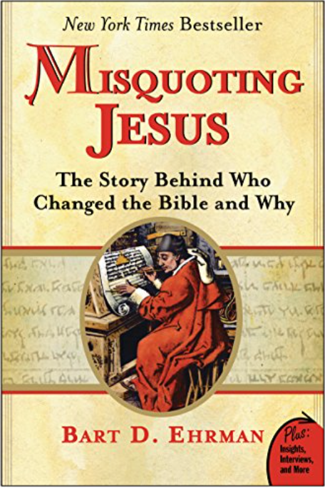

Slide 2
Almost 5900 Greek manuscripts have been discovered, containing either all of the NT or part of it.
These are dated from the early 2nd century to late 14th century.
The number continues to grow, as new discoveries are made.
-------
The New Testament itself contains roughly 138,000 words in 8000 verses.

Slide 4
Textual Criticism: Comparing manuscripts in order to reconstruct the original document.
Generally speaking, the more copies we have, and the earlier the copies, the more confidence there is in that reconstruction.

Slide 6
Document or Author | Surviving Manuscripts | Time Gap (Earliest)
New Testament | 5900 | 40
Josephus | 9 | 400
Tacitus | 31 | 750-950
Pliny the Elder | 200 | 400
Titus Livius | 150 | 400
Herodotus | 109 | 1350
Julius Caesar | 251 | 950
Plato | 210 | 1300
Homer | 1800 | 400

Slide 7
Document or Author | Surviving Manuscripts | Time Gap (Earliest)
New Testament | 5900 | 40
Josephus | 9 | 400
Tacitus | 31 | 750-950
Pliny the Elder | 200 | 400
Titus Livius | 150 | 400
Herodotus | 109 | 1350
Julius Caesar | 251 | 950
Plato | 210 | 1300
Homer | 1800 | 400

Slide 8
If we reject the authenticity of the New Testament on textual grounds, we’d also have to reject every work of antiquity prior to 1000 A.D., since there is less evidence for their authenticity than for the New Testament.
– Greg Koukl

Slide 9
Surviving Manuscripts
- Greek: 5900
- Latin translations: 10,000+
- Other translations: 9300+
- Writings of the early church fathers
- Church lexicons, catechisms, etc.

Slide 11
UNINTENTIONAL ERRORS
1. Errors of the eye
2. Errors of the ear
3. Errors of memory
4. Errors of judgment
5. Errors of writing

Slide 12
WHICH READING IS PREFERRED?
1. The older reading.
2. The more difficult reading.
3. The shorter reading.
4. The reading with the widest geographical support.
5. The reading that most conforms to the style of the author.
6. The reading that doesn’t reflect a doctrinal bias.

Slide 13
AUTOGRAPHS
MANUSCRIPT COPIES
UBS NESTLE / ALAND
MODERN TRANSLATIONS

