Slide 1
Romans
Part X 5:12-21

Slide 2
“…and there’s nothing you can do about it!”

Slide 3
Romans
Ch.1 – 4
Review

Slide 4
Romans 1:16-17 (NIV)
= WHAT
¹⁶ I am not ashamed of the gospel, because it is the power of God for the salvation of everyone who believes: first for the Jew, then for the Gentile.
¹⁷ For in the gospel a righteousness from God is revealed, a righteousness that is by faith from first to last, just as it is written:
"The righteous will live by faith."
= HOW

Slide 5
Romans 1-4
Ch.1 Gentiles: General Revelation (Creation)
Ch.2 Jews: Specific Revelation (Law)
2:5-16 God’s Impartial Judgement of Works
Ch.3 Jews & Gentiles
‘both-and’

Slide 6
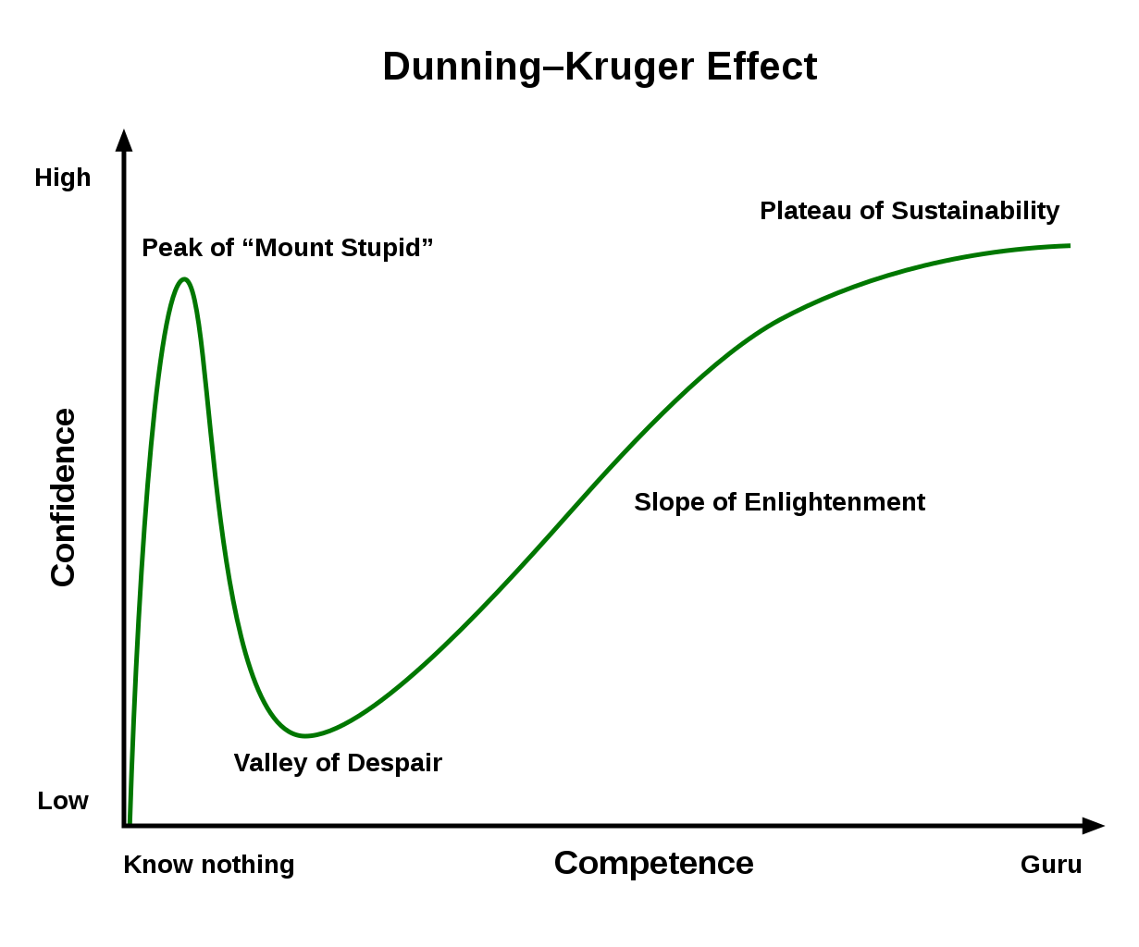
²⁰ Therefore, no one will be declared righteous in God’s sight by the works of the law.

Slide 7
²¹ But now apart from the law the righteousness of God has been made known, to which the Law and the Prophets testify. ²² This righteousness from God comes through faith in Jesus Christ to all who believe.

Slide 8
Romans 1-4
Ch.1 Gentiles: General Revelation (Creation)
Ch.2 Jews: Specific Revelation (Law)
2:5-16 God’s Impartial Judgement of Works
Ch.3 Jews & Gentiles
3:20 Conclusion on the Law
3:21-Ch.4 Salvation by Faith in Christ

Slide 9
Romans
‘both-and’
Ch.1 – 4
Review

Slide 10
‘He writes the same way in all his letters, speaking in them of these matters. His letters contain some things that are hard to understand, which ignorant and unstable people distort, as they do the other Scriptures, to their own destruction.’
2 Peter 3:16

Slide 11
Romans 3:20a & 2:7 (2011 NIV)
3:20a Therefore, no one will be declared righteous in God’s sight by observing the law
2:7 To those who by persistence in doing good seek glory, honor and immortality, he will give eternal life.

Slide 12
‘You see that a person is considered righteous by what they do and not by faith alone.’
James 2:24

Slide 13
Romans
The Expectation of Justification
Review 5:1-11

Slide 14
Romans 5:1 (2011 NIV)
¹ Therefore, since we have been justified through faith we have peace with God through our Lord Jesus Christ.
‘already but not yet’

Slide 15
Romans
Death Through Adam
Life Through Christ
PART x 5:12-21

Slide 16
Romans 5:10 (2011 NIV)
¹⁰ For if, while we were God’s enemies, we were reconciled to him through the death of his Son, how much more, having been reconciled, shall we be saved through his life!

Slide 17
Romans 5:12-21 (1984 NIV)
¹² Therefore, just as sin entered the world through one man, and death through sin, and in this way death came to all men, because all sinned – ¹³ (for before the law was given, sin was in the world. But sin is not taken into account when there is no law.
¹⁴ Nevertheless, death reigned from the time of Adam to the time of Moses, even over those who did not sin by breaking a command, as did Adam, who was a pattern of the one to come.)

Slide 18
Romans 5:12-21 (1984 NIV)
¹⁵ But the gift is not like the trespass. For if the many died by the trespass of the one man, how much more did God's grace and the gift that came by the grace of the one man, Jesus Christ, overflow to the many! ¹⁶ Again, the gift of God is not like the result of the one man's sin: The judgment followed one sin and brought condemnation, but the gift followed many trespasses and brought justification. ¹⁷ For if, by the trespass of the one man, death reigned through that one man, how much more will those who receive God's abundant provision of grace and of the gift of righteousness reign in life through the one man, Jesus Christ.

Slide 19
Romans 5:12-21 (1984 NIV)
¹⁸ Consequently, just as the result of one trespass was condemnation for all men, so also the result of one act of righteousness was justification that brings life for all men. ¹⁹ For just as through the disobedience of the one man the many were made sinners, so also through the obedience of the one man the many will be made righteous. ²⁰ The law was added so that the trespass might increase. But where sin increased, grace increased all the more, ²¹ so that, just as sin reigned in death, so also grace might reign through righteousness to bring eternal life through Jesus Christ our Lord.

Slide 20
Romans 5:12-21 (1984 NIV)
¹² Therefore, just as sin entered the world through one man, and death through sin, and in this way death came to all men, because all sinned – ¹³ (for before the law was given, sin was in the world. But sin is not taken into account when there is no law.
¹⁴ Nevertheless, death reigned from the time of Adam to the time of Moses, even over those who did not sin by breaking a command, as did Adam, who was a pattern of the one to come.)

Slide 21
Romans 5:12-21 (1984 NIV)
¹⁵ But the gift is not like the trespass. For if the many died by the trespass of the one man, how much more did God's grace and the gift that came by the grace of the one man, Jesus Christ, overflow to the many! ¹⁶ Again, the gift of God is not like the result of the one man's sin: The judgment followed one sin and brought condemnation, but the gift followed many trespasses and brought justification. ¹⁷ For if, by the trespass of the one man, death reigned through that one man, how much more will those who receive God's abundant provision of grace and of the gift of righteousness reign in life through the one man, Jesus Christ.

Slide 22
Romans 5:12a,18b (1984 NIV)
¹² Therefore, just as sin entered the world through one man, and death through sin… ¹⁸ so also the result of one act of righteousness was justification that brings life for all men.
Sin came to all mankind through Adam’s act.
Death came to all through sin.
Life comes to all through Jesus’ act.

Slide 23
Romans
Death Through Adam
Life Through Christ
PART x 5:12-21

Slide 24
Romans 5:12 (1984 NIV)
¹² Therefore, just as sin entered the world through one man, and death through sin, and in this way death came to all men, because all sinned.

Slide 25
Romans 5:12 (1984 NIV)
¹² Therefore, just as sin entered the world through one man, and death through sin, and in this way death came to all men, because all sinned.
¹⁹ For just as through the disobedience of the one man the many were made sinners, so also through the obedience of the one man the many will be made righteous.

Slide 26
Romans 5:12 (1984 NIV)
¹² Therefore, just as sin entered the world through one man, and death through sin, and in this way death came to all men, because all sinned.
"And will you teach us Death?" said the Lady to Weston's shape, where it stood above her. "Yes," it said, "it is for this that I came here, that you may have Death in abundance. But you must be very courageous.” Perelandra, C.S. Lewis

Slide 27
Romans 5:12 (1984 NIV)
¹² Therefore, just as sin entered the world through one man, and death through sin, and in this way death came to all men, because all sinned.
“Sin is pictured as an insidious power that, once allowed entry, multiplies until it dominates, enslaves, and kills everyone. Here, the chief agent of sin is death which ‘advanced’ to every human being.” Frank Thielman

Slide 28
And the Lord God commanded the man, “You are free to eat from any tree in the garden; but you must not eat from the tree of the knowledge of good and evil, for when you eat from it you will certainly die.” Genesis 2:16-17
…till you return to the ground, for out of it you were taken; for you are dust, and to dust you shall return.” Genesis 3:19b

Slide 29
”Death comes to man as something for which he was not made, as an offense, cutting short and reducing to meaninglessness all that is highest and distinctive about him.”
Martin Heidegger

Slide 30
Romans 5:12 (1984 NIV)
¹² Therefore, just as sin entered the world through one man, and death through sin, and in this way death came to all men, because all sinned.
¹² …and so death passed upon all men, in whom all have sinned.

Slide 31
Romans 5:12 (1984 NIV)
¹² Therefore, just as sin entered the world through one man, and death through sin, and in this way death came to all men, because all sinned.
¹² …death came to all men, with the result that all sinned.

Slide 32
Romans 5:13-14 (1984 NIV)
– ¹³ (for before the law was given, sin was in the world. But sin is not taken into account when there is no law. ¹⁴ Nevertheless, death reigned from the time of Adam to the time of Moses, even over those who did not sin by breaking a command, as did Adam, who was a pattern of the one to come.)
Sin (hamartia) = ‘missing the mark’
Breaking a command; transgression (parabasis)
= ‘intentionally crossing a line’

Slide 33
Romans 5:13-14 (1984 NIV)
– ¹³ (for before the law was given, sin was in the world. But sin is not taken into account when there is no law. ¹⁴ Nevertheless, death reigned from the time of Adam to the time of Moses, even over those who did not sin by breaking a command, as did Adam, who was a pattern of the one to come.)

Slide 34
Romans 5:13-14 (1984 NIV)
– ¹³ (for before the law was given, sin was in the world. But sin is not taken into account when there is no law. ¹⁴ Nevertheless, death reigned from the time of Adam to the time of Moses, even over those who did not sin by breaking a command, as did Adam, who was a pattern of the one to come.)

Slide 35
Romans 5:15-17 (1984 NIV)
¹⁵ But the gift is not like the trespass. For if the many died by the trespass of the one man, how much more did God's grace and the gift that came by the grace of the one man, Jesus Christ, overflow to the many! ¹⁶ Again, the gift of God is not like the result of the one man's sin: The judgment followed one sin and brought condemnation, but the gift followed many trespasses and brought justification. ¹⁷ For if, by the trespass of the one man, death reigned through that one man, how much more will those who receive God's abundant provision of grace and of the gift of righteousness reign in life through the one man, Jesus Christ.

Slide 36
Romans 5:18-19 (1984 NIV)
¹⁸ Consequently, just as the result of one trespass was condemnation for all men, so also the result of one act of righteousness was justification that brings life for all men. ¹⁹ For just as through the disobedience of the one man the many were made sinners, so also through the obedience of the one man the many will be made righteous.

Slide 37
Romans 5:18-19 (1984 NIV)
¹⁸ Consequently, just as the result of one trespass was condemnation for all men, so also the result of one act of righteousness was justification that brings life for all men. ¹⁹ For just as through the disobedience of the one man the many were made sinners, so also through the obedience of the one man the many will be made righteous.

Slide 38
Romans 5:20 (1984 NIV)
²⁰ The law was added so that the trespass might increase. But where sin increased, grace increased all the more.
knowledge
- Paul

Slide 39
Romans 5:20b-21 (1984 NIV)
But where sin increased, grace increased all the more, ²¹ so that, just as sin reigned in death, so also grace might reign through righteousness to bring eternal life through Jesus Christ our Lord.

Slide 40
COMPARISON SUMMARY
Adam | Christ
Sin | Grace
Trespass | Gift
Death | Life
Condemnation | Justification
Disobedience | Obedience

