Slide 1
Romans
Part IX 5:1-11

Slide 2
Romans
‘both-and’
Ch.1 – 4
Review

Slide 3
Romans 1:16-17 (NIV)
= WHAT
¹⁶ I am not ashamed of the gospel, because it is the power of God for the salvation of everyone who believes: first for the Jew, then for the Gentile.
¹⁷ For in the gospel a righteousness from God is revealed, a righteousness that is by faith from first to last, just as it is written:
"The righteous will live by faith."
= HOW

Slide 4
Correct Course

Slide 5
Correct Course

Slide 6
Correct Course

Slide 7
Correct Course

Slide 8
Correct Course

Slide 9
Romans 1-4
Ch.1 Gentiles: General Revelation (Creation)
Ch.2 Jews: Special Revelation (Law)
2:5-16 God’s Impartial Judgement of Works
⁶ God "will give to each person according to what he has done.” ⁷ To those who by persistence in doing good seek glory, honor and immortality, he will give eternal life. ⁸ But for those who are self-seeking and who reject the truth and follow evil, there will be wrath and anger.

Slide 10
Romans 1-4
Ch.1 Gentiles: General Revelation (Creation)
Ch.2 Jews: Specific Revelation (Law)
2:5-16 God’s Impartial Judgement of Works
¹⁴ (Indeed, when Gentiles, who do not have the law, do by nature things required by the law, they are a law for themselves, even though they do not have the law, ¹⁵ since they show that the requirements of the law are written on their hearts, their consciences also bearing witness, and their thoughts now accusing, now even defending them.)

Slide 11
Romans 1-4
Ch.1 Gentiles: General Revelation (Creation)
Ch.2 Jews: Specific Revelation (Law)
2:5-16 God’s Impartial Judgement of Works
“Law, which is not written on papyrus scrolls or wooden tablets, but is his own reason within the soul, which perpetually dwells with him and guards him and never leaves the soul bereft of leadership.” – Plutarch

Slide 12
Romans 1-4
Ch.1 Gentiles: General Revelation (Creation)
Ch.2 Jews: Specific Revelation (Law)
2:5-16 God’s Impartial Judgement of Works
¹⁶ This will take place on the day when God judges people’s secrets through Jesus Christ, as my gospel declares.

Slide 13
Romans 1-4
Ch.1 Gentiles: General Revelation (Creation)
Ch.2 Jews: Specific Revelation (Law)
2:5-16 God’s Impartial Judgement of Works
Ch.3 Jews & Gentiles
¹ What advantage, then, is there in being a Jew, or what value is there in circumcision? ² Much in every way!
⁹ Jews and Gentiles alike are all under the power of sin.

Slide 14
Romans 1-4
Ch.1 Gentiles: General Revelation (Creation)
Ch.2 Jews: Specific Revelation (Law)
2:5-16 God’s Impartial Judgement of Works
Ch.3 Jews & Gentiles
3:20 Conclusion on the Law
²⁰ Therefore, no one will be declared righteous in God’s sight by the works of the law.

Slide 15
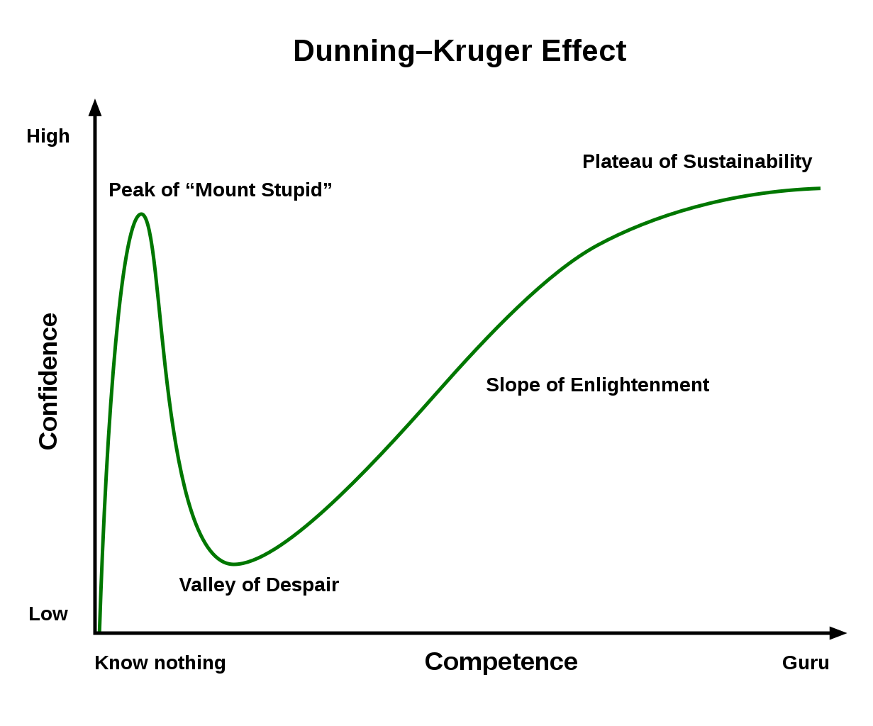
“Not only is this a dogmatic claim by Paul, one could say it is axiomatic.” - John AT Robinson

Slide 16
Romans 1-4
Ch.1 Gentiles: General Revelation (Creation)
Ch.2 Jews: Specific Revelation (Law)
2:5-16 God’s Impartial Judgement of Works
Ch.3 Jews & Gentiles
3:20 Conclusion on the Law
‘both-and’
²⁰ Therefore, no one will be declared righteous in God’s sight by the works of the law.

Slide 17
²¹ But now apart from the law the righteousness of God has been made known, to which the Law and the Prophets testify. ²² This righteousness from God comes through faith in Jesus Christ to all who believe.
^{1:17} For in the gospel a righteousness from God is revealed, a righteousness that is by faith from first to last, just as it is written:
"The righteous will live by faith."

Slide 18
Romans 1-4
Ch.1 Gentiles: General Revelation (Creation)
Ch.2 Jews: Specific Revelation (Law)
2:5-16 God’s Impartial Judgement of Works
Ch.3 Jews & Gentiles
3:20 Conclusion on the Law
3:21-Ch.4 Salvation by Faith in Christ
^{4:3} Abraham believed God, and it was credited to him as righteousness.

Slide 19
Righteous / Righteousness
Virtuous ’morally upright’
Conduct ‘righteous deeds’
Justification ‘pronounced or treated as righteous’
Righteousness of God ’ability to carry out His actions completely and perfectly’

Slide 20
Romans 4:2-5 (NIV)
² If, in fact, Abraham was justified by works, he had something to boast about—but not before God. ³ What does Scripture say? “Abraham believed God, and it was credited to him as righteousness.” ⁴ Now to the one who works, wages are not credited as a gift but as an obligation. ⁵ However, to the one who does not work but trusts God who justifies the wicked, their faith is credited as righteousness.
And without faith it is impossible to please God, because anyone who comes to him must believe that he exists and that he rewards those who earnestly seek him.
Hebrews 11:6

Slide 21
Romans 4:23-25 (NIV)
²³ The words “it was credited to him” were written not for him alone, ²⁴ but also for us, to whom God will credit righteousness—for us who believe in him who raised Jesus our Lord from the dead.
²⁵ He was delivered over to death for our sins and was raised to life for our justification.

Slide 22
Romans
Peace and Joy
Peace and Hope
Part IX 5:1-11
Therefore,

Slide 23
Romans
Peace with God through Faith
Faith Brings Joy
Faith Triumphs
Part IX 5:1-11
Therefore,

Slide 24
Romans
Assurance
Free from God’s Wrath
Part IX 5:1-11
Therefore,

Slide 25
Romans
Results of Justification
The Expectation of Justification
Part IX
Part IX 5:1-11
Therefore,

Slide 26
Romans 5:1-11 (2011 NIV)
¹ Therefore, since we have been justified through faith we have peace with God through our Lord Jesus Christ, ² through whom we have gained access by faith into this grace in which we now stand. And we boast in the hope of the glory of God. ³ Not only so, but we also glory in our sufferings, because we know that suffering produces perseverance; ⁴ perseverance, character; and character, hope. ⁵ And hope does not put us to shame, because God’s love has been poured out into our hearts through the Holy Spirit, who has been given to us.

Slide 27
⁶ You see, at just the right time, when we were still powerless, Christ died for the ungodly. ⁷ Very rarely will anyone die for a righteous person, though for a good person someone might possibly dare to die. ⁸ But God demonstrates his own love for us in this: While we were still sinners, Christ died for us. ⁹ Since we have now been justified by his blood, how much more shall we be saved from God’s wrath through him! ¹⁰ For if, while we were God’s enemies, we were reconciled to him through the death of his Son, how much more, having been reconciled, shall we be saved through his life! ¹¹ Not only is this so, but we also boast in God through our Lord Jesus Christ, through whom we have now received reconciliation.

Slide 28
Romans 5:1
¹ Therefore, since we have been justified through faith we have peace with God through our Lord Jesus Christ
…we have been justified by faith (ESV)
…having been justified on the principle of faith (DBY)
Standing then acquitted as the result of faith (WNT)
…we have been made righteous through his faithfulness
combined with our faith (CEB)
… we have been made right with God by our faith (NCV)
We have been made right with God because of our faith (NIRV)

Slide 29
Romans 5:1
¹ Therefore, since we have been justified through faith we have peace with God through our Lord Jesus Christ
Note: Many manuscripts “let us have peace”
And the peace of God, which surpasses all understanding, will guard your hearts and minds through Christ Jesus.
Phil. 4:7

Slide 30
Romans 5:1
¹ Therefore, since we have been justified through faith we have peace with God through our Lord Jesus Christ
“This is not some sort of inner experience of harmony, but the objective fact of a new relationship with God. In the Bible ‘peace’ often describes the total blessing of salvation.” CSB Study Bible

Slide 31
Romans 5:1
¹ Therefore, since we have been justified through faith we have peace with God through our Lord Jesus Christ
‘already but not yet’
Dear friends, now we are children of God,
and what we will be has not yet been made known.
1 John 3:2

Slide 32
Romans 5:2 (2011 NIV)
¹ Therefore, since we have been justified through faith we have peace with God through our Lord Jesus Christ
² through whom we have gained access by faith into this grace in which we now stand. And we boast in the hope of the glory of God.
“Grace describes the free, unconstrained manner in which God acts towards his creatures.”
– Douglas Moo

Slide 33
Romans 5:2 (2011 NIV)
¹ Therefore, since we have been justified through faith we have peace with God through our Lord Jesus Christ
² through whom we have gained access by faith into this grace in which we now stand. And we boast in the hope of the glory of God.

Slide 34
Romans 5:2 (2011 NIV)
¹ Therefore, since we have been justified through faith we have peace with God through our Lord Jesus Christ
² through whom we have gained access by faith into this grace in which we now stand. And we boast in the hope of the glory of God.
¹⁸ And we all, who with unveiled faces contemplate the Lord’s glory, are being transformed into his image with ever-increasing glory, which comes from the Lord, who is the Spirit. 2 Cor. 3:18
^{4:18} Against all hope, Abraham in hope believed…

Slide 35
Romans 5:3-4
³ Not only so, but we also glory in our sufferings, because we know that suffering produces perseverance; ⁴ perseverance, character; and character, hope.

Slide 36
Romans 5:5
⁵ And hope does not put us to shame, because God’s love has been poured out into our hearts through the Holy Spirit, who has been given to us.

Slide 37
Romans 5:6-8 (NEB)
⁶ For at the very time when we were still powerless, then Christ died for the wicked. ⁷ Even for a just man one of us would hardly die, though perhaps for a good man one might actually brave death; ⁸ but Christ died for us while we were yet sinners, and that is God's own proof of his love towards us.

Slide 38
Romans Road to Salvation
Romans 3:23 For all have sinned…
Romans 6:23 ...the wages of sin is death…
Romans 5:8 …Christ died for us.
Romans 10:9 …if you declare with your mouth “Jesus is Lord” and believe in your heart that God raised him from the dead, you will be saved.
Romans 5:1 …we have peace with God.

Slide 39
Romans 5:9-11 (2011 NIV)
⁹ Since we have now been justified by his blood, how much more shall we be saved from God’s wrath through him! ¹⁰ For if, while we were God’s enemies, we were reconciled to him through the death of his Son, how much more, having been reconciled, shall we be saved through his life! ¹¹ Not only is this so, but we also boast in God through our Lord Jesus Christ, through whom we have now received reconciliation.

Slide 40
Romans 5:9-11 (2011 NIV)
⁹ Since we have now been justified by his blood, how much more shall we be saved from God’s wrath through him! ¹⁰ For if, while we were God’s enemies, we were reconciled to him through the death of his Son, how much more, having been reconciled, shall we be saved through his life! ¹¹ Not only is this so, but we also boast in God through our Lord Jesus Christ, through whom we have now received reconciliation.

Slide 41
Romans 5:9-11 (2011 NIV)
⁹ Since we have now been justified by his blood, how much more shall we be saved from God’s wrath through him! ¹⁰ For if, while we were God’s enemies, we were reconciled to him through the death of his Son, how much more, having been reconciled, shall we be saved through his life! ¹¹ Not only is this so, but we also boast in God through our Lord Jesus Christ, through whom we have now received reconciliation.

Slide 42
Romans 5:9-11 (2011 NIV)
⁹ Since we have now been justified by his blood, how much more shall we be saved from God’s wrath through him! ¹⁰ For if, while we were God’s enemies, we were reconciled to him through the death of his Son, how much more, having been reconciled, shall we be saved through his life! ¹¹ Not only is this so, but we also boast in God through our Lord Jesus Christ, through whom we have now received reconciliation.

Slide 43
Romans 5:9-11 (2011 NIV)
⁹ Since we have now been justified by his blood, how much more shall we be saved from God’s wrath through him! ¹⁰ For if, while we were God’s enemies, we were reconciled to him through the death of his Son, how much more, having been reconciled, shall we be saved through his life! ¹¹ Not only is this so, but we also boast in God through our Lord Jesus Christ, through whom we have now received reconciliation.
⁶ Being confident of this, that he who began a good work in you will carry it on to completion until the day of Christ Jesus. Philippians 1:6

Slide 44
“The whole Christian life is built upon the pattern of ‘become what you are.’ All things are yours – all is to be made yours, in Christ.”
– John AT Robinson

