Slide 1
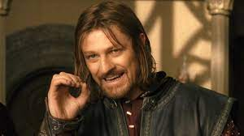
One does not simply walk into Mordor!

Slide 2
One does not simply read the book of Revelation!
Its mysteries are beyond comprehension.
There is symbolism that perplexes the greatest of minds.
Its pages are riddled with paradoxes and crazy drama and wild images.
There are monsters and devils and dragons and multi-headed beasts.
Its prophecies are both terrifying and baffling.
Not with ten thousand scholars could you do this!

Slide 4
Ephesus
Smyrna
Pergamum
Thyatira
Sardis
Philadelphia
Laodicea

Slide 5
Ephesus
Smyrna
Pergamum
Thyatira
Sardis
Philadelphia
Laodicea

Slide 6
Ephesus
Smyrna
Pergamum
Thyatira
Sardis
Philadelphia
Laodicea

Slide 7
Ephesus
Smyrna
Pergamum
Thyatira
Sardis
Philadelphia
Laodicea

Slide 8
• Preterism
• Historicism
• Futurism
• Idealism

Slide 9
1. Christ commissions John to write
2. Christ is identified with a title or description
3. An assessment of the church is made
4. A correction is mandated
5. Christ promises to follow up (to come)
6. A promise is made to those who overcome
7. A call to hear is issued

Slide 10
A) Ephesus, unhealthy
B) Smyrna, healthy
C) Pergamum: unhealthy
D) Thyatira: unhealthy
C’) Sardis: unhealthy
B’) Philadelphia: healthy
A’) Laodicea: unhealthy

Slide 11
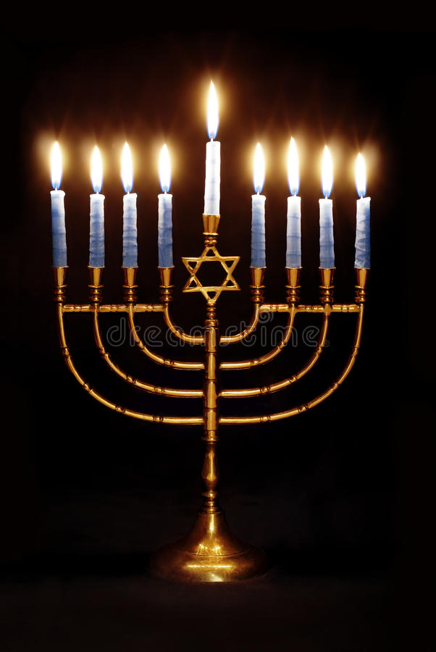
A) Ephesus, unhealthy
B) Smyrna, healthy
C) Pergamum: unhealthy
D) Thyatira: unhealthy
C’) Sardis: unhealthy
B’) Philadelphia: healthy
A’) Laodicea: unhealthy

Slide 12
A) Ephesus, unhealthy
B) Smyrna, healthy – synagogue of Satan / Jews
C) Pergamum: unhealthy
D) Thyatira: unhealthy
C’) Sardis: unhealthy
B’) Philadelphia: healthy - synagogue of Satan / Jews
A’) Laodicea: unhealthy

Slide 13
A) Ephesus, unhealthy
B) Smyrna, healthy
C) Pergamum: unhealthy
D) Thyatira: unhealthy
C’) Sardis: unhealthy
B’) Philadelphia: healthy
A’) Laodicea: unhealthy

