Slide 2
1. Christ commissions John to write
2. Christ is identified with a title or description
3. An assessment of the church is made
4. A correction is mandated
5. Christ promises to follow up (to come)
6. A call to hear is issued
7. A promise is made to those who overcome

Slide 4
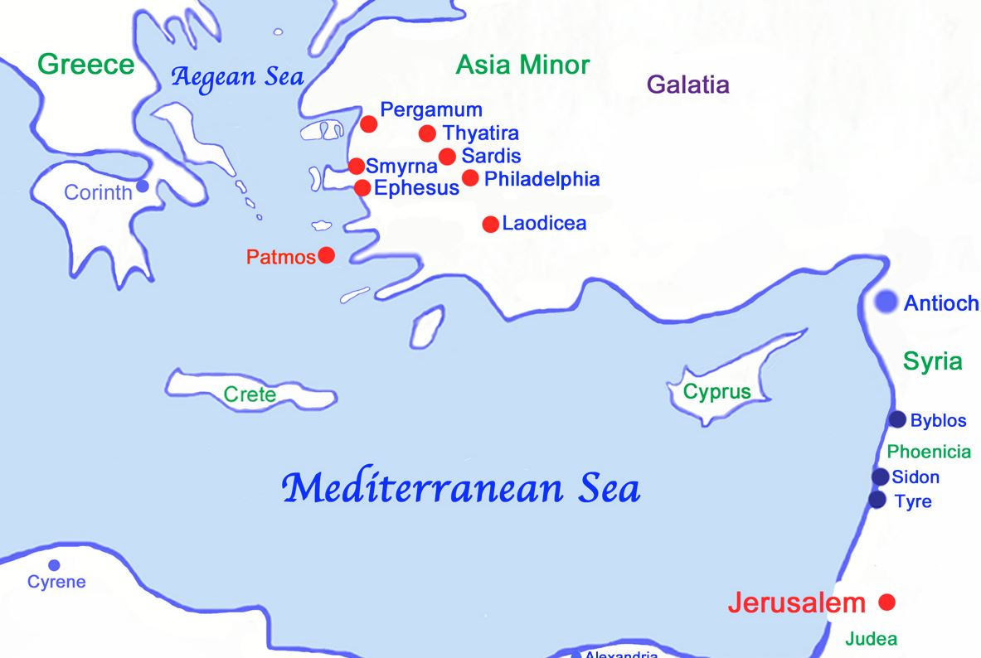

Slide 6
1 To the angel of the church in Ephesus write: These are the words of him who holds the seven stars in his right hand and walks among the seven golden lampstands:
2 I know your deeds, your hard work and your perseverance. I know that you cannot tolerate wicked men, that you have tested those who claim to be apostles but are not, and have found them false.
3 You have persevered and have endured hardships for my name, and have not grown weary.

Slide 8
4 Yet I hold this against you: You have forsaken your first love.
5 Remember the height from which you have fallen! Repent and do the things you did at first. If you do not repent, I will come to you and remove your lampstand from its place.

Slide 10
James 1:22-25
Do not merely listen to the word, and so deceive yourselves. Do what it says.
Anyone who listens to the word but does not do what it says is like a man who looks at his face in a mirror and, after looking at himself, goes away and immediately forgets what he looks like.
But the man who looks intently into the perfect law that gives freedom, and continues to do this, not forgetting what he has heard, but doing it--he will be blessed in what he does.

Slide 12
Titus 2:11-15
For the grace of God that brings salvation has appeared to all men.
It teaches us to say "No" to ungodliness and worldly passions, and to live self-controlled, upright and godly lives in this present age, while we wait for the blessed hope-- the glorious appearing of our great God and Savior, Jesus Christ, who gave himself for us to redeem us from all wickedness and to purify for himself a people that are his very own, eager to do what is good.
These, then, are the things you should teach.

Slide 13
6 But you have this in your favor: You hate the practices of the Nicolaitans, which I also hate.
7 He who has an ear, let him hear what the Spirit says to the churches. To him who overcomes, I will give the right to eat from the tree of life, which is in the paradise of God.

