Slide 1
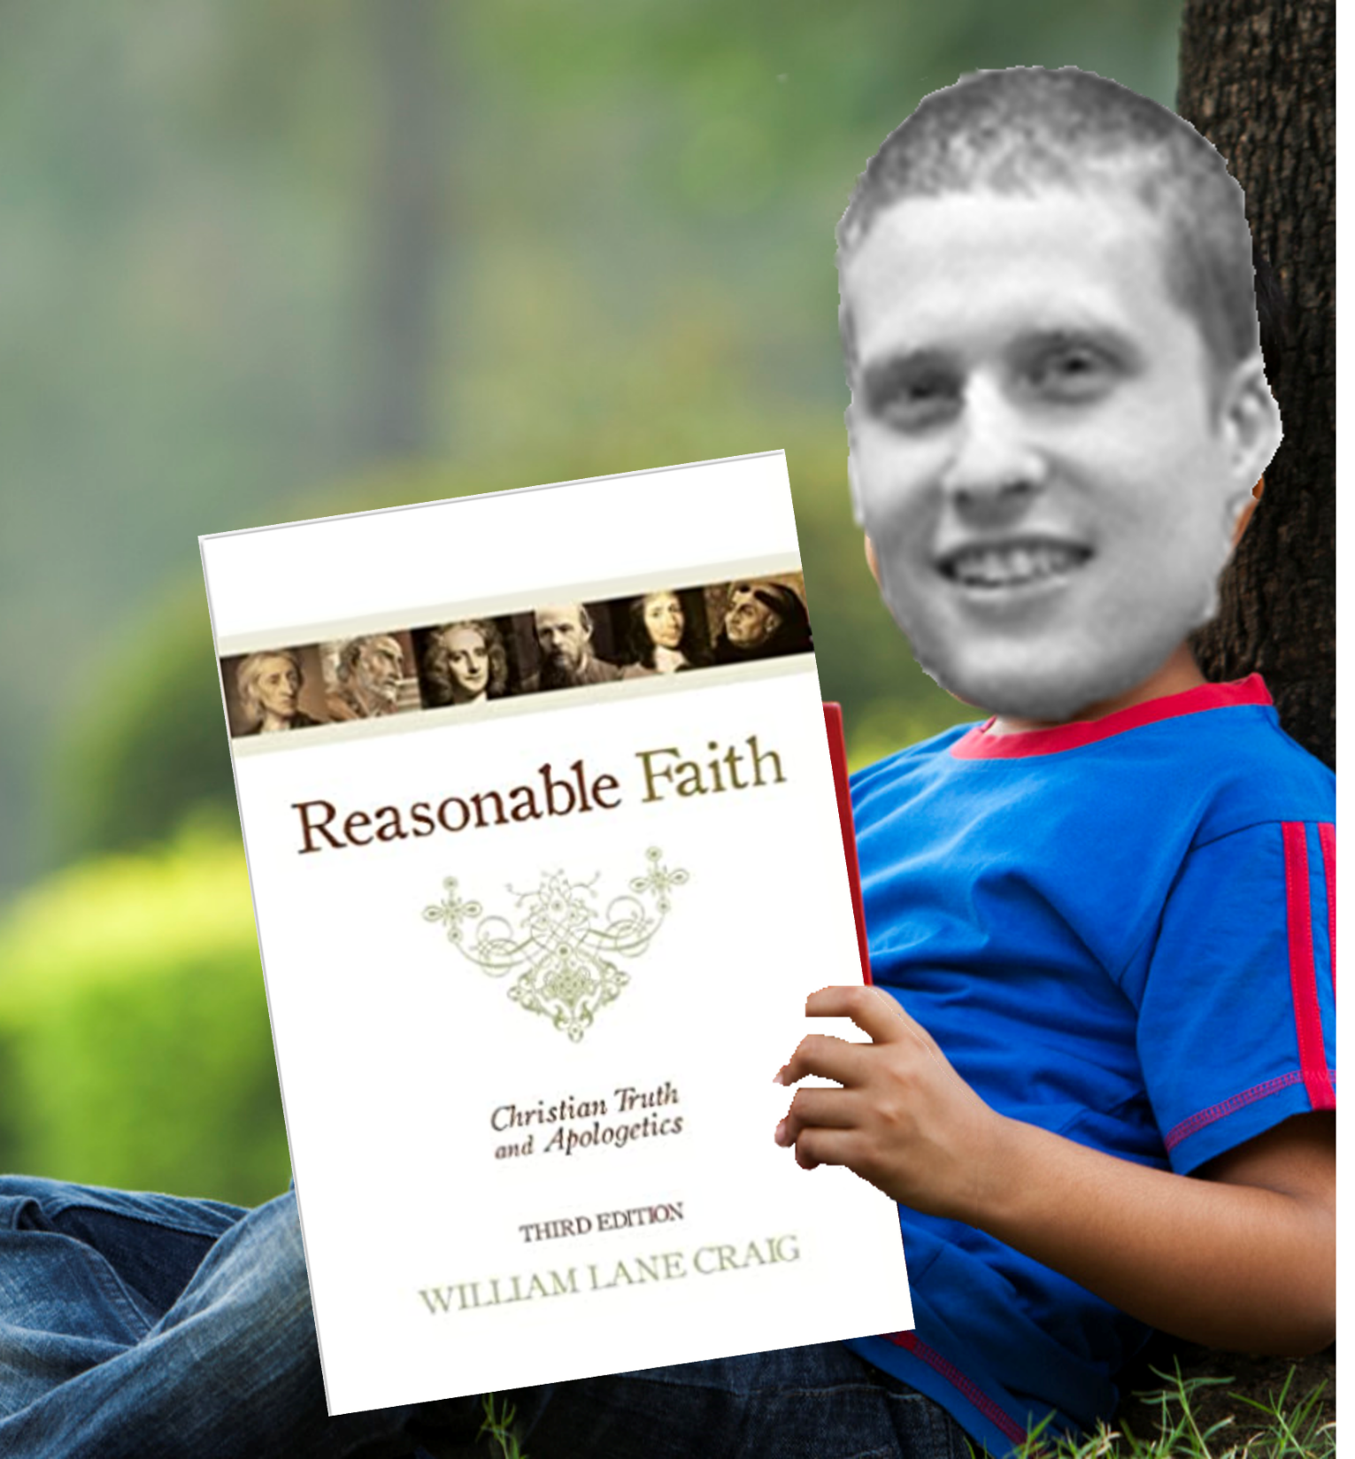

Slide 3
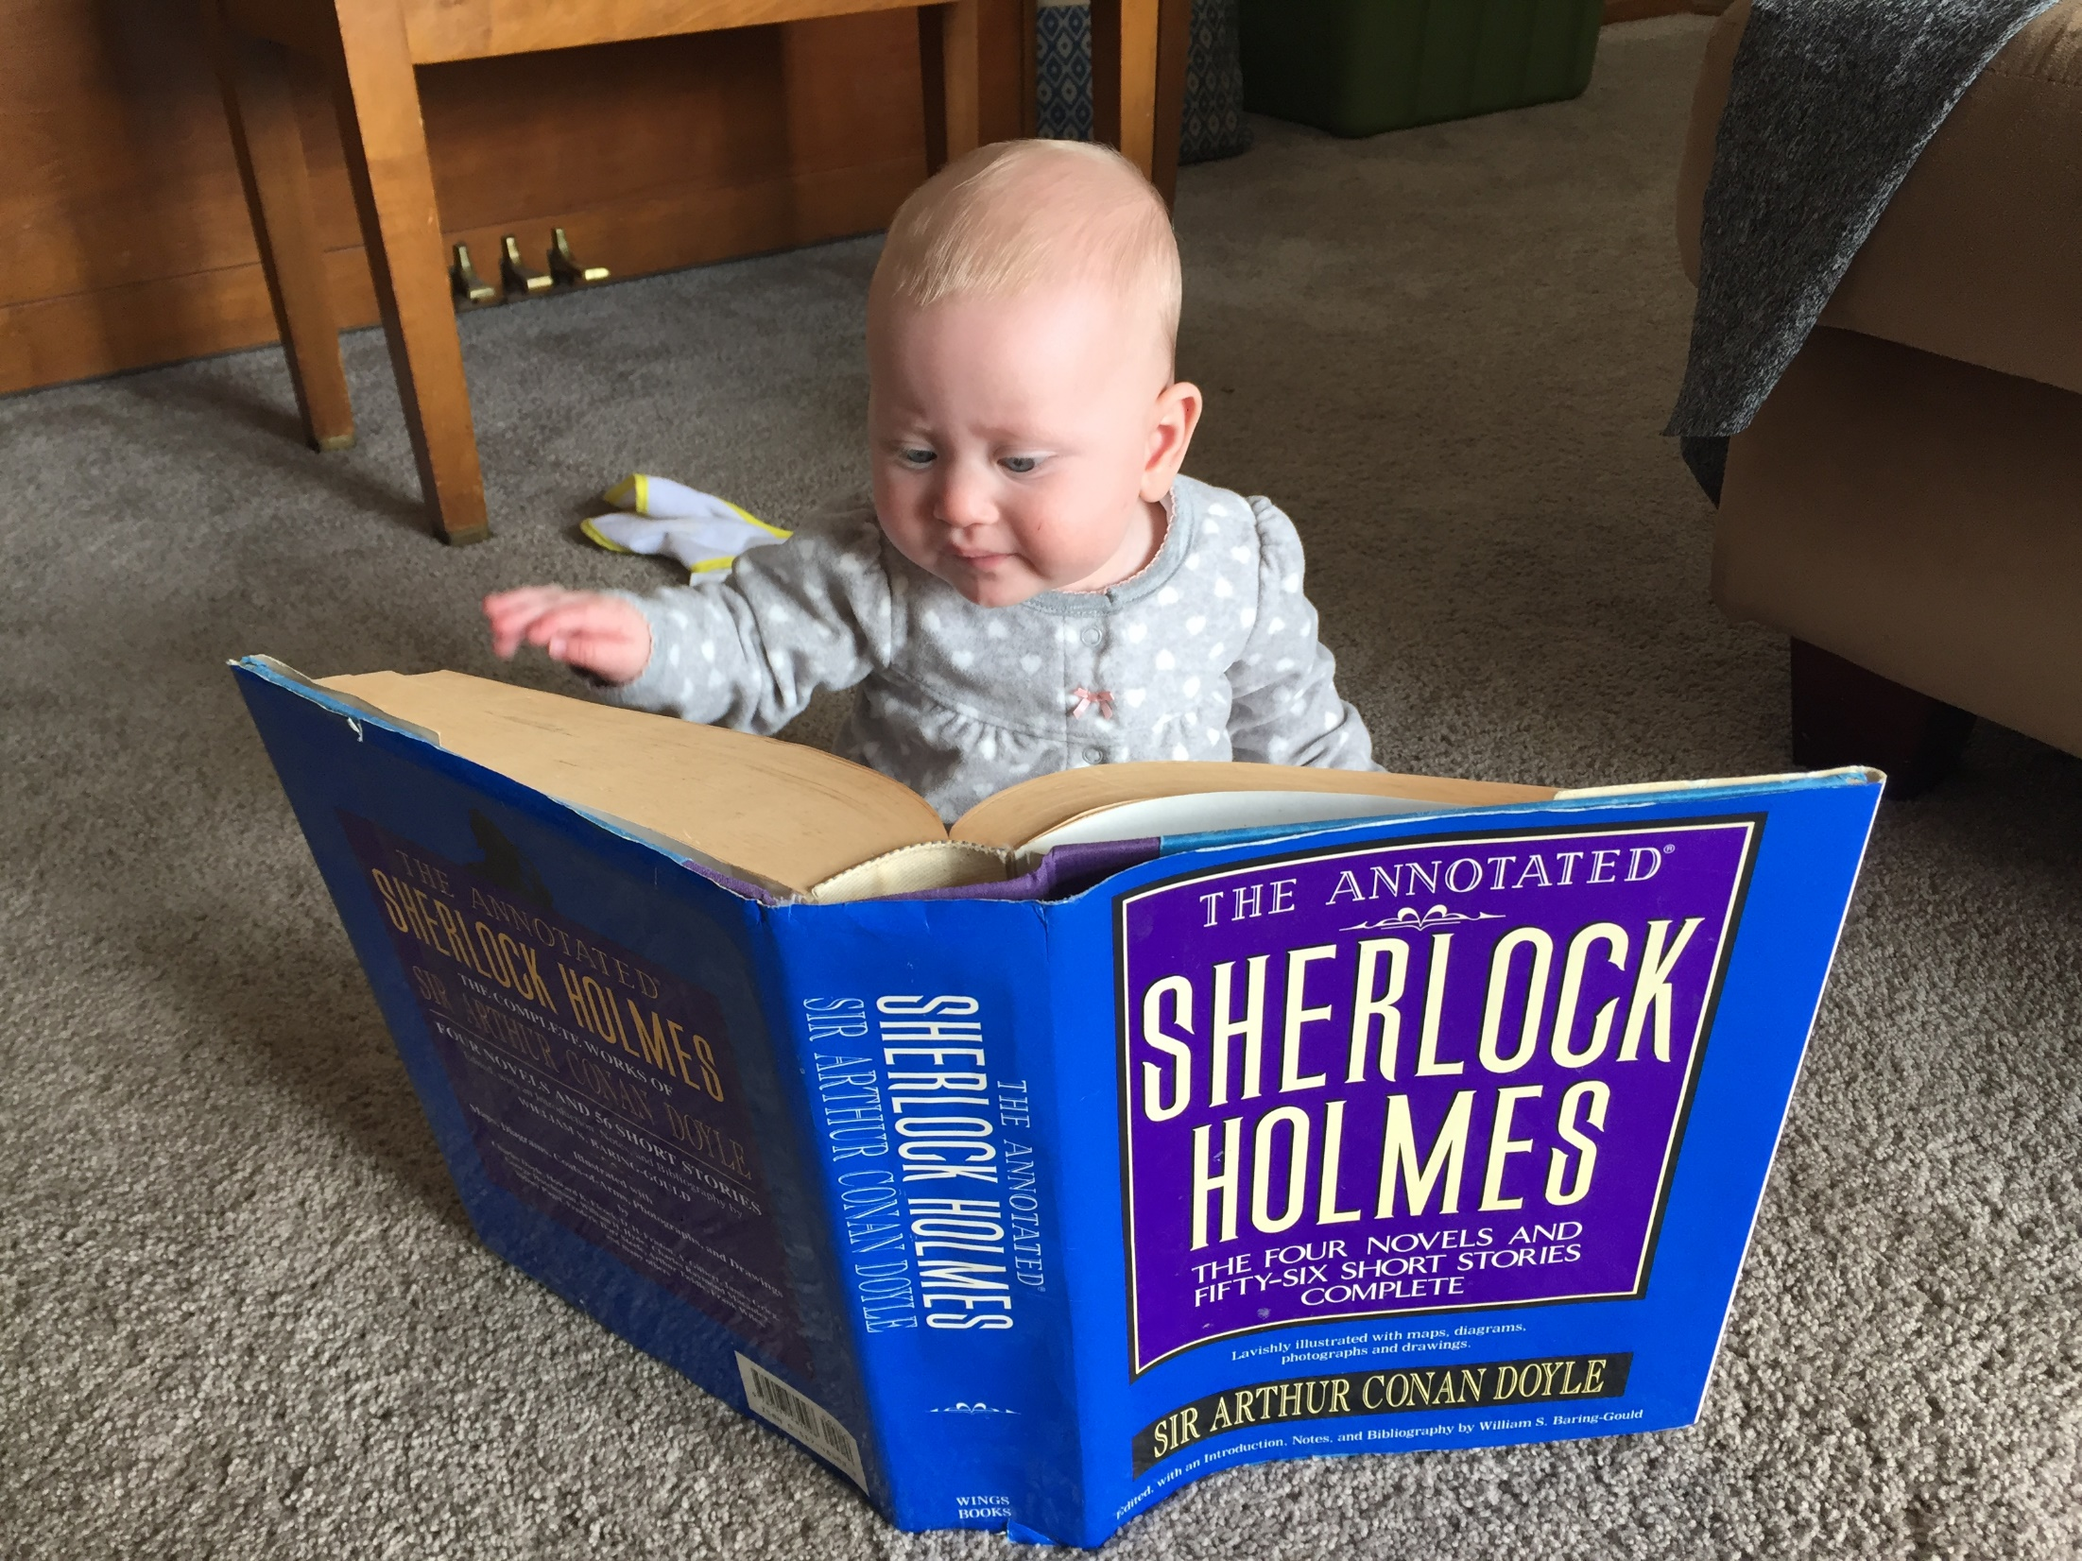

Slide 5
“It can scarcely be necessary to adduce proof to one who has even a superficial acquaintance with the genealogies of the Bible that these are frequently abbreviated by the omission of unimportant names. In fact, abridgement is the general rule, induced by the indisposition of the sacred writers to encumber their pages with more names than were necessary for their immediate purpose.”
-William Henry Green

Slide 6
Notable Omissions in Biblical Genealogies
Matthew
Omits at least 4 generations in the genealogy found in Matthew 1:2-17
Summarizes entire genealogy in 3 generations in Matthew 1:1
1 Chronicles 26:24
Lists a grandson of Moses as ruler of the treasury under King David
1 Chronicles 23
Lists a great-grandson of Levi as living during the time of King David
Ezra
Genealogy in Ezra 7:1-6 omits 6 consecutive names
Ezra 8 lists a great-grandson of Aaron, a grandson of Aaron, and a son of David returning with Ezra from the Babylonian exile

Slide 7
Notable Omissions in Biblical Genealogies Cont’d
Genealogy of Moses and Aaron
Lists 4 generations from Jacob to Moses
In contrast, genealogy of Joshua lists 11 generations from Jacob to Joshua
Genealogy of David in Ruth 4
Lists 10 generations from Perez to David
This would require the average father in this sequence to be 93 years old when his son was born

Slide 9
Evidence for Omissions in Gen 5 & 11
Parallels between genealogies

Slide 10
Genesis 4
Genesis 5
Genesis 11
Adam
Cain
Enoch
Irad
Mehujael
Methusahel
Lamech
Jabel, Jubal, Tubal-Cain
Adam
Seth
Enosh
Kenan
Mahalalel
Jared
Enoch
Methuselah
Lamech
Noah
Shem, Ham, Japheth
Shem
Arphaxad
Shelah
Eber
Peleg
Reu
Serug
Nahor
Terah
Abram, Nahor, Haran

Slide 12
Genesis 4
Genesis 5
Genesis 11
Adam
Cain
Enoch
Irad
Mehujael
Methusahel
Lamech
Jabel, Jubal, Tubal-Cain
Adam
Seth
Enosh
Kenan
Mahalalel
Jared
Enoch
Methuselah
Lamech
Noah
Shem, Ham, Japheth
Noah
Shem
Arphaxad
Shelah
Eber
Peleg
Reu
Serug
Nahor
Terah
Abram, Nahor, Haran

Slide 14
Evidence for Omissions in Gen 5 & 11
Parallels between genealogies
Consequences that don’t seem to fit with text if genealogies are continuous/without gaps
Extra-biblical evidence for gaps

Slide 15
Anticipated Questions/Objections
Question: does positing that the genealogies in Genesis 5 and 11 contain gaps raise questions regarding the inerrancy of scripture?
Answer: No.

Slide 16
“Inerrancy means that when all the facts are known, the scriptures in their original autographs and properly interpreted will be shown to be wholly true in everything that they affirm, whether that has to do with doctrine or morality or with the social, physical, or life sciences.”
– Paul Feinberg

Slide 17
Anticipated Questions/Objections
Question: does positing that the genealogies in Genesis 5 and 11 contain gaps raise questions regarding the inerrancy of scripture?
Answer: No.
Question: If we are positing gaps in the genealogies of Genesis 5 and 11 does this mean we are denying the literal meaning of these passages?
Answer: No.
Question: What about the ages included in the genealogies?

Slide 18
“…do not the chronological statements introduced in these genealogies oblige us to regard them as necessarily continuous? Why should the author be so particular to state, in every case, with unfailing regularity, the age of each patriarch at the birth of his son, unless it was his design thus to construct a chronology of the entire period, and to afford his readers the necessary elements for a computation of the interval from the creation to the deluge and from the deluge to Abraham? And if this was his design, he must of course have aimed to make his list complete.”
-William Henry Green

Slide 20
Anticipated Questions/Objections
Question: does positing that the genealogies in Genesis 5 and 11 contain gaps raise questions regarding the inerrancy of scripture?
Answer: No.
Question: If we are positing gaps in the genealogies of Genesis 5 and 11 does this mean we are denying the literal meaning of these passages?
Answer: No.
Question: What about the ages included in the genealogies?
Answer: We don’t know
It is possible ages were never intended to be understood literally

