Slide 2
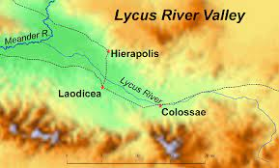

Slide 4
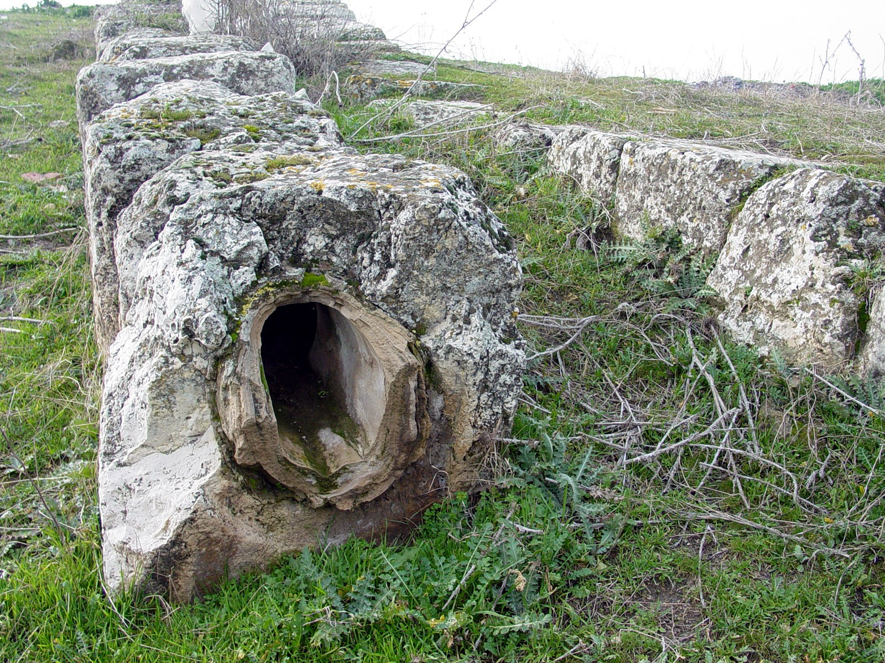

Slide 6
Traditional View (lukewarm = mediocre devotion)
Cold Lukewarm Hot

Slide 8
Traditional View (lukewarm = mediocre devotion)
Cold Lukewarm Hot
Modern View (lukewarm = useless endeavors and works)
Lukewarm Hot or Cold

Slide 10
Isaiah 55:1 Come, all you who are thirsty, come to the waters; and you who have no money, come, buy and eat! Come, buy wine and milk without money and without cost.

Slide 12
