Slide 1
Romans
Chapter 7
Part XIi

Slide 2
Why learn hermeneutics?
“You are my friends of you do what I command.” John 15:14
“Listen, I tell you a mystery: We will not all fall asleep, but we
will all be changed.” I Cor.15:51
“I was waiting for you to explain why marriage followed slavery.”
– Silas M.

Slide 3
Romans
“…calling Gentiles to the righteousness that is by faith…”
Ch.1 – 6
SUPER QUICK Review

Slide 4
Romans Ch.6 – 7:6
We died to sin, how can we live in it any longer?
Baptism (6:3-7)
Slavery (6:14-23)
Marriage (7:1-6)

Slide 5
Romans 7:1-6
Marriage Illustration
1. Connection between the married woman, the husband,
the law and death.
2. Paul’s use of law is fidelity in marriage. Conclusions?

Slide 6
Romans 7 (1984 NIV)
¹ Do you not know, brothers--for I am speaking to men who know the law--that the law has authority over a man only as long as he lives? ² For example, by law a married woman is bound to her husband as long as he is alive, but if her husband dies, she is released from the law of marriage. ³ So then, if she marries another man while her husband is still alive, she is called an adulteress. But if her husband dies, she is released from that law and is not an adulteress, even though she marries another man. way of the written code.

Slide 7
Romans 7 (1984 NIV)
⁴ So, my brothers, you also died to the law through the body of Christ, that you might belong to another, to him who was raised from the dead, in order that we might bear fruit to God. ⁵ For when we were controlled by the sinful nature, the sinful passions aroused by the law were at work in our bodies, so that we bore fruit for death. ⁶But now, by dying to what once bound us, we have been released from the law so that we serve in the new way of the Spirit, and not in the old way of the written code.
^{6:11} In the same way, count yourselves dead to sin but alive to God in Christ Jesus.
^{6:18} You have been set free from sin.

Slide 8
Romans 7 (1984 NIV)
⁴ So, my brothers, you also died to the law through the body of Christ, that you might belong to another, to him who was raised from the dead, in order that we might bear fruit to God. ⁵ For when we were controlled by the sinful nature, the sinful passions aroused by the law were at work in our bodies, so that we bore fruit for death. ⁶But now, by dying to what once bound us, we have been released from the law so that we serve in the new way of the Spirit, and not in the old way of the written code.

Slide 9
Romans 7 (1984 NIV)
⁴ So, my brothers, you also died to the law through the body of Christ, that you might belong to another, to him who was raised from the dead, in order that we might bear fruit to God. ⁵ For when we were controlled by the sinful nature, the sinful passions aroused by the law were at work in our bodies, so that we bore fruit for death. ⁶But now, by dying to what once bound us, we have been released from the law so that we serve in the new way of the Spirit, and not in the old way of the written code.

Slide 10
Romans 7 (1984 NIV)
⁷ What shall we say, then? Is the law sin? Certainly not! Indeed I would not have known what sin was except through the law. For I would not have known what coveting really was if the law had not said, "Do not covet." ⁸But sin, seizing the opportunity afforded by the commandment, produced in me every kind of covetous desire. For apart from law, sin is dead. ⁹ Once I was alive apart from law; but when the commandment came, sin sprang to life and I died. ¹⁰ I found that the very commandment that was intended to bring life actually brought death. ¹¹ For sin, seizing the opportunity afforded by the commandment, deceived me, and through the commandment put me to death.

Slide 11
Romans 7 (1984 NIV)
⁷ What shall we say, then? Is the law sin? Certainly not! Indeed I would not have known what sin was except through the law. For I would not have known what coveting really was if the law had not said, "Do not covet." ⁸But sin, seizing the opportunity afforded by the commandment, produced in me every kind of covetous desire. For apart from law, sin is dead. ⁹ Once I was alive apart from law; but when the commandment came, sin sprang to life and I died. ¹⁰ I found that the very commandment that was intended to bring life actually brought death. ¹¹ For sin, seizing the opportunity afforded by the commandment, deceived me, and through the commandment put me to death.

Slide 12
Romans 7 (1984 NIV)
⁷ What shall we say, then? Is the law sin? Certainly not! Indeed I would not have known what sin was except through the law. For I would not have known what coveting really was if the law had not said, "Do not covet." ⁸But sin, seizing the opportunity afforded by the commandment, produced in me every kind of covetous desire. For apart from law, sin is dead. ⁹ Once I was alive apart from law; but when the commandment came, sin sprang to life and I died. ¹⁰ I found that the very commandment that was intended to bring life actually brought death. ¹¹ For sin, seizing the opportunity afforded by the commandment, deceived me, and through the commandment put me to death.

Slide 13
Romans 7 (1984 NIV)
¹² So then, the law is holy, and the commandment is holy, righteous and good. ¹³ Did that which is good, then, become death to me? By no means! But in order that sin might be recognized as sin, it produced death in me through what was good, so that through the commandment sin might become utterly sinful.

Slide 14
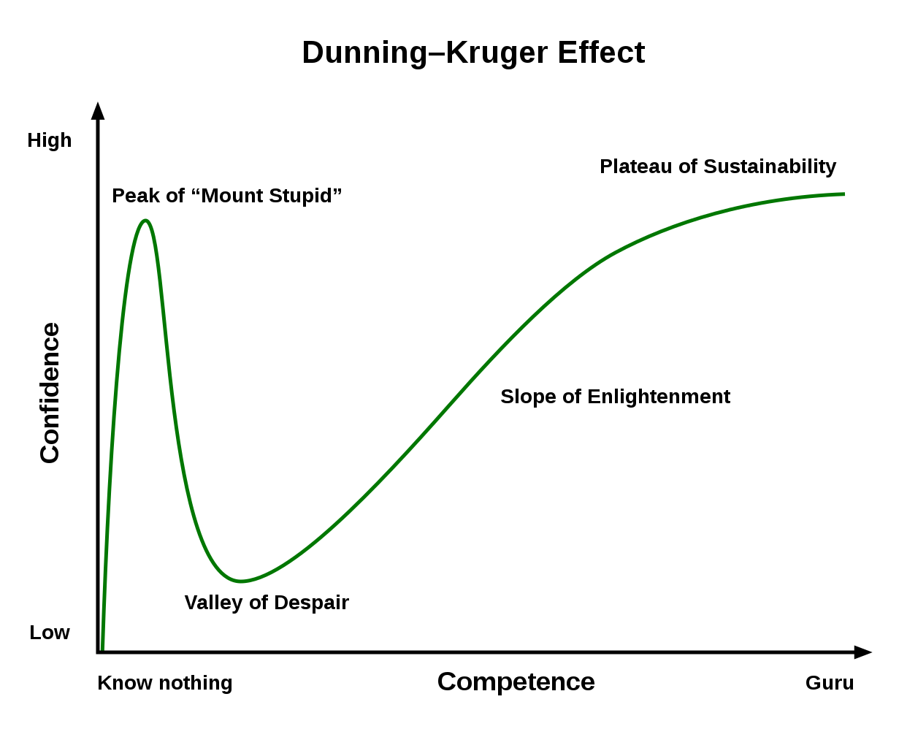
²⁰ Therefore, no one will be declared righteous in God’s sight by the works of the law;

Slide 15
²⁰ Therefore, no one will be declared righteous in God’s sight by the works of the law; rather, through the law we become conscious of sin.

Slide 16
Romans 7 (1984 NIV)
¹² So then, the law is holy, and the commandment is holy, righteous and good. ¹³ Did that which is good, then, become death to me? By no means! But in order that sin might be recognized as sin, it produced death in me through what was good, so that through the commandment sin might become utterly sinful.

Slide 17
Romans 7 (1984 NIV)
¹⁴ We know that the law is spiritual; but I am unspiritual, sold as a slave to sin. ¹⁵ I do not understand what I do. For what I want to do I do not do, but what I hate I do. ¹⁶ And if I do what I do not want to do, I agree that the law is good. ¹⁷ As it is, it is no longer I myself who do it, but it is sin living in me. ¹⁸ I know that nothing good lives in me, that is, in my sinful nature. For I have the desire to do what is good, but I cannot carry it out. ¹⁹ For what I do is not the good I want to do; no, the evil I do not want to do--this I keep on doing. ²⁰ Now if I do what I do not want to do, it is no longer I who do it, but it is sin living in me that does it.

Slide 18
Romans 7 (1984 NIV)
²¹ So I find this law at work: When I want to do good, evil is right there with me. ²² For in my inner being I delight in God's law; ²³ but I see another law at work in the members of my body, waging war against the law of my mind and making me a prisoner of the law of sin at work within my members. ²⁴ What a wretched man I am! Who will rescue me from this body of death? ²⁵ Thanks be to God--through Jesus Christ our Lord! So then, I myself in my mind am a slave to God's law, but in the sinful nature a slave to the law of sin.

Slide 19
Two views: Romans 7:14-25
Pre-Christian State

Slide 20
Romans 7-8 (1984 NIV)
²⁴ What a wretched man I am! Who will rescue me from this body of death? ²⁵ Thanks be to God--through Jesus Christ our Lord! So then, I myself in my mind am a slave to God's law, but in the sinful nature a slave to the law of sin.
¹ Therefore, there is now no condemnation for those who are in Christ Jesus, ² because through Christ Jesus the law of the Spirit of life set me free from the law of sin and death.

Slide 21
Two views: Romans 7:14-25
Pre-Christian State
Contrast in Ch.7-8
Transition from the old to new life is complete
Depiction of Christian life

Slide 22
Two views: Romans 7:14-25
Present Christian State
Tense of 7:7-13 vs 7:14-25
Sanctification Outline
Depiction of Christian life
Ch.5 Deliverance from wrath
Ch.6 Deliverance from sin
Ch.7 Deliverance from the law
Ch.8 Deliverance from death

Slide 23
Two views: Romans 7:14-25
Pre-Christian State Problems?
Contrast in Ch.7-8
Transition from the old to new life is complete
Depiction of Christian life

Slide 24
Two views: Romans 7:14-25
Present Christian State Problems?
Tense of 7:7-13 vs 7:14-25
Ch.5-8 Sanctification Outline
Depiction of Christian life

Slide 25
Two views: Romans 7:14-25
Take-aways!
Is 7:14 insurmountable?
¹⁴ We know that the law is spiritual; but I am unspiritual, sold as a slave to sin.
^{25b} So then, I myself in my mind am a slave to God's law, but in the sinful nature a slave to the law of sin.

Slide 26
Two views: Romans 7:14-25
Take-aways!
Is 7:14 insurmountable?
Natural Christian Conflict
Boundaries for Questioning Salvation

Slide 27
Boundaries for Questioning Salvation
Heb. 10:26-27
’For if we deliberately go on sinning after receiving the knowledge of the truth, there no longer remains a sacrifice for sins, but a terrifying expectation of judgment and the fury of a fire about to consume the adversaries.
If we confess our sins, he is faithful and just to forgive us our sins and to cleanse us from all unrighteousness.
1 John 1:9

Slide 28
‘Yes, we will always struggle with sin, but as long as we are struggling, that means that we haven't given up. Intentionally sinning without remorse
or a desire to repent is not something one who has truly accepted Christ will want to do.
God will forgive us when we sincerely repent. That's true grace for true sin.’

