Slide 1
Romans
Part II Chapter 1

Slide 2
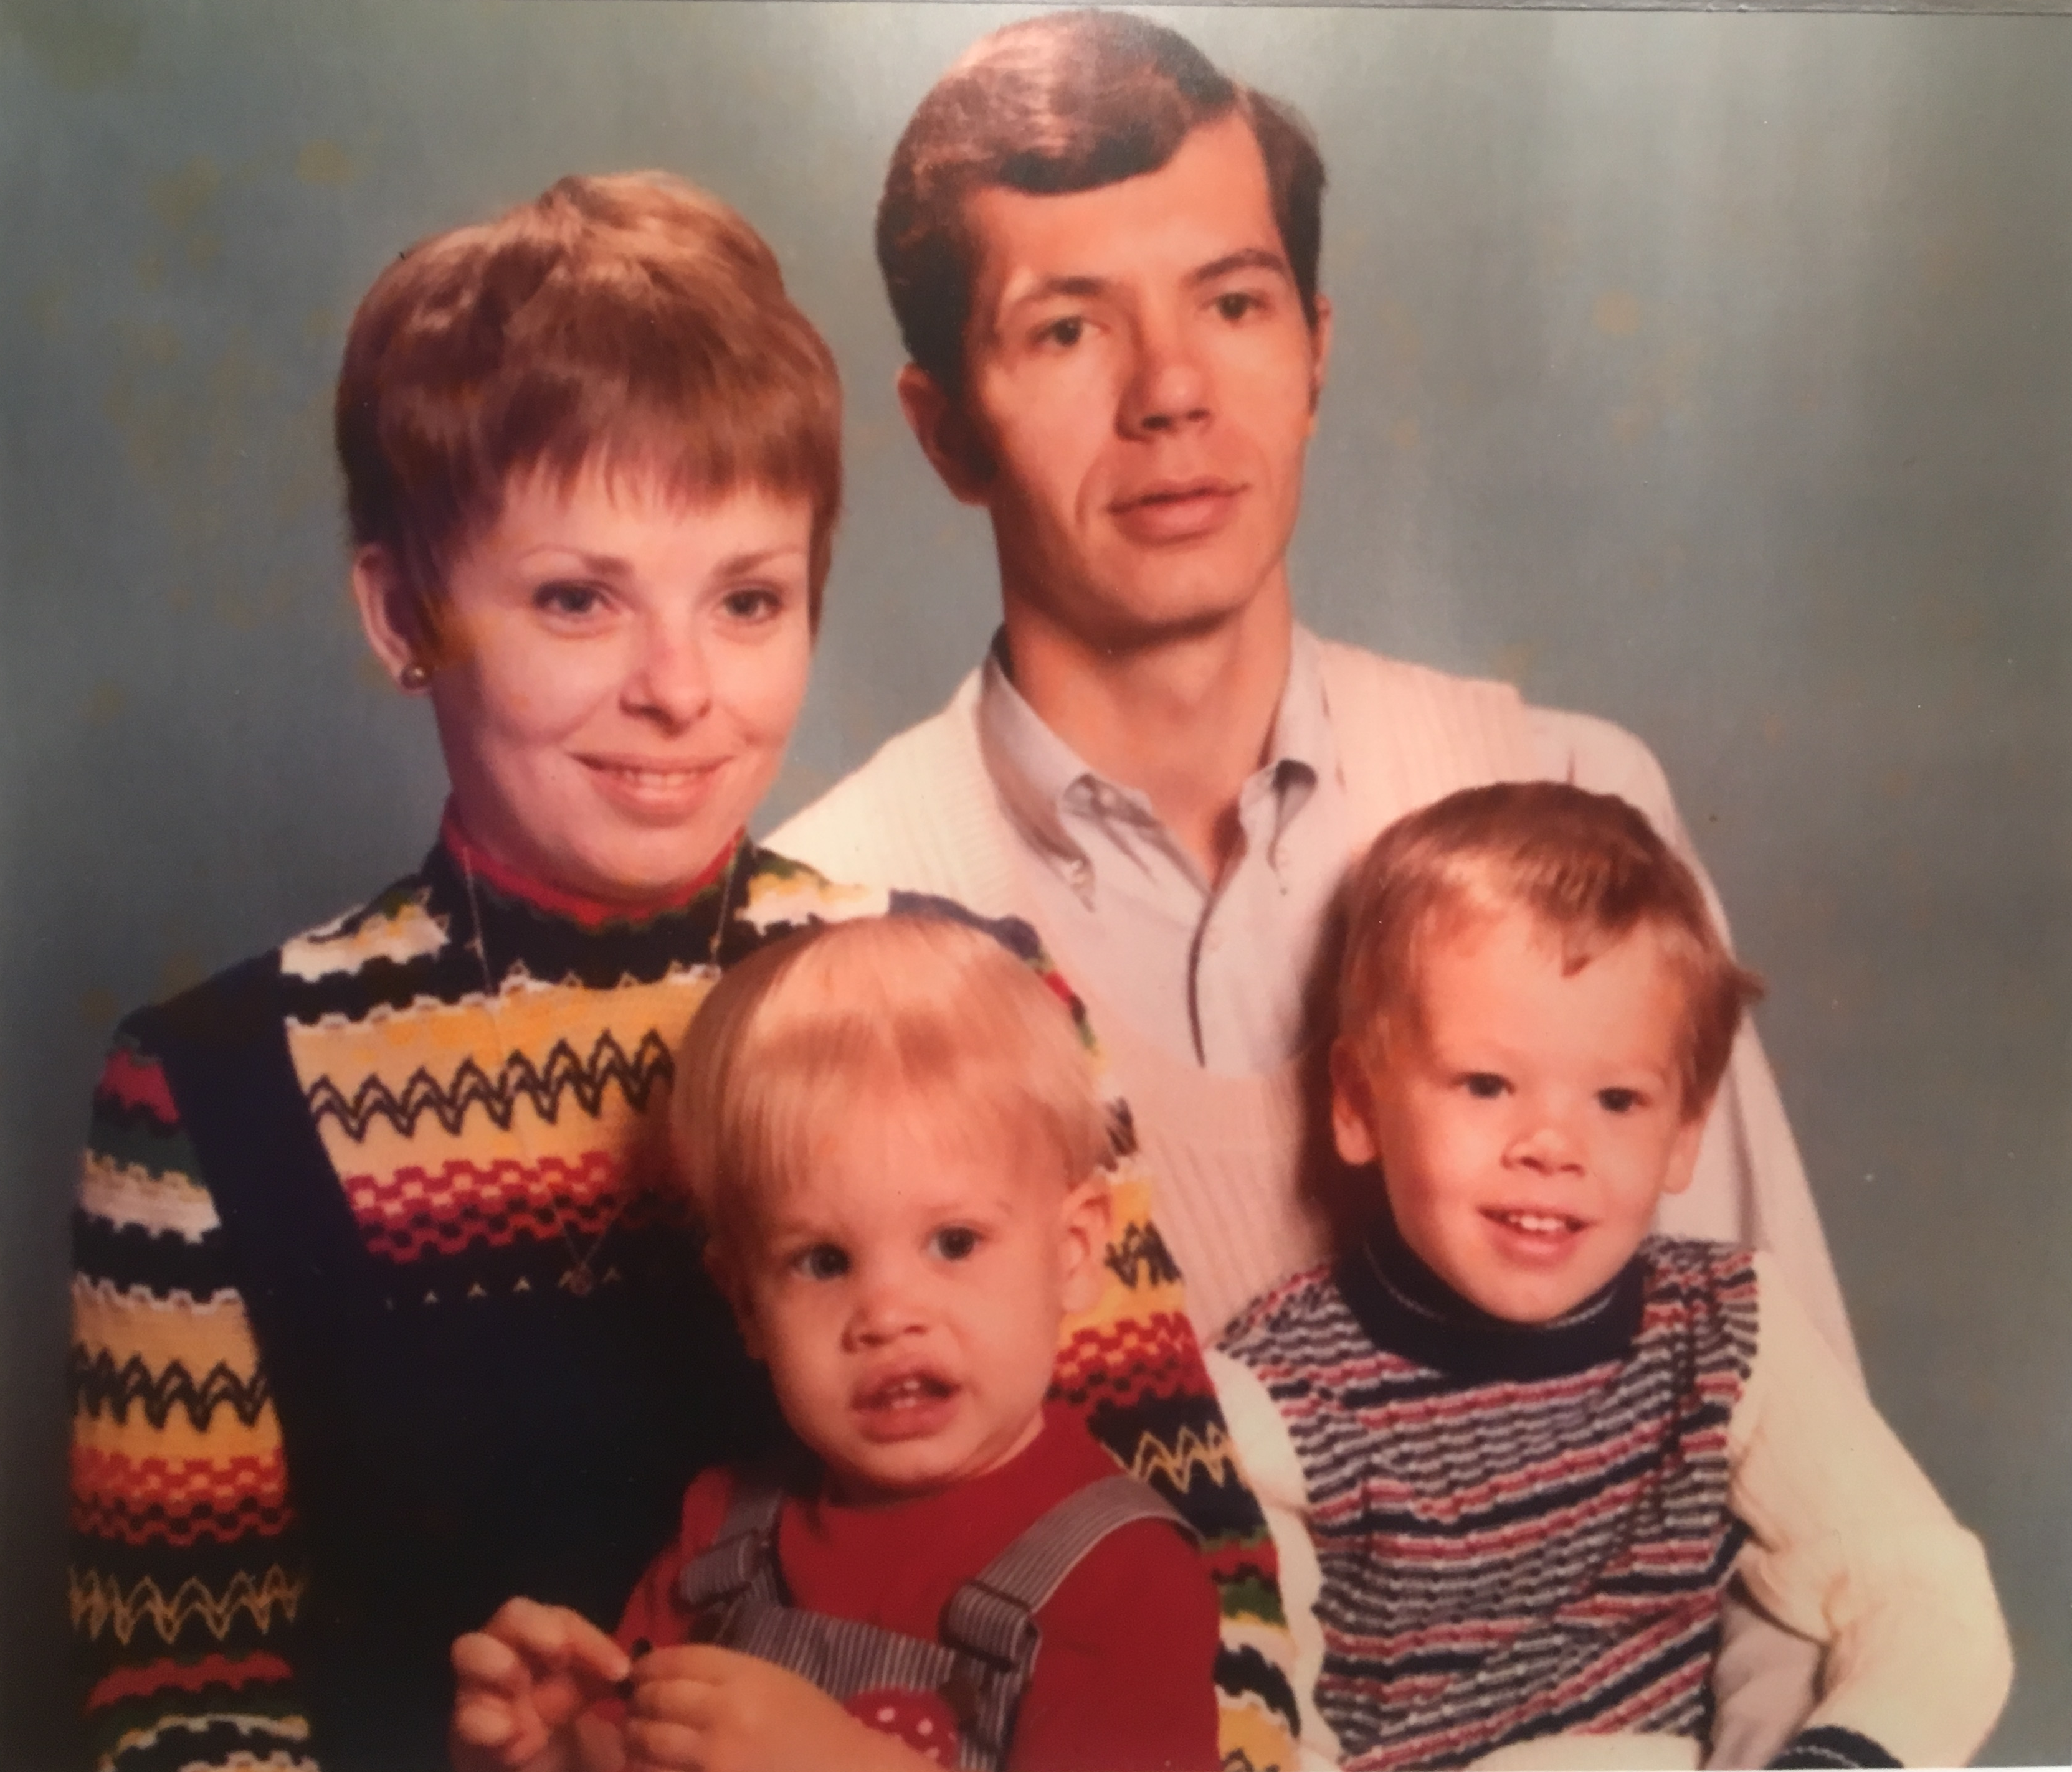
Good morning, TEC…
Romans 1
Part 2

Slide 3
Good morning, TEC…
It is
Mother’s day.

Slide 4
Good morning, TEC…
Mom, I would protect you
from wolves.
with my muscular body

Slide 5
Good morning, TEC…

Slide 6
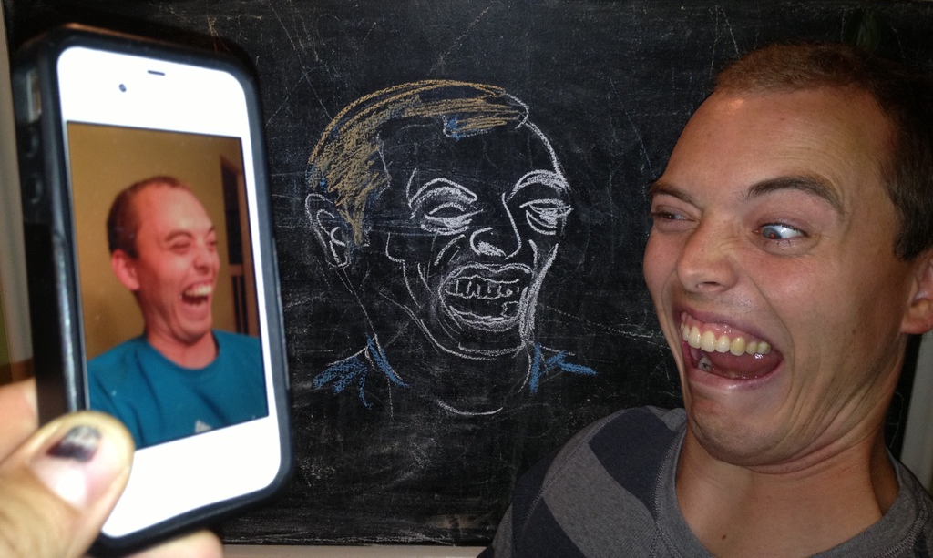
Good morning, TEC…
I’m sorry.

Slide 7
Good morning, TEC…
‘Frailty, thy name is woman.’
I appreciate you bearing by progeny.

Slide 8
Good morning, TEC…
Blessed Latvian Orthodox Day!

Slide 9
Romans
Part XI Chapter 6

Slide 10
Romans
Ch.1 – 5
Review

Slide 11
Romans 1
= WHAT
¹⁶ I am not ashamed of the gospel, because it is the power of God for the salvation of everyone who believes: first for the Jew, then for the Gentile.
¹⁷ For in the gospel a righteousness from God is revealed, a righteousness that is by faith from first to last, just as it is written:
"The righteous will live by faith."
⁵ Through him we received grace and apostleship to call all Gentiles to the obedience that comes from faith for his name’s sake.
= HOW

Slide 12
Romans 1-5
Ch.1 Gentiles: General Revelation (Creation)
Ch.2 Jews: Specific Revelation (Law)
2:5-16 God’s Impartial Judgement
Ch.3 Jews & Gentiles alike under sin

Slide 13
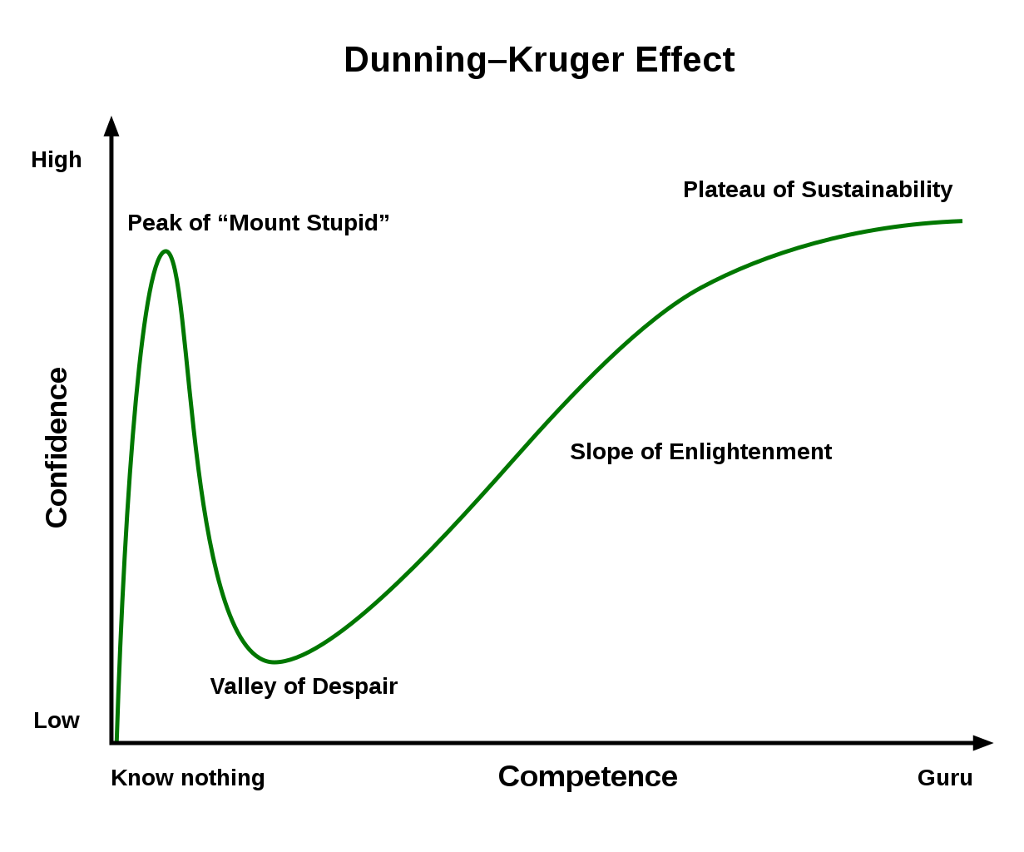
²⁰ Therefore, no one will be declared righteous in God’s sight by the works of the law.

Slide 14
²¹ But now apart from the law the righteousness of God has been made known, to which the Law and the Prophets testify. ²² This righteousness from God comes through faith in Jesus Christ to all who believe.

Slide 15
Romans 1-5
Ch.1 Gentiles: General Revelation (Creation)
Ch.2 Jews: Specific Revelation (Law)
2:5-16 God’s Impartial Judgement
Ch.3 Jews & Gentiles alike under sin
3:20 Law does not bring Righteousness
3:21 Christ brings Righteousness
Ch.4 Abraham: Faith in Action
Ch.5 Sanctification

Slide 16
Romans 5
¹² Therefore, just as sin entered the world through one man, and death through sin, …
¹³ for before the law was given, sin was in the world. But sin is not taken into account when there is no law.
¹⁸ So also the result of one act of righteousness was justification that brings life for all men.

Slide 17
Romans 1-5
Ch.1 Gentiles: General Revelation (Creation)
Ch.2 Jews: Specific Revelation (Law)
2:5-16 God’s Impartial Judgement
Ch.3 Jews & Gentiles alike under sin
3:20 Law does not bring Righteousness
3:21 Christ brings Righteousness
Ch.4 Abraham: Faith in Action
Ch.5 Sanctification → Ch.6–8

Slide 18
“Sin is pictured as an insidious power that, once allowed entry, multiplies until it dominates, enslaves, and kills everyone. Here, the chief agent of sin is death which ‘advanced’ to every human being.”
- Frank Thielman

Slide 19
Romans
Part XI Chapter 6

Slide 20
Romans 5:20-21 → Ch.6 (1984 NIV)
²⁰ The law was added so that the trespass might increase. But where sin increased, grace increased all the more, ²¹ so that, just as sin reigned in death, so also grace might reign through righteousness to bring eternal life through Jesus Christ our Lord.
¹ What shall we say, then? Shall we go on sinning so that grace may increase? ² By no means!
¹⁵ What then, shall we sin because we are not under the law but under grace? By no means!

Slide 21
“Our faith in Christ does not free us from works but from false opinions concerning works, that is, from the foolish presumption that justification is acquired by works. Faith redeems, corrects, and preserves our consciences so that we know that righteousness does not consist in works, although works neither can nor ought to be wanting.” – Martin Luther

Slide 22
Romans 5:20-21 → Ch.6 (1984 NIV)
²⁰ The law was added so that the trespass might increase. But where sin increased, grace increased all the more, ²¹ so that, just as sin reigned in death, so also grace might reign through righteousness to bring eternal life through Jesus Christ our Lord.
¹ What shall we say, then? Shall we go on sinning so that grace may increase? ² By no means!
We died to sin, how can we live in it any longer?

Slide 23
Romans Ch.6 – 7:6
Baptism (6:3-7)
Slavery (6:14-23)
Marriage (7:1-6)
We died to sin, how can we live in it any longer?

Slide 24
Romans 6 (1984 NIV)
¹ What shall we say, then? Shall we go on sinning so that grace may increase? ² By no means! We died to sin; how can we live in it any longer? ³ Or don't you know that all of us who were baptized into Christ Jesus were baptized into his death? ⁴ We were therefore buried with him through baptism into death in order that, just as Christ was raised from the dead through the glory of the Father, we too may live a new life.
⁵ If we have been united with him like this in his death, we will certainly also be united with him in his resurrection. ⁶ For we know that our old self was crucified with him so that the body of sin might be done away with, that we should no longer be slaves to sin – ⁷ because anyone who has died has been freed from sin.

Slide 25
Romans 6 (1984 NIV)
¹ What shall we say, then? Shall we go on sinning so that grace may increase? ² By no means! We died to sin; how can we live in it any longer? ³ Or don't you know that all of us who were baptized into Christ Jesus were baptized into his death? ⁴ We were therefore buried with him through baptism into death in order that, just as Christ was raised from the dead through the glory of the Father, we too may live a new life.
⁵ If we have been united with him like this in his death, we will certainly also be united with him in his resurrection. ⁶ For we know that our old self was crucified with him so that the body of sin might be done away with, that we should no longer be slaves to sin – ⁷ because anyone who has died has been freed from sin.

Slide 26
Romans 6 (1984 NIV)
⁸ Now if we died with Christ, we believe that we will also live with him. ⁹ For we know that since Christ was raised from the dead, he cannot die again; death no longer has mastery over him. ¹⁰ The death he died, he died to sin once for all; but the life he lives, he lives to God.
¹¹ In the same way, count yourselves dead to sin but alive to God in Christ Jesus. ¹² Therefore do not let sin reign in your mortal body so that you obey its evil desires. ¹³ Do not offer the parts of your body to sin, as instruments of wickedness, but rather offer yourselves to God, as those who have been brought from death to life; and offer the parts of your body to him as instruments of righteousness. ¹⁴ For sin shall not be your master, because you are not under law, but under grace.

Slide 27
Romans 6 (1984 NIV)
⁸ Now if we died with Christ, we believe that we will also live with him. ⁹ For we know that since Christ was raised from the dead, he cannot die again; death no longer has mastery over him. ¹⁰ The death he died, he died to sin once for all; but the life he lives, he lives to God.
¹¹ In the same way, count yourselves dead to sin but alive to God in Christ Jesus. ¹² Therefore do not let sin reign in your mortal body so that you obey its evil desires. ¹³ Do not offer the parts of your body to sin, as instruments of wickedness, but rather offer yourselves to God, as those who have been brought from death to life; and offer the parts of your body to him as instruments of righteousness. ¹⁴ For sin shall not be your master, because you are not under law, but under grace.

Slide 28
Romans 6 (1984 NIV)
⁸ Now if we died with Christ, we believe that we will also live with him. ⁹ For we know that since Christ was raised from the dead, he cannot die again; death no longer has mastery over him. ¹⁰ The death he died, he died to sin once for all; but the life he lives, he lives to God.
¹¹ In the same way, count yourselves dead to sin but alive to God in Christ Jesus. ¹² Therefore do not let sin reign in your mortal body so that you obey its evil desires. ¹³ Do not offer the parts of your body to sin, as instruments of wickedness, but rather offer yourselves to God, as those who have been brought from death to life; and offer the parts of your body to him as instruments of righteousness. ¹⁴ For sin shall not be your master, because you are not under law, but under grace.

Slide 29
Romans 6 (1984 NIV)
“Paul describes how believers, through their union with Christ’s death and resurrection,
are able to shift their physical, intellectual
and emotional capacities into God’s service.”
- Frank Thielman
⁸ Now if we died with Christ, we believe that we will also live with him. ⁹ For we know that since Christ was raised from the dead, he cannot die again; death no longer has mastery over him. ¹⁰ The death he died, he died to sin once for all; but the life he lives, he lives to God.
¹¹ In the same way, count yourselves dead to sin but alive to God in Christ Jesus. ¹² Therefore do not let sin reign in your mortal body so that you obey its evil desires. ¹³ Do not offer the parts of your body to sin, as instruments of wickedness, but rather offer yourselves to God, as those who have been brought from death to life; and offer the parts of your body to him as instruments of righteousness. ¹⁴ For sin shall not be your master, because you are not under law, but under grace.

Slide 30
Romans 6 (1984 NIV)
⁸ Now if we died with Christ, we believe that we will also live with him. ⁹ For we know that since Christ was raised from the dead, he cannot die again; death no longer has mastery over him. ¹⁰ The death he died, he died to sin once for all; but the life he lives, he lives to God.
¹¹ In the same way, count yourselves dead to sin but alive to God in Christ Jesus. ¹² Therefore do not let sin reign in your mortal body so that you obey its evil desires. ¹³ Do not offer the parts of your body to sin, as instruments of wickedness, but rather offer yourselves to God, as those who have been brought from death to life; and offer the parts of your body to him as instruments of righteousness. ¹⁴ For sin shall not be your master, because you are not under law, but under grace.

Slide 31
Romans 6 (1984 NIV)
¹⁶ Don't you know that when you offer yourselves to someone to obey him as slaves, you are slaves to the one whom you obey--whether you are slaves to sin, which leads to death, or to obedience, which leads to righteousness?
¹⁷ But thanks be to God that, though you used to be slaves to sin, you wholeheartedly obeyed the form of teaching to which you were entrusted. ¹⁸ You have been set free from sin and have become slaves to righteousness.

Slide 32
Romans 6 (1984 NIV)
¹⁶ Don't you know that when you offer yourselves to someone to obey him as slaves, you are slaves to the one whom you obey--whether you are slaves to sin, which leads to death, or to obedience, which leads to righteousness?
¹⁷ But thanks be to God that, though you used to be slaves to sin, you wholeheartedly obeyed the form of teaching to which you were entrusted. ¹⁸ You have been set free from sin and have become slaves to righteousness.

Slide 33
Romans 6 (1984 NIV)
¹⁹ I put this in human terms because you are weak in your natural selves. Just as you used to offer the parts of your body in slavery to impurity and to ever-increasing wickedness, so now offer them in slavery to righteousness leading to holiness. ²⁰ When you were slaves to sin, you were free from the control of righteousness. ²¹ What benefit did you reap at that time from the things you are now ashamed of? Those things result in death! ²² But now that you have been set free from sin and have become slaves to God, the benefit you reap leads to holiness, and the result is eternal life.

Slide 34
Romans 6 (1984 NIV)
¹⁹ I put this in human terms because you are weak in your natural selves. Just as you used to offer the parts of your body in slavery to impurity and to ever-increasing wickedness, so now offer them in slavery to righteousness leading to holiness. ²⁰ When you were slaves to sin, you were free from the control of righteousness. ²¹ What benefit did you reap at that time from the things you are now ashamed of? Those things result in death! ²² But now that you have been set free from sin and have become slaves to God, the benefit you reap leads to holiness, and the result is eternal life.
²¹ ‘What fruit, then, did you use to have at that time? Things for which you are now ashamed! For the end of those things is death.’ [NEB]

Slide 35
Romans 6 (1984 NIV)
¹⁹ I put this in human terms because you are weak in your natural selves. Just as you used to offer the parts of your body in slavery to impurity and to ever-increasing wickedness, so now offer them in slavery to righteousness leading to holiness. ²⁰ When you were slaves to sin, you were free from the control of righteousness. ²¹ What benefit did you reap at that time from the things you are now ashamed of? Those things result in death! ²² But now that you have been set free from sin and have become slaves to God, the benefit you reap leads to holiness, and the result is eternal life. ²³ For the wages of sin is death, but the gift of God is eternal life in Christ Jesus our Lord.

Slide 36
Romans 7 (1984 NIV)
¹ Do you not know, brothers--for I am speaking to men who know the law--that the law has authority over a man only as long as he lives? ² For example, by law a married woman is bound to her husband as long as he is alive, but if her husband dies, she is released from the law of marriage.
³ So then, if she marries another man while her husband is still alive, she is called an adulteress. But if her husband dies, she is released from that law and is not an adulteress, even though she marries another man. way of the written code.

Slide 37
Romans 7 (1984 NIV)
⁴ So, my brothers, you also died to the law through the body of Christ, that you might belong to another, to him who was raised from the dead, in order that we might bear fruit to God. ⁵ For when we were controlled by the sinful nature, the sinful passions aroused by the law were at work in our bodies, so that we bore fruit for death. ⁶But now, by dying to what once bound us, we have been released from the law so that we serve in the new way of the Spirit, and not in the old way of the written code.

Slide 38
Romans 7:1-6
Marriage Illustration
1. Connection between the married woman, the husband,
the law and death.
2. Paul’s use of law is fidelity in marriage. Conclusions?

Slide 39
Romans
Part XII Chapter 7

