Slide 1
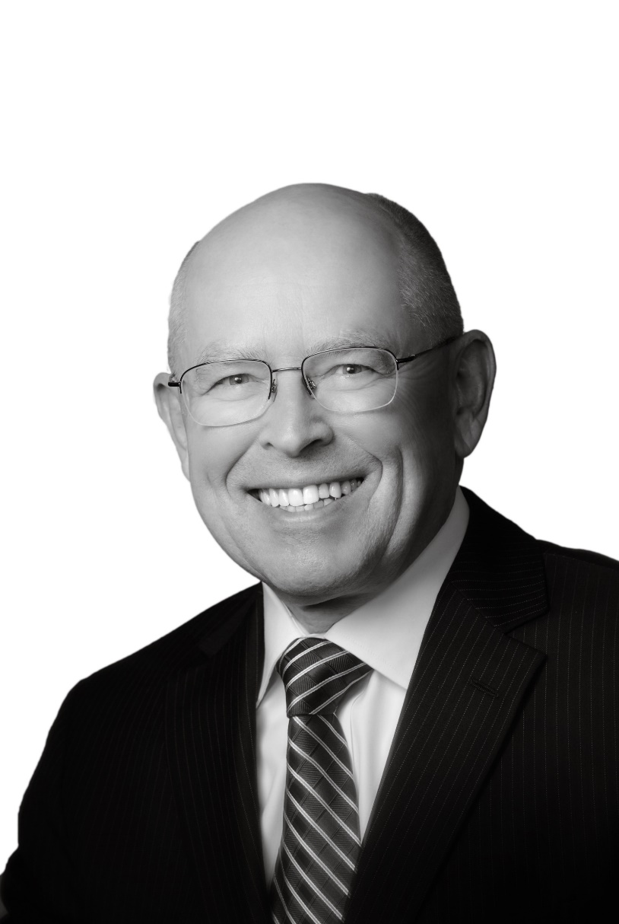
“All arguments for an absolute authority must ultimately appeal to that authority for proof; otherwise, the authority would not be an absolute or highest authority.”
Wayne Grudem, Systematic Theology

Slide 3
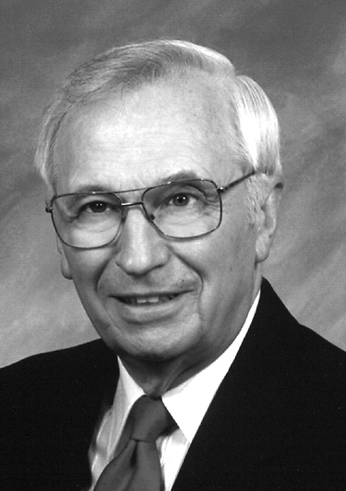
“Authority is the right to command belief and action.”
Erickson J. Millard Christian Theology, Third Edition

Slide 4
“God himself is the ultimate authority in religious matters. He has the right, both by virtue of who he is and what he does, to establish the standard for belief and practice…”
Erickson J. Millard Christian Theology, Third Edition

Slide 5
“He has delegated that authority by creating a book, the Bible. Because it conveys his message, the Bible, as the spoken word of God, carries the same weight God himself would command if he were speaking to us personally.”
Erickson J. Millard Christian Theology, Third Edition

Slide 7
Verbal Plenary Inspiration
God so moved the human authors of Scripture that the resulting product was the word of God written, totally without error in all that it affirms in the original autographs.

Slide 9
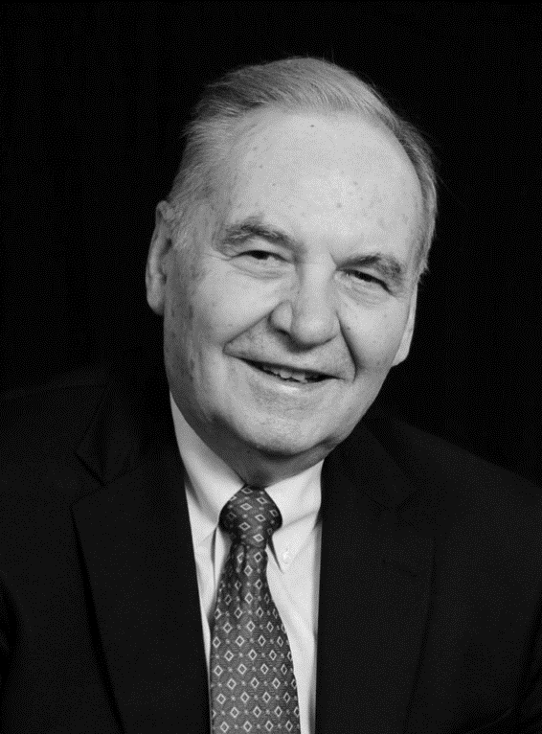
“That he who was “The Truth” and who spoke no falsehood, should accommodate himself to error is not only a demonstration of poor hermeneutics, but it is reflective of a low view of the nature of Christ.”
Norman L. Geisler, A General Introduction to the Bible

Slide 11
Christ’s Displayed Authority
Authority to forgive (Mark 2:5)
Authority to judge (Matthew 25:31-46)
Authority over angels (Matthew 13:41)
Authority over the Sabbath (Mark 2:27-28)
Authority over dietary laws (Mark 7:14-15)
Authority in his commands (John 14:23)

Slide 13
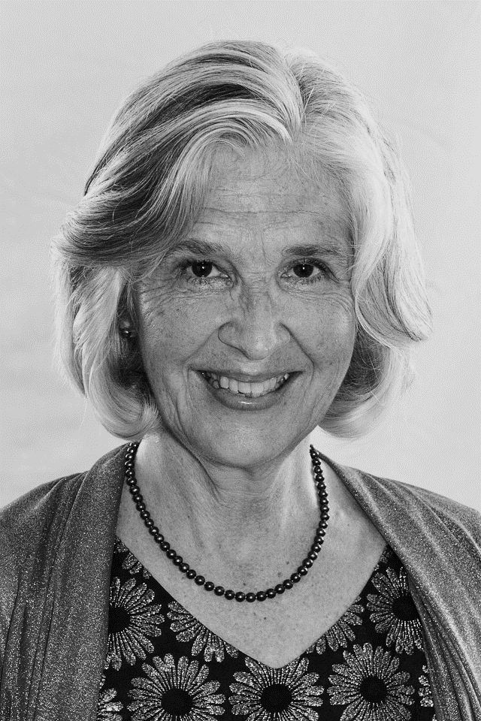
“Jesus and the Scriptures are both authoritative; yet the latter is an authority because of and on behalf of the former…”
Edith M. Humphrey, Jesus and Scripture

Slide 14
“The One we adore; the other we honor because of that One who is all lovely…”
Edith M. Humphrey, Jesus and Scripture

Slide 15
“In the Scriptures, letters, words, sentences, precepts, propositions, and stories are dignified and pressed into service by that One who is God’s first, perfect, and ultimate Word.”
Edith M. Humphrey, Jesus and Scripture

Slide 17
Promise of the Spirit
John 14:26 “But the Helper, the Holy Spirit, whom the Father will send in my name, he will teach you all things and bring to your remembrance all that I have said to you.
John 16:13 “When the Spirit of truth comes, he will guide you into all the truth.”

Slide 18
Authority of the Apostles
Matthew 10:14-15
Matthew 28:18-20
Luke 10:16 “The one who hears you hears me, and the one who rejects you rejects me, and the one who rejects me rejects him who sent me.”
John 13:20 “Truly, truly, I say to you, whoever receives the one I send receives me, and whoever receives me receives the one who sent me.”

Slide 20
Luke 5:36-39
“He also told them a parable: “No one tears a piece from a new garment and puts it on an old garment. If he does, he will tear the new, and the piece from the new will not match the old. And no one puts new wine into old wineskins. If he does, the new wine will burst the skins and it will be spilled, and the skins will be destroyed. But new wine must be put into fresh wineskins. And no one after drinking old wine desires new, for he says, ‘The old is good.’”

